Slide 1
JavaScript Juggernauts
Coding boot camp
April 22, 2017

Slide 2
Juggernauts? Or Jugglers?
Practice, practice, practice
Press on, persevere
Collaborate, work together

Slide 3
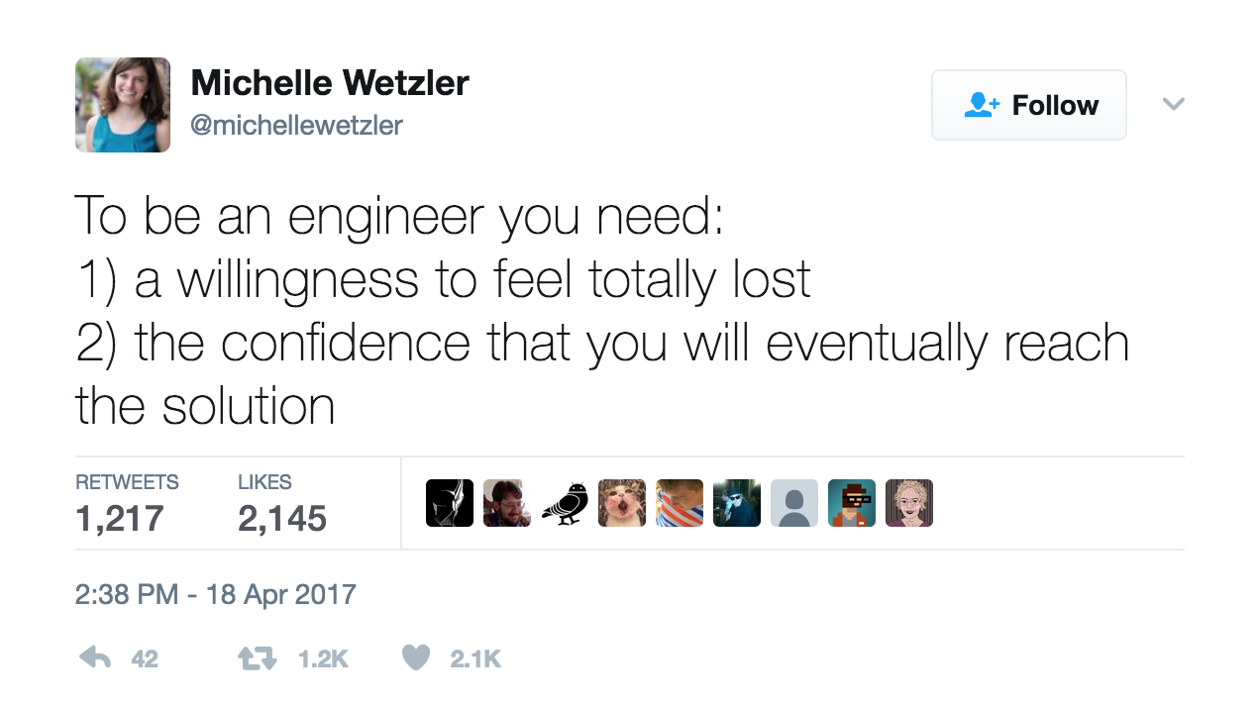
Notes:
https://twitter.com/michellewetzler/status/854449147063054336
Saw this today. Constant reminders and discussions around this idea in the industry.

Slide 4
Today
Review via an activity: arrays, for loops
More: functions
More: objects
Building JavaScript Applications
Notes:
2.
Encourage students to ask questions about the week’s material.
Do activity 1.

Slide 5
Functions
Notes:
5.
Walk through activity 2 “no functions”.

Slide 6
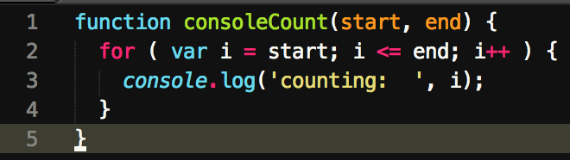
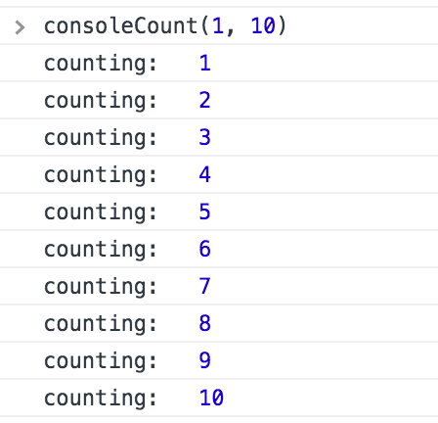
Functions
Wrap a chunk of code
Takes inputs
Manipulates inputs/other data
Returns a value (optional)
“callable”
Notes:
After talking through this slide, revisit Activity 2, write a function to log things instead of doing a for loop for each array.

Slide 7
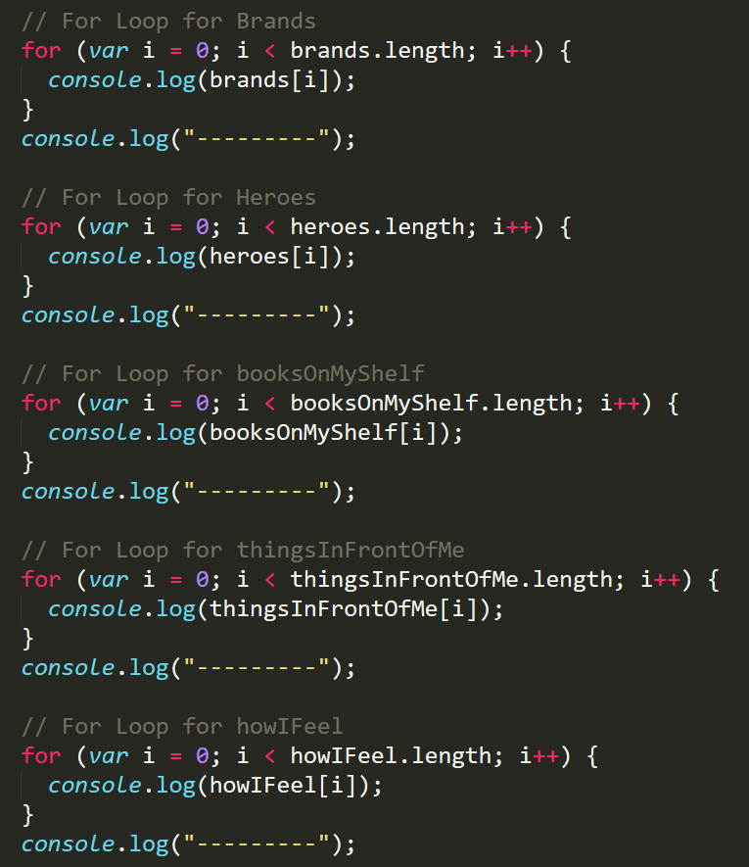
WET code
Notes:
Back to the array-looping-console-logging code…
“We enjoy typing”
Dry it out as a group. Loop at each loop, see the pattern, abstract that to a function.

Slide 8
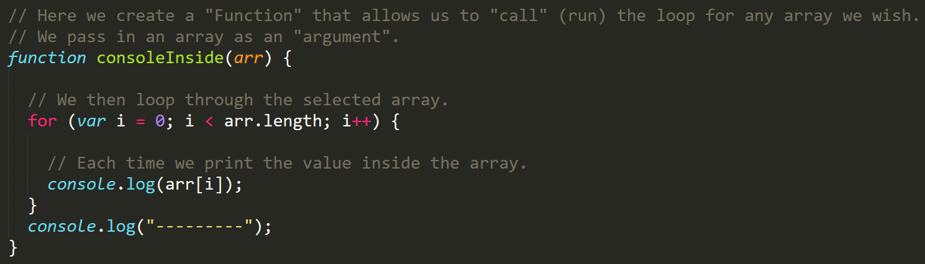
DRY code
Notes:
6. Maybe not exactly what we did…but close.

Slide 9
Activity: First Functions
You’ll write code to:
Add three numbers
Multiply three numbers
Check if inputs are strings
Check if an input is a vowel
Define functions
Call() functions
Notes:
7. Send 03-MyFirstFunctions/my-first-functions-unsolved.html via slack.
Work in groups of 2-3. 20 minutes. Aim to finish all four functions.

Slide 10
Activity review
Defining functions
function adder(a, b, c) { return a + b + c; }
Call functions
adder(23, 77, 13); // returns…what?
Inputs to functions are arguments
Use a variable: var sum = adder(23, 77, 13);
Don’t forget to call!
Notes:
7. Send 03-MyFirstFunctions/my-first-functions-unsolved.html via slack.
Work in groups of 2-3. 20 minutes. Aim to finish all four functions.

Slide 11
Objects

Slide 12
Arrays are great…
Versatile storage
Easy to loop
Convenient access to items
But…difficult to model relationships
Notes:
9. Walk through activity 4.
Hard to maintain links between separate arrays.
Walk through activity 5. Then open activity 6.

Slide 13
Objects
Composed of properties and values
“properties” have associated “values”
Use a property to access a value
Properties also referred to as keys
{
property: value,
key: value
}
Notes:
13. Review activity 6.

Slide 14
Activity: Basic Objects
Access values using keys
Call methods()
Notes:
14. Send 07-MyFirstObject/car-object-unsolved.html via slack.
Work together! 15 minutes. Log the requested info. Methods are functions. Properties are keys.

Slide 15
Break – 40 minutes

Slide 16
Activity Review: Basic Objects
Let’s walk through this…
Notes:
16.

Slide 17
Activity: Car Game
Admittedly, a pretty lame game.
Valuable practice and experience though!
Notes:
17. Demo car game.
18. Slack out file + instructions.

Slide 18
Scope & Callbacks
Notes:
20. Slack out scope-examples.html
Then scope-unsolved.html (do as a group).
Then scope-solved.html.

Slide 19
Homework #3
Notes:
21.
https://github.com/coding-boot-camp/FullStack-Lesson-Plans/blob/master/02-lesson-plans/03-intro-js-hangman-dom/2-Homework/Instructions/homework-instructions.md

Slide 20
Bonus: Question Game
Notes:
22. Talk through then slack out instructions.

