Slide 1
jQuery
Coding Boot Camp

Slide 2
git review
git clone: copy a repository
git add: include in next commit
git commit: formally include changed files
git push: send commits to another repo
git pull: download updates
Notes:
Everyone follow along:
Make a repository
Clone it
Create then add a file
Commit
Push

Slide 3
Questions
JavaScript?
Functions?
Objects?
Scope?

Slide 4
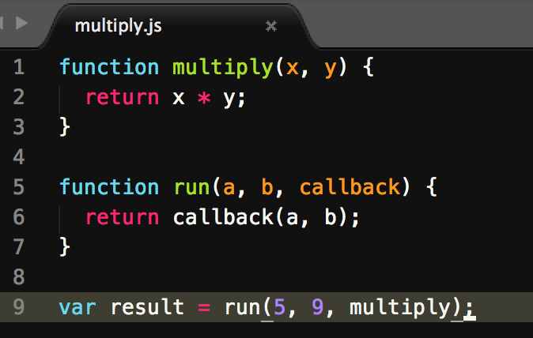
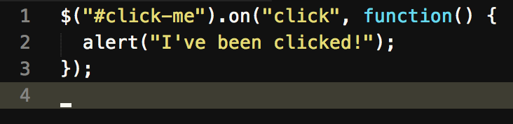
Callback functions
What’s a callback function?
a function passed to another as an argument
Why is it important?
execute code responding to an event
Notes:
A function passed to another function as an argument. What.

Slide 5
Some Reminders
Homework: check what is in github, check github pages, double-check
Homework: due Saturday, turn in something!
Submit both github pages and github repo urls.
You only need to do/submit one of them.
Office hours 45 minute before and 30 minutes after.
If something is not clicking, or you have any questions, come ask!
If you need help practicing, drop by, we can practice together.
Don’t be afraid to ask for help!
Be willing to lend a hand!

Slide 6
Today’s goals
DOM manipulation with:
plain JavaScript
jQuery
Browser events:
plain JavaScript
jQuery
Notes:
DOM?
jQuery: $, dom querying, event handling, animation, ajax, browser inconsistencies

Slide 7
Less slides, more code
Fewer and fewer slides
More and more time coding
Get used to being in your editor

