Slide 1
jQuery (cont.)

Slide 2
Perspective…
“You can’t tell whether you’re learning something when you’re learning it—in fact, learning feels a lot more like frustration.”
Notes:
Jeff Dickey, Author of Write Modern Web Apps with the MEAN Stack: Mongo, Express, AngularJS, and Node.JS

Slide 3
Tonight
Captain Planet
Practice jQuery on a Fridge
Pretend to learn scoping
More click events experience

Slide 4
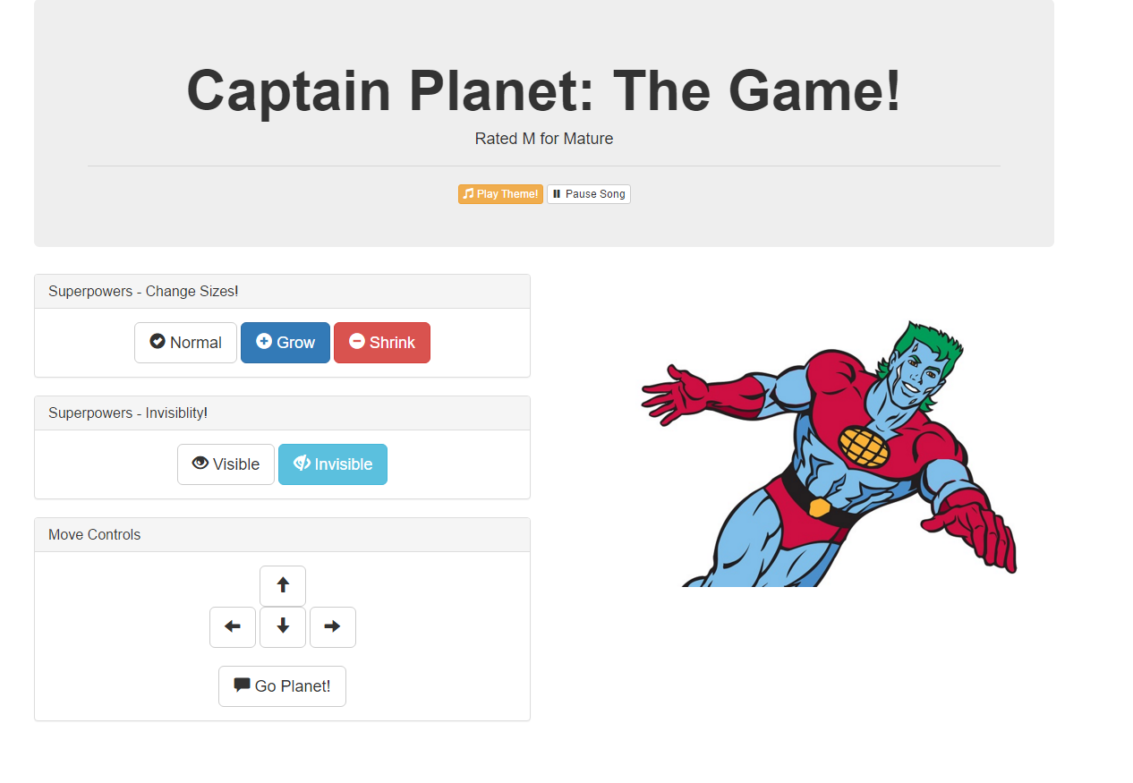
Notes:
Demo the page.
Game? Mature?

Slide 5
Captain Planet Pseudocode
Using five steps, explain how the Captain Planet page was built
.
.
.
.
.
Notes:
Do this as a group.
Mention that getting started, making a plan can be the hardest part to a project or task.

Slide 6
Improve Captain Planet
Use the jQuery API Docs and add a button of your own that gives Captain Planet a new power.
…with a click you could:
stretch Captain Planet
trigger a maniacal laugh
create clones of Captain Planet
create a shield (hint: border)
create fire or water (hint: images)
Notes:
Slack out a screenshot of the working example

Slide 7
jQuery review
Find an element or set of elements: $(‘div’)
Attach to an event: .on(‘click’, eventHandler);
Do something: function(e) {log(e.target); }

Slide 8
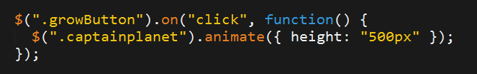

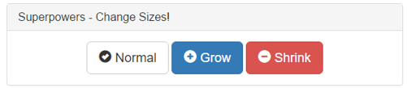

1. Click the Grow Button
2. Make Captain Planet Grow

Slide 9
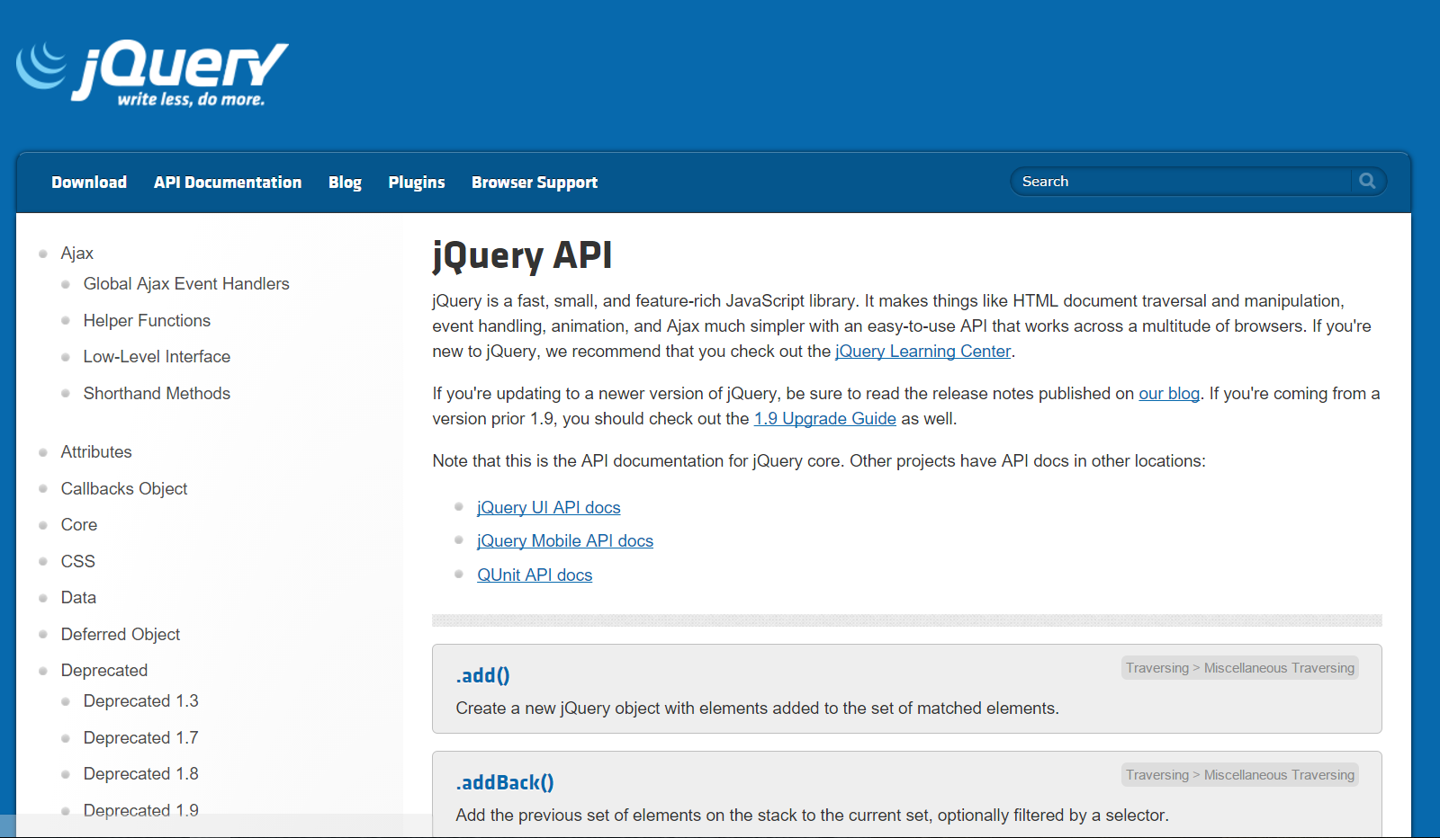
RTFM
Read the docs: http://api.jquery.com/
Notes:
Not just jQuery, all project documentation!

Slide 10
The fridge
Working in groups of 3-4, complete the code for the fridge activity such that:
Javascript generates a button to for each letter.
Clicking any button puts that letter on the fridge.
Hitting the clear button erases all of the letters from the fridge.
Refer to comments in the file slacked out.
This is a challenging exercise. You may want one person to type, while the other two watch over to catch bugs and/or research necessary snippets.

Slide 11
Scope
Curly brackets { } indicate blocks of code.
Blocks of code affect variables outside the curly brackets
Scope impacts which variables can be accessed by which function

Slide 12
Nested boxes
global
function outer()
function inner()
Notes:
In a browser, what is “global”?
Inner can access variables declared in outer(), and also declared in global.

Slide 13
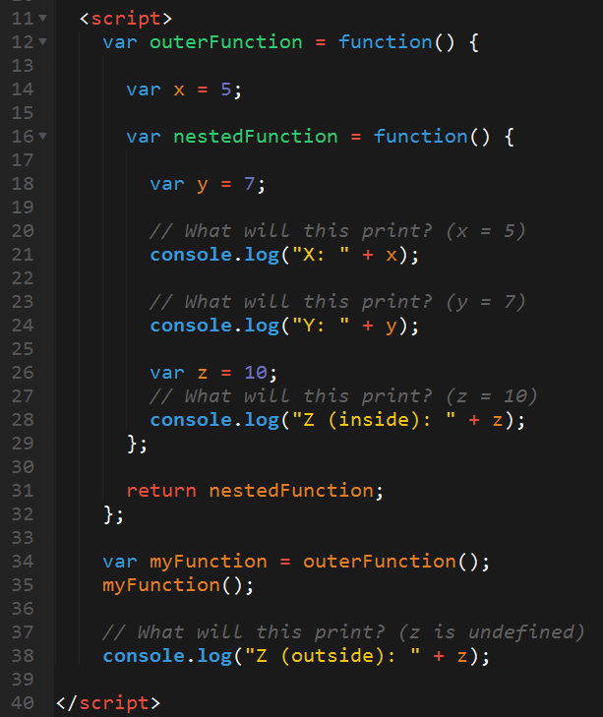

Slide 14
Scope activities…
Notes:
Scope leads to lots of confusion, lots of bugs, so we’ll spend some extra time walking through activities.

Slide 15
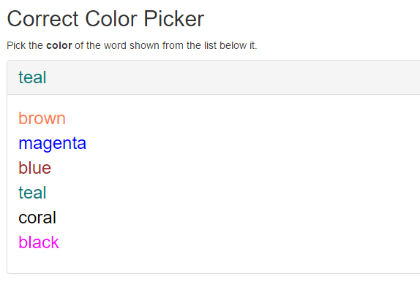
Bonus activity

