Slide 1
Node.js
Coding Boot Camp – June 13, 2017

Slide 2
But first: Group Projects
Have retrospectives with your groups.
Share individual feedback.
Share links to your projects in slack.
Continue to working on them!
Write a thorough readme for your projects.
Consider writing about your experiences in a blog post.
Notes:
Re-visit especially difficult or tricky issues. CORS?

Slide 3
And the winners are…

Slide 4
Most useful
Jobba
Convene
Jobs BnB

Slide 5
Most fun and/or interesting
Coders Against Humanity
Convene
DiXit

Slide 6
Most innovative
Jobba
Convene
Convoy Connection

Slide 7
Congratulations All!
Lots of great design and user experience.
Props for persevering!
Executing: Ideas -> applications!
👏 👏 👏

Slide 8
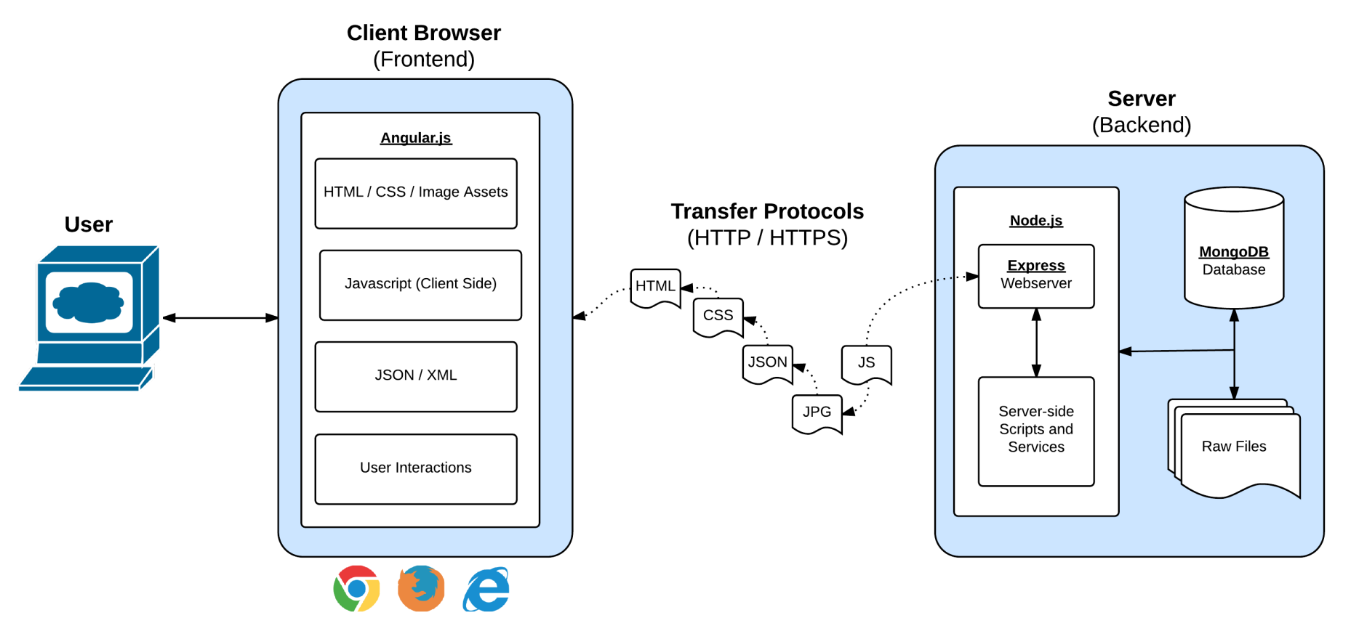
In modern web applications there is a constant back-and-forth communication between the visuals displayed on the user’s browser (frontend) and the data and logic stored on the server (backend).
Notes:
Full-Stack refresher

Slide 9
Servers
Servers: receives requests, do something, return responses.
Clients: generate requests, receive responses.
Sometimes a physical machine, not always.
Why do we want a server? What purposes do they serve?

Slide 10
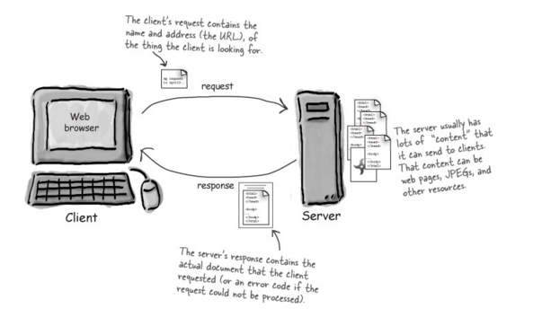
Servers

Slide 11
Why? What does a server do?
Handle HTTP requests (web server).
Host databases (database server).
Data processing.
File access.
JSON-based APIs.
Notes:
Server vs. service.
Server-less technology?

Slide 12

JavaScript on servers

Slide 13
What is Node.js?
Like the console in DevTools, but via command line.
Chrome’s JavaScript engine without any UI, for use on a server.
Who’s using Node, and why? Discuss…
Notes:
More command line? Doesn’t sound too exciting.
Do: search for some companies using node.

Slide 14
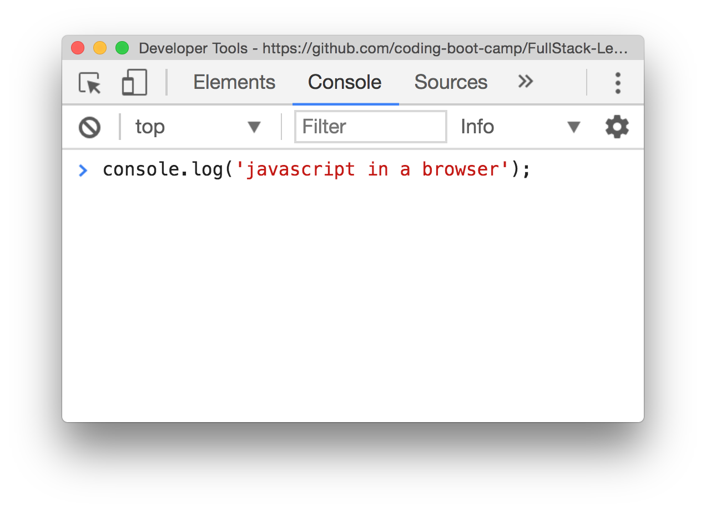
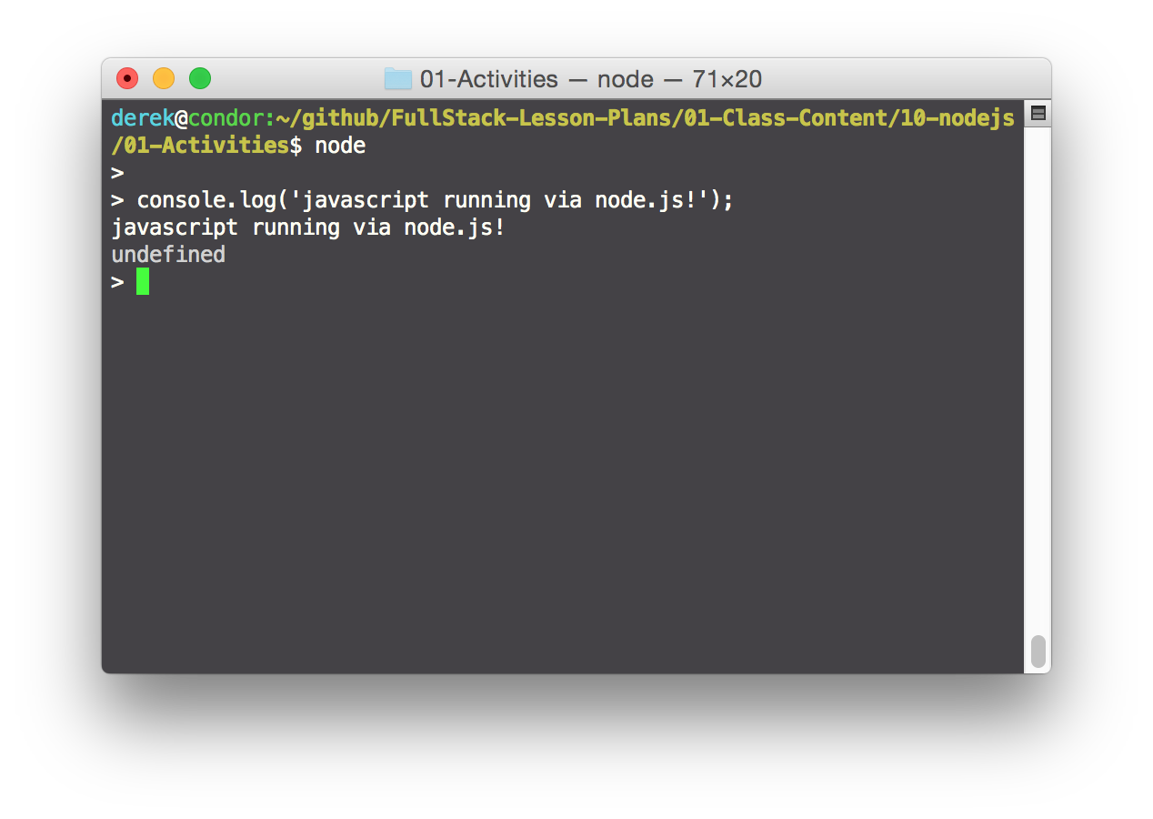

Slide 15
Why Node.js?
One language for client and server, rather than two (or more).
Extensible, with an active, vibrant community (NPM, more Saturday).
Easy to implement applications (additional easy to use frameworks).
Scalable and asynchronous.

Slide 16
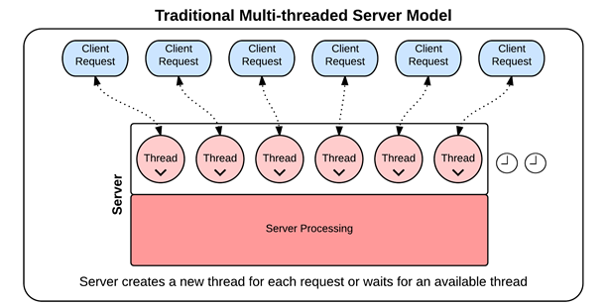
Syncrononous (Blocking) Threading
Notes:
In traditional synchronous threading, each request requires its own thread. No other request can pass through that thread until complete. Since there is a limited pool of threads, this can create bottlenecks.

Slide 17
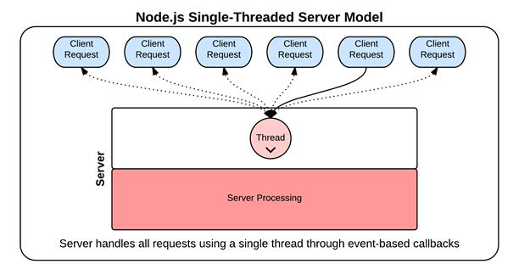
Asyncrononous (Non-Blocking) Threading
Notes:
This is what node does.

