Slide 1
Your Objectives
Before you walk out the door you should…
Know how to create a generic Express Server (copy and paste is fine).
Know how to create a basic Express GET route
Know how to create an Express POST route
Know what POST Man is for
Understand “conceptually” how to use AJAX to GET and POST data to an Express server

Slide 2
A Big Box
Server
Take a few moments to answer the following questions with the person next to you:
How does this box represent a server?
What modules or “sub-boxes” commonly exist inside?

Slide 3
And More!
Server
In a way, servers can be represented as hardware boxes with modules of server-side code contained inside.
Servers typically contain code for tasks such as listening, parsing URLs, route handling, and more.
Listen
URL Parse
Route Handling
Send HTML
Send JSON
Receive POSTs
Server Side Logic
And More!

Slide 4
What is Express?
In modern web applications there is a constant back-and-forth communication between the visuals displayed on the user’s browser (frontend) and the data and logic stored on the server (backend).

Slide 5
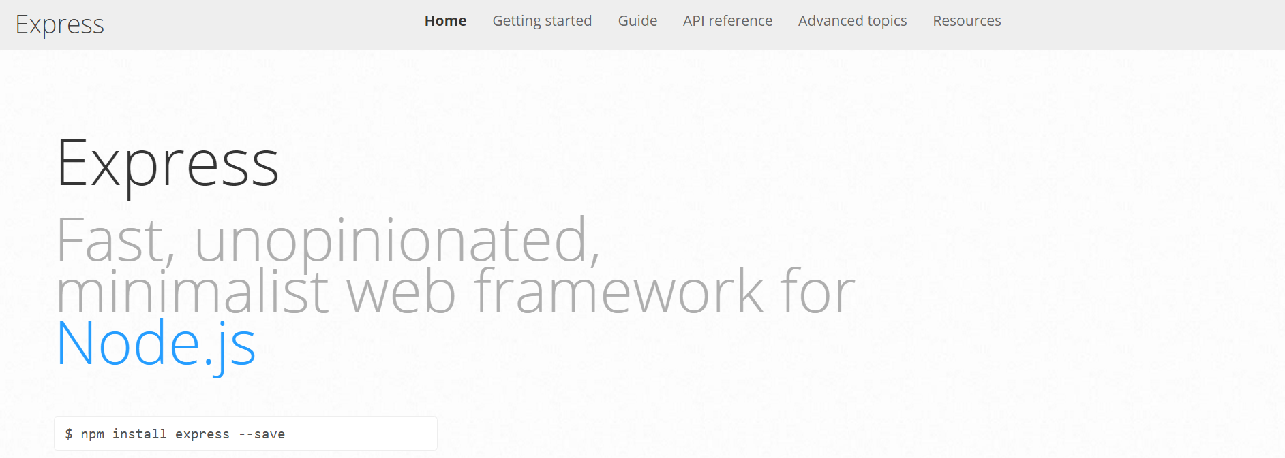
Express.JS
Web framework for node to make creating code for server much simpler
In modern web applications there is a constant back-and-forth communication between the visuals displayed on the user’s browser (frontend) and the data and logic stored on the server (backend).

Slide 6
Remind me again…
What is a route?
In modern web applications there is a constant back-and-forth communication between the visuals displayed on the user’s browser (frontend) and the data and logic stored on the server (backend).

Slide 7
Routes
/
User is shown the “Home” Page
/saved
User is shown the “Saved” Page
User visits a link…
/api/headlines
User is given JSON containing all of the headline data.

