Slide 1
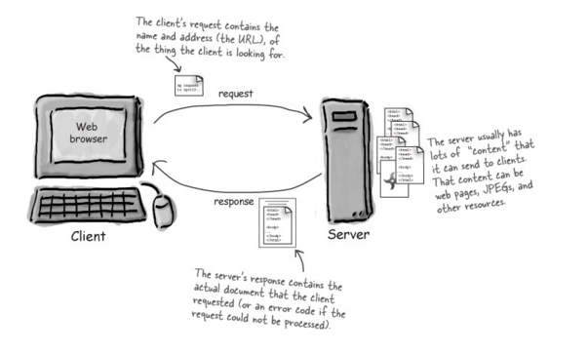
Server Definition
Server: The Machine and Code that handles requests and respond to them.

Slide 2
Remind me again…
What are examples of server-side functions?
In modern web applications there is a constant back-and-forth communication between the visuals displayed on the user’s browser (frontend) and the data and logic stored on the server (backend).

Slide 3
Server-Side Code in Action!
Visiting a URL and then being given an HTML page.
Visiting an API end-point that parse URL parameters to provide selective JSONs.
Clicking an invoice that provides a PDF report.
Image processing software that takes an image applies a filter, then saves the new version.
Google providing “results” relevant to your searches on other sites.

Slide 4
Remind me again…
What is a client?
In modern web applications there is a constant back-and-forth communication between the visuals displayed on the user’s browser (frontend) and the data and logic stored on the server (backend).

Slide 5
Client Definition
Client: The users’ personal machines that make “requests” of the server.

Slide 6
Bonus Question:
How do the client and server communicate with one another?
In modern web applications there is a constant back-and-forth communication between the visuals displayed on the user’s browser (frontend) and the data and logic stored on the server (backend).

Slide 7
HTTP Definition
Clients and Servers communicate back and forth using a series of understood communications defined by HTTP / HTTPs.

Slide 8
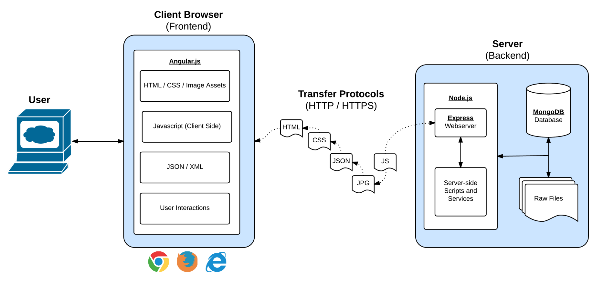
Full-Stack Development
In modern web applications there is a constant back-and-forth communication between the visuals displayed on the user’s browser (frontend) and the data and logic stored on the server (backend).

Slide 9
Full-Stack Development
In a way think of this as being two distinct machines.
A server is one machine and the client is a second machine.

Slide 10
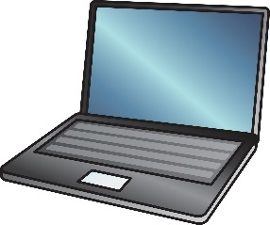
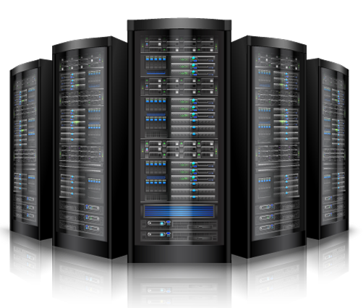
Visualizing Servers
These machines (and their respective code) handle all of the requests coming in from browsers accessing a website.

Slide 11



Where Do Servers Live?
Servers live in dedicated hardware intended to handle ALL the requests and responses of many clients.
Servers can live most often live on cloud platforms like AWS, Heroku, Google Cloud, etc.

Slide 12


Servers During Development
localhost
Important Note:
During development our personal computers will be able to simulate both.
We will create a “local server”
And then use our browser to interact with it.
browser

