Slide 1
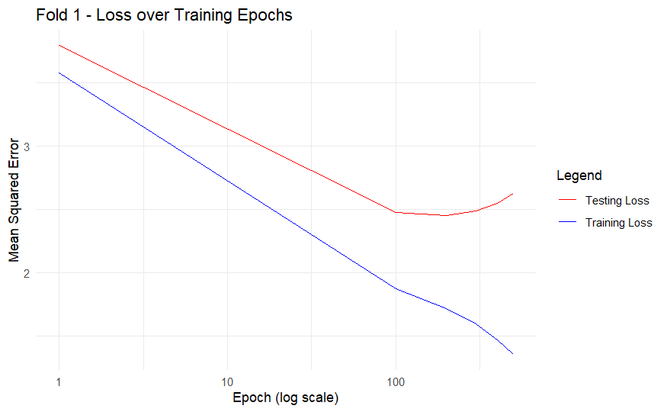
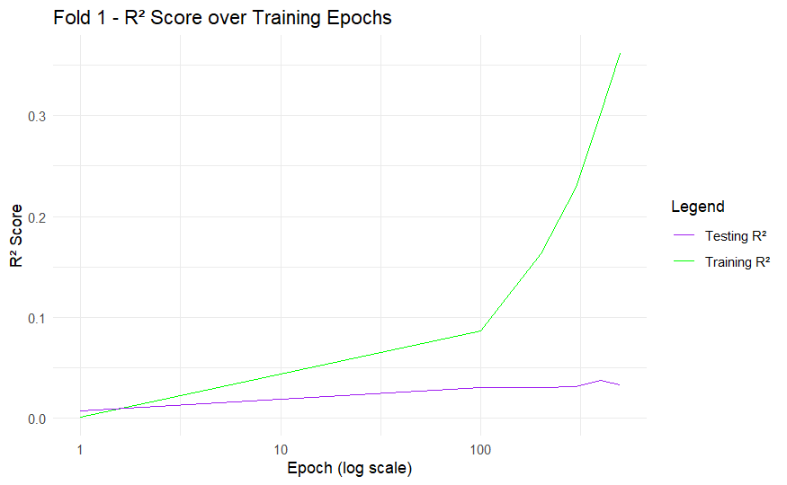
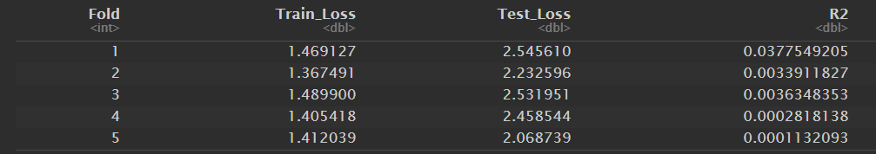
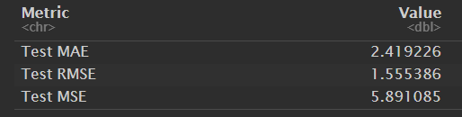
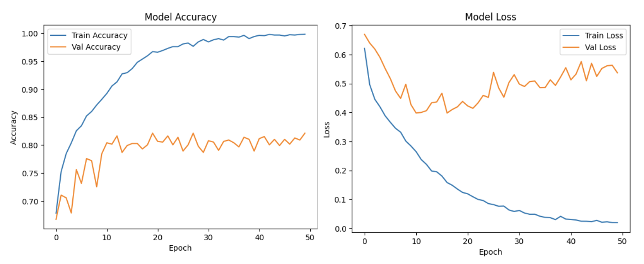
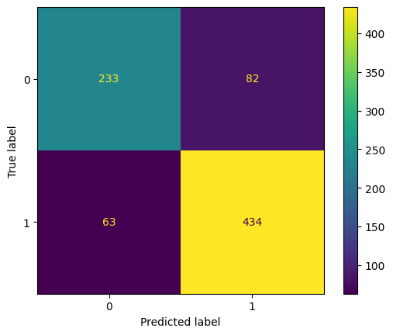
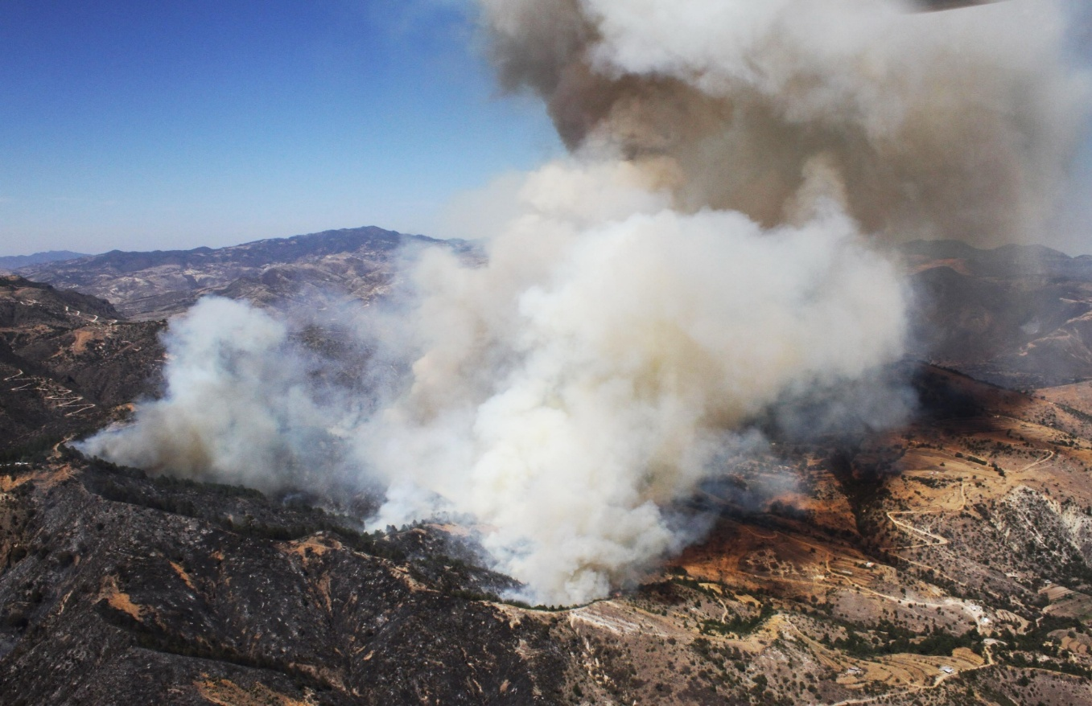
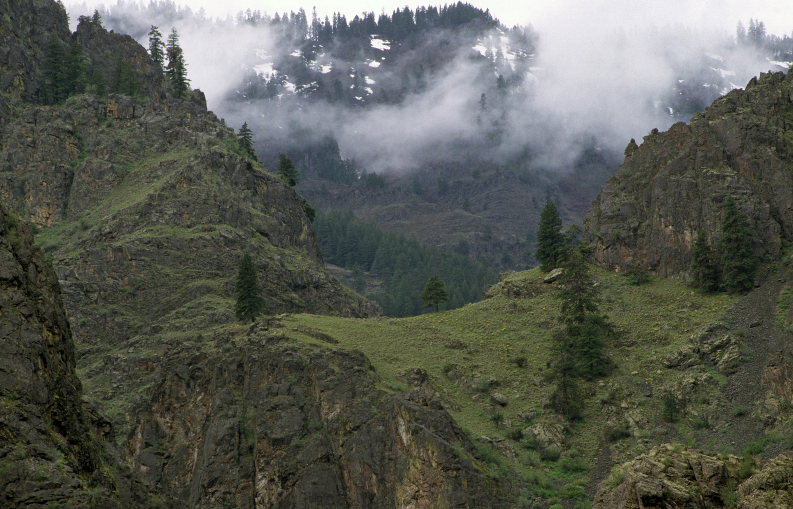
Final Project
DS 4420 – Machine Learning 2
Predicting Wildfire Severity and Occurrences using MLP and CNN models
Jeffrey Pan and Jocelyn Min
Purpose and Objectives
Results and Discussion
The purpose of this project is to utilize Multi-Layer Perceptron and Convolutional Neural Networks to predict wildfires and their severity. We want to test their performance to see if they can work in tandem to identify and predict fire severity.
MLP uses structured forest fire data containing Fire Weather Index (FWI) values, temporal data, and location to be trained and tested on. It attempts to predict the area of forest fire damage in log-scaled hectares. This dataset contains 517 records.
CNN uses RGB images of fire v. no-fire to be trained and tested on. It attempts to accurately predict whether an area will be impacted by fires or not. This dataset contains 2699 records.
MLP Model: Demonstrated strong learning on training data but failed to generalize (test R² ≈ 0), indicating overfitting and architectural mismatch for the dataset size and quality. The small size of the dataset could also be the reason of poor performance. Additional regularization and improved feature engineering are needed for better test performance. This model must be redeveloped for further integration in multi-model framework.
Figure 6: Loss and R^2 over 400 epochs of training and testing data for MLP model.
Figure 7 + 8: MLP metrics containing loss for training and testing sets and R^2 value. Also contains MAE, RMSE, and MSE.
CNN Model: Achieved 82.14% validation accuracy, with moderate overfitting indicated by rising validation loss. Despite regularization the model misclassified some samples (82 false positives, 63 false negatives), suggesting potential gains from data augmentation or architecture tuning. This model seems to do well and can be integrated in multi-model fire prediction framework.
Methodology & Model Architecture
Multilayer Perceptron (MLP):
Two hidden layers with Leaky ReLU, L2 regularization, and batch normalization for stability and generalization.
Trained using backpropagation and evaluated with MAE, RMSE, R², and MSE.
Convolutional Neural Network (CNN):
Classifies 32x32 RGB images into fire vs. no fire using two convolutional layers (32 & 64 filters).
Uses batch normalization, max pooling, and a dense layer for feature extraction and classification.
Final sigmoid-activated layer outputs binary probabilities; quantified with binary cross-entropy loss (for sigmoid).
Figure 3 + 4: Accuracy and loss over epochs for training and validation sets for CNN.
Figure 5: Confusion Matrix of the CNN model.
Conclusion and Future Work
Robust validation strategies and expanded datasets will be critical to improving performance and reliability. A key direction for future work is the development of a dual-model framework that leverages the CNN for image-based classification and a refined MLP for predicting continuous variables, integrating both models into a more comprehensive system for environmental analysis.
References
Figure 1. A fire image from ”The Wildfire Dataset” [2].
Figure 2. A no-fire image from ”The Wildfire Dataset” [2].
[1] Cortez, P, Morais, A. “A Data Mining Approach to Predict Forest Fires using Meteorological Data”. In J. Neves, M. F. Santos and J. Machado Eds., New Trends in Artificial Intelligence,
Proceedings of the 13th EPIA 2007 - Portuguese Conference on Artificial Intelligence, December, Guimaraes, Portugal, pp. 512-523, 2007. APPIA, ISBN-13 978-989-95618-0-9.
Available at: http://www.dsi.uminho.pt/~pcortez/fires.pdf
[2] El-Madafri I, Peña M, Olmedo-Torre N. “The Wildfire Dataset: Enhancing Deep Learning-Based Forest Fire Detection with a Diverse Evolving Open-Source Dataset Focused on Data Representativeness and a Novel Multi-Task Learning Approach”. Forests. 2023; 14(9):1697. https://doi.org/10.3390/f14091697

