Slide 1



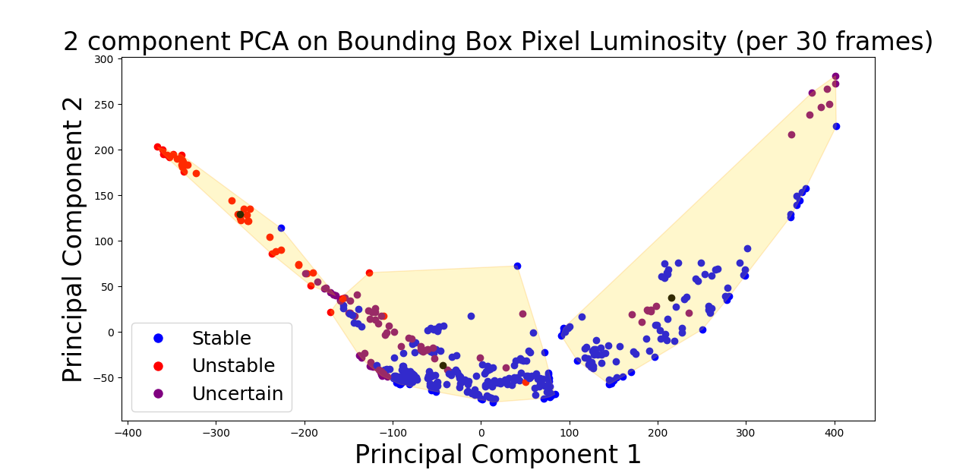
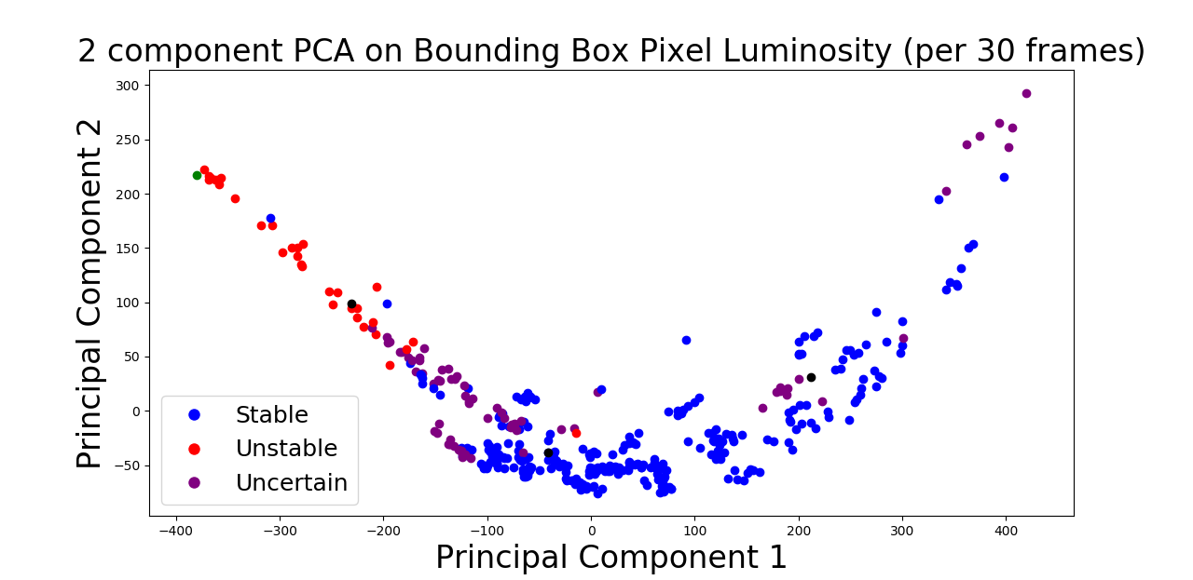
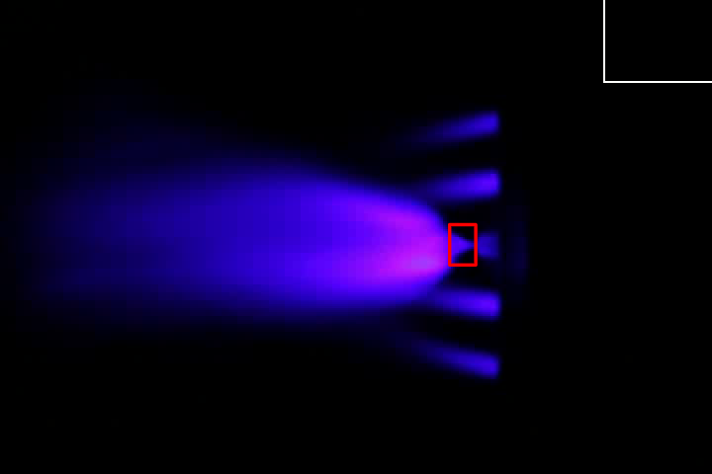
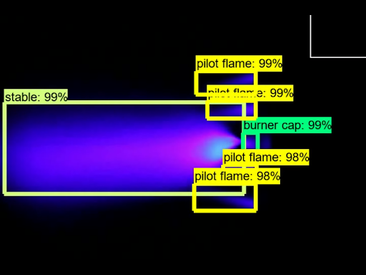
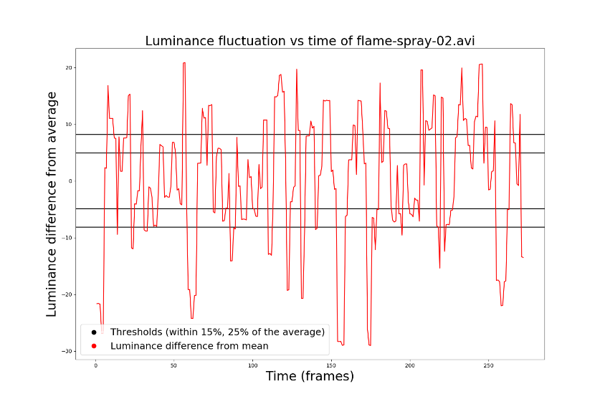
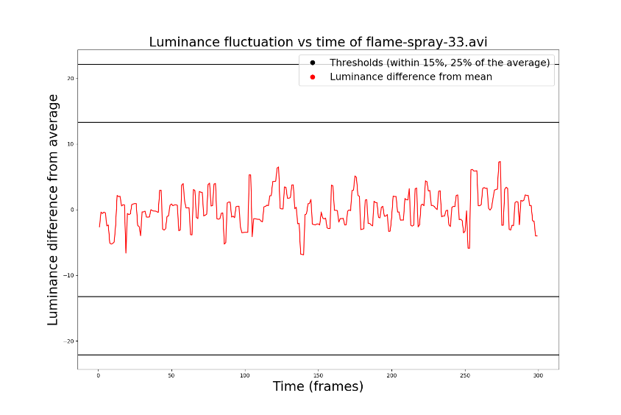
Real-Time, Artificial-Intelligence-Assisted Flame Stability Analysis for Flame Spray Pyrolysis
Jessica Pan, COS ‘21
Center For Statistics and Machine Learning, Princeton University
Applied Materials Division, Argonne National Laboratory
Abstract
Data and Materials
Supervised and Unsupervised Learning
Results and Conclusion
Flame spray pyrolysis (FSP) is an experimental process used to synthesize nanoparticles through the ignition of a solvent as it is ejected from a burner. However, current limitations in the understanding of how to consistently achieve a stable flame is impeding the reliable production of particles using this method. Therefore, streamlining the flame spray process using machine learning and artificial intelligence on FSP video feed to detect unstable flame conditions will contribute to fewer wasted resources as well as a safer working environment. We first determine a way to quantitatively decide whether or not the burner flame is stabilized by analyzing the anchor point of the flame. This method can be used to label data for both unsupervised and supervised learning techniques or applications, such as principal component analysis or image detection. In doing so, we can track and classify FSP flame conditions in real time, and alert users if an unstabilized flame state is achieved at any point in the synthesis process. This research has the potential to more efficiently manage manufacturing processes using machine learning and computer vision.
Data: Our data consisted of 53 full-color, 10-second video clips of flame spray pyrolysis burning a simple ethanol (EtOH) solvent with no solute in a controlled environment. Also, 11 human experts in the field of combustion (Argonne researchers, Princeton professors and graduate/undergraduate students) were each asked to view the 53 FSP video clips and classify the state of the flame (stable, unstable, or uncertain).
Tools: Python was used for machine learning and image classification, with extensive use of its Scikit-learn, SciPy, and OpenCV libraries. TensorFlow and CUDA were also used to train the RCNN we used to detect and classify images in video feed. The object detection classifier code was based off of the tutorial on the EdjeElectronics GitHub [6].
Principal Component Analysis:
Dimensionality reduction
45,000-feature space to 2 principal components
Cluster into 3 regions of interest using k-means clustering
Classify new FSP video clips as stable or unstable depending on where they fall on the plot
Proximity to centroids of 3 regions
For 45 of the 53 videos, or in about 85% of the cases, the prediction achieved from our bounding box prediction (used in unsupervised machine learning) matches that of the human classification. For the computer vision approach, the accuracy is even higher, with human experts and model agreeing in 92% of the cases.
Using a bounding box indicator on images to detect luminosity fluctuations near the nozzle of a burner flame makes it possible to quantitatively determine flame stability and use it to classify flame spray pyrolysis footage and images. By applying principal component analysis for two principal components, we are able to isolate clusters of events determined to be in relative groups of stability; giving the algorithm additional points (in the forms of individual frames) and assigning them to the nearest cluster would provide a near-real-time means of generating stability classifications for new data. Additionally, it is possible to train an object detection classifier for the purpose of recognizing and labeling features in videos of flame spray pyrolysis, and a warning can be sent to a user if the flame should reach an unstable state.
Stability Classification
Our approach for quantitatively determining flame stabilization involves analyzing the luminosity (a measure of pixel brightness) of pixels within a bounding box region of the burner flame. We know that the area closest to the nozzle exhibits great fluctuations in luminosity when the flame is not stabilized due to the occurrence of momentary extinction events, where the flame is no longer anchored to the nozzle. We averaged the luminosity of all the pixels in that bounding box across all of the frames in a given video clip. Each frame's deviance in luminosity from the average luminosity of all of the frames in the video is then plotted. If the fluctuation in luminosity deviated more than 25% from the average, the flame in the clip is considered unstabilized. If it deviates more than 15% from the average, we consider the flame neither stable nor unstable and give it an uncertain rating. Otherwise, the flame is considered stabilized.
Introduction and Problem
References
Flame spray pyrolysis (FSP) is a cost-effective, versatile and scalable synthesis process used generate make powder-like nanoparticles by combusting a solvent loaded with precursors [1]. Because FSP is an novel and experimental process, we do not know how the nanoparticles nucleate and grow, nor can we create nanoparticles of the desired size consistently [3]. However, flame spray pyrolysis will not produce a favorable yield of nanoparticles if the burner flame becomes unstabilized [4].
In the past, researchers like Dasgupta et al. [5] have used methods such as computational fluid dynamics modeling to better understand the mechanism behind nanoparticle synthesis in flame spray pyrolysis. While Dasgupta and her team's research focuses modelling the dynamics of the FSP flame, in practice such a method would be too inefficient to provide scientists with a real-time evaluation of their flame condition. We aim to devise a method of alerting scientists of unstable (and therefore also unsafe and wasteful) flame conditions as soon as they happen. This would save the need for human monitoring and improve laboratory/factory safety.
Thus, the specific purpose and application of this project is to optimize burner flame stability of flame spray pyrolysis in near-real-time (within seconds) by processing video feed of the burner. This could allow for a program to autonomously learn from the process and correctly label the flame state faster and with less error when compared to its human counterparts. We do this in two ways: by using principal component analysis (unsupervised machine learning) and a convolutional neural network to create an object detection classifier (supervised machine learning).
[1] Madler, L. et al. “Controlled Synthesis of Nanostructured Particles by Flame Spray Pyrolysis.”Journal of AerosolScience, 2002, doi:10.1016/s0021-8502(01)00159-8.
[2] Nunes, D. et al. “Synthesis, Design, and Morphology of Metal Oxide Nanostructures.” Metal Oxide Nanostructures, 2019, pp. 21–57., doi:10.1016/b978-0-12-811512-1.00002-3.
[3] Hinklin, T., et al. “Liquid-Feed Flame Spray Pyrolysis of Metalloorganic and Inorganic Alumina Sources in the Production of Nanoalumina Powders.” Chemistry of Materials, vol. 16, no. 1, 2004, pp. 21–30., doi:10.1021/cm021782t.
[4] Solero, G. et al. "Synthesis of Nanoparticles through Flame Spray Pyrolysis: Experimental Apparatus and Preliminary Results." Nanoscience and Nanotechnology, 2017, pp. 21-25, doi: 10.5923j.nn.20170701.05.
[5] Dasgupta, D. et al. “Computational Fluid Dynamic Modeling of the Flame Spray Pyrolysis Process for Silica Nanopowder Synthesis.” Journal of Nanoparticle Research, vol. 17, no. 7, 2015, doi:10.1007/s11051-015-3109-z.
[6] Juras, Evan. “TensorFlow Object Detection API Tutorial Train Multiple Objects Windows 10”EdjeElectronics,https://github/com/EdjeElectronics/TensorFlow-Object-Detection-API-Tutorial-Train-Multiple-Objects-Windows-10.\noindent
[7] Jolliffe, Ian T., and Jorge Cadima. “Principal Component Analysis: a Review and Recent Developments.” Philosophical Transactions of the Royal Society A: Mathematical, Physical and Engineering Sciences, vol. 374, no. 2065, 2016, p. 20150202., doi:10.1098/rsta.2015.0202.
[8] Brems, Matt. “A One-Stop Shop for Principal Component Analysis.” Medium, Towards Data Science, 10 June 2019, towardsdatascience.com/a-one-stop-shop-for-principal-component-analysis-5582fb7e0a9c.
[9] Tensorflow. “Tensorflow/Models.” GitHub, github.com/tensorflow/models/blob/master/ research/objectdetection/g3doc/detection_model_zoo.md.
[10] Xu, Joyce. “Deep Learning for Object Detection: A Comprehensive Review.” Medium, Towards Data Science, 29 Sept. 2017, towardsdatascience.com/deep-learning-for-object-detection-a-comprehensive-review-73930816d8d9.
[11] Gandhi, Rohith. “R-CNN, Fast R-CNN, Faster R-CNN, YOLO - Object Detection Algorithms.” Medium, Towards Data Science, 9 July 2018, towardsdatascience.com/r-cnn-fast-r-cnn-faster-r-cnn-yolo-object-detection-algorithms-36d53571365e.
RCNN :
Region-based convolutional neural network → image classifier
Real-time detection of flame instabilization
Trained on a subset of our video clips and detected objects:
Burner cap
Pilot flame
Unstable (flame)
Stable (flame)
Acknowledgements
Thank you to Marius Stan, Noah Paulson, Debolina Dasgupta, Joe Libera and Noah Paulson for advising and contributing to all parts of this project and offering guidance, support, and constructive insight.. Thank you to Jia Deng who was my independent work advisor for this project.

