Slide 1
An idealized diagnostic baroclinic eddy flux model (Part I): explaining the Ferrel cell through QG dynamics
Joshua Pan
July 2025

Slide 2
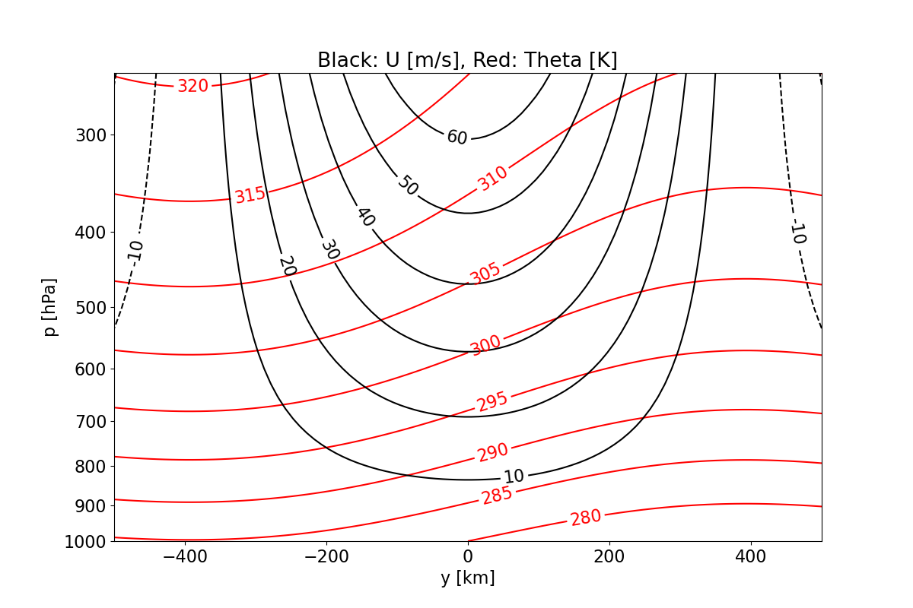
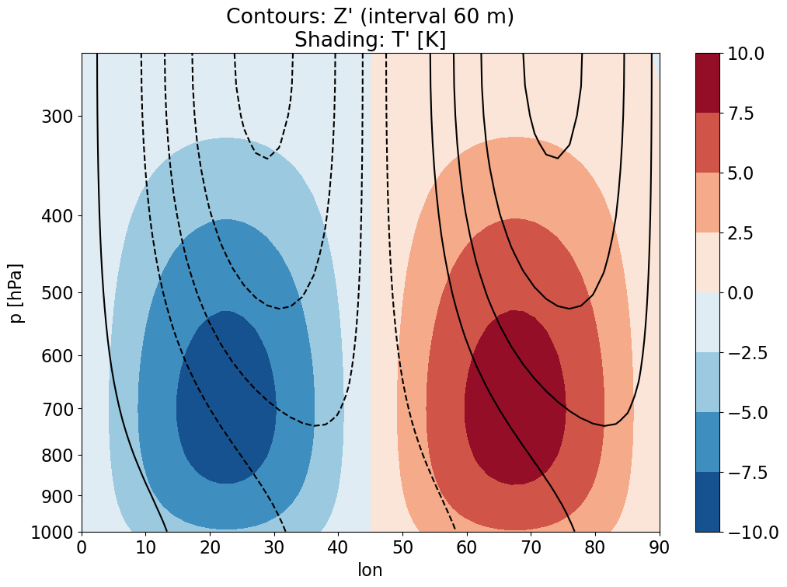
Overview of setup
North→
East→
Model config: QG Boussinesq atmosphere on an f-plane at 45°N
All fields shown have been generated from analytical expressions/approximations
Baroclinic zonal-mean background state (not strictly necessary for eddy flux diagnostics in a zonal-mean framework)
Stratification consistent with a constant buoyancy freq. squared (N²)
Vertical shear consistent with thermal wind balance
Ageostrophic meridional circulation not prescribed but diagnosed
Baroclinically unstable eddies (zonally sinusoidal, covering the entire latitude circle)
Barotropic component (i.e., lower-boundary condition Z1000) in quadrature with temperature anomalies to maximize lower-tropospheric advection
Baroclinic component tilts westward with height
Prescribed phase tilt in the x-y plane (see next slide…)

Slide 3
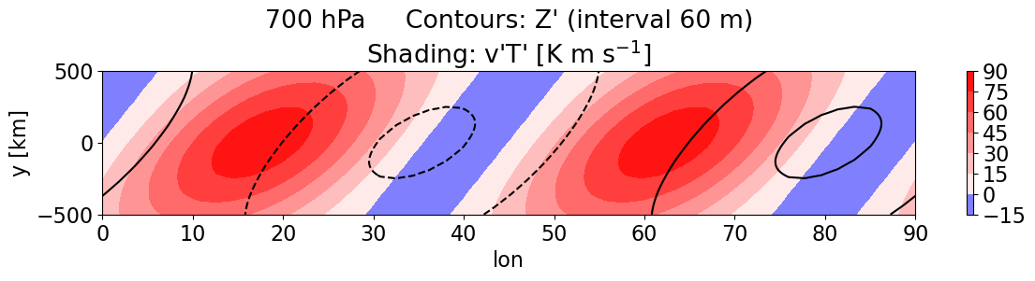
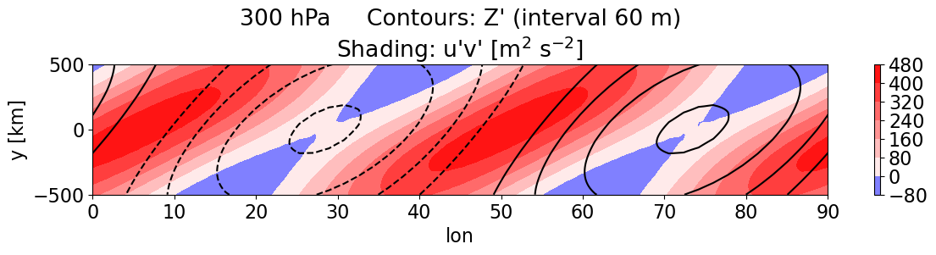
Meridional eddy fluxes
Meridional eddy heat flux (EHF) is overwhelmingly poleward as v’ and T’ are in-phase in the lower-troposphere
Phase tilt in the x-y plane allows u’ and v’ to covary in the zonal mean, giving rise to net poleward fluxes of westerly momentum (eddy momentum flux; EMF)

Slide 4
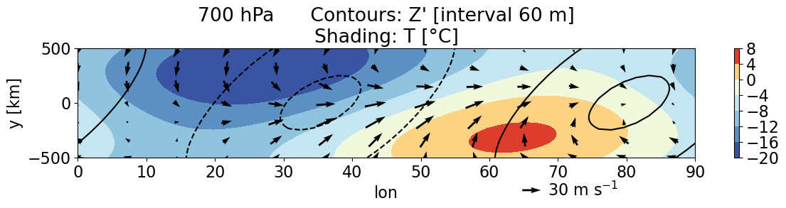
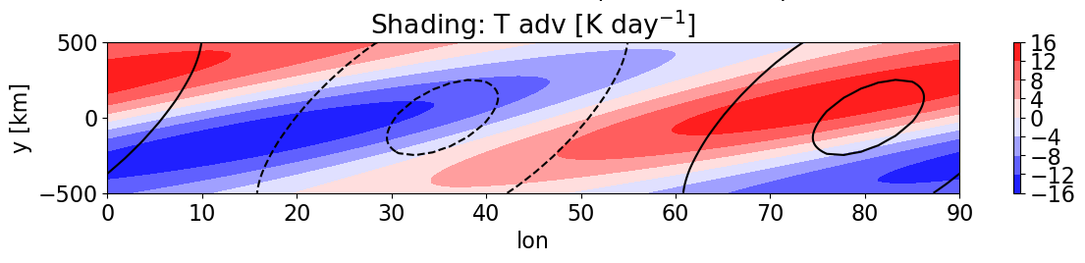
Typical synoptic map view of T and T advection
Cold air advection (CAA) is generally upstream of cyclones, and warm air advection (WAA) occurs downstream of cyclones.
No realistic frontal structures are present because
Practically: they add a lot of mathematical complexity
Dynamically: there has been no prognostic model evolution to allow for frontogenic processes/feedbacks. Note that such processes would be better described by semigeostrophic dynamics.

Slide 5
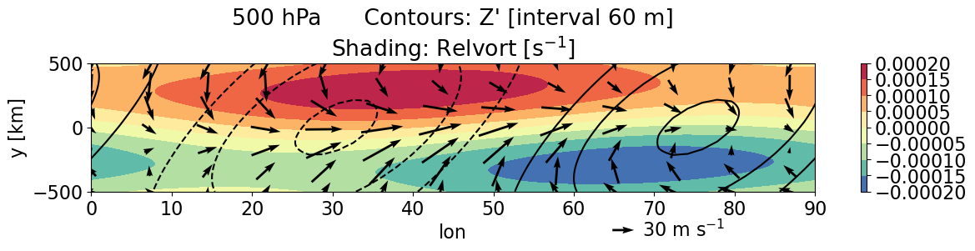
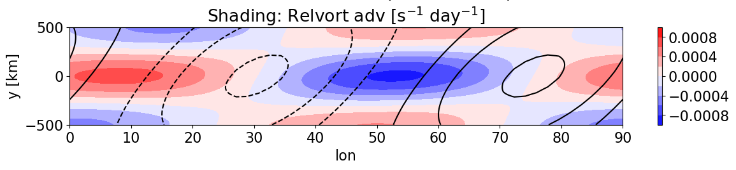
Typical synoptic map view of relative vorticity
Both the eddies and the meridional shear of the zonal-mean jet contribute to the relative vorticity fields.
Due to the x-y phase tilt, the lobes of anticyclonic (negative) vorticity advection are slightly stronger than lobes of cyclonic vorticity advection.

Slide 6
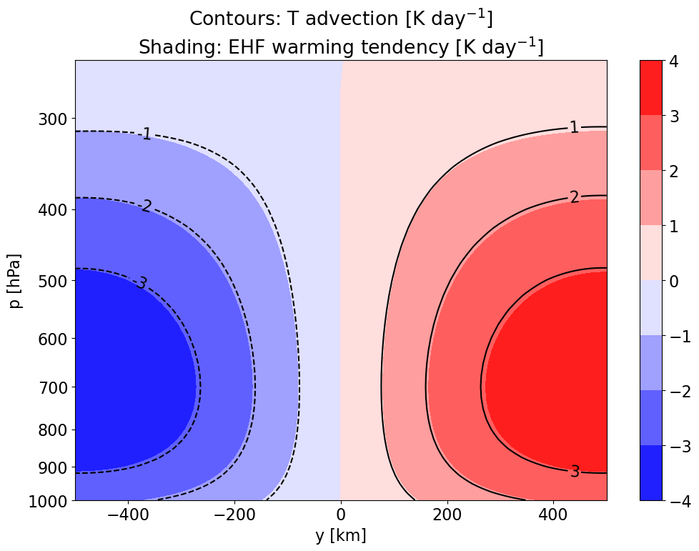
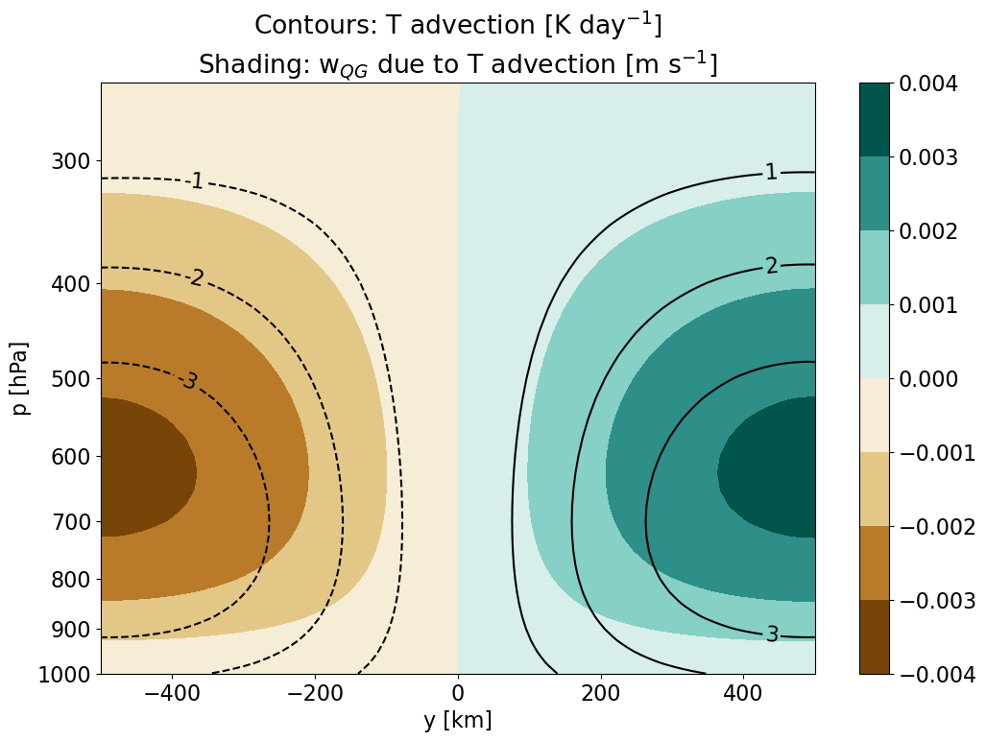
Zonal-mean view of T advection
There is net WAA on the poleward flank of the eddies and CAA on the equatorward flank.
The advective temperature tendency is nearly identical to the temperature tendency due to EHF convergence -(v’T’)_{y}

Slide 7
Solving for vertical motion
Use the Boussinesq QG-omega equation (Davies 2015, MWRe)
Turn the PDE into an eigenvalue problem by setting the y and p dependence of forcing fields to sines and cosines that approximate the true fields.

Slide 8
Forcing
Response: vertical motion induces adiabatic temperature tendencies
Cooling due to CAA
Warming due to WAA
Warming due to subsidence ↓
Cooling due to ascent
↑
How the QG secondary circulation counteracts T advection
The QG system is quasigeostrophic, meaning nearly in thermal wind balance.
Poleward transport of heat by eddies weaken the equator-to-pole temperature gradient.
In order to maintain thermal wind balance, the secondary circulation induces opposing adiabatic temperature tendencies.
Note that the secondary circulation also induces momentum tendencies through the Coriolis force, acting to maintain thermal wind balance (see later slides…)

Slide 9
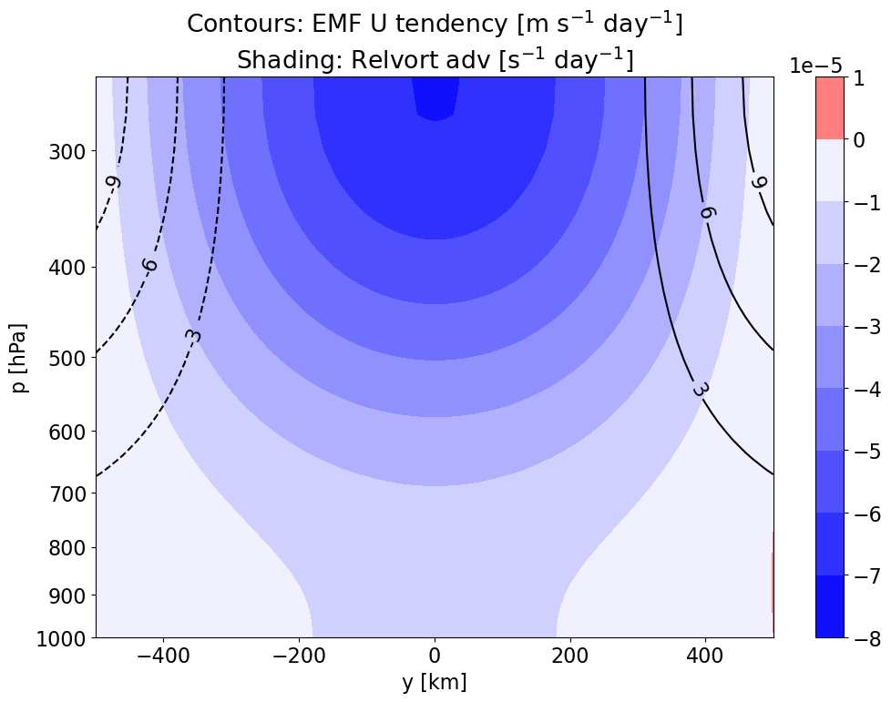
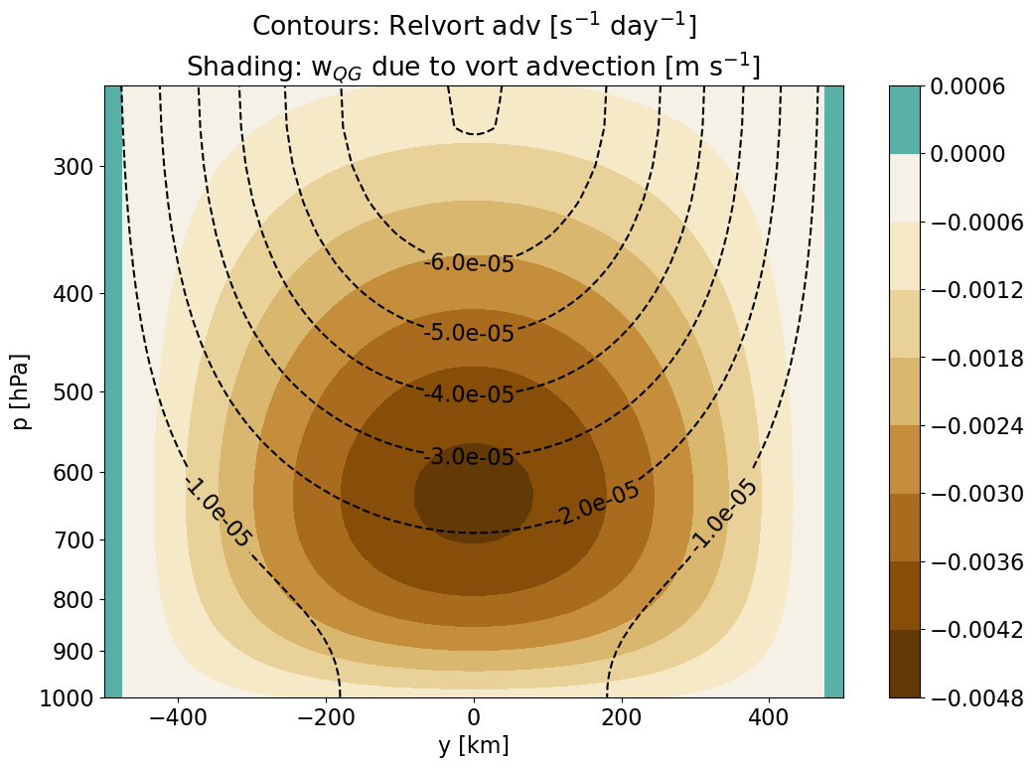

Zonal-mean view of EMF and vorticity advection
EMF divergence decelerates upper-tropospheric westerlies on the equatorward flank of the domain and accelerates westerlies on the poleward flank.
There is net anticyclonic vorticity advection associated with EMF, which is consistent with the definition of relative vorticity:

Slide 10

Response: vertical motion induces adiabatic temperature tendencies
Forcing
Anticyclonic vort adv strengthens with height
Warming due to subsidence ↓
Vertical shear of westerlies decreases
Vertical shear of westerlies increases
T_{y} increases
T_{y} decreases
Thermodynamic response to vorticity advection
As a consequence of thermal wind balance, upper-level relative vorticity minima are roughly collocated with temperature maxima at lower levels:
In order to maintain balance, the secondary circulation must induce warming beneath areas of anticyclonic vorticity advection.

Slide 11
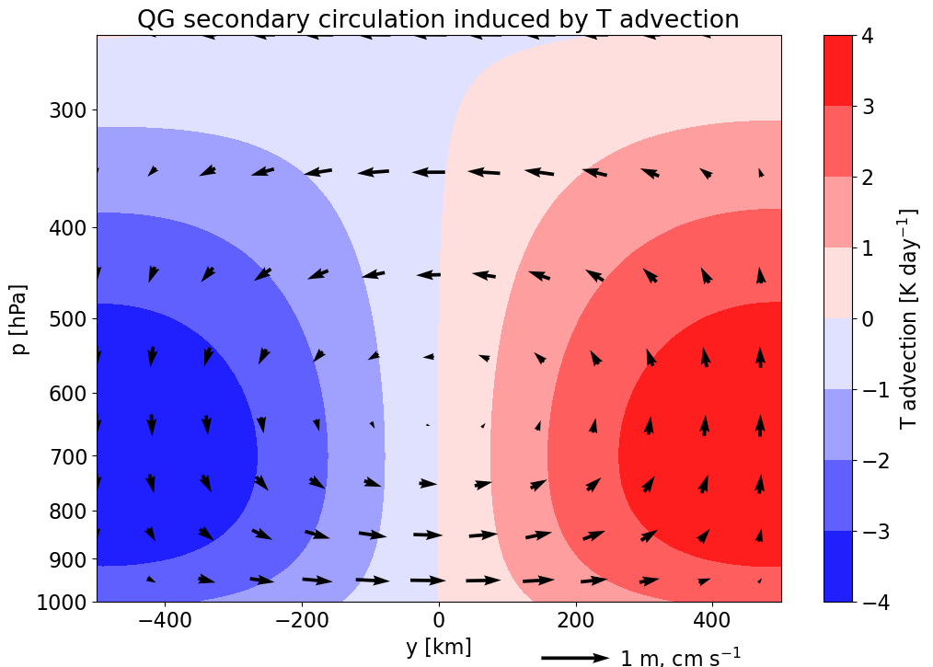
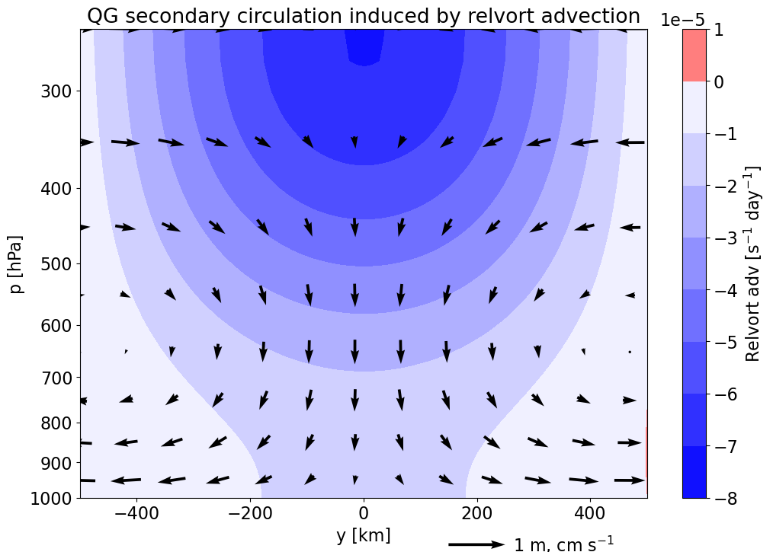
X
⦿
X
⦿
X
⦿
⦿
eastward and
X
westward Coriolis force
Momentum tendencies induced by the vertical circulation
The meridional winds of the secondary circulation can be obtained from vertical velocities using continuity.
As poleward EHF weakens the equator-to-pole temperature gradient, the secondary circulation also weakens the vertical shear to maintain balance.
As upper-tropospheric poleward EMF changes the vertical shear of westerlies, the secondary circulation produces an opposing shear tendency.

Slide 12
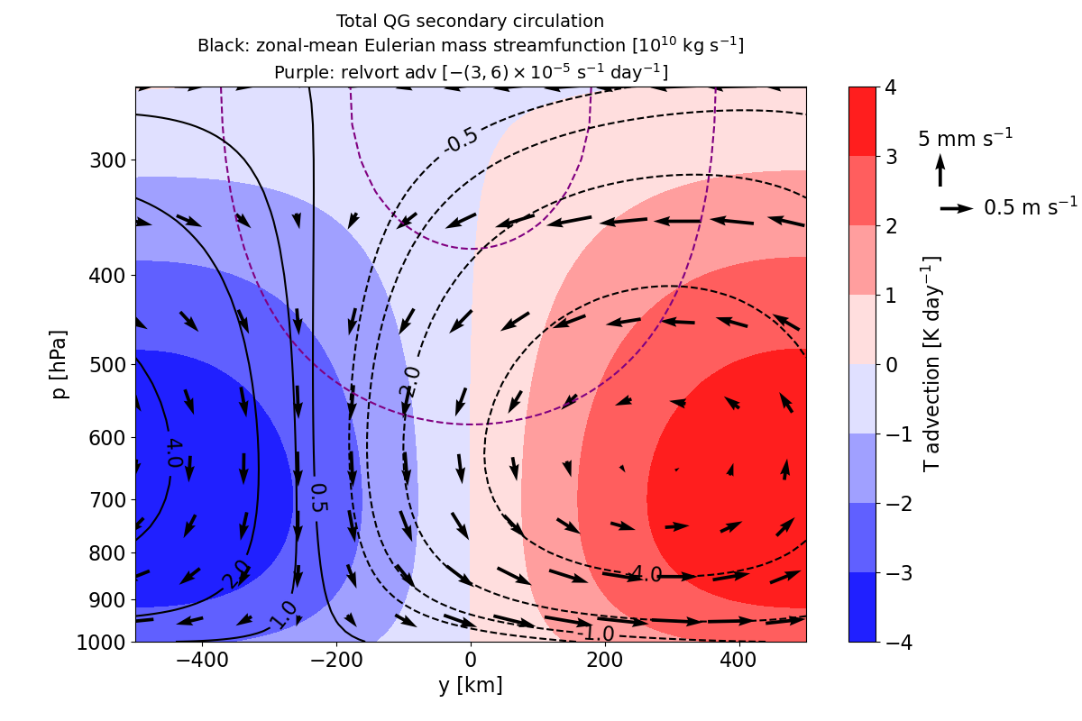
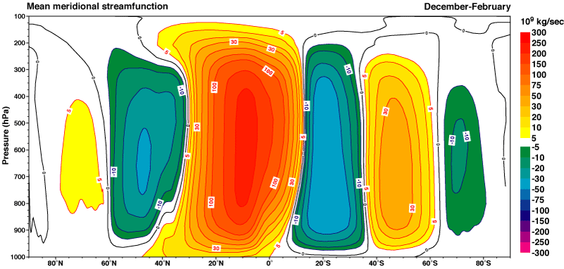
https://sites.ecmwf.int/era/40-atlas/docs/section_D25/charts/D27_XS_DJF.html
The “thermally indirect” Ferrel cell
The QG omega equation and continuity are linear equations, so the secondary circulations from the two forcing terms can be added together.
EHF and EMF collectively drive ascent poleward of the storm track and descent equatorward of the storm track in the Eulerian mean.
In reality, the relative positions of advection fields, zonal jets, and meridional circulations are different due to dissipation and non-linear dynamics.

