Slide 1
Silverspoon Visualizer
PB138 Course Project

Slide 2
Team
Juraj Pančík
Team Leader & Graphical User Interface
Martin Žilák
SVG generation from parsed XML
Norbert Slivka
Parser of input XML data
Jan Hlava

Slide 3
Silverspoon Visualizer
Project Description
Visualize Camel route configuration
Boards: BeagleBoneBlack, Raspberry PI B+, CubieBoard 2
Each of them has different layout
Input in form of XML
Output is an SVG file
Graphical user interface

Slide 4
XML Parser
Norbert Slivka

Slide 5
XML Parser
JavaX parser
Scalability
Forest-like structure
API
Text Output
Notes:
Javax parser
Doraz na skalovatelnost – IoT rychly vyvoj
Struktura podobna lesu – routy su stromy – vie viac rout
Poskytuje API s rozsiahlou funkcionalitou
Textovy vystup pre jednoduchu vizualizaciu pri vyvoji

Slide 6
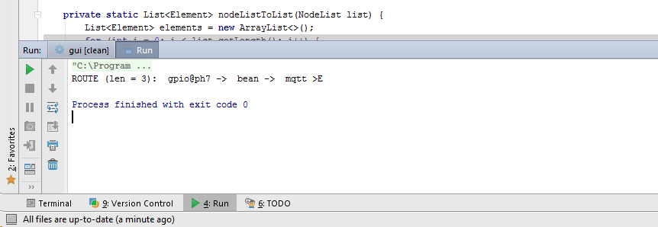

Slide 7
SVG generator
Martin Žilák

Slide 8
SVG Generator
What is SVG?
Board layout
Drawing route
Adding route to board
I/O connections & board modifications

Slide 9
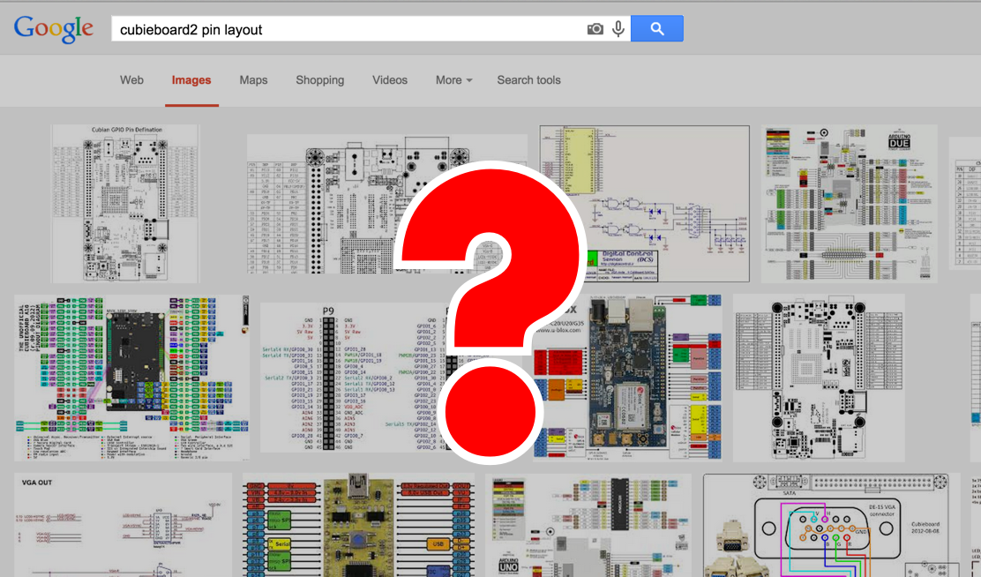

Slide 10
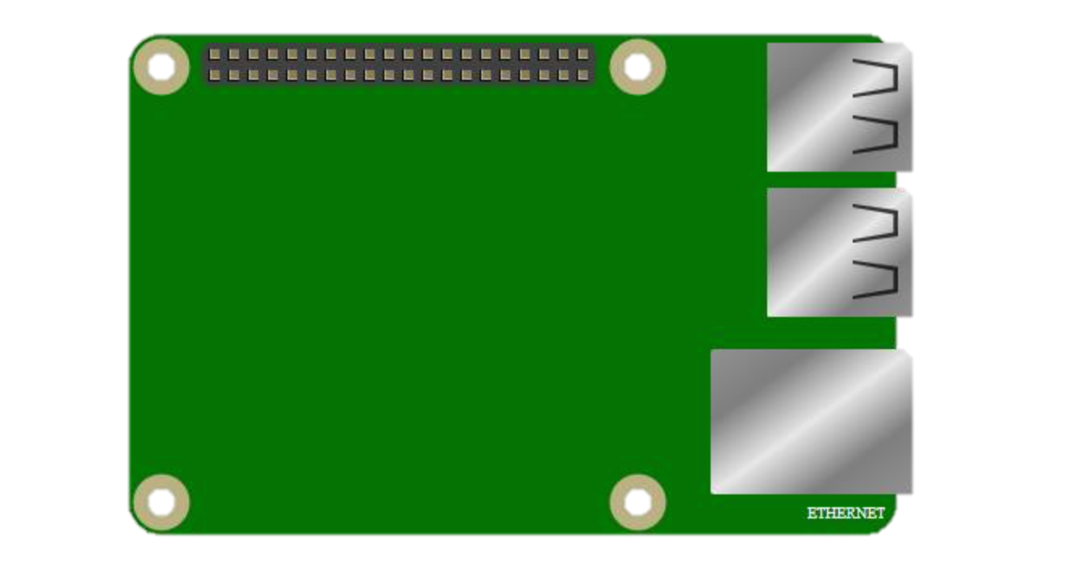
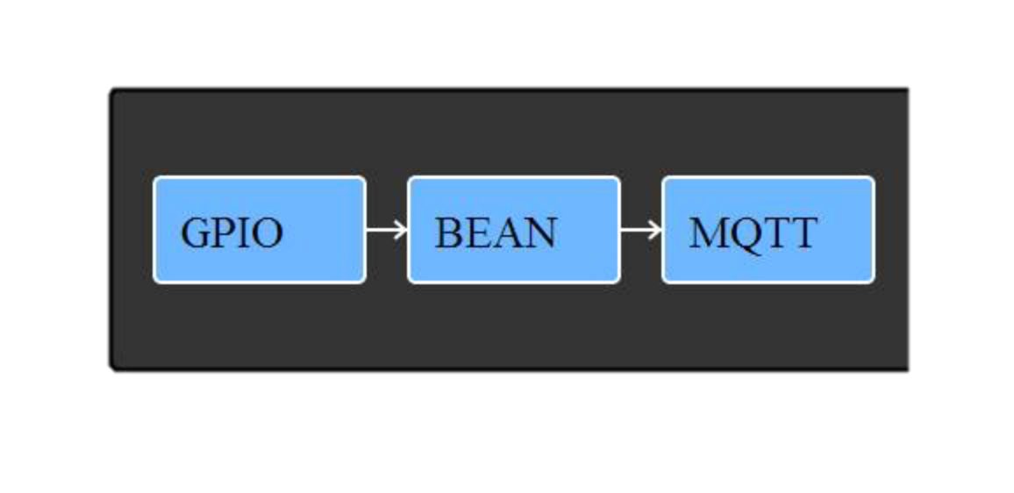

Slide 11
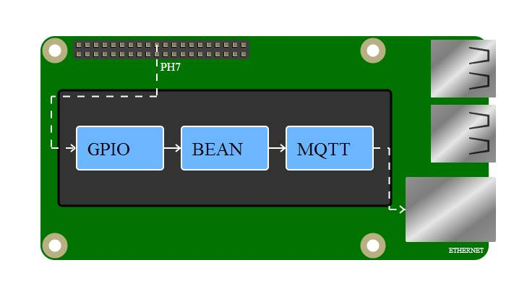
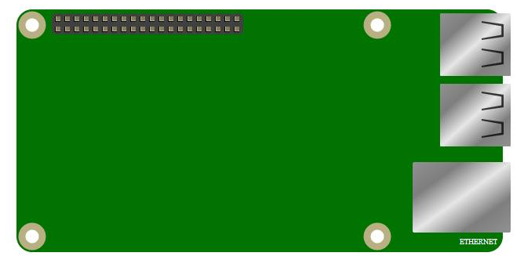

Slide 12
Graphical User Interface
Juraj Pančík

Slide 13
Graphical User Interface
KISS
Java Swing
Load input
Generate SVG
HTML output

Slide 14
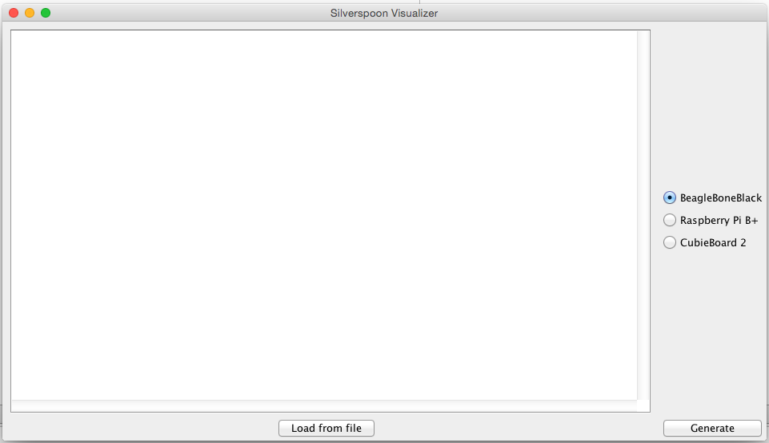

Slide 15
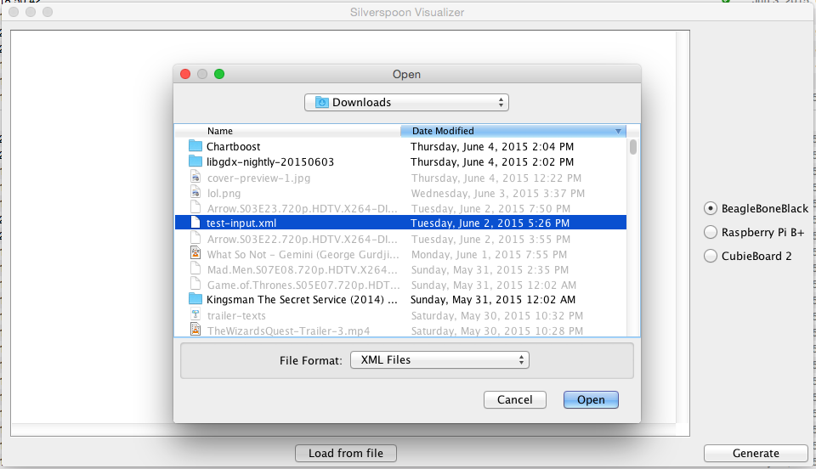

Slide 16
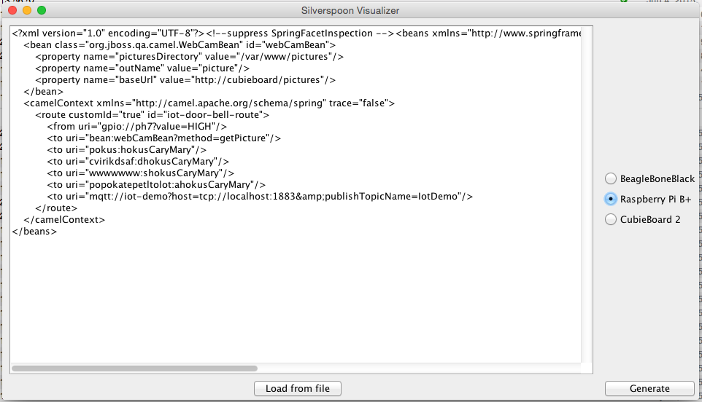

Slide 17
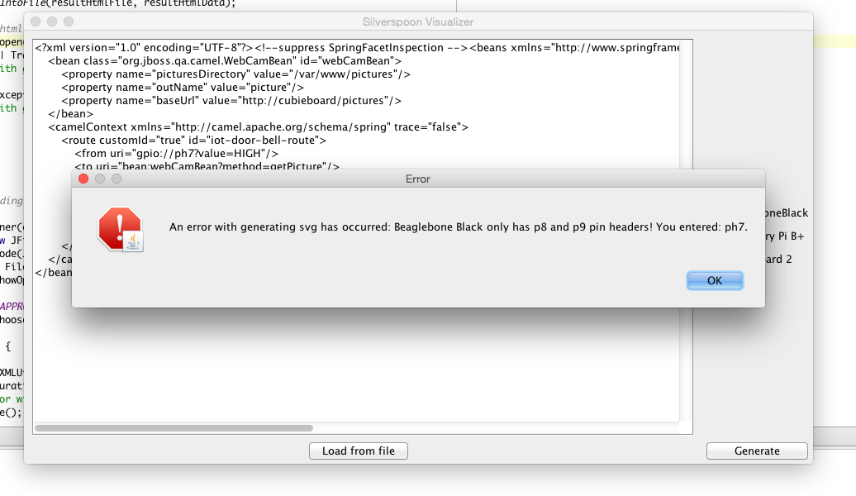

Slide 18
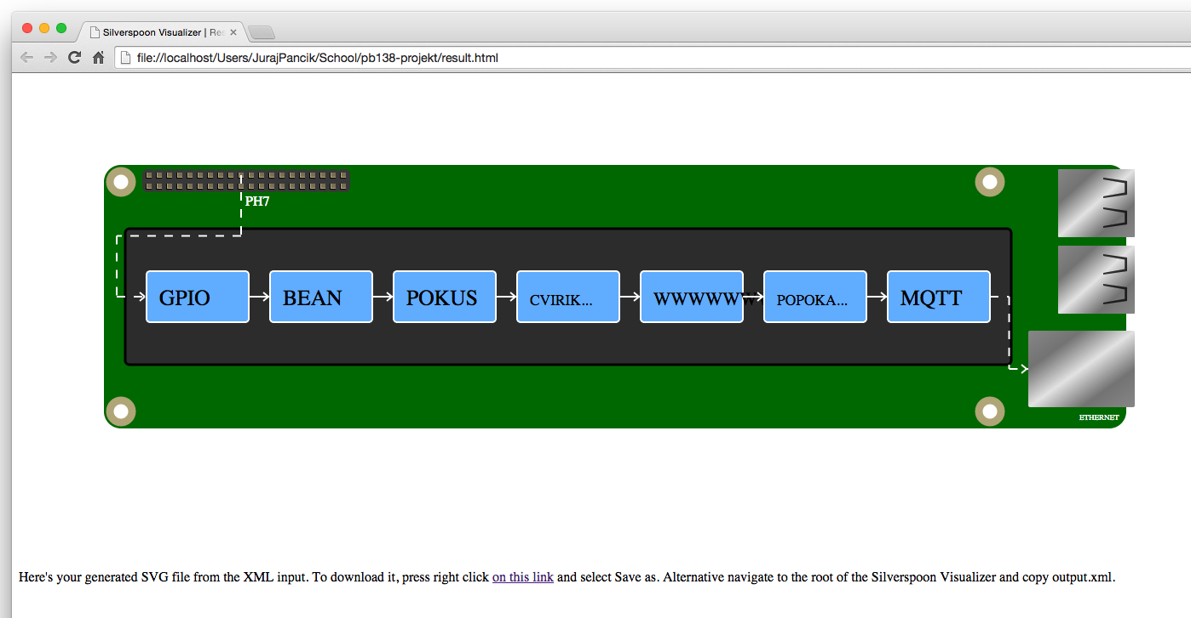

Slide 19
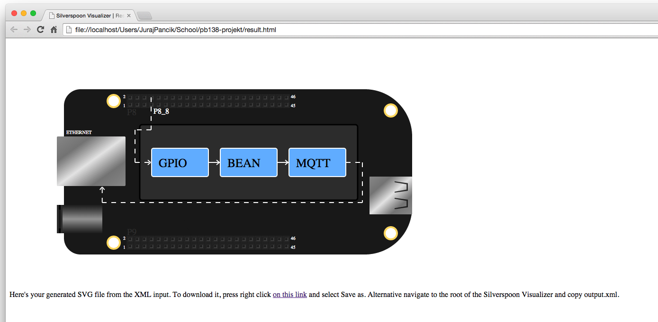

Slide 20
Thank you for your attention

