Slide 1

Analysis of Housing Price Predication
Submitted By - Jay Pandey
Internship 32

Slide 2

Housing Price Prediction
Here are some home market predictions made by professionals. Today, data science plays a crucial role in finding solutions to issues that assist businesses boost overall revenue and profits. Making a realistic machine learning model for real estate would therefore be very helpful in predicting the selling price of the property and the scenario for how the price will develop in the future.

Slide 3
Problem Statement
A US-based housing company named Surprise Housing has decided to enter the Australian market. The company uses data analytics to purchase houses at a price below their actual values and flip them at a higher price. For the same purpose, the company has collected a data set from the sale of houses in Australia.
We are required to build a model using Machine Learning in order to predict the actual value of the prospective properties and decide whether to invest in them or not. For this company wants to know:
Which variables are important to predict the price of variable?
How do these variables describe the price of the house?

Slide 4
Background Concepts of the Domain Problem
For housing organizations to achieve their commercial objectives, machine learning approaches including predictive modelling, market mix modelling, and recommendation systems are applied. One of these housing companies is the source of our issue. Modeling the cost of homes using the relevant independent variables is necessary. The management will then utilize this model to determine exactly how the prices fluctuate depending on the variables. As a result, they can influence the company's strategy and concentrate on areas that will provide large returns. Additionally, using the model will help management better understand how prices change in a new market.

Slide 5
Mathematical Models to Solve the Issue
With the aid of a regression-based algorithm, the project's objective is to forecast home prices. Different kinds of algorithms are used in this research. The algorithms operate with their own underlying mathematical equation.
For training and testing purposes, this project uses two distinct data sets. The training and testing data are first subjected to several data pre-processing stages, such as data cleaning, data visualisation, and relationship between features and labels. After that, extraneous features are eliminated. When developing a model, the final model is chosen based on the accuracy score, RMSE value, tuning of the hyperparameters, and cross validation score of several algorithms. then identify the most crucial aspect out of all features.

Slide 6
Sources of data and their formats
The model is trained using training data. It contains 81 columns and 1168 rows. With the aid of this dataset, the model will be trained. It has one target variable and 80 independent characteristics (SalePrice).
Test data, on the other hand, has 292 rows and 80 columns. After choosing the appropriate model, the target variable for the test data is predicted using the model.
Using the info() method, the data format is determined. Out of 81 columns, there are a total of 43 category columns.

Slide 7
Exploratory Data Analysis
he feature analysis observation exploration.

Slide 8
Project Flow Tasks Perform
Check the presence of duplicate or any data error.
Missing values present in data set.
Imputation of missing value with mean, median or mode is performed.
Feature Engineering for extraction of few new features out of existing features.
Feature selection
Label Encoding of Categorical features
Splitting of dataset into input & target feature
Standard Scaling of data
Finding Final model with respect to best R2 Score, RMSE

Slide 9
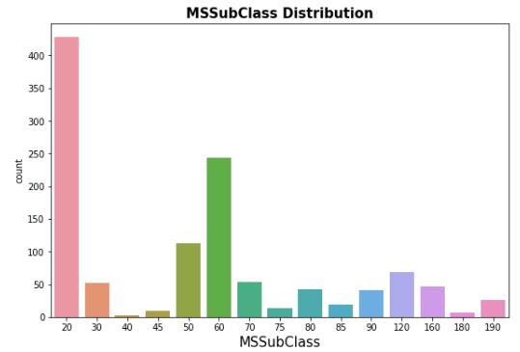
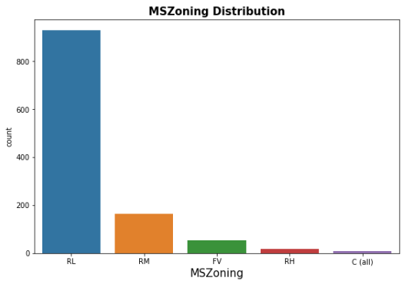
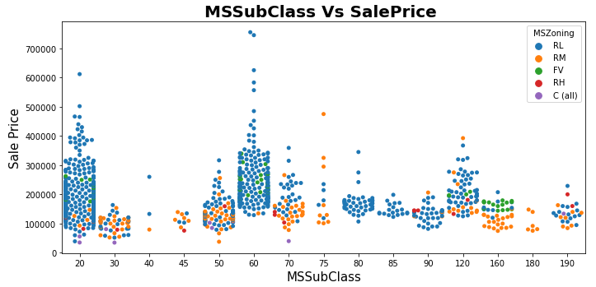

Slide 10
Observations:
For MSSubClass class 20 and 60, SalePrice is high and maximum MSZoning is Residential Low Density
79.5% of house are in Residential Low Density followed by 14 % of house are in Residential Medium Density area.
Floating Village Residential is only 4.5%
Very few house (0.8%) are in Commercial zone.

Slide 11
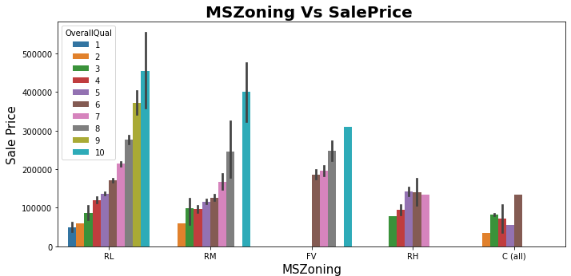
Observations:
1. Max property have overall condition rating of either 6 to 7.
2. Average selling price for RL zone property is 200000-500000.
3. In Commercial zone the property price is minimum.
4. Sale Price inside RL Zone is much higher than other zone.
5. It is clear that if OverallQual increased, SalePrice also increased.

Slide 12
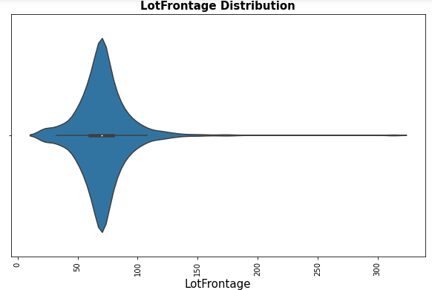
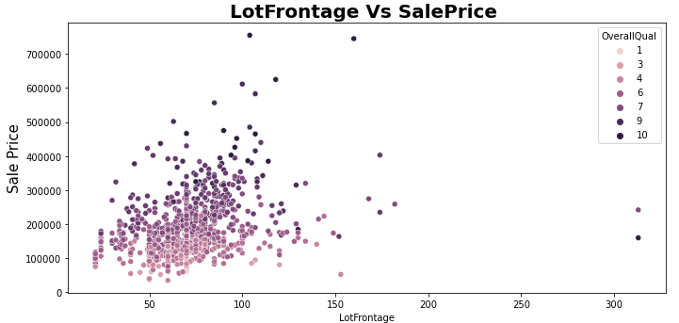
1. Average LotFrontage is around 50-80 2. A lot of outliers are present. 3. There is No Significant relationship found between SalePrice & LotFrontage.

Slide 13
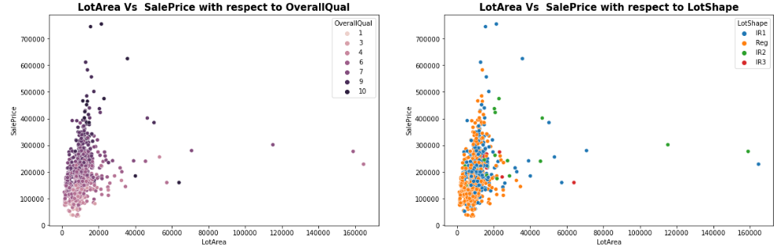
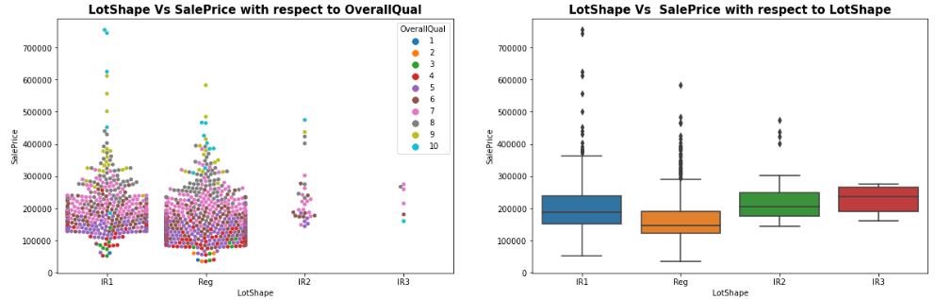
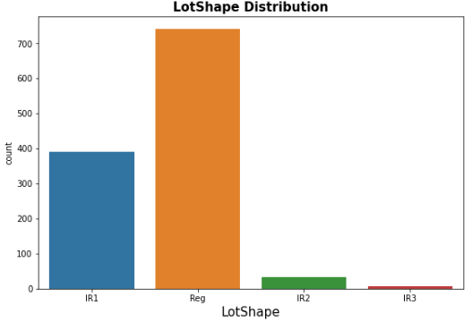

Slide 14
Observations:
Average LotArea is around 0-25000
A lot of outliers are present.
As OverallQual increased, saling price of the property also increased.
No relation is found between LotArea and SalePrice with respect to LotShape.
Min LotShape is Irregular.
63.4% LotShape is Regular followed by Slightly irregular and there is some outliers also with very high price range
There is no relationship between LotShape and selling price.

Slide 15
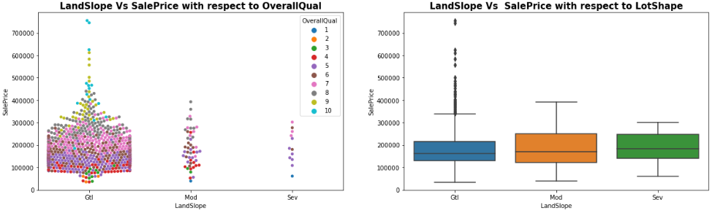
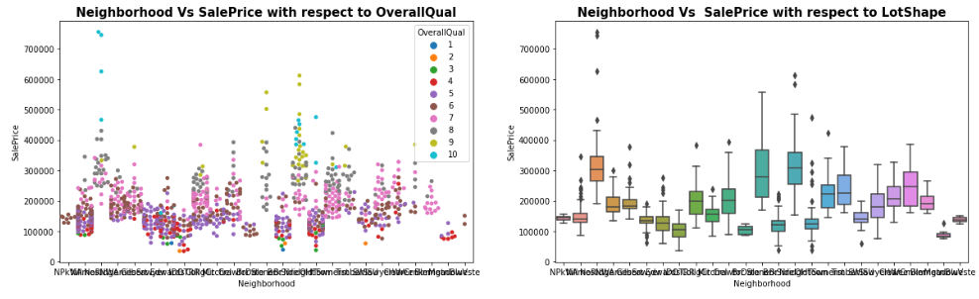

Slide 16
Observations:
72.1% of house comes with inside Lot configuration.
Cheapest property are in Inside lot configuration.
Only 2 are in Frontage on 3 sides of property.
95% LandSlope is Gentle slope.
1% properties come with severe slope and the average price is high compare to Gentle slope.
Max Neighborhood is Names with 182 values
Around 90% property is in Level land contour type. It is quite obvious also!!
Banked area is the less costly area compare to others.

Slide 17
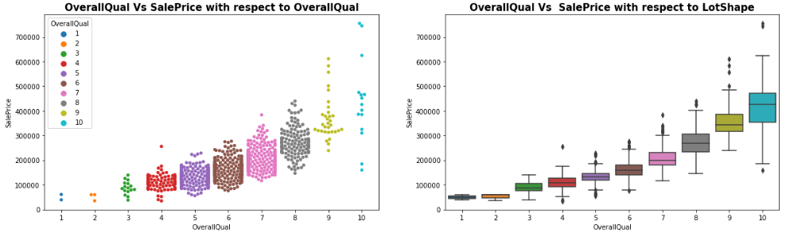
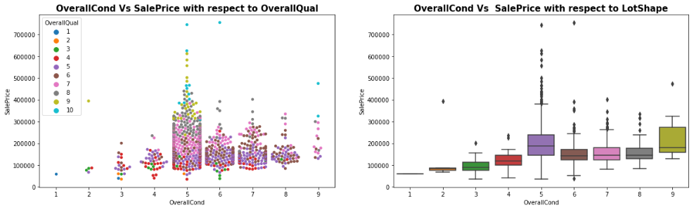

Slide 18
Observations:
Max OverallQual is with rating 5-7.
For OverallCond the max value is 5.
As usual if Overall Quality is increased, price is also increased.
Price is max for OverallCond 5

Slide 19
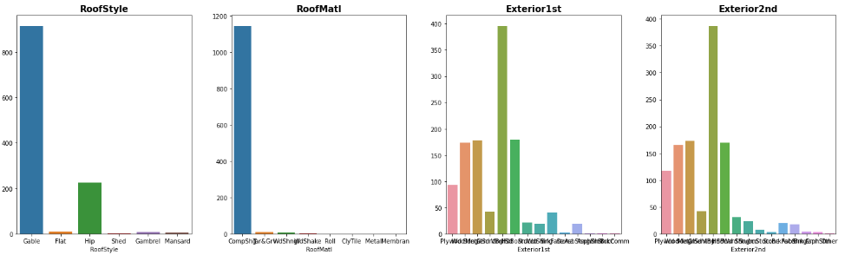
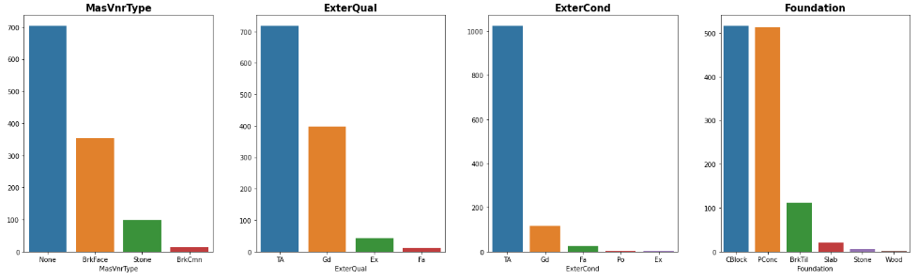

Slide 20
Observations:
1. 78.3% house is with Gable RoofStyle followed by 19.3 % house is with Hip Style.
2. 98% material is Standard (Composite) Shingle and other 7 types are only 2% togetherly.
3. Around 33% material is Vinyl Siding as Exterior covering on house for both Exterior1st and Exterior2nd.
4. Around 60% of house comes with None as Masonry veneer type. Maybe there is some mistake during entry the data.
5. Around 60% of house comes with Average quality of the material on the exterior.

Slide 21
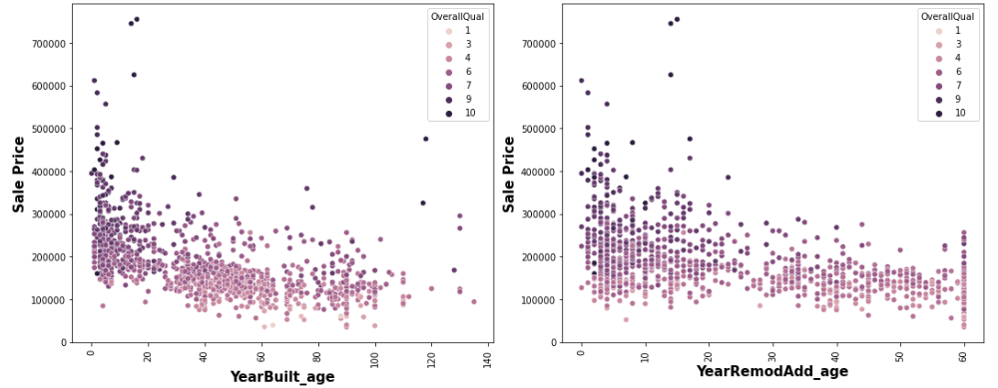
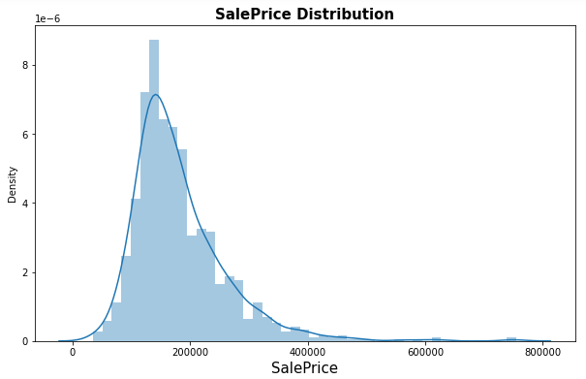
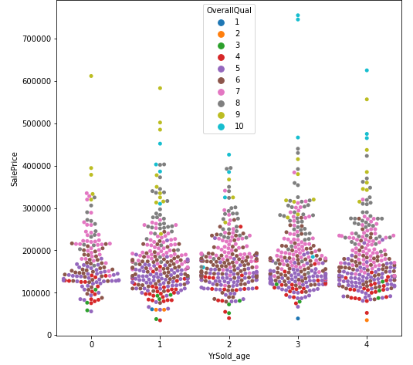
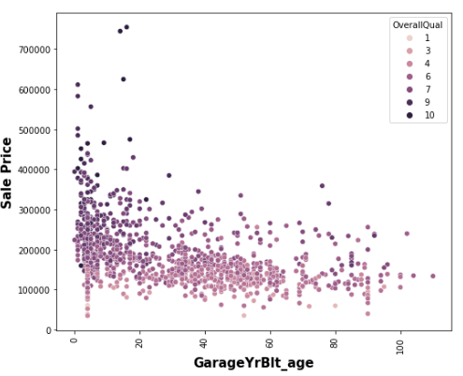

Slide 22
Observations:
1. The selling price of new property is higher than old one.
2. 10 years after Remodelling the properties, the price start decreasing.
3. The selling price of new garage is also higher than old one.
4. Average SalePrice is 100000 to 300000.
5. As OverallQual increased, SalePrice is also increased.

Slide 23
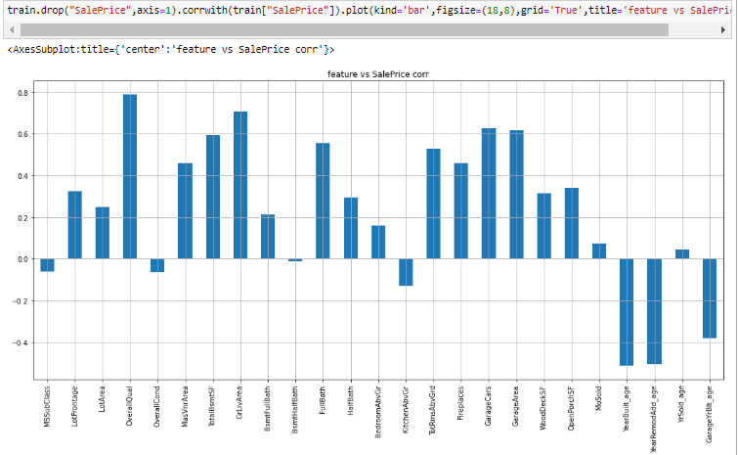
Correlation:
All the features are correlated with target. Overall quality and total ground area is highly correlated with target variable sales.

Slide 24
Machine Learning Algorithm Used
The different regression algorithm used in this project to build ML model are as below:
RandomForestRegressor
DecisionTreeRegressor
SupportVectorRegressor
GradientBoostingRegressor
AdaBoostRegressor
KNeighborsRegressor
RandomForestRegressor

Slide 25
ML Model Building Flow
ML Model Training on Various Algorithms
Finding Best Random state
Using test train split to Divide Training Data
Every model is hyper-parameter tuned.
Apply 5 Fold Cross Validation with every different Model
Saving final Model
Use 5 Fold Cross Validation on each unique model.
The Best Model is Chosen Using Evaluation Criteria

Slide 26
Principal Findings and Study Conclusions
Tables of Findings using different algorithms after Hyper Parameter Tuning
Algorithm | R2 Score | RMSE Value | CV Score | Standard Deviation
Linear Regression | 0.881 | 25567 | 0.789 | 0.052
Decision Tree Regressor | 0.788 | 34163 | 0.733 | 0.059
KNeighbors Regressor | 0.862 | 27563 | 0.789 | 0.030
Random Forest Regressor | 0.908 | 22793 | 0.833 | 0.034
SVR | 0.631 | 45080 | 0.595 | 0.038
Gradient Boosting Regressor | 0.922 | 20728 | 0.846 | 0.018
Ada Boost Regressor | 0.827 | 30823 | 0.766 | 0.033

Slide 27
Conclusion:
The Gradient Boosting Regressor provides the highest R2 Score, the lowest RMSE Value, the highest CV Score, and the lowest Standard Deviation. As a result, the Gradient Boosting Regressor is chosen as the best model. R2 score is 0.922, or 92.2%, in total.

Slide 28


