Slide 1
Campus eats Project
Group 27: Andrea Peralta, Julio Paniagua

Slide 2
purpose
In this project, we have modified a database system for students, faculty, and staff to look up a ratings system which ratings for drivers and restaurants.

Slide 3
Business rules
Customer can create an account and search the database for restaurants and their ratings.
Customer may provide restaurant and/or driver ratings after each order.
Administrators may look up drivers’ ratings and restaurants’ ratings.
Administrators may look up who highest or lowest ratings.
Administrator can add or remove drivers and/or restaurants.

Slide 4
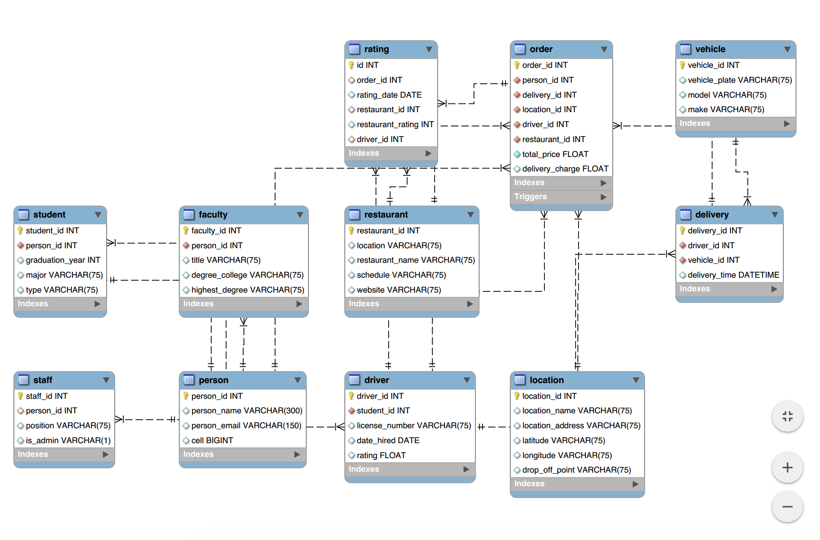
Entity relationship diagram

Slide 5
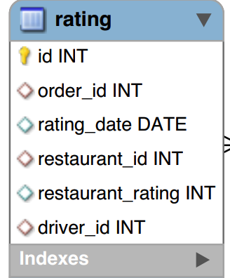
Rating table - eerd
Primary Key: id
Foreign Keys:
order_id
restaurant_id
driver_id

Slide 6
Types of users and roles
Customers
Drivers
Admin

Slide 7
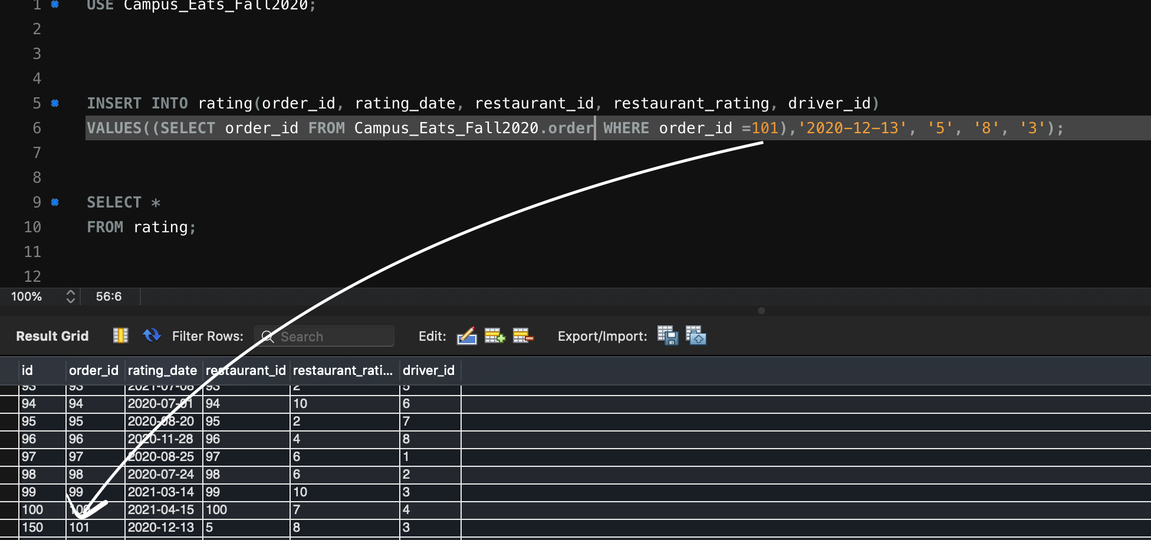
Stored procedure

Slide 8
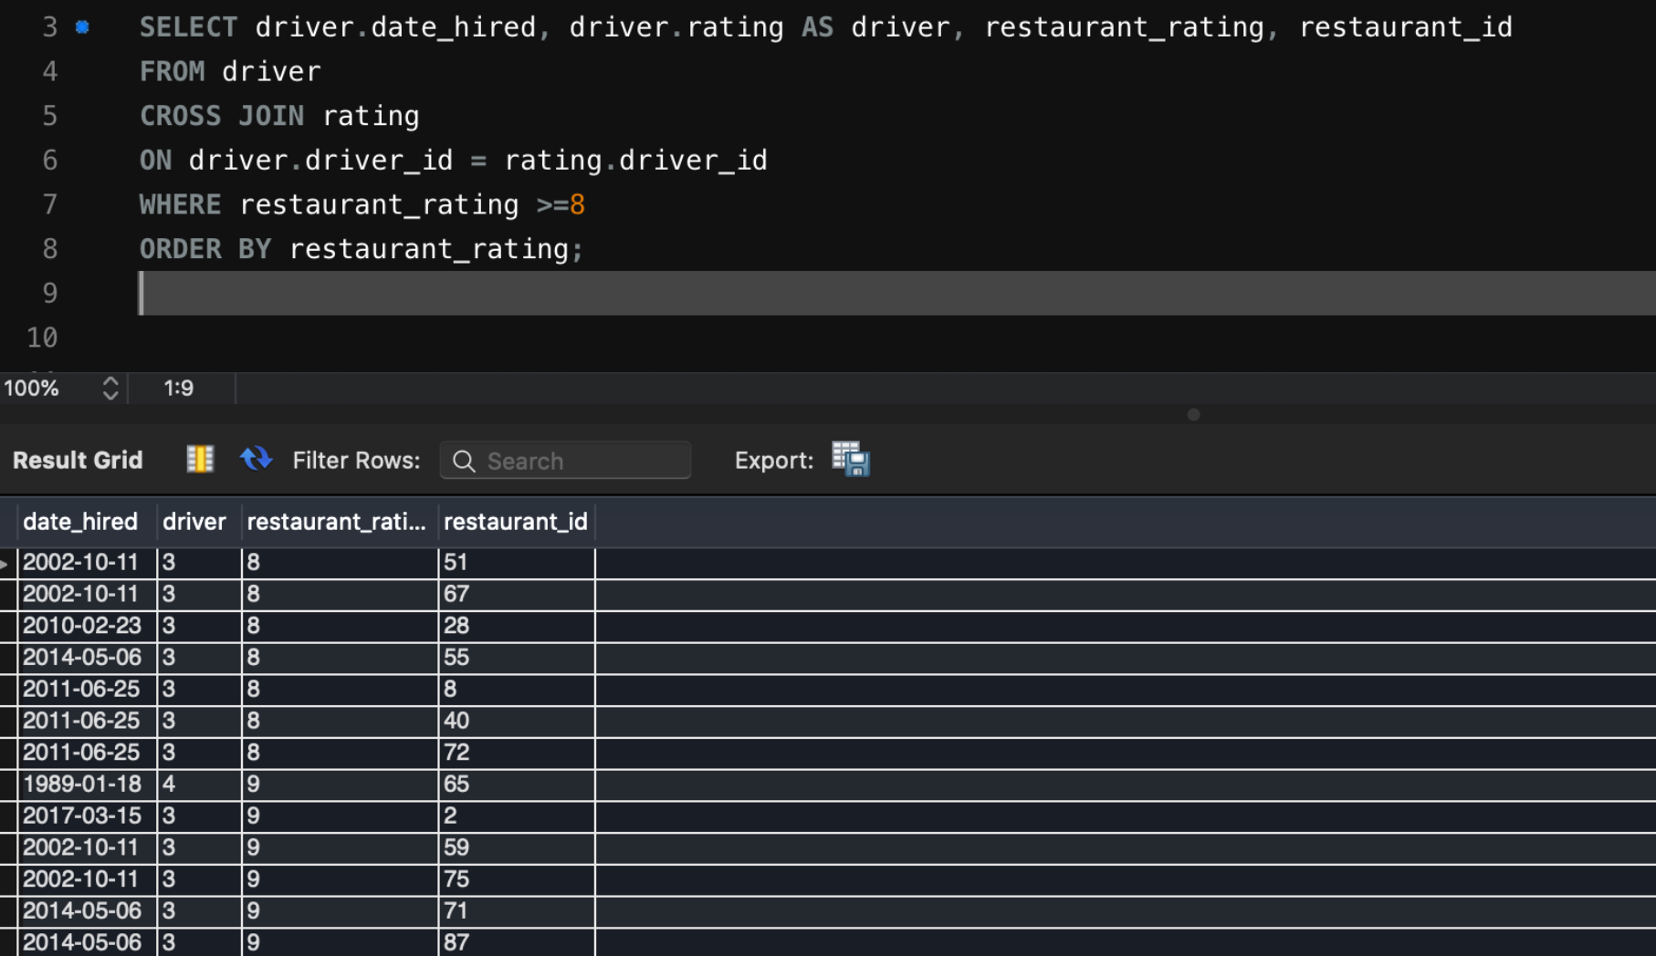
queries

Slide 9
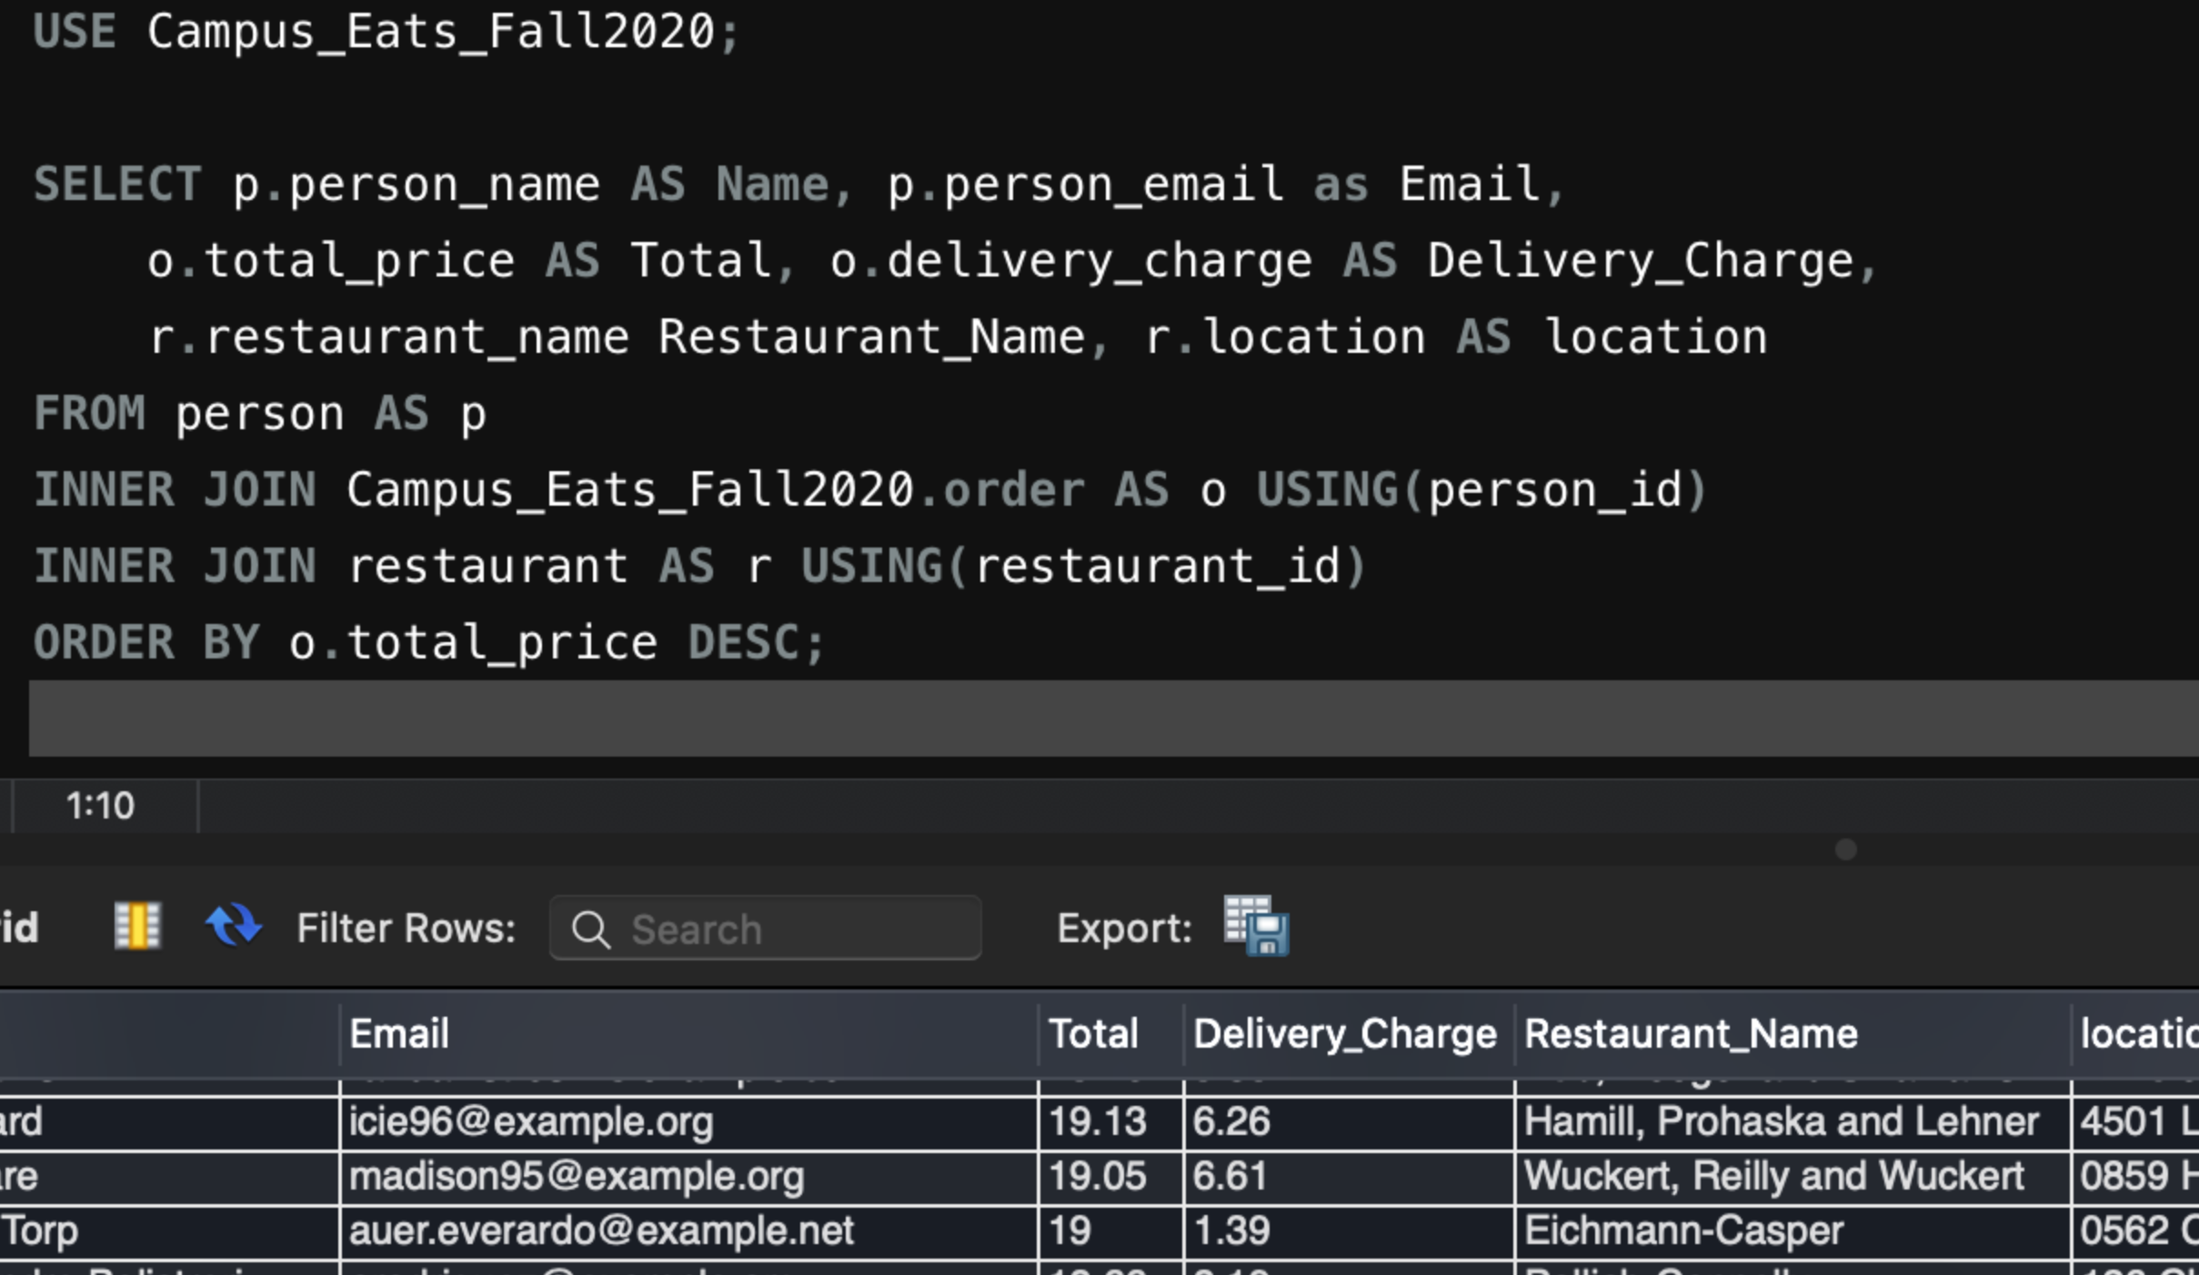
queries

Slide 10
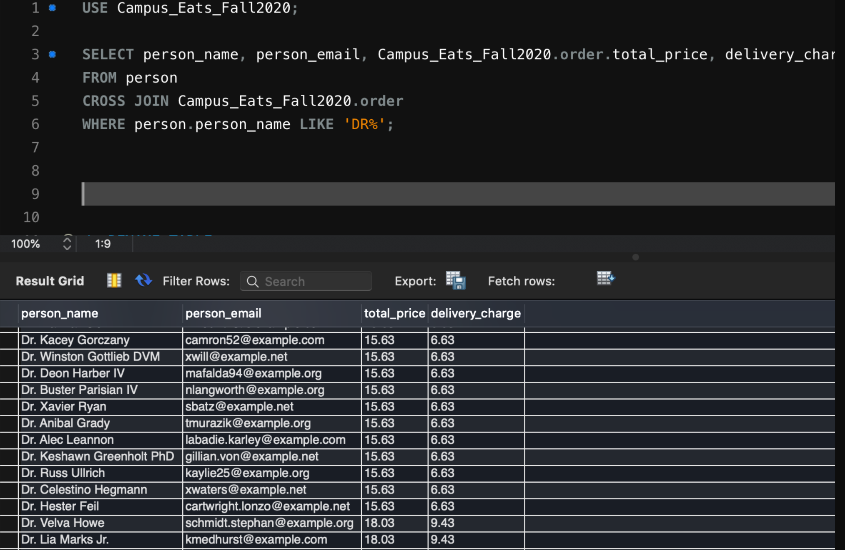
queries

