Slide 1
Oqulus: “My Christmas Vacation”
Technical Review - 1/7/2014

Slide 2
Technical Improvements
Parallelization - More efficient use of resources
Accuracy Tracking - Progress visualization

Slide 3
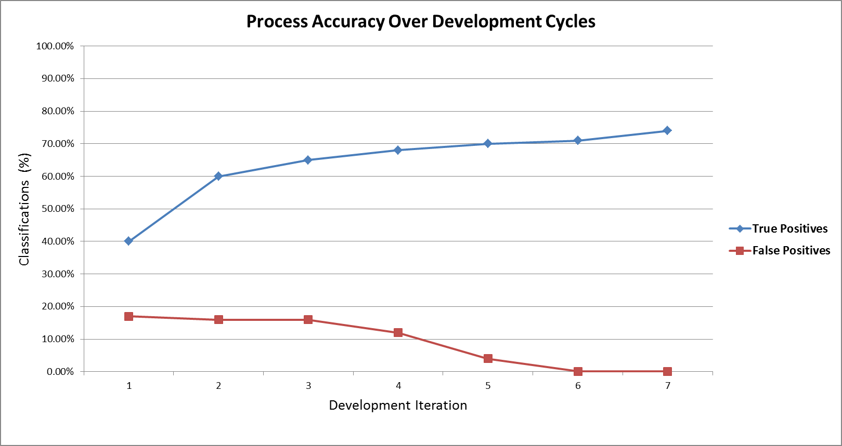
Accuracy Tracking

Slide 4
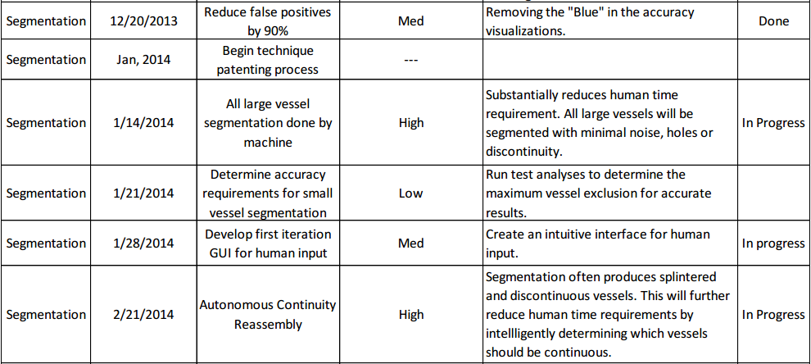
Deliverables for Jan. and Feb.

Slide 5
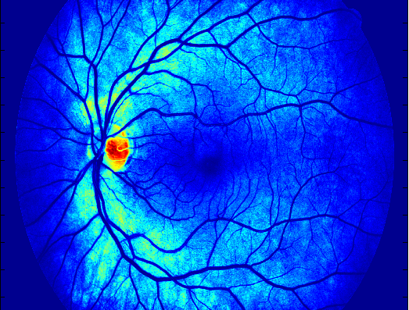
Isolating Background

Slide 6
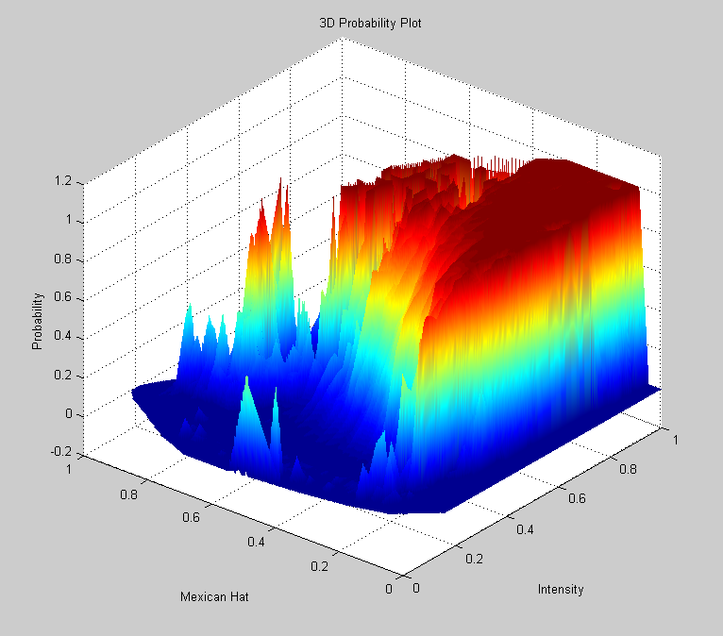

Slide 7
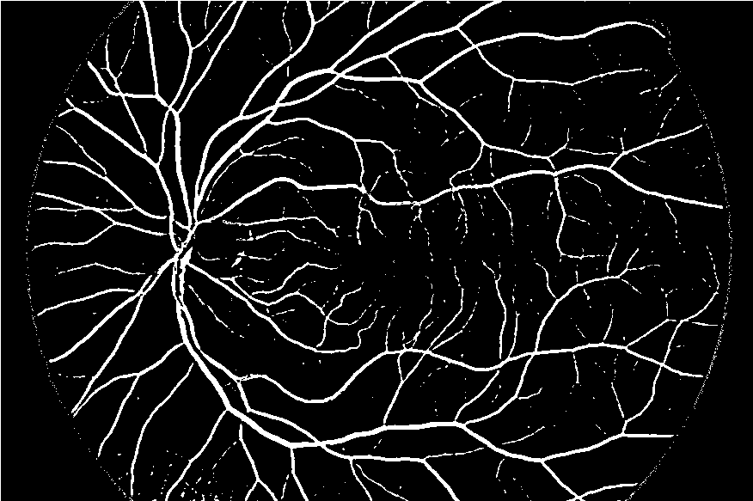
Large Vessel Segmentation

Slide 8
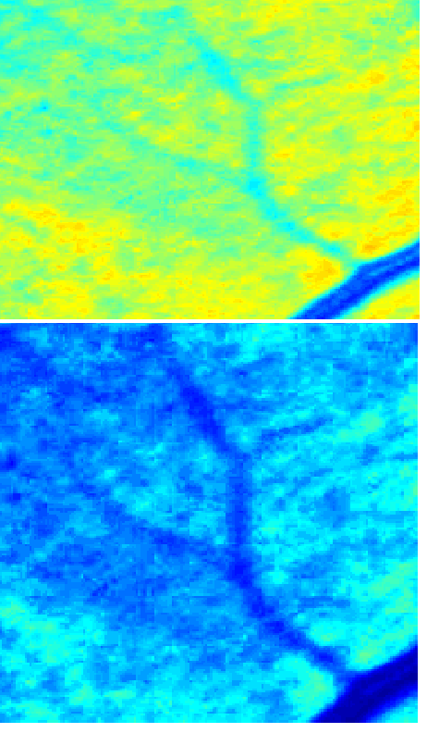
Small Vessel Segmentation
“Boosting”
Defining a blood vessel

Slide 9
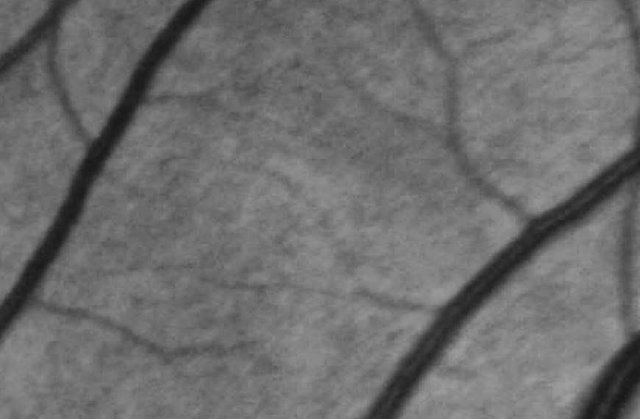
Noisy, Discontinuous Vessels

Slide 10
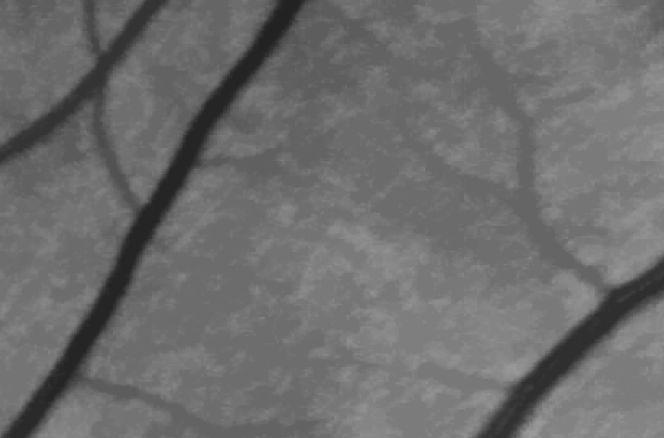
Continuity with morphological reconstruction

Slide 11
Current Roadblocks
Lost access to MATLAB as of Sunday

Slide 12
Deliverables for Jan. and Feb.

