Slide 1


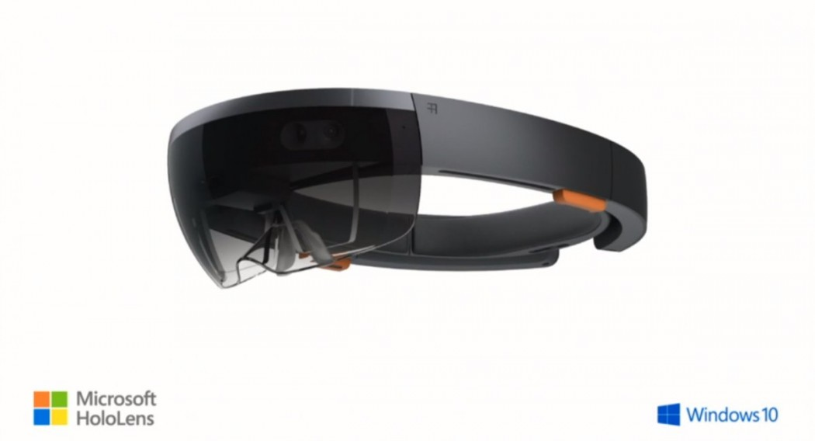
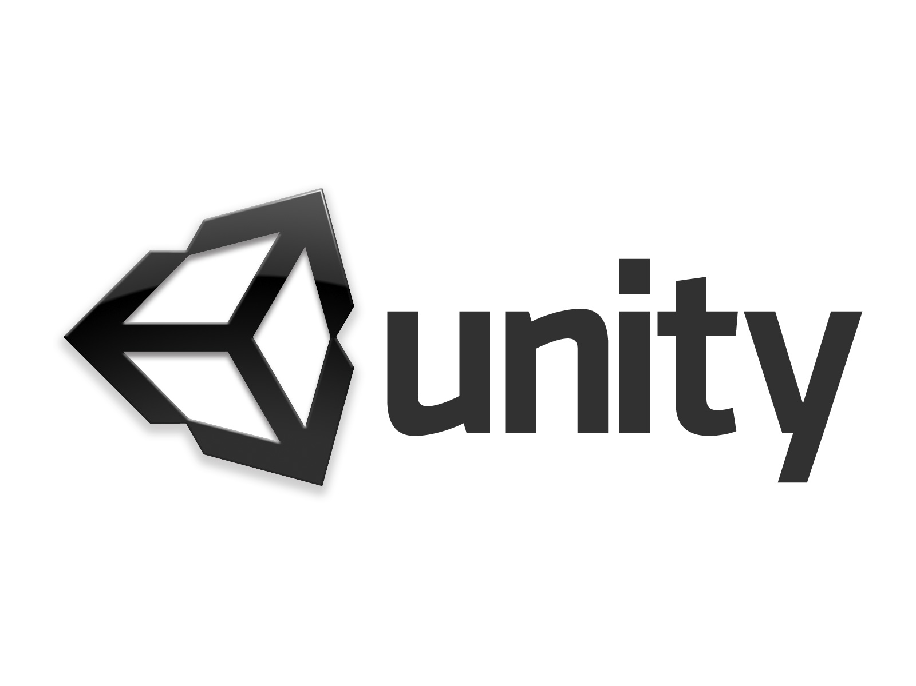

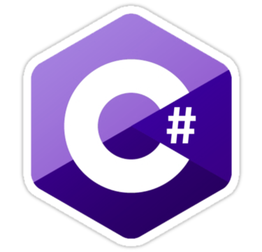
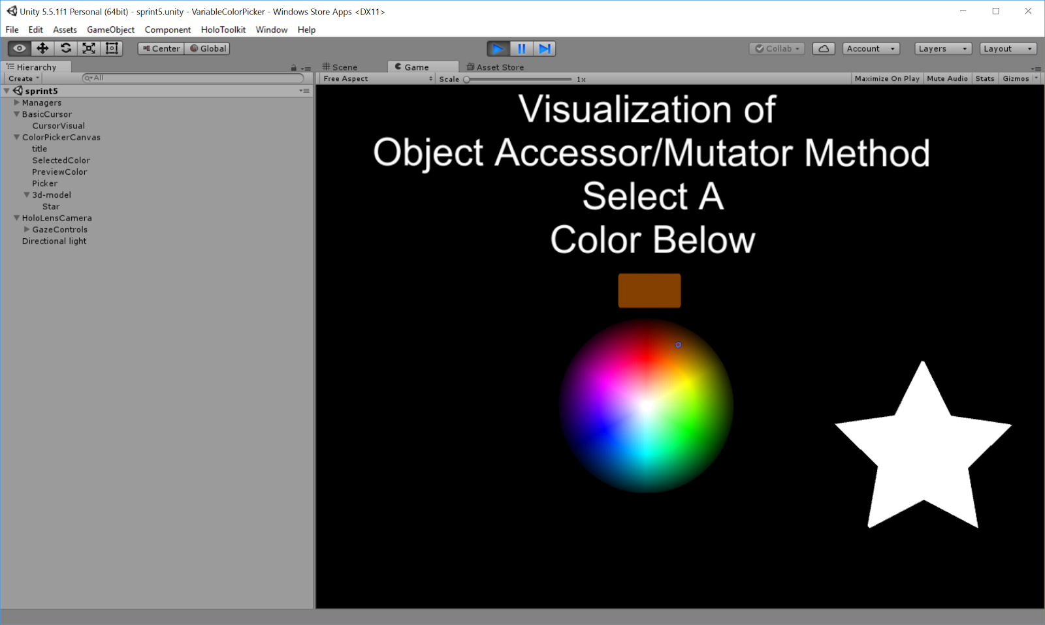
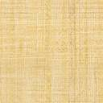
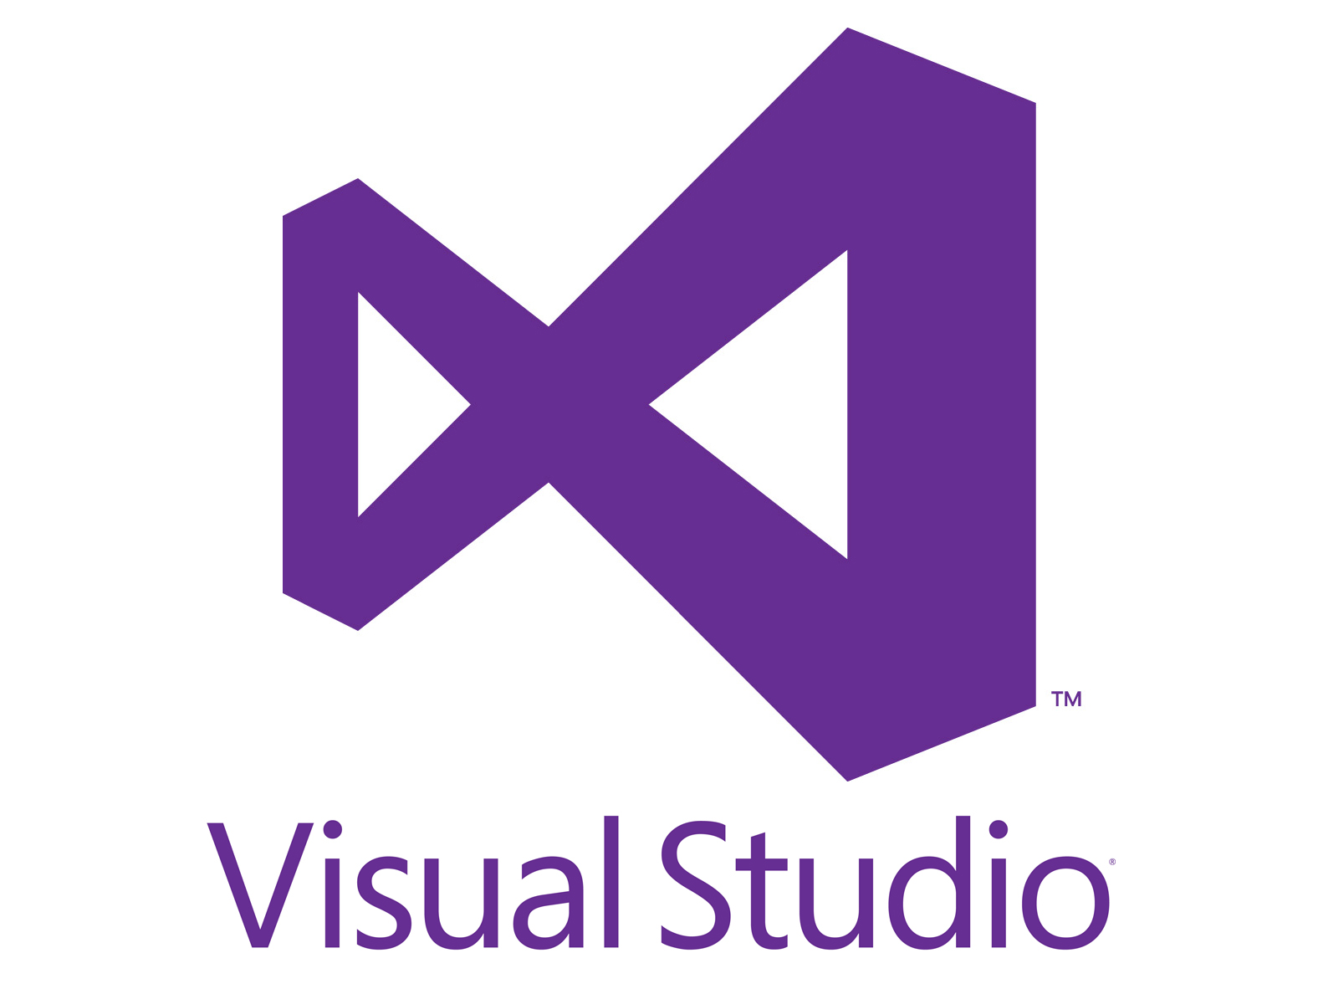
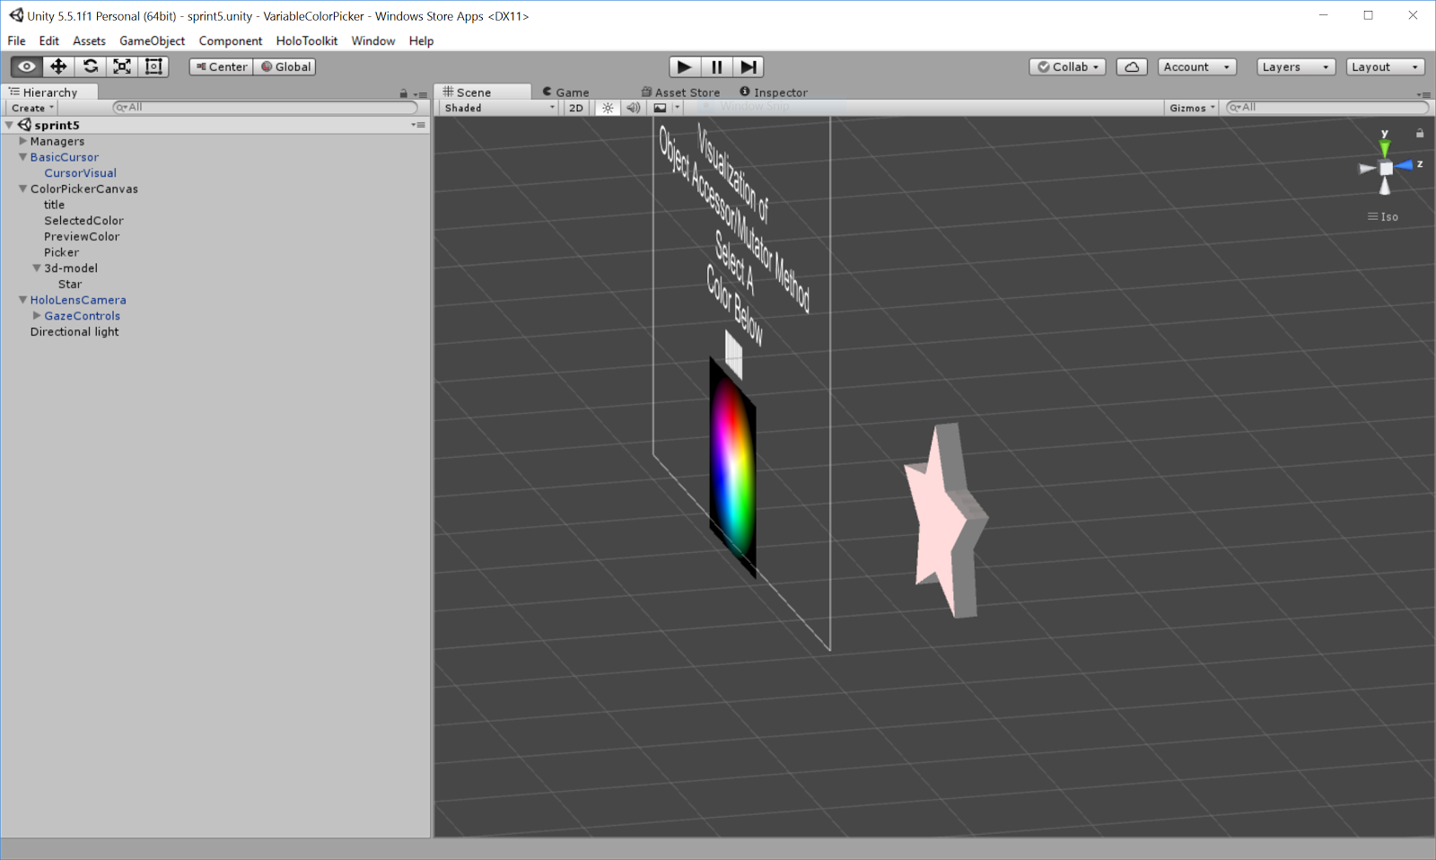
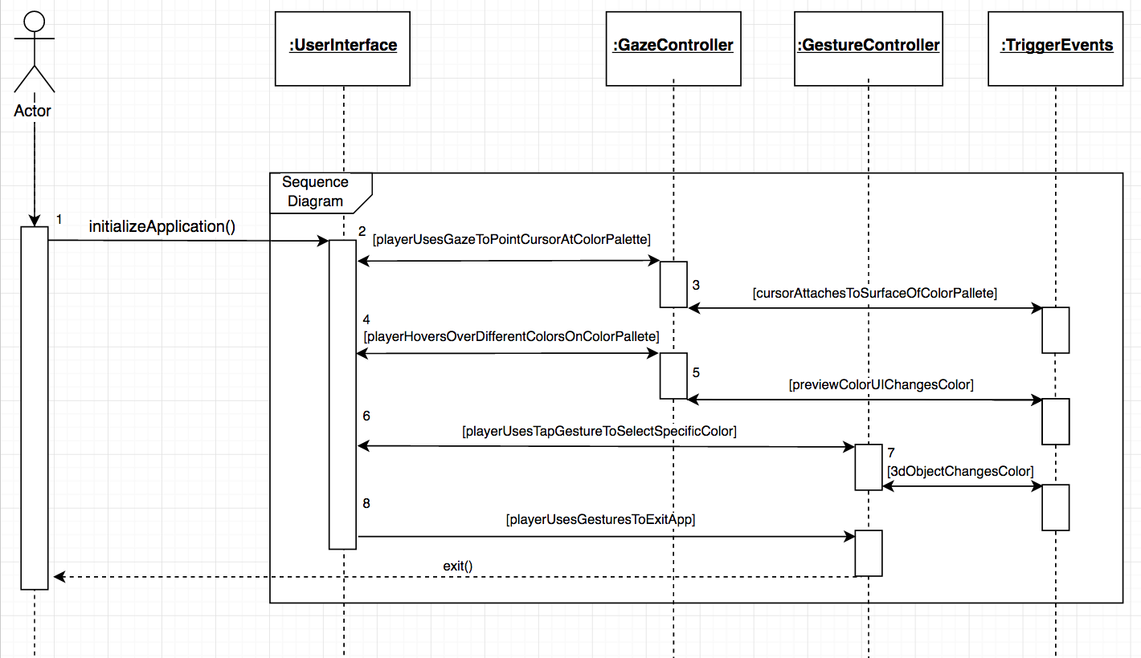
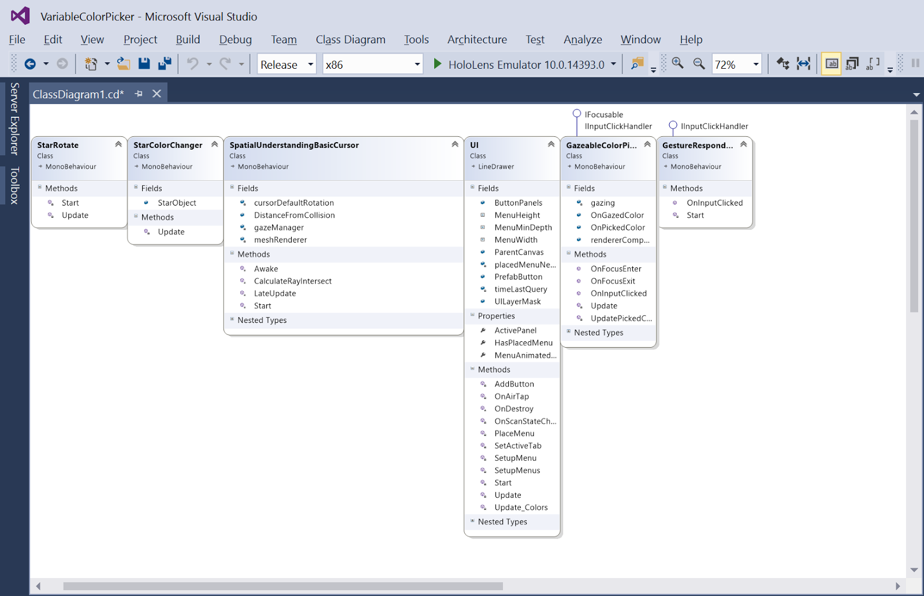
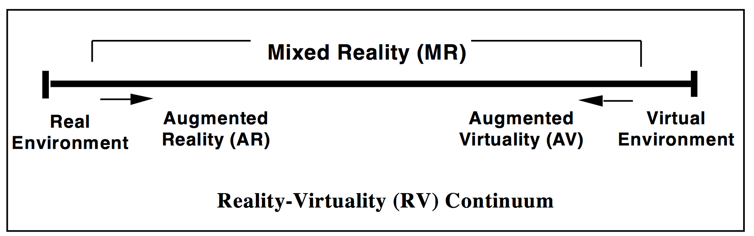
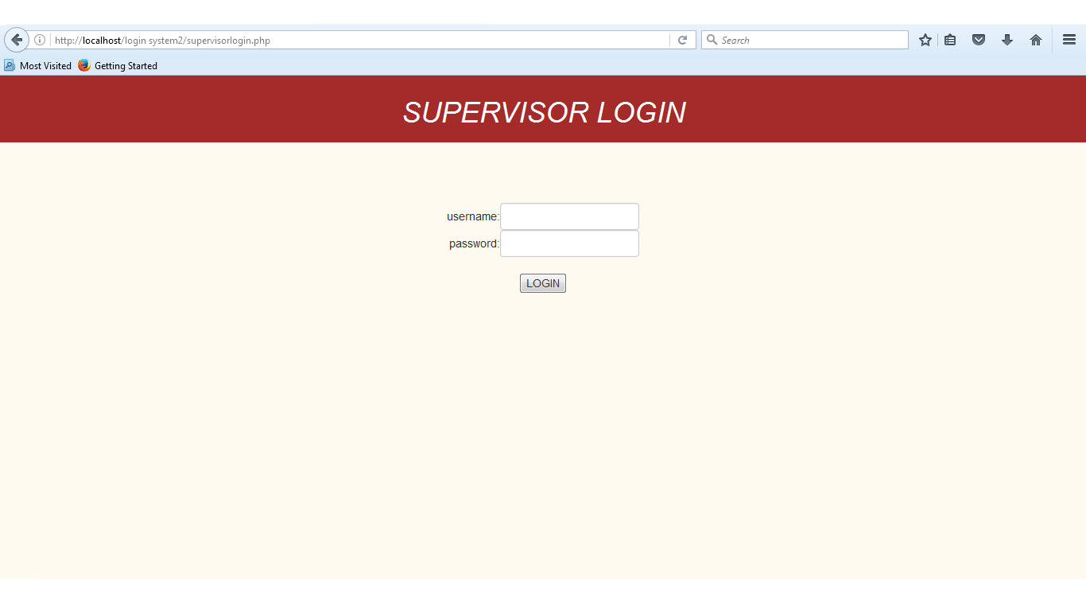
TAM: MULTI-TOUCH-MIDAIR-AND MOTION
FOR VIRTUAL AND AUGMENTED REALITY 6.0
HoloLens Sub-Group: AR/VR Computer Science Education Research
(Spring 2017 - VIP Junior)
Student: Andres Chalela, Florida International University
Mentor: Francisco Ortega
Instructor: Francisco Ortega, Masoud Sadjadi, Florida International University
Problem
The technological advances that humans have experienced in the past decade have had an influence upon several sectors within our society. Traditional educational methods involved a face to face interaction, as class activities were arranged and conveyed by the teacher. These different mediums are dated in today’s high-tech modern society, and effectively slow down the process of knowledge acquisition and retention.
Current System
Status:
The HoloLens VariableColorPicker application executes and runs without issue.
My Core Contributions: Used Unity platform for basic implementation of holographic Computer Science Education HoloLens Application
Implemented C# scripts for user input and object interactions.
Completed research on benefits of AR/VR technology within the Education domain.
Requirements
Provided Functionality to Users:
Application must should informational prompt for user
User can preview manipulation of object’s color variable via Preview UI
User can use HoloLens Gaze functionality and ‘tap’ gestures for object variable color selection input
Solution
The purpose of the implementation of the VariableColorPicker HoloLens Application, is to help new students that are beginning their studies within Computer Science. The project is for demonstrating the concepts of Object Variables within Object Oriented Programming, and to demonstrate how variables have Accessor/Mutator methods for dynamically accessing and setting information. By developing interactive holographic applications targeted for Computer Science students, learners are encouraged to actively participate during their lessons, which leads to a dramatic increase in knowledge acquisition and retention.
Screen Shots
Implementation
- Microsoft HoloLens platform and user interface
- Visual Studio used for building and deployment of project
- Unity used for holographic HoloLens 3D application development
- Figure 1: Main HoloLens Application Scene
- C# used for project and script development
Verification
Test Case 1: Integration of Gaze & 3D Cursor
Purpose:
User uses HoloLens Gaze to hover over different colors within color palette using the implemented cursor. Preview Color UI element changes according to the color that cursor is focused on. Preconditions:
HoloLens app should be initialized and user must be wearing the HoloLens device to be able to utilize Gaze and gesture functionality.
Input:
A user uses sideways rotation of head to manipulate Gaze functionality. Expected Result:
User sees the 3D holographic object change color once they use ‘tap’ gesture on color palette.
Test Case 2: Use ‘tap’ Gesture for Color Manipulation
Purpose:
User uses Holens Gaze to hover over a specific color using the implemented cursor. Once color is decided, user can use ‘tap’ gesture to change the color of floating 3D holographic object. Preconditions:
HoloLens app should be initialized and user must be wearing the HoloLens device to be able to utilize Gaze and gesture functionality.
Input:
A user uses sideways rotation of head to manipulate Gaze functionality & ‘tap’ hand gesture for selections. Expected Result:
User sees the 3D holographic object change color once they use ‘tap’ gesture on color palette.
Summary
- Transformation caused by technological advancements has offered exciting opportunities for the creation of proper learning environments.
- Research within the Education/Learning domain shows that implementation of interactive and engaging technology such as AR/VR provides a platform for improved student engagement and content comprehension, which leads to better academic performance.
- This simple Unity/HoloLens application demonstrating the concept of an object’s variable manipulation via getters and setter methods, sets a basic framework of how Computer Science concepts can interactively be introduced to new students entering the field.
- Figure 2: Side-View of 3D Holographic Unity Project
Object Design
- Figure 1: VariableColorPicker HoloLens Application Sequence Diagram
- Figure 2: Visual Studio Generated Class Diagram for HoloLens VariableColorPicker Holographic Application
Acknowledgement
The material presented in this poster is based upon the work supported by Andres Chalela. I am incredibly grateful for the privilege of being able to collaborate with Paola Jiron as a group member throughout the semester. I thank my mentor Francisco Ortega for all the advice and guidance provided throughout the completion of this project.
Notes:
1

