Slide 1
Fake News Classification

Slide 2

HELLO!
Project members:
Jinit Parikh (A20517770)
Ruchit Mer (A20516697)

Slide 3
Outline
Problem Statement
Data Preprocessing
Models
Results

Slide 4
Problem Statement
1

Slide 5
The prevalence of fake news and misinformation on social media can have a serious negative impact on individuals and society.
The task is to classify a coming news article into one of the three categories - agreed, disagreed, or unrelated.

Slide 6
Data Preprocessing
2

Slide 7
Data Preprocessing
Convert uppercase to lowercase
Removing Stopwords
Removing punctuation
Lemmatization

Slide 8
Used nltk.corpus package to get stopwords and removed them from data.
For lemmatizing, WordNetLemmatize is used.

Slide 9
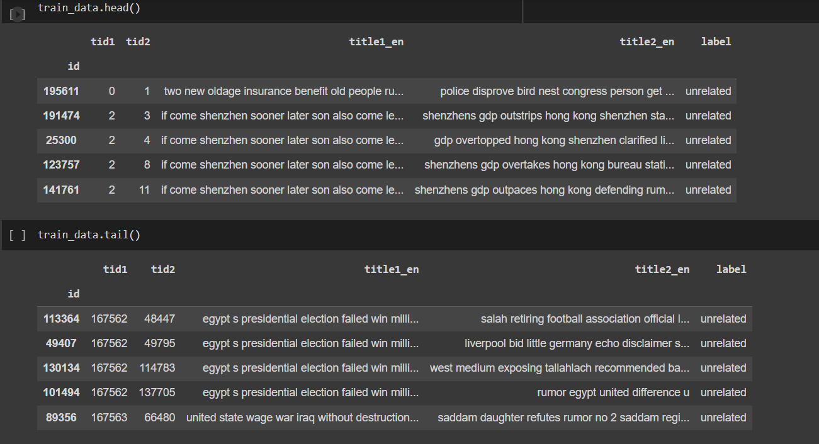
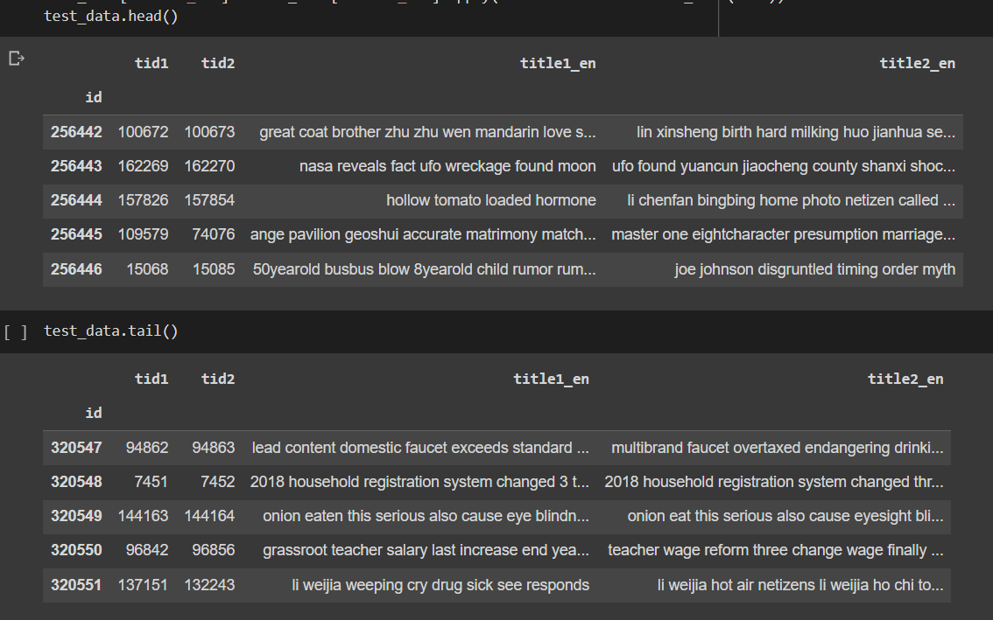
Output of preprocessed data
Training data:
Test data:

Slide 10
ML Models implementation
3

Slide 11
Algorithms Implemented
Linear support vector classification
Logistic regression
Naive Bayes
Random Forest

Slide 12
Steps followed
1.Tf-IDF
Vectorized each columns using TfidfVectorizer from sklearn.
2. Sparse matrix
In order to increase columns in sparse matrix, we used hstack from scipy.sparse. We obtained matrix of 256408 rows and 57258 columns.
3.Model training
Split the data into train and test sets using train_test_split from sklearn.model_selection, then trained models using LinearSVC, MultinomialNB, LogisticRegression, and RandomForestClassifier from sklearn.
4. Prediction
Checked the metrics such as accuracy and f1-score and checked the predicted labels for the test data.

Slide 13
Results
4

Slide 14
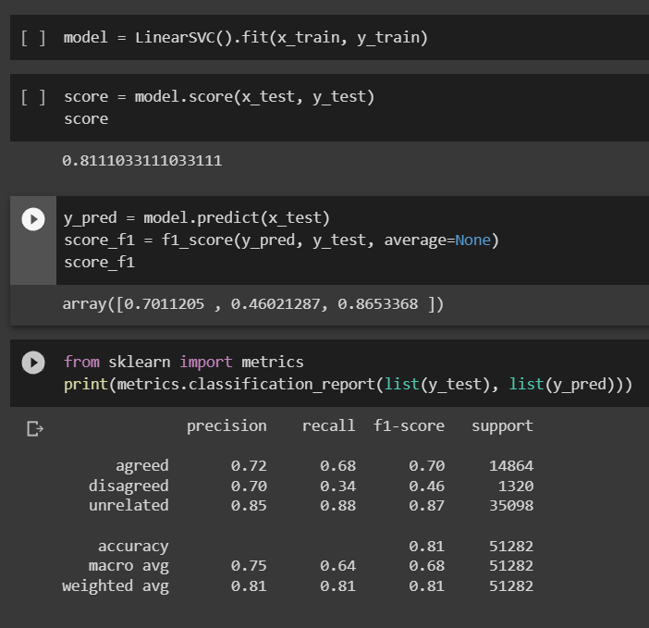
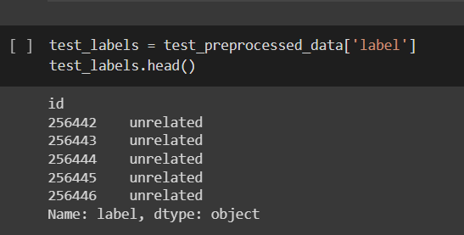
Accuracy and output (LinearSVC)

Slide 15
Why LinearSVC?
It is a binary classification model that can handle large datasets with many features, which is suitable for the given dataset.
It finds the best hyperplane to separates the data into different classes (words in the news titles).

Slide 16
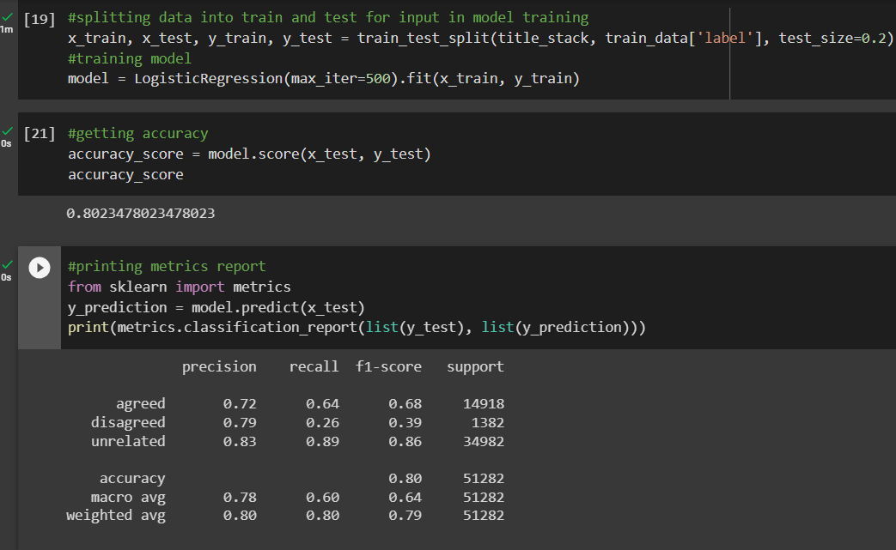
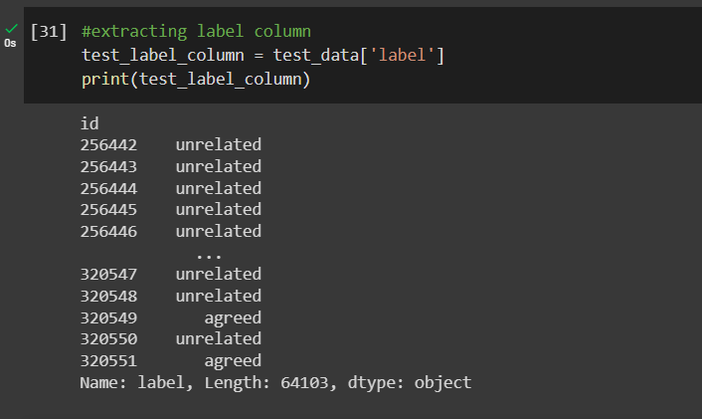
Accuracy and output (Logistic regression)

Slide 17
Why Logistic regression?
It is computationally feasible.
It can classify comparing the obtained probability.

Slide 18
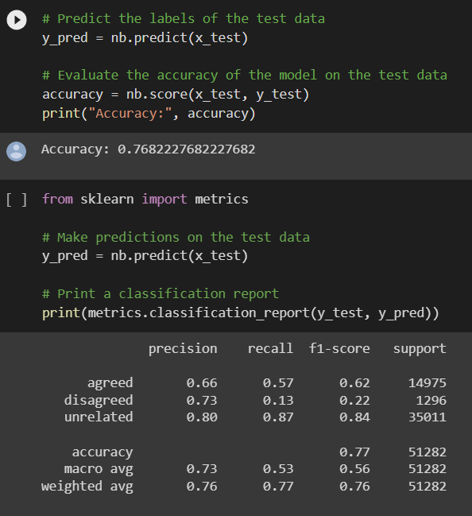
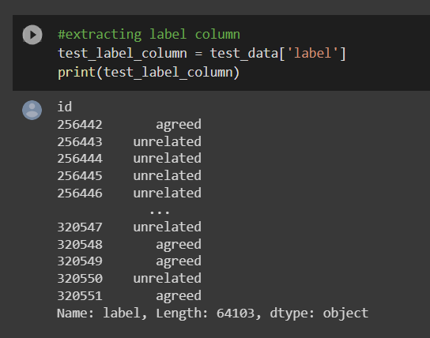
Accuracy and output (Naive Bayes)

Slide 19
Why Naive Bayes?
It can handle high dimensional data and is ideal for text classification task like this.
Features - each word in news title classes - agreed, disagreed, unrelated. Using naive bayes, we can easily calculate the probability of each class given the input features.

Slide 20
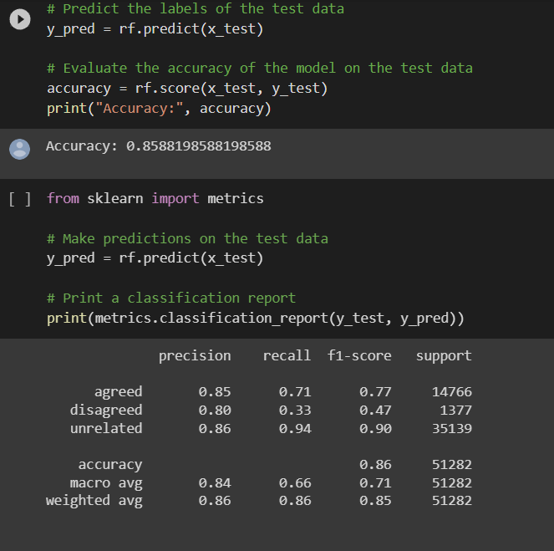
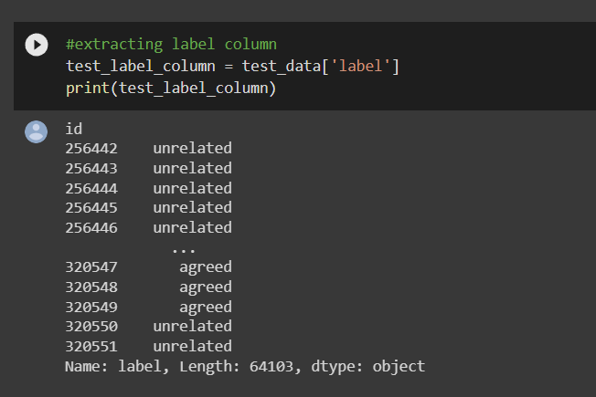
Accuracy and output (Random Forest)

Slide 21
Why Random Forest?
It generates multiple decision trees and combines them which increase the performance.

Slide 22
Brief Comparison
Based on accuracy and f1 scores, LinearSVC, Logistic Regression, and Random Forest are all good fit for this task.
Naive bayes cannot handle this complex dataset and achieved lowest accuracy.
Random Forest gave the best performance.

Slide 23
THANKS!
You can find us at
jparikh9@hawk.iit.edu & rmer@hawk.iit.edu

