Slide 1

Python in PHP: Internals
Jon Parise <jon@php.net>
2002 International PHP Conference
Frankfurt, Germany
November 6, 2002

Slide 2
About This Session
Presentation of the internals of the Python in PHP extension
Some familiarity with PHP extensions is expected.
Python knowledge is not required, but familiarity will be helpful.

Slide 3
About Me
Bachelor of Science in Information Technology from the Rochester Institute of Technology
Completing Masters of Entertainment Technology at Carnegie Mellon University
Software engineer at Maxis on The Sims Online
Long history of involvement with PHP, PEAR, and The Horde Project
Co-author of Professional PHP4 Programming
Long-time Pythonista!

Slide 4
Ground Rules
Questions
  Ask for clarification at any time.
  Please save scope-expanding questions until the end.
Pacing
  Ask me to slow down if I move too quickly.
  I’m from New Jersey.

Slide 5
Session Agenda
Overview
Extension architecture
Type conversions
Object handling
PHP Python Module
Next Steps
Questions

Slide 6
Confessions
I am not an expert on PHP internals.
I am not an expert on Python internals.
I just read a lot of code and documentation.

Slide 7
What Is The Python Extension?
Embedded Python interpreter
Interface handled by PHP extension
Python-to-PHP object proxy
Handles type conversions
Exposes PHP environment to Python

Slide 8
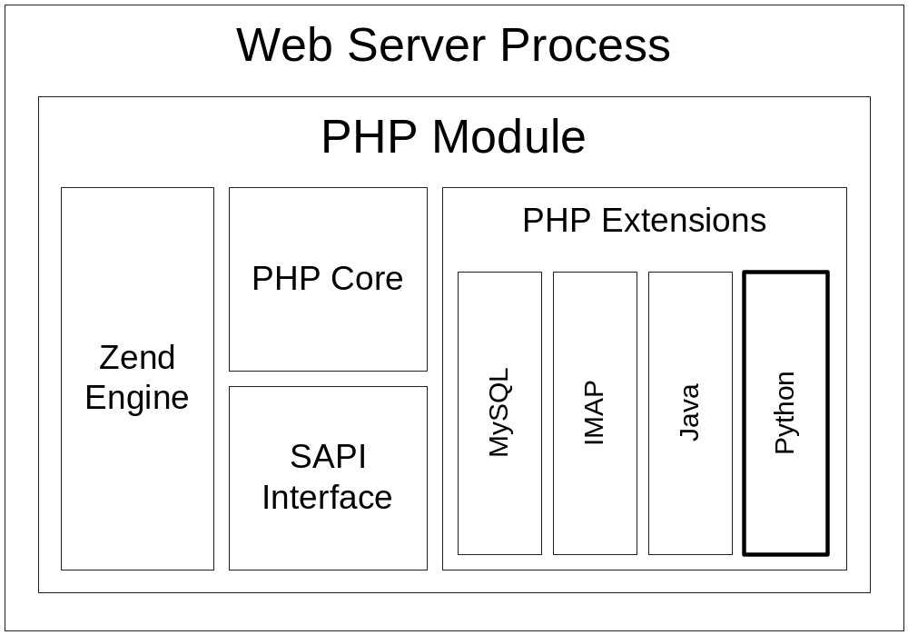
PHP Extension Architecture

Slide 9
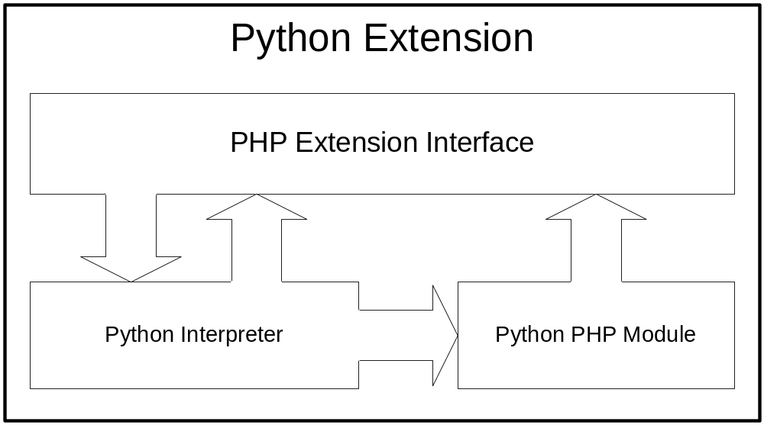
Python Extension Architecture

Slide 10
How It Happens
PHP starts and initializes the Python extension.
The Python extension initializes the Python interpreter.
Python-related operations are performed in PHP.
PHP shuts down the Python extension, which cleans up the Python interpreter.

Slide 11
Executing Python Code
Python:
print "Hello, Frankfurt!"
PHP:
echo py_eval('print "Hello, Frankfurt!"');
Output:
Hello, Frankfurt!

Slide 12
Executing More Python Code
Python:
fruits = ['apples', 'oranges', 'pears']
for fruit in fruits:
print fruit
PHP:
$code = <<<END
fruits = ['apples', 'oranges', 'pears']
for fruit in fruits:
print fruit
END;
py_eval($code);

Slide 13
How It Works
Extension initialization
Python initialization
Python code execution
Extension shutdown
Python shutdown
PHP_MINIT_FUNCTION
Py_Initialize()
PyRun_SimpleString()
PHP_MSHUTDOWN_FUNCTION
Py_Finalize()

Slide 14
py_eval()
Executes a string of Python code
Uses PyRun_SimpleString()
Only returns success or failure
Always executes in the same Python environment
py_eval('where = "Frankfurt"');
py_eval('print "Hello, " + where');

Slide 15
Calling Python Functions
Python:
import math
print math.cos(0)
PHP:
echo py_call('math', 'cos', array(0));
Output:
1

Slide 16
py_call()
Calls a function of a module
Uses PyObject_CallObject()
Implicitly imports the module
Allows parameter passing
Returns the result of the function call
echo py_call('math', 'cos', array(0));

Slide 17
PHP to Python Type Conversion
PHP
Boolean
Long (Integer)
Double (Float)
String
Null
Python
Integer
Long
Double
String
None

Slide 18
Python to PHP Type Conversion
Python
Integer
Long
Float
String
None
PHP
Long
Long
Double
String
NULL

Slide 19
Arrays, Sequences & Mappings
PHP only has hashes, indexed by:
  Numbers: array(1, 2)
  Strings: array('one' => 1, 'two' => 2)
Python has sequences:
  Tuples: (1, 2)
  Lists: [1, 2]
And mappings:
  Dictionaries: {'one': 1, 'two': 2}

Slide 20
Array Conversions
PHP arrays (hashes) are always converted to Python dictionaries.
Results in no data loss.
PHP:
$a = array(1, 2);
$b = array('one' => 1, 'two' => 2);
Python:
a = {'1': 1, '2': 2}
b = {'one': 1, 'two' : 2}

Slide 21
Array Conversion Exceptions
Arrays of arguments are always passed as a tuple.
String keys are discarded.
PHP:
py_call('math', 'cos', array(0));
py_call('math', 'cos', array('zero' => 0));

Slide 22
Sequence Conversions
Python tuples and lists are always converted to PHP arrays.
The numerical indices are preserved.
Python:
a = (1, 2)
b = [1, 2]
PHP:
$a = array(1, 2);
$b = array(1, 2);

Slide 23
Mapping Conversions
Python dictionaries are always converted to PHP associative arrays.
Keys will be converted to strings.
Python:
a = {'one': 1, 'two': 2}
b = {0.123: 1, 0.456: 2}
PHP:
$a = array('one' => 1, 'two' => 2);
$b = array('0.123' => 1, '0.456' => 2);

Slide 24
About Python Objects
The Python extension proxies Python objects
Python objects are represented as instances of a "python" class in PHP
PHP:
object(python)(1) {
[0]=>
int(4)
}

Slide 25
Creating Python Objects
Python objects are creating using the Python() object constructor
Python (test.py):
class TestClass:
def __init__(self, s):
print 'TestClass:', s
PHP:
$test = new Python('test', 'TestClass',
array('Test Argument'));

Slide 26
Manipulating Python Objects
Python objects work like PHP objects
Python (test.py):
class TestClass:
def __init__(self):
self.name = 'Testing'
def get_name(self):
return self.name
PHP:
$test = new Python('test', 'TestClass');
echo $test->name;
echo $test->get_name();

Slide 27
Python Class Internals
static int le_pyobject = 0;
static zend_class_entry python_class_entry;
INIT_OVERLOADED_CLASS_ENTRY(
python_class_entry, /* Class container */
"python", /* Class name */
NULL, /* Functions */
python_call_function_handler, /* Function call handler */
python_get_property_handler, /* Get property handler */
python_set_property_handler); /* Set property handler */
zend_register_internal_class(&python_class_entry TSRMLS_CC);
le_pyobject = zend_register_list_destructors_ex(
python_destructor, NULL, "python", module_number);

Slide 28
Storing Python Objects
Once created, Python objects are stored in the engine symbol hash
ALLOC_ZVAL(handle);
ZVAL_LONG(handle, zend_list_insert(obj, le_pyobject));
pval_copy_constructor(handle);
INIT_PZVAL(handle);
zend_hash_index_update(Z_OBJPROP_P(object), 0, &handle,
sizeof(pval *), NULL);

Slide 29
Retrieving Python Objects
Python objects are retrieved by their handle
pval *object = property_reference->object;
PyObject *obj;
pval **handle;
int type;
zend_hash_index_find(Z_OBJPROP_P(object), 0,
(void **) &handle);
obj = (PyObject *) zend_list_find(Z_LVAL_PP(handle), &type);
if (type == le_pyobject) {

Slide 30
Handling Method Calls
If the method name is 'python':
  Import the requested module
  Construct a new Python object
  Register and return the new object
Else:
  Retrieve the Python object handle
  Look for the requested method
  Call the method with any arguments
  Convert and return the result

Slide 31
The Case-Sensitivity Problem
PHP converts all function and method calls to lowercase internally
  You type: $test->GetSomeValue()
  PHP sees: $test->getsomevalue()
Python is case-sensitive, making it impossible to call any function or method with capital letters from PHP!

Slide 32
The Case-Sensitivity Solution
Build a map of Python object methods!
PyObject *dir = PyObject_Dir(obj)
PyObject *map = PyDict_New();
for (i = 0; i < PyList_Size(dir); i++) {
item = PyList_GetItem(dir, i);
key = estrdup(PyString_AsString(item));
key_len = PyString_Size(item);
PyDict_SetItemString(map, php_strtolower(key, key_len), item);
efree(key);
}
Py_DECREF(dir);

Slide 33
Handling Object Attributes
Both "get" and "set" operations call the same attribute handler
Retrieve the requested Python object
Find the named attribute
Convert and return its value
Note: No case-sensitivity hacks necessary here!

Slide 34
The PHP Python Module
Allows access to the PHP environment from within the embedded Python environment
Functionality is still very limited!
PHP:
$test = 'This is a test';
Python:
import php
print php.var('test')

Slide 35
php.var() Implementation
static PyObject * py_php_var(PyObject *self, PyObject *args)
{
char *name;
zval **data;
TSRMLS_FETCH();
if (!PyArg_ParseTuple(args, "s", &name)) {
return NULL;
}
if (zend_hash_find(&EG(symbol_table), name, strlen(name) + 1,
(void **) &data) != SUCCESS) {
return NULL;
}
return convert_zval_to_pyobject(data);
}

Slide 36
Building the Python Extension
$ cd pear/PECL/python
$ pear build
running: phpize
PHP Api Version : 20020307
Zend Module Api No : 20020429
Zend Extension Api No : 20021010
Python installation directory? [autodetect] :
building in /var/tmp/pear-build-jon/python-0.1
running: /home/jon/src/pear/PECL/python/configure --with-python
running: make
python.so copied to /home/jon/src/pear/PECL/python/python.so

Slide 37
Next Steps
Extending Python objects from PHP
Exposing PHP objects to Python
More namespace sharing
  Global and local variables
Multiple Python interpreters
Better threading support
Fix bugs

Slide 38
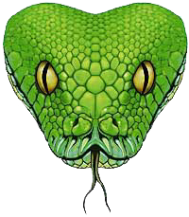

Questions

Slide 39
References
Presentation Slides
http://www.csh.rit.edu/~jon/pres/
Python in PHP
http://www.csh.rit.edu/~jon/projects/pip/
Python
http://www.python.org/

