Slide 1
MaxDiff Analysis Example Report

Slide 2
Table of Contents
Background & Methodology
Key Findings
Detailed Findings
Demographic Profile
Appendix

Slide 3
Background & Methodology

Slide 4

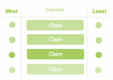

Background & Approach
The purpose of this study is to optimize claims messaging for current and prospective customer in order to accelerate acquisition and improve retention.
Sample
MaxDiff
Approach
Survey
Flow
Total sample size: n=2174
This fielded from December 2-12, 2019
Respondents were…
  Customers (1471)
  Prospects (617)
  Non-Members (67)
MaxDiff (Maximum Difference)
is an advanced survey research technique that is used to obtain preference and importance scores for multiple items.
Screener
MaxDiff
Claim Attributes
Demographics
It informs on the relative importance of a product or service’s feature in influencing your customers.

Slide 5

MaxDiff Methodology
MaxDiff presents respondents with samples of the full list of items you wish to assess, then has them mark the items they prefer the most and the items they prefer the least in each set.
Example:
Most
Least
Claim
Claim
Relies on paired comparisons
Seeks to find the maximum difference in preference
Identifies the features your program should be most focused on providing for customers, and which you can set aside.
Claim
Claim

Slide 6

Scoring Methodology
We implemented a scoring system to quantify the impact of the claims across our four metrics- including three perceptions and one evaluating trigger. This allows us to evaluate the overall health of a claim and quickly identify which claims are making a tradeoff in one area versus others.
Top Rank
= 15
Bottom Rank
= 1
Uniqueness
Believability
The 15 claims are sorted by rank order for each metric. For the top rank, a score of 15 is assigned, for bottom rank, a score of 1. The scores are added up to an overall number and compared alongside MaxDiff results.
Brand Fit
Likelihood to Enroll

Slide 7
Key Findings

Slide 8
Audience Summary
 | Total Sample | Customers | Prospects | Non-Members
Definition | All respondents | Customers | Have not used, but in the category | Have used, but not a member
Sample Size | N=2174 | N=1471 | N=617 | N=86
Key Findings | Earning rewards 30% faster is the most compelling claim. Tangible benefits or leadership claims without direct comparisons tend to resonate most. “A YYY spent is an YYY earned” (1:1) rates highest in scoring but is only middle of the pack on uniqueness and is low on overall preference. “Rewards within the US starts at just XXX” performs well across attributes and as a MaxDiff choice, perhaps making it the optimal choice for consistency. | Customers see [brand]’s industry high benefits as unique and a good fit with the brand. “Rewards within the US starts at just XXX” performs well across both metrics and MaxDiff. “Earn rewards 30% faster” and “most generous loyalty program,” while strongly preferred overall, trade off either brand fit or uniqueness. | Prospects respond best to the tangible, numeric claims, but are also the most turned off by competitive claims. Among prospects, 1:1 earning is seen as the most believable and moves respondents to enroll in [brand]’s Loyalty Program. The low barrier “Rewards within the US starts at just XXX” claim is the most consistent of the claims across the metrics, but it is a bit lower on motivating to enroll. | Non-Members rank the 1:1 earning highest, with strong scores across all four measures and solid overall preference. The low barrier “Rewards within the US starts at just XXX” claim is next, but struggles towards appearing unique. Non-Members feel faster is better and is the strongest claim when it comes to their likelihood to enroll.

Slide 9



Claims Summary
SPEED LIMIT
“Earn rewards 30% faster than other major [category]” is most compelling, though has notable drawbacks.
“Rewards within the US starts at just XXX” may be the most optimal choice for consistency.
“A YYY spent is a YYY earned” shows some promise towards acquiring new members.
Tangible benefits or leadership claims without direct comparisons tend to resonate most.
Among Total sample, it is the most compelling claim. However, it falls behind in terms of brand fit across all audiences.
Prospects rate it low in believability.
The claim does not have strong likelihood to enroll amongst Non-Members.
The low barrier resonates with Members, performing well across both metrics and MaxDiff.
For Prospects, it is the most consistent but it is a bit lower on motivating to enroll.
Among Non-Members, it has some struggles towards appearing unique.
Total sample rates it highest in scoring but is average on uniqueness and is low on overall preference.
Among Prospects, it is the most believable and moves to enroll.
Non-Members rank it highest, rating strong across the four measures with solid overall preference.
Prospects respond best to the tangible, numeric claims, but are also the most turned off by competitive claims.
In terms of retention, Members see [brand]’s industry high benefits as unique and a good brand fit.

Slide 10
Detailed Findings

Slide 11
MaxDiff

Slide 12
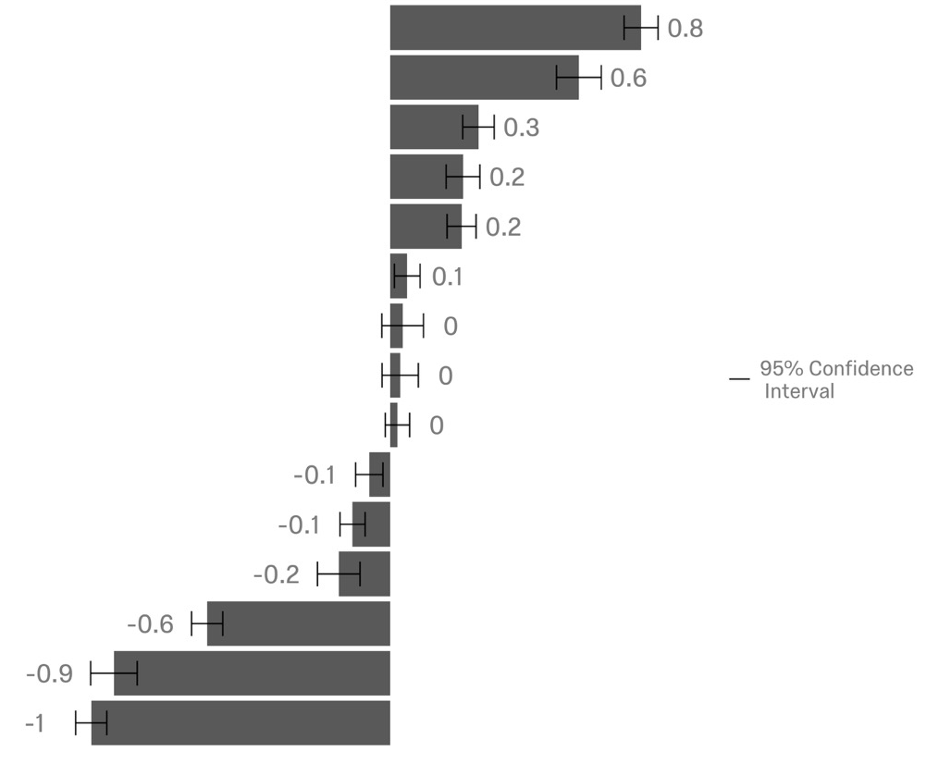
Earning rewards 30% faster is the most compelling claim. Tangible benefits (where numbers are given) or leadership claims (most generous, highest value) without direct comparisons tend to resonate most.
Earn rewards 30% faster than other major [category]
Rewards within the US starts at just XXX
The most generous [category] loyalty program
[brand] offers the highest value benefits in the industry
Earn awards faster so you are 30% faster to your next reward
Earn awards faster
Earn by the experience, not but the dollar
Buy at any price, earn all the rewards
Earn rewards 25% % faster than other major [category]
Earn faster, redeem sooner
[brand] rewards are worth more than other [category] rewards
A YYY spent is a YYY earned
The smartest value compared to any other [category] rewards program
The most valuable rewards among US [category]
Only [brand] can get to you your free rewards sooner

Slide 13
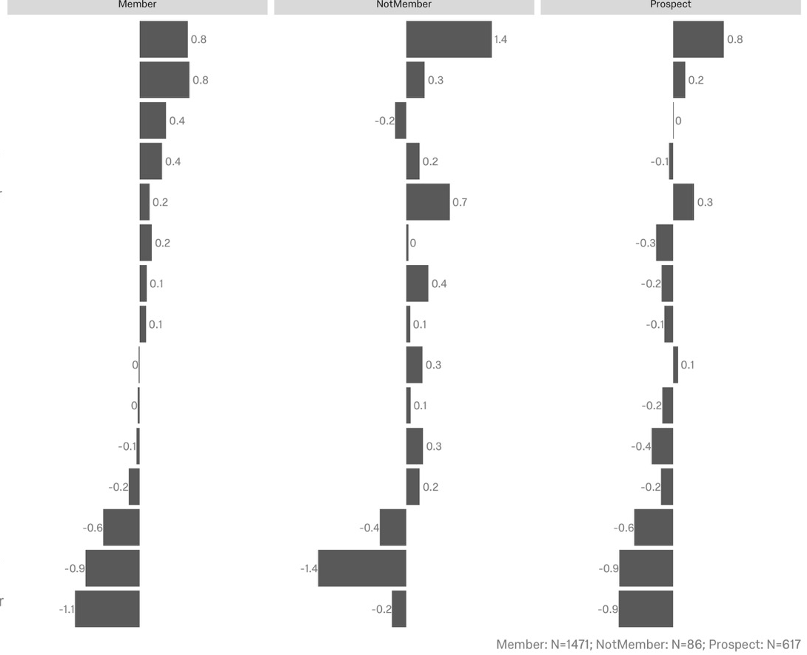
Prospects respond best to the tangible, numeric claims, but are also the most turned off by competitive claims.
Earn rewards 30% faster than other major [category]
Rewards within the US starts at just XXX
The most generous [category] loyalty program
[brand] offers the highest value benefits in the industry
Earn awards faster so you are 30% faster to your next reward
Earn awards faster
Earn by the experience, not but the dollar
Buy at any price, earn all the rewards
Earn rewards 25% % faster than other major [category]
Earn faster, redeem sooner
[brand] rewards are worth more than other [category] rewards
A YYY spent is a YYY earned
The smartest value compared to any other [category] rewards program
The most valuable rewards among US [category]
Only [brand] can get to you your free rewards sooner
**Non-member group has large margins of error due to small sample size. *See appendix for these charts ordered with error bars.

Slide 14
Total Sample

Slide 15
Scoring | Total Sample
“A YYY spent is a YYY earned” rates highest but is only middle of the pack on uniqueness and is low on overall preference. “Rewards within the US starts at just XXX” performs well across attributes and as a MaxDiff choice, perhaps making it the optimal choice for consistency.
Claim | Overall Score | Unique | Believable | Brand Fit | Likelihood to Enroll | MaxDiff
A YYY spent is a YYY earned | 50 | 8 | 15 | 14 | 13 | 4
Buy at any price, earn all the rewards | 45 | 7 | 13 | 13 | 12 | 8
Rewards within the US starts at just XXX | 45 | 15 | 12 | 9 | 9 | 14
[brand] offers the highest value benefits in the industry | 43 | 12 | 10 | 15 | 6 | 12
Earn rewards 30% faster than other major [category] | 43 | 14 | 14 | 5 | 10 | 15
Earn by the experience, not but the dollar | 40 | 11 | 14 | 11 | 4 | 9
The most valuable rewards among US [category] | 36 | 13 | 11 | 10 | 2 | 2
The most generous [category] loyalty program | 35 | 6 | 9 | 12 | 8 | 13
Earn awards faster so you are 30% faster to your next reward | 30 | 9 | 4 | 2 | 15 | 11
Earn awards faster | 29 | 1 | 7 | 7 | 14 | 10
[brand] rewards are worth more than other [category] rewards | 23 | 10 | 2 | 6 | 5 | 5
Earn faster, redeem sooner | 23 | 3 | 5 | 4 | 11 | 6
Earn rewards 25% % faster than other major [category] | 23 | 5 | 8 | 3 | 7 | 7
The smartest value compared to any other [category] rewards program | 18 | 4 | 3 | 8 | 3 | 3
Only [brand] can get to you your free rewards sooner | 5 | 2 | 1 | 1 | 1 | 1

Slide 16
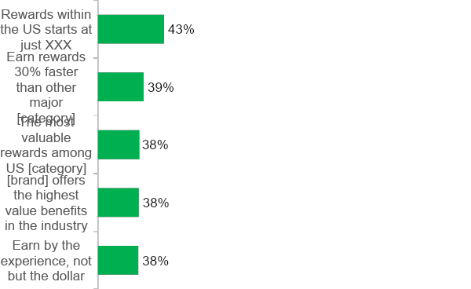
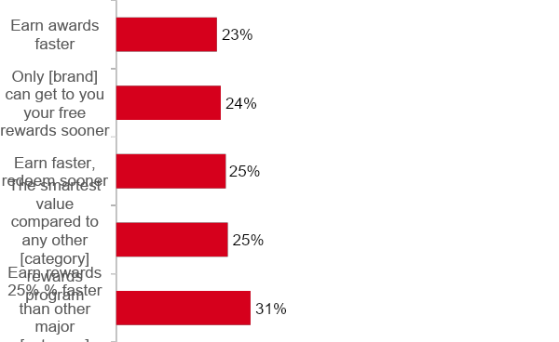
Uniqueness | Total Sample
“Rewards” stands out as the most unique, while more general claims regarding speed fall to the bottom. While there is not a lot of disparity between top and bottom, clearly showing value is a common thread among the leaders on uniqueness.
Sorted by Top 2 Box (“Very unique” + “Extremely unique”)
Top 5
Bottom 5

Slide 17
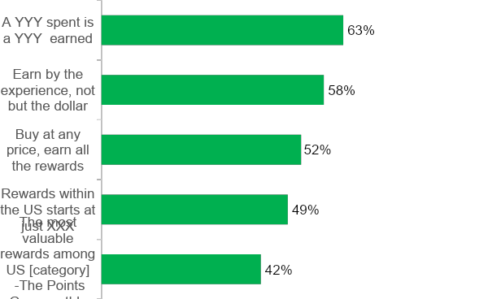
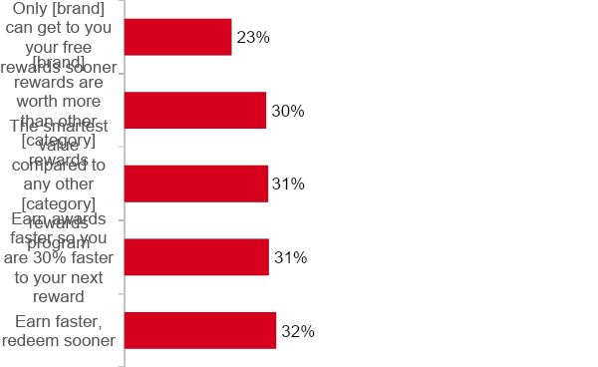
Believability | Total Sample
“A YYY spent is a YYY earned” scores high on believability. Note that most of the believable claims are short and don’t make any specific promises. A claim regarding differentiation from competitors as the “only” plan falls short in terms of communicating a believable statement.
Sorted by Top 2 Box (“Very believable” + “Extremely believable”)
Top 5
Bottom 5

Slide 18
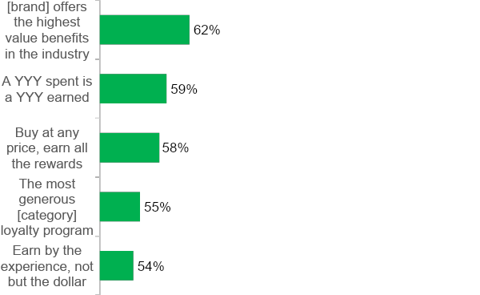
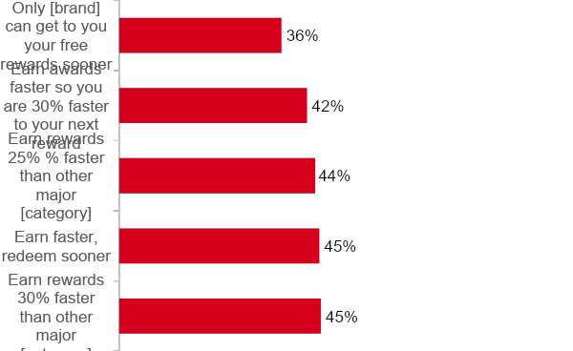
Brand Fit | Total Sample
Brand fit is highest amongst claims that communicate high value, generosity, and rewards despite the dollars spent. Note that including the brand and program name does not immediately correlate to brand fit – both the best and worst claims on this measure use the brand and program.
Sorted by Top 2 Box (“Fits the brand very well” + “Fits the brand perfectly”)
Top 5
Bottom 5

Slide 19
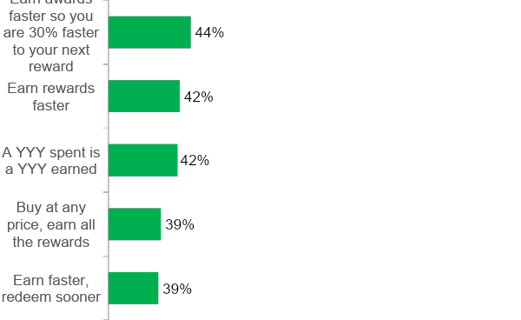
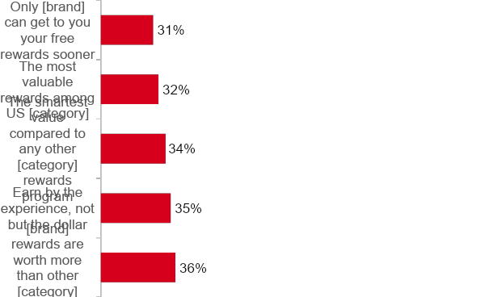
Likelihood to Enroll | Total Sample
Respondents are most likely to enroll in [brand]’s Loyalty program for earning and rewards faster. Again, respondents gravitate toward simple, shorter claims, although there is not a lot of disparity between the top and bottom.
Sorted by Top 2 Box (“Very likely” + “Extremely likely”)
Top 5
Bottom 5
‹#›

Slide 20
Members

Slide 21
Scoring | Members
Customers see [brand]’s industry high benefits as unique and a good fit with the brand.
“Rewards within the US starts at just XXX” performs well across both metrics and MaxDiff.
“Earn rewards 30% faster” and “most generous loyalty program,” while strongly preferred overall, trade off either brand fit or uniqueness.
Claim | Overall Score | Unique | Believable | Brand Fit | Likelihood to Enroll | MaxDiff
[brand] offers the highest value benefits in the industry | 38 | 13 | 10 | 15 | N/A | 12
Earn by the experience, not but the dollar | 37 | 12 | 14 | 11 |  | 9
Rewards within the US starts at just XXX | 36 | 15 | 12 | 9 |  | 15
Buy at any price, earn all the rewards | 35 | 8 | 13 | 14 |  | 8
A YYY spent is a YYY earned | 35 | 7 | 15 | 13 |  | 4
The most valuable rewards among US [category] | 35 | 14 | 11 | 10 |  | 2
The most generous [category] loyalty program | 27 | 6 | 9 | 12 |  | 13
Earn rewards 30% faster than other major [category] | 24 | 11 | 8 | 5 |  | 14
[brand] rewards are worth more than other [category] rewards | 20 | 10 | 4 | 6 |  | 5
The smartest value compared to any other [category] rewards program | 17 | 4 | 5 | 8 |  | 3
Earn rewards 25% % faster than other major [category] | 15 | 5 | 7 | 3 |  | 7
Earn rewards faster | 14 | 1 | 6 | 7 |  | 11
Earn awards faster so you are 30% faster to your next reward | 13 | 9 | 2 | 2 |  | 10
Earn faster, redeem sooner | 9 | 2 | 3 | 4 |  | 6
Only [brand] can get to you your free rewards sooner | 5 | 3 | 1 | 1 |  | 1

Slide 22
Prospects

Slide 23
Scoring | Prospects
Among prospects, 1:1 earning is seen as the most believable and moves respondents to enroll in [brand]’s Loyalty Program.
The low barrier “Rewards start at just XXX” claim is the most consistent of the claims across the metrics, but it is a bit lower on motivating Prospects to enroll.
Claim | Overall Score | Unique | Believable | Brand Fit | Likelihood to Enroll | MaxDiff
A YYY spent is a YYY earned | 40 | 11 | 15 | N/A | 14 | 6
Buy at any price, earn all the rewards | 33 | 8 | 13 |  | 12 | 9
Rewards within the US starts at just XXX | 32 | 13 | 12 |  | 7 | 13
Earn awards faster so you are 30% faster to your next reward | 31 | 10 | 6 |  | 15 | 14
Earn by the experience, not but the dollar | 30 | 12 | 14 |  | 4 | 7
Earn rewards faster | 28 | 4 | 11 |  | 13 | 5
Earn rewards 30% faster than other major [category] | 28 | 15 | 3 |  | 10 | 15
The most generous [category] loyalty program | 28 | 14 | 5 |  | 9 | 11
[brand] offers the highest value benefits in the industry | 24 | 9 | 7 |  | 8 | 10
Earn faster, redeem sooner | 23 | 3 | 9 |  | 11 | 8
Earn rewards 25% % faster than other major [category] | 19 | 5 | 8 |  | 6 | 12
The most valuable rewards among US [category] | 18 | 6 | 10 |  | 2 | 2
[brand] rewards are worth more than other [category] rewards | 14 | 7 | 2 |  | 5 | 4
The smartest value compared to any other [category] rewards program | 9 | 2 | 4 |  | 3 | 3
Only [brand] can get to you your free rewards sooner | 3 | 1 | 1 |  | 1 | 1

