Slide 1
TC Typing Tool Training
September 2021

Slide 2
What is a Typing Tool?
Respondent enters the survey, answer the survey questions
A typing tool is a set of questions for classifying new respondents into existing segments, it contains the following:
A set of questions
A set of algorithms
Outputs/Segments
Algorithms working in the back
Respondent gets assigned to a segment/group based on how they answered the questions

Slide 3
Why Do We Program Typing Tools?
The biggest advantage for programming typing tools is that respondents will get assigned to a segment in real time.
Better user experience than an Excel document (which is how they typically come in)
There is no matching database from multiple platforms
Clients do not have to download and upload data multiple times
It saves clients both time and effort in the backend analyses
The programmed typing tool can be used in multiple surveys
Sometimes clients have quota requirements on each segment - without the typing tool programmed - this would not be possible.
It is important for us to program it right, so always QC the work!

Slide 4
Overall Project Process
Just like a typical programming project, we build the typing tool in our own account and then once it is approved we transfer to the client’s account.
The way we program typing tools is by using Survey Flow and Math Operations, another common way of programming typing tools is through Java Scripts, but our team currently do not handle this method.
We often recommend using the Library Reference Survey feature. This is so that the typing tool can be used in multiple surveys and reduce the chance of the clients accidentally break something in the survey flow.
In order for this feature to work, all typing tool questions must be grouped together.
For some reason if the clients need to separate the typing tool questions among one survey, we can’t use the reference survey feature, and the typing tool can only be implemented in one survey instead of being used over and over again

Slide 5
What Do We Need Prior to Programming A Typing Tool
Must Have:
Calculation algorithm guide (e.g. How is each segment score being calculated, How do we decide the segment assignments)
Questions being used in the algorithms and their corresponding values
Segment Values and/or Names
Usually Receive (Both are not required but usually comes with typing tool documents and are nice to have, we need at least one to QC unless you want to do extra work):
Individual input sheet (this will assign a segment for ONE respondent)
Batch input sheet (this will assign a segment for MULTIPLE respondents)
Files usually come in Excels, make sure you enable macros and check any hidden pages before asking clients for more information.
Typing tools come in all shapes and sizes! Familiarize yourself with the documentation and keep an eye out for abnormal calculations or ways to categorize.
Example Programmed Typing Tool: FitBit Typing Tool

Slide 6
Building
Typing Tools

Slide 7
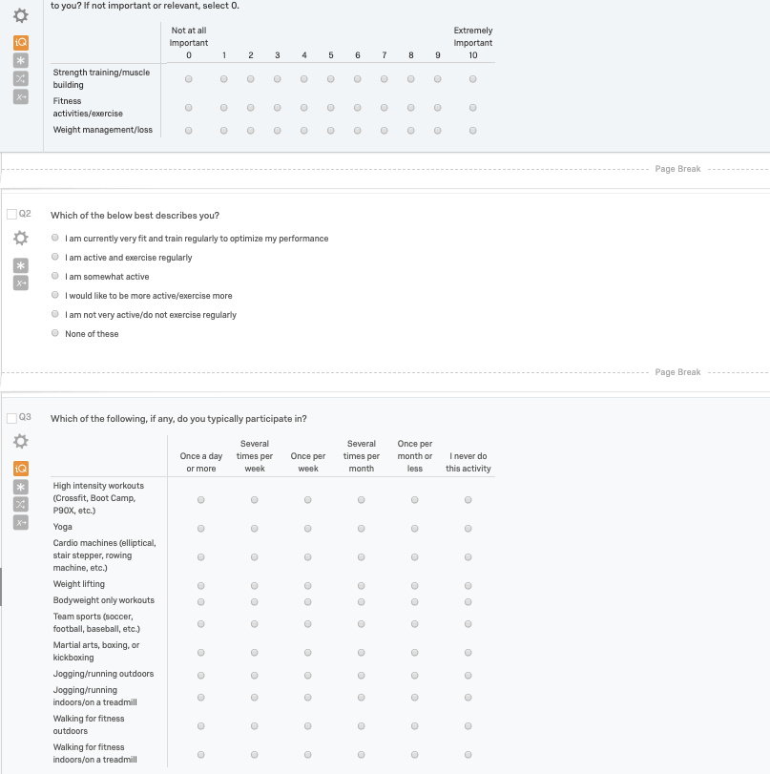
Step 1: Review Client Documents and Program the Questions
Make sure you understand how the typing tool works before programming to avoid any rework or delays. Ask the RX team or the client if you have any questions on the typing tool document.
Program the survey questions that are included in the typing tool, pay attention to recode values if any.
Note: you may need to recode the question data values using branch logic in the survey flow. In either case, these will act as the inputs in our algorithms, the results of which determine the segment score.

Slide 8
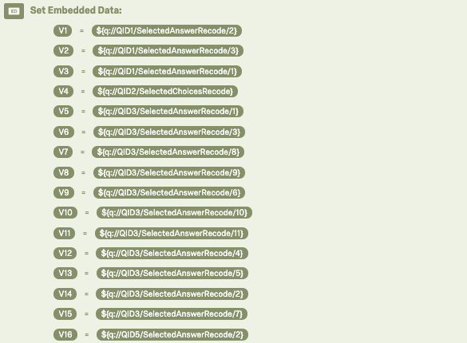
Step 2: Assign Variable Values In The Survey Flow
Assigning variables isn’t necessary, but makes the further equation building later on.
I personally like V1, V2, V3 because it looks cleaner and easier to check if something is wrong, but all we are doing is having these variables reference the recoded values of what was answered
Note: sometimes it is not recode value but logic based on what respondents select, i.e., if they selected any extreme sports, code as 1. In which case we would need to defined this prior with branch logicw

Slide 9
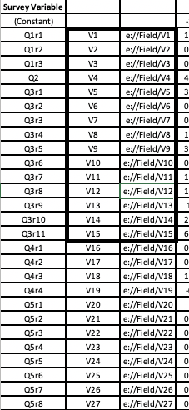
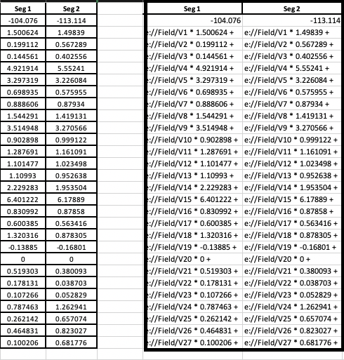
Step 3: Prepare the Excel Document for Programming
Idea: Setting up our equation using the coefficients * piped text
Step 1: Create a column “V1, V2, V3…”, make sure they correspond to the correct questions in the survey.
Step 2: Create another column using this function: ="e://Field/"&CELL (CELL refers to the column with the variable names) - this is to ensure we are pulling the embedded data fields
Step 3: Create a field that is variable value times the coefficient value by using this function: =$C3&" * "&D3&" + " (C3 refers to the column with the coefficient values, make sure to lock this column by putting the “$” on the column, pay special attention to the spaces: before and after “*” and “+”, this is because math operation is very picky on spaces)
Step4: Drag the formula for all segments

Slide 10
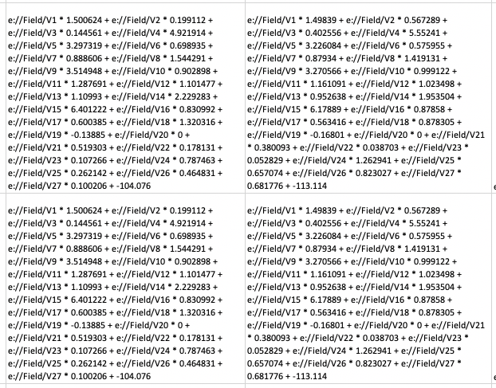
Step 3: Prepare the Excel Document for Programming
Step 5: Use “CONCATENATE” function in Excel to combine all individuals scores to come up with the segment score, do not forget the constant value. Example CONCATENATE formula: =CONCATENATE(M3,M4,M5,M6,M7,M8,M9,M10,M11,M12,M13,M14,M15,M16,M17,M18,M19,M20,M21,M22,M23,M24,M25,M26,M27,M28,M29,M2)
Step 6: Apply the “CONCATENATE” formula to all segments.
Step 7: Now we should have the formulas to calculate all segment values, copy the formula and paste it below as value (I recommend this way so that it is easy to change the formula if anything is wrong)

Slide 11
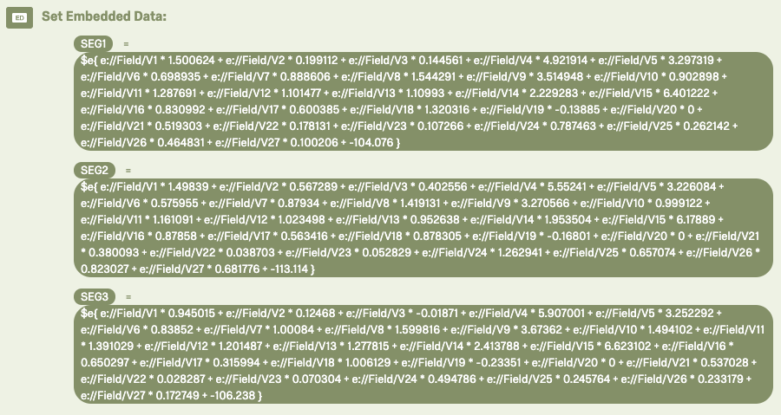
Step 4: Transition from Excel to Survey Flow - Create Segment Scores
Create individual Segment scores:
Go back to the survey we programmed, open survey flow, and start to copy and paste the cell we created in Excel into survey flow using math operation. Pay special attention to spaces - when you should and shouldn’t include them.

Slide 12
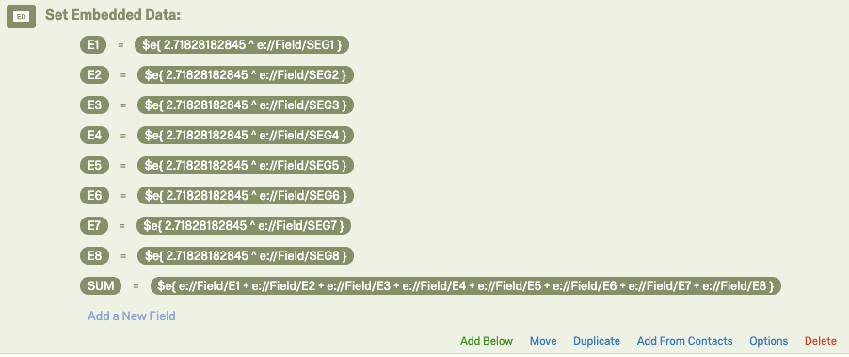
Step 5: Create Euler Power Values and Sum of All Power Values
This step is not always required, but very common in typing tool algorithms when categorical variables are involved. Double-check your calculation sheet to see what is involved in segment assignments.
e (Euler’s number) is the base of nature logarithms, the first few digits are: 2.718281828459045
Make sure in the calculations, segment values is set up as an embedded data field, i.e. e://Field/SEG1

Slide 13
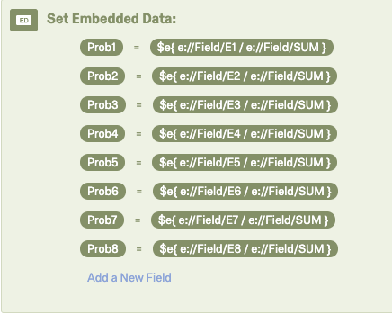
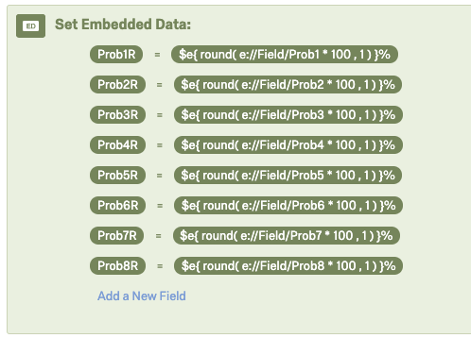
Step 6: Create Probability Values for Each Segment
Use the sum of all power values, we can now compute the probability value of each segment.
Tips/Common Mistakes: pay close attention to spaces, and make sure everything in calculations is set up as embedded data fields.
To make probabilities user-friendly (round to 1 digit), you can use this function: $e{ round( e://Field/Prob1 * 100 , 1 ) }%
If you do decide to round it, create another variable such as Prob1_rounded

Slide 14
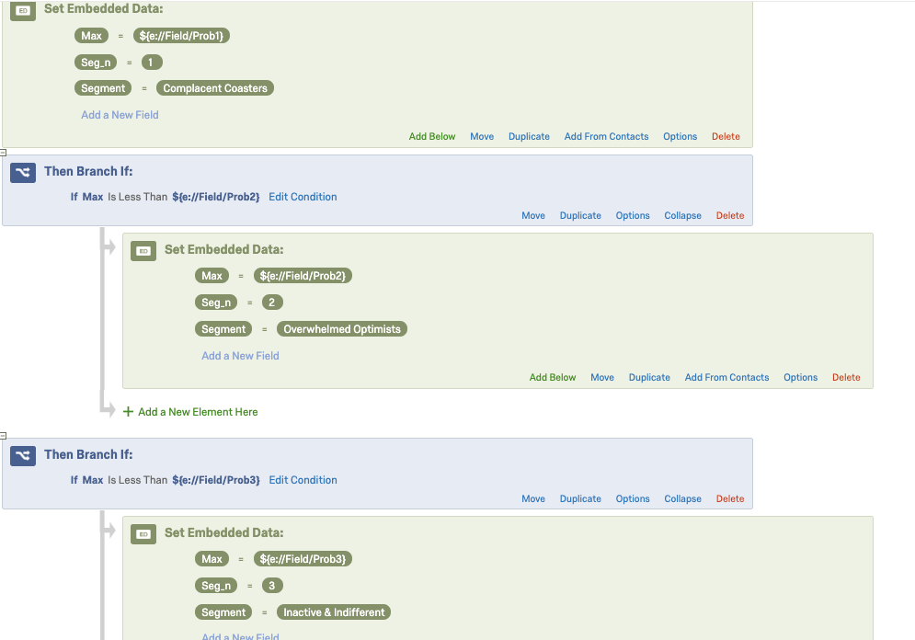
Step 7: Determine Max & Assign Segment
Good job - Now all of the hard calculations are all done! Give yourself a high five. We can then move forward with segment assignments. The method we use is a waterfall logic to determine which segment has the biggest probability value. Here is how we do it:
Step 1: Set Embedded Data Field “Max” to segment 1’s probability
Max = ${e://Field/Prob1}
Seg_n=1
Segment Name=Whatever the segment name is
Step 2: Add a separate branch logic for each segment to rewrite the “Max” value so that in the end it is the max value of all segment probability values.

Slide 15
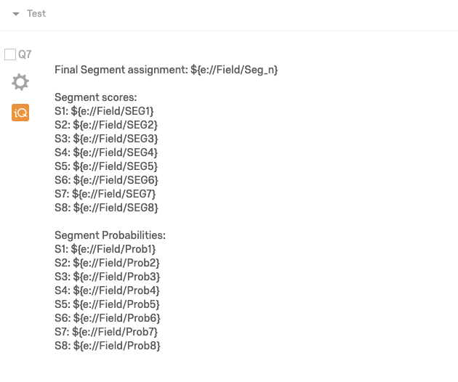
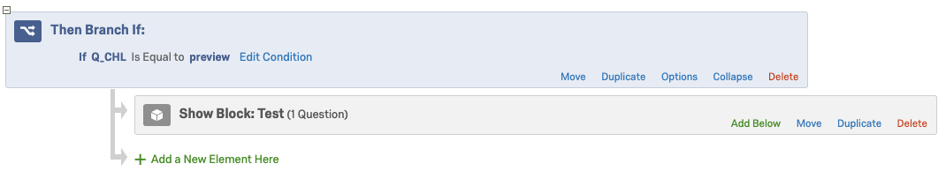
Step 8: Set Up the Test Page
Step 1: Go back to the survey, create a block, name it “test”: I usually include final segment assignment, segment score, and segment probability scores on this page.
Step 2: In the survey flow, set up a branch logic to only display this block under preview mode.

Slide 16
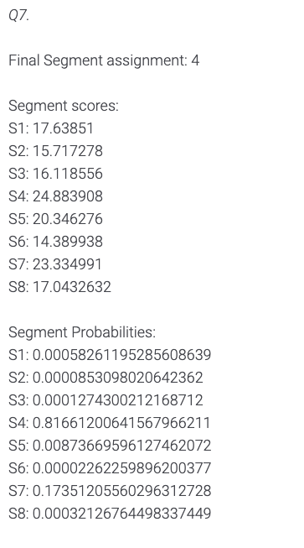
Step 9: Thoroughly Test The Typing Tool
Using Test Screen (most common way)
Go through the survey as a respondent, and compare your test screen to see if they match the excel sheet.
Make sure you hit all segments
Using Bulk Scoring (after programming is complete)
Client documents often come with a “Bulk Scoring” tool in which you can assign multiple segments at a time
Step 1: Generate Test Responses (Tools → Review → Generate test responses)
Step 2: Download relevant embedded data fields in Data & Analysis tab (Deselect “Download all fields”)
Step 3: Import variables into bulk scoring tool
Step 4: Compare using the “IF” function and conditional formatting in Excel* (=IF(CellA=CellB,” ”,”Check”)
*Note: you may need to use the “ROUND” function for the conditional formatting to work properly.
Note: The QC process is the same as standard programming.
Notes:
Client’s original tool is the source of truth. Your calculations should always match.

Slide 17
Typing Tool Hand-off Process

Slide 18
QCing a Typing Tool
Typing tools work or they don’t. To test, run ~1000 test responses through the survey and verify that they are typed accurately.
Why?
Occasionally a typing tool will be nearly completely accurate, causing a small percentage of respondents to be mistyped. For this reason, run 1000 tests.
Generally, if a small percentage of the tests are mistyped, there is a rounding error, or a minor typo.
If most are mistyped, there is likely a larger error.
Following testing the typing tool, where appropriate, follow the RX QC process for survey programming.
QC Document
Notes:
If it’s a complicated tool, I like to schedule a call to walk through the variables and which ones really matter for what they’re wanting to do.

Slide 19
Reference Surveys
Unless it’s a special circumstance, we always recommend the client to use typing tools as a reference survey.
Why?
Typing tool calculations can be complicated and sensitive. Reference surveys lock the survey flow so there’s much less risk of the client or their colleagues messing up the calculations within the survey flow.
Can be reused over and over
Support Page
Notes:
If it’s a complicated tool, I like to schedule a call to walk through the variables and which ones really matter for what they’re wanting to do.

Slide 20
UAT Auto-Text
Hi [Client],
We have completed the initial construction of the typing tool and tested through it on our end. You can test through the tool using this link. I have enabled the back button and question numbers for ease of testing but they will be removed once the survey is moved into your account. I've also attached a Word Doc version of the survey and the documents I referenced while creating the tool.
I have a couple of questions/comments for you:
For ease of testing, I have disabled randomization logic. This will be added back in once the survey is moved into your account.
I have enabled a test screen at the end of the survey that includes the predicted segment name, predicted segment number, predicted segment probability as well as all of the segment probabilities. These test screens are only displayed while the survey is in preview mode and will not be shown to actual respondents.
How many questions would you like per page? (currently one, recommended)
Would you like to enable force response on all questions? (currently in place, recommended)
Which Qualtrics account and Library should we move the survey into?
Please let me know if you have any questions or edits prior to moving the survey into your account!
Thanks,

Slide 21
Importing the Typing Tool into Client’s Account
After moving the survey into the client’s account:
Enable randomization
Disable the back button and question numbers
Add the survey to their specified Library
If the tool is particularly complicated, we recommend scheduling a call with the client to go over it
Transfer Auto-Text:
Hi [Client],
I have moved the typing tool into your account. You can find it using the information below:
Survey Name:
Survey ID:
Account:
Library:
As the survey logic is complex and fragile, we highly recommend using this tool as a reference survey and being super careful if you choose to make any edits. Please let me know if you have additional questions or concerns!
Notes:
If it’s a complicated tool, I like to schedule a call to walk through the variables and which ones really matter for what they’re wanting to do.

Slide 22
Appendix

Slide 23
Common Uncommon Typing Tool Logics and What to Do
Change assignment after initial assignment
Example: if initially assigned to segment 6, reassign to segment 2.
Solution: Add branch logic after assignment block to replace segment 6 assignment variables with segment 2.
Code strength
Example: if probability is >80%, code as strong, if it is between 30 to 79%, code as moderate, if it is below 30%, code as weak
Solution: add additional branch logic based on the probability value
Do not use a Euler power value
Example: The maximum segment score indicates which segment is assigned
Solution: Instead of using maximum probabilities to determine the predicted segment, use the maximum segment score values
Notes:
If it’s a complicated tool, I like to schedule a call to walk through the variables and which ones really matter for what they’re wanting to do.

Slide 24
Common Uncommon Typing Tool Logics and What to Do
Different segment calculations based on demographic groups
Example: Females can be assigned segment 1,2, and 3. Males can be assigned segment 4,5, and 6.
Solution: Nest segment calculations for segment 1,2, and 3 under “If female is selected” branch logic. Nest segment calculations for segment 4,5, and 6 under “if male is selected” branch logic.
Variable values is calculated based on logic instead of recoded values
Example: If they select option A for Q1 and B for Q2, assign to segment 1.
Solution: Use branch logic to set conditions for each segment assignment.
Notes:
If it’s a complicated tool, I like to schedule a call to walk through the variables and which ones really matter for what they’re wanting to do.

Slide 25
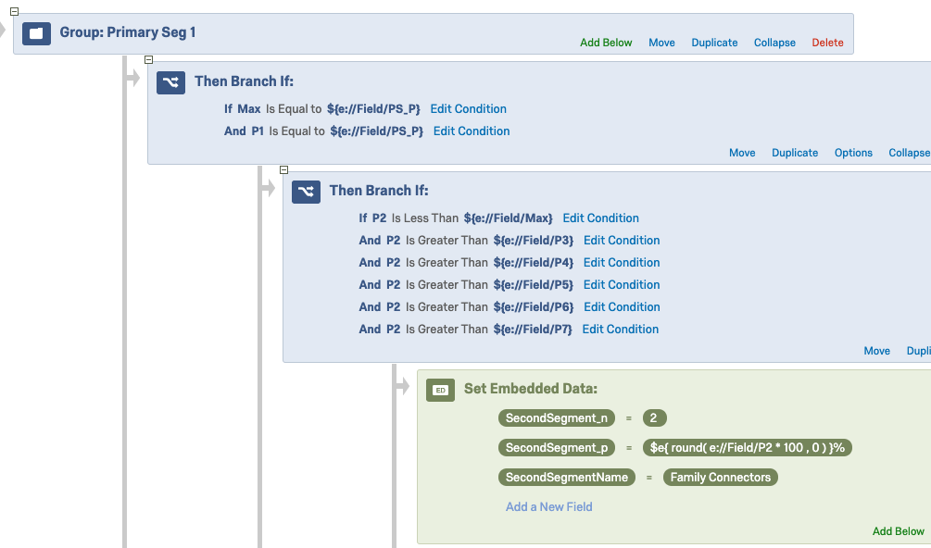
Common Uncommon Typing Tool Logics and What to Do
Secondary Segment
Example: The next-highest probability is the assigned secondary segment.
Solution:
Notes:
If it’s a complicated tool, I like to schedule a call to walk through the variables and which ones really matter for what they’re wanting to do.

Slide 26
Q&A

