Slide 1
Ballpark Pitch Fit
How MLB ballparks change pitcher results, and what that means for free agency
Joseph Pascarella
Data: Baseball Savant (Statcast), 2022-2026 regular seasons

Slide 2
The question and the approach
Question: will this pitcher's results hold up in our ballpark?
1. Measure each park's effect on balls in play, by batter side and batted-ball type.
Expected wOBA (from exit velocity and launch angle) does not know the park. The gap between actual and expected wOBA, compared with the league for the same kind of contact, is the park effect.
2. Describe pitchers and pitch types by the batted balls they produce.
A sinker-baller and a high-fastball pitcher give up very different mixes of ground balls and fly balls, so one park treats them differently.
3. Project each pitcher's wOBA allowed at each park.
His park-neutral wOBA allowed (pulled toward the league average, since results are noisy) adjusted by that park's expected effect on him.
4. Test it.
Do park effects repeat across seasons, and do they predict real home-vs-road results the model never saw?

Slide 3
Does it hold up? Testing the model
Do park effects repeat from one set of seasons to the next?
Effects by pitch archetype: correlation 0.05. That is noise, so my first idea (a park rewards specific pitch types) did not hold.
Effects by batter side and batted-ball type: correlation 0.50. These repeat, so the model is built on them.
Do they predict results the model never saw?
Backtest on 849 pitcher-seasons: how hitters did at a pitcher's home park vs. on the road, predicted from the other seasons only.
The park effect predicts it (correlation 0.21, even though a single pitcher-season is very noisy).
The pitcher-specific part adds nothing we can confirm (R-squared gain 0.000, 90% interval 0.000 to 0.004). It varies only about 3 points between pitchers against 49 points of noise, so a test this size cannot see it.
Takeaway: parks matter a lot and that is solid. Which pitcher benefits more is a small, unconfirmed tiebreaker.

Slide 4
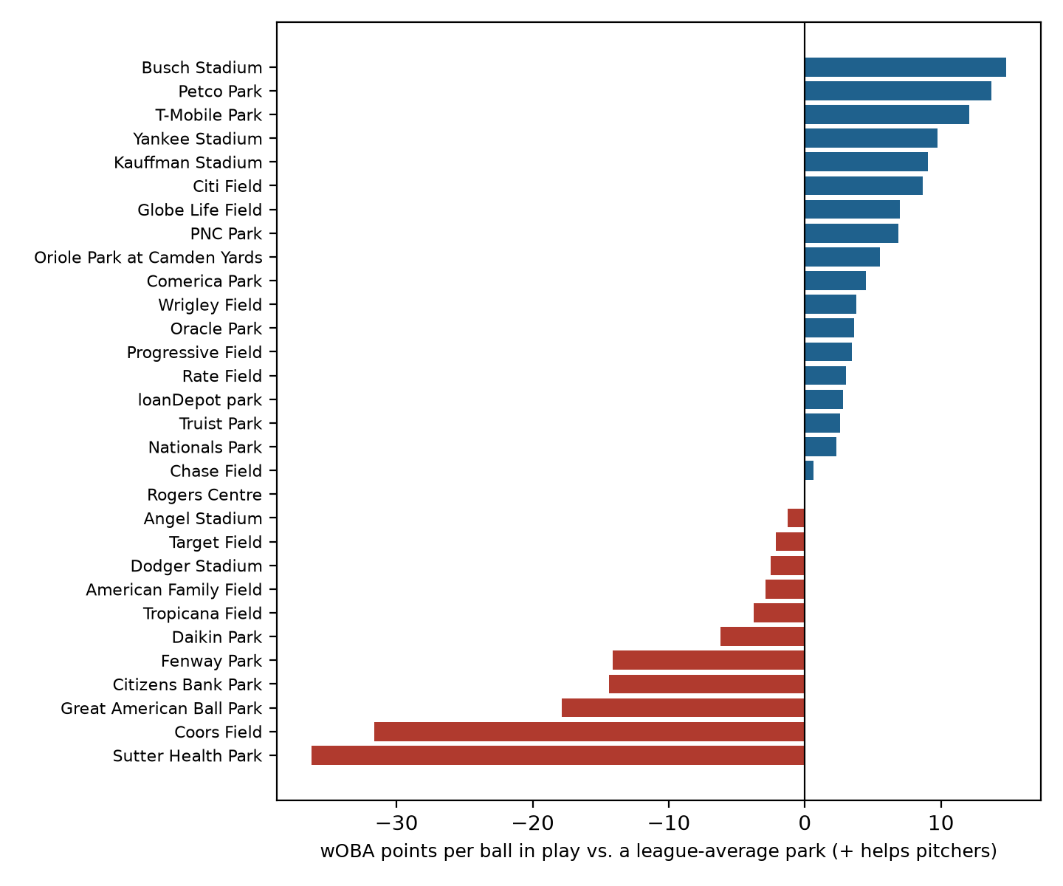
How much each park helps or hurts pitchers
Most hitter-friendly
Sutter Health Park, Coors Field, Great American Ball Park
Most pitcher-friendly
Busch Stadium, Petco Park, T-Mobile Park
Scale: these are per ball in play. Roughly two-thirds of plate appearances end in a ball in play, so a 25-point park effect moves a pitcher's overall wOBA allowed by about 17 points.
Low confidence (fewer than 3 seasons of data): Sutter Health Park.

Slide 5
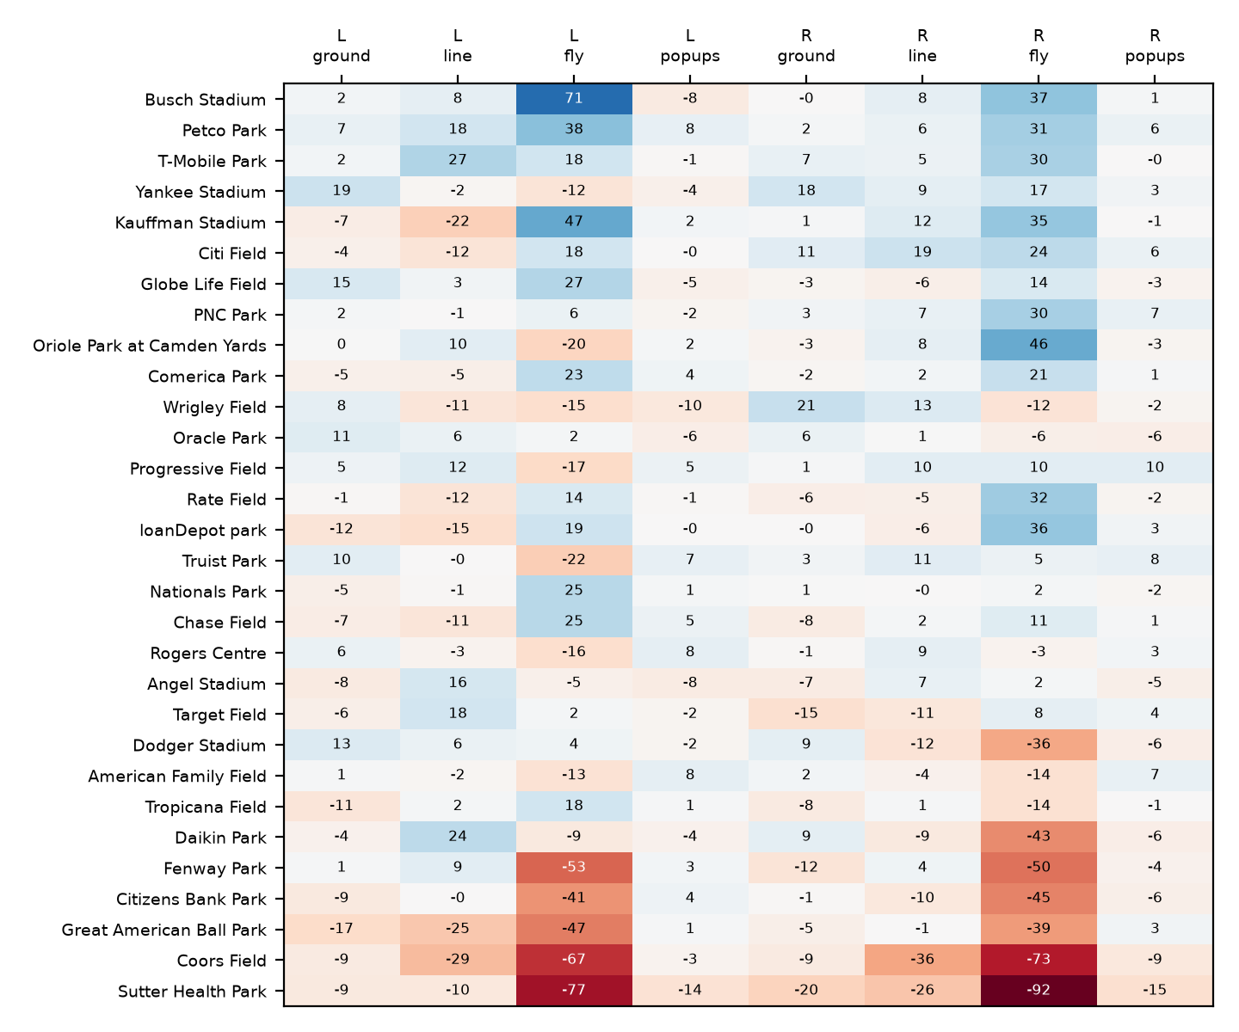
Which kind of contact each park punishes
How to read it
Each cell is the park's effect on pitchers, in wOBA points per ball in play, for one batter side (L or R) and one kind of contact. Blue helps the pitcher; red hurts.
Parks are ordered from most pitcher-friendly (top) to most hitter-friendly (bottom).
Average size of the effect: biggest for fly balls (26 pts), line drives (10 pts); smallest for ground balls (7 pts) and popups (4 pts).

Slide 6
Buy-low free agents: results worse than the pitcher
Pitcher | Role | Recent wOBA allowed | Park-neutral | Talent estimate | Undervalued by (pts) | Contact luck (pts) | Best park (projected)
Dustin May | SP | .338 | .340 | .334 | +4 | +4 | Busch Stadium .323
Casey Mize | SP | .330 | .330 | .327 | +2 | +30 | Busch Stadium .314
Foster Griffin | SP | .322 | .322 | .321 | +2 | +2 | Busch Stadium .311
David Peterson | SP | .331 | .335 | .331 | +1 | +2 | Yankee Stadium .322
Nick Martinez | SP | .309 | .304 | .308 | +1 | -6 | Busch Stadium .295
Robbie Ray | SP | .314 | .314 | .315 | -1 | -3 | Busch Stadium .305
Sonny Gray | SP | .312 | .312 | .314 | -3 | +7 | Busch Stadium .304
Freddy Peralta | SP | .305 | .304 | .308 | -3 | +6 | Busch Stadium .296
Kevin Gausman | SP | .301 | .300 | .305 | -4 | -5 | Busch Stadium .293
Shota Imanaga | SP | .303 | .306 | .310 | -7 | -0 | Busch Stadium .297
Undervalued by = recent wOBA allowed minus the talent estimate, in points. It removes the parks he pitched in and pulls extreme results toward average.
Contact luck = points per plate appearance that hitters gained on contact beyond what exit velocity and launch angle warranted, after removing the park (positive = unlucky for the pitcher; includes defense).
Contract cost is not in this data. Use it alongside a salary projection to find who is cheap relative to his talent.

Slide 7
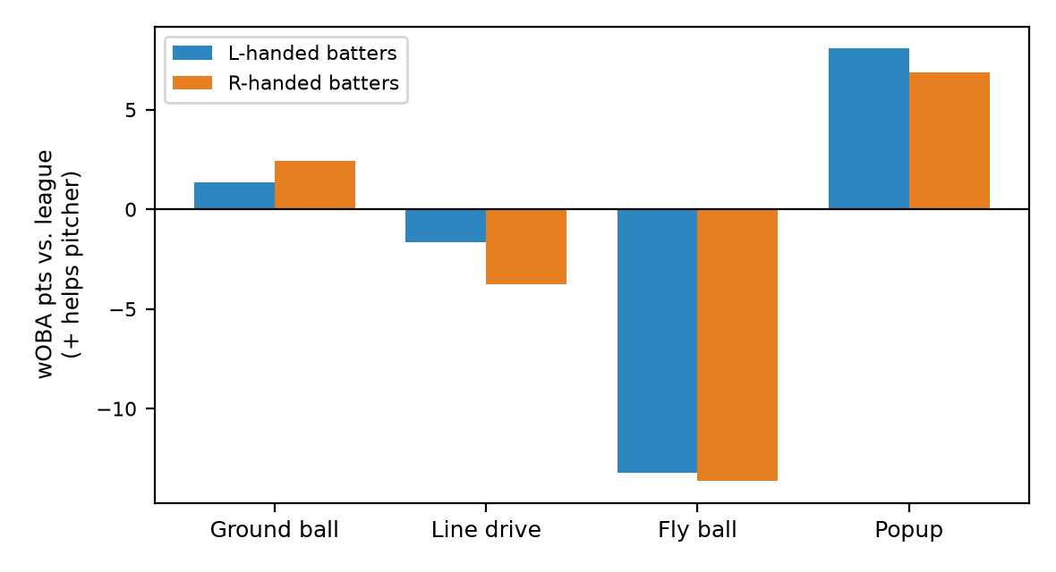
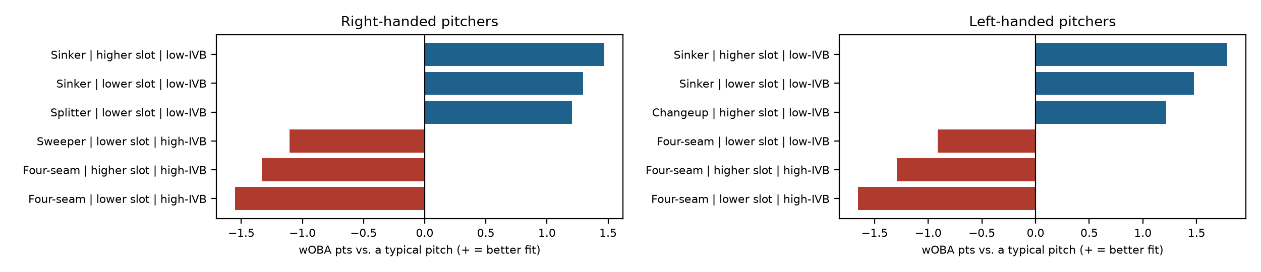
American Family Field
What this park does
Overall: -3 wOBA points per ball in play for pitchers (rank 23 of 30; 1 = most pitcher-friendly).
Biggest effect: fly balls by right-handed batters, 14 points against the pitcher.
Free agents with the lowest projected wOBA allowed here
1. Tarik Skubal (SP): .278 projected, .276 talent
2. Adrian Morejón (RP): .282 projected, .280 talent
3. Steven Okert (RP): .283 projected, .280 talent
Buy-low free agents here (recent results vs. projection)
Dustin May (SP): .338 recent, .336 projected (+2 pts)
Casey Mize (SP): .330 recent, .329 projected (+0 pts)
Foster Griffin (SP): .322 recent, .323 projected (-0 pts)
Pitch bars: how much better this park suits the pitch than a typical pitch (wOBA points on contact). Park effects are validated; the pitcher-specific fit is exploratory.

Slide 8
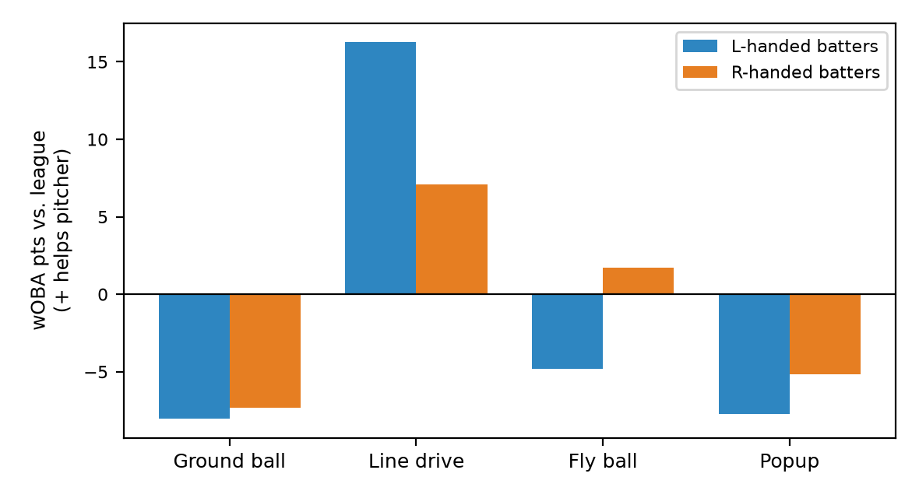
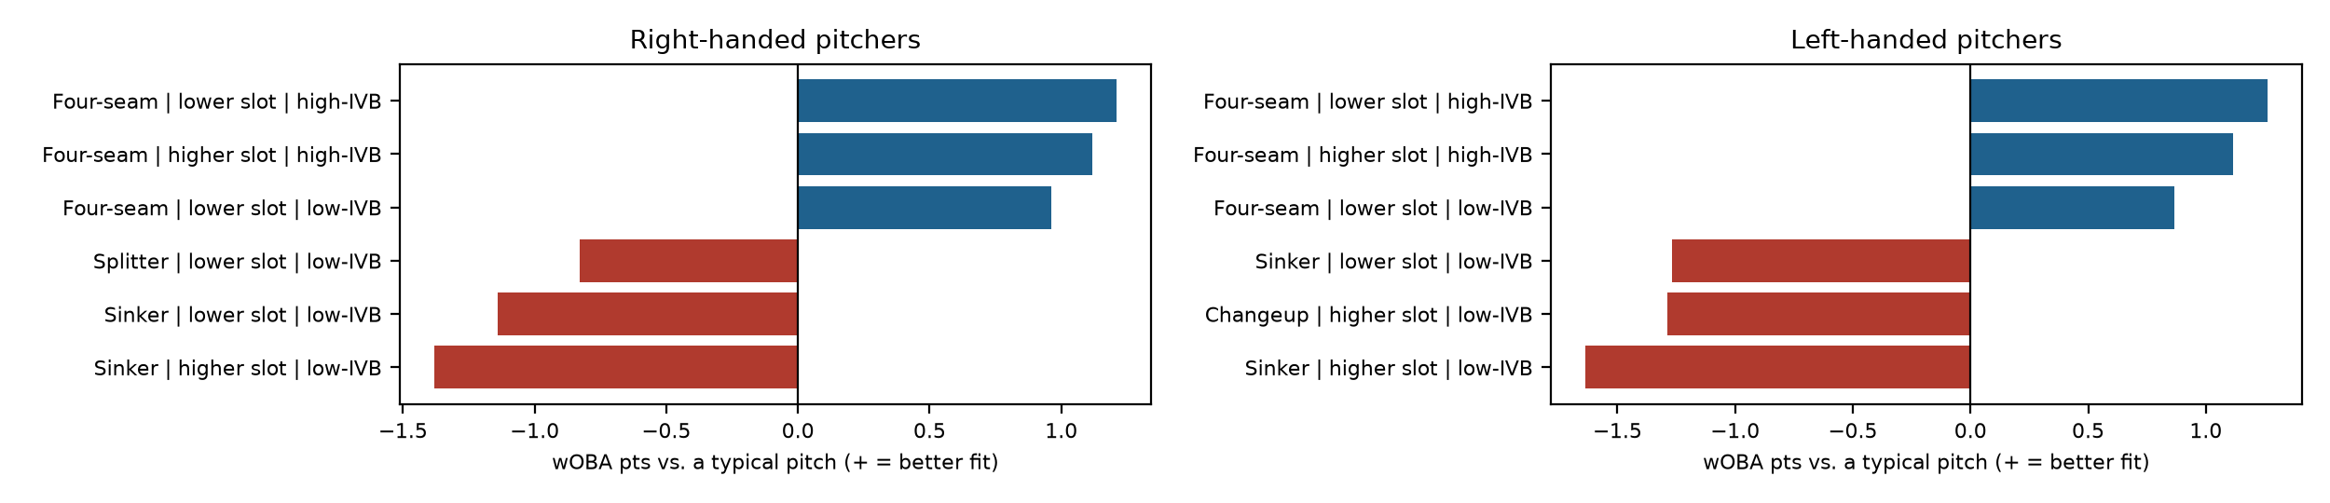
Angel Stadium
What this park does
Overall: -1 wOBA points per ball in play for pitchers (rank 20 of 30; 1 = most pitcher-friendly).
Biggest effect: line drives by left-handed batters, 16 points in the pitcher's favor.
Free agents with the lowest projected wOBA allowed here
1. Tarik Skubal (SP): .277 projected, .276 talent
2. Steven Okert (RP): .281 projected, .280 talent
3. Adrian Morejón (RP): .282 projected, .280 talent
Buy-low free agents here (recent results vs. projection)
Dustin May (SP): .338 recent, .335 projected (+4 pts)
Casey Mize (SP): .330 recent, .328 projected (+2 pts)
Foster Griffin (SP): .322 recent, .322 projected (+1 pts)
Pitch bars: how much better this park suits the pitch than a typical pitch (wOBA points on contact). Park effects are validated; the pitcher-specific fit is exploratory.

Slide 9
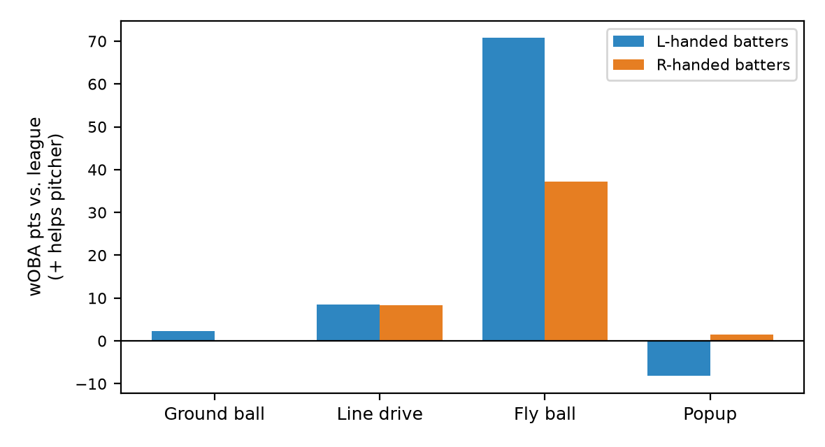
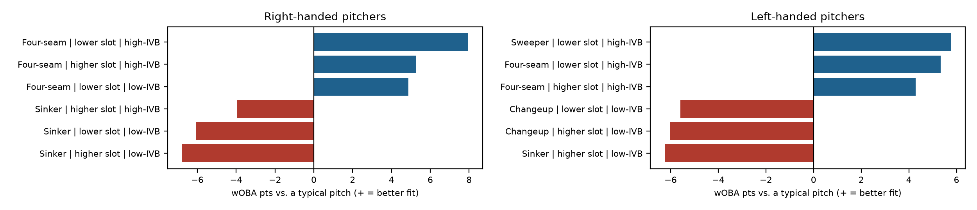
Busch Stadium
What this park does
Overall: +15 wOBA points per ball in play for pitchers (rank 1 of 30; 1 = most pitcher-friendly).
Biggest effect: fly balls by left-handed batters, 71 points in the pitcher's favor.
Free agents with the lowest projected wOBA allowed here
1. Tarik Skubal (SP): .268 projected, .276 talent
2. Steven Okert (RP): .268 projected, .280 talent
3. Adrian Morejón (RP): .272 projected, .280 talent
Buy-low free agents here (recent results vs. projection)
Casey Mize (SP): .330 recent, .314 projected (+15 pts)
Dustin May (SP): .338 recent, .323 projected (+15 pts)
Nick Martinez (SP): .309 recent, .295 projected (+14 pts)
Pitch bars: how much better this park suits the pitch than a typical pitch (wOBA points on contact). Park effects are validated; the pitcher-specific fit is exploratory.

Slide 10
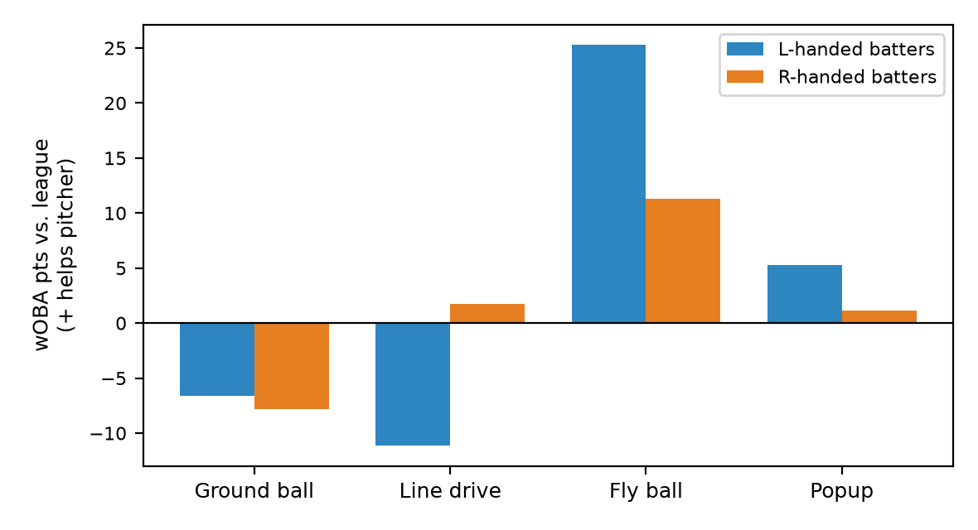
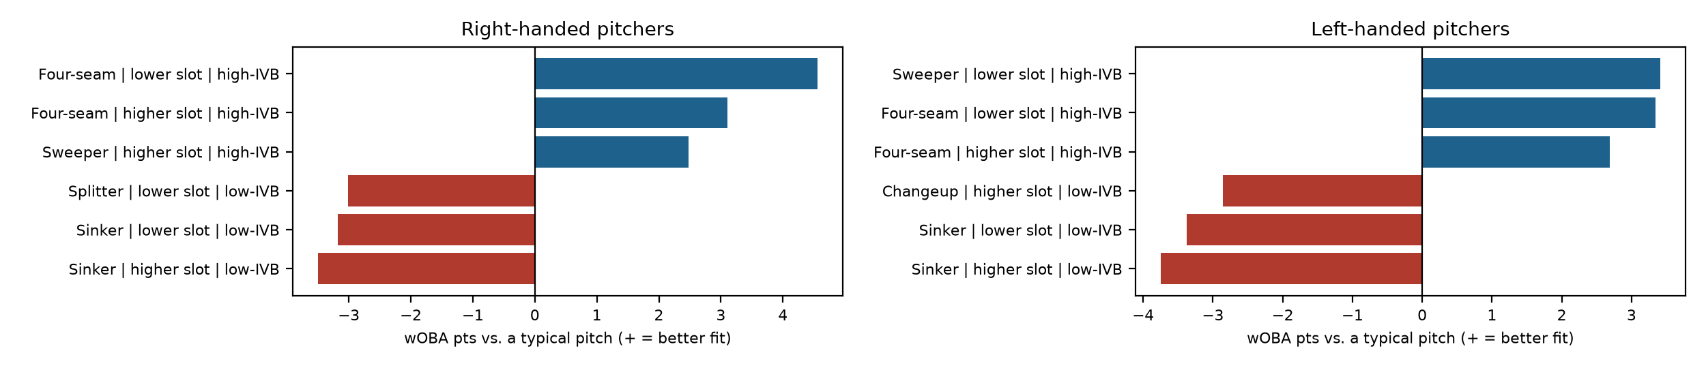
Chase Field
What this park does
Overall: +1 wOBA points per ball in play for pitchers (rank 18 of 30; 1 = most pitcher-friendly).
Biggest effect: fly balls by left-handed batters, 25 points in the pitcher's favor.
Free agents with the lowest projected wOBA allowed here
1. Tarik Skubal (SP): .276 projected, .276 talent
2. Steven Okert (RP): .278 projected, .280 talent
3. Adrian Morejón (RP): .281 projected, .280 talent
Buy-low free agents here (recent results vs. projection)
Dustin May (SP): .338 recent, .334 projected (+5 pts)
Casey Mize (SP): .330 recent, .326 projected (+4 pts)
Nick Martinez (SP): .309 recent, .307 projected (+2 pts)
Pitch bars: how much better this park suits the pitch than a typical pitch (wOBA points on contact). Park effects are validated; the pitcher-specific fit is exploratory.

Slide 11
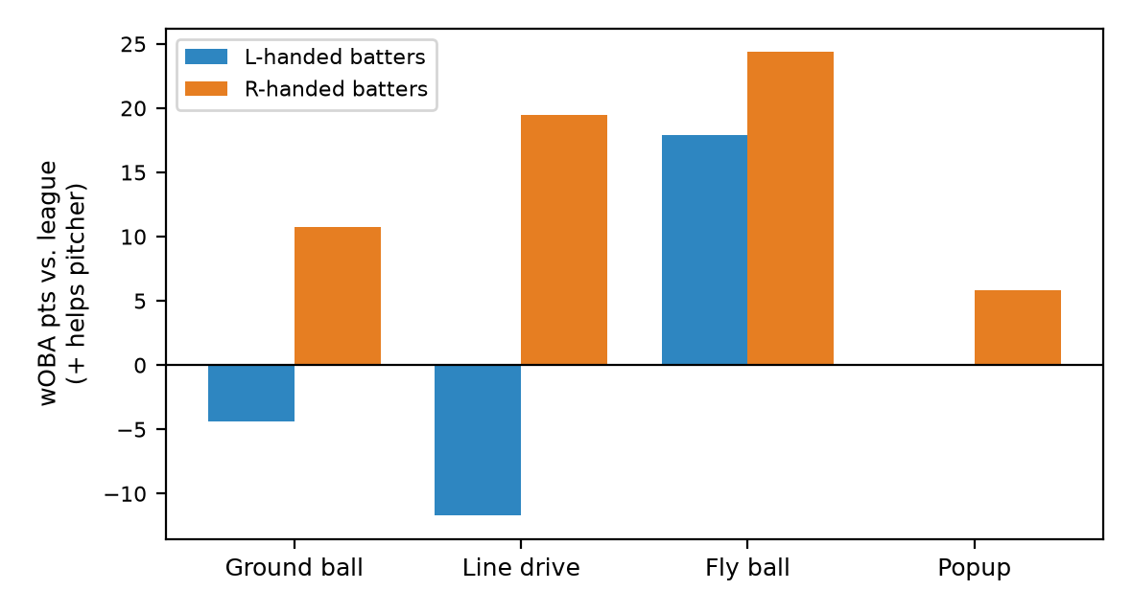
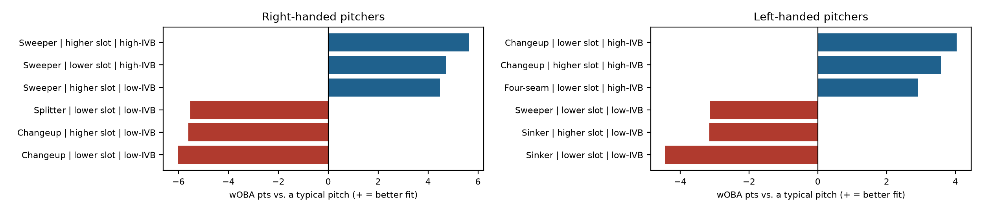
Citi Field
What this park does
Overall: +9 wOBA points per ball in play for pitchers (rank 6 of 30; 1 = most pitcher-friendly).
Biggest effect: fly balls by right-handed batters, 24 points in the pitcher's favor.
Free agents with the lowest projected wOBA allowed here
1. Tarik Skubal (SP): .269 projected, .276 talent
2. Steven Okert (RP): .273 projected, .280 talent
3. Adrian Morejón (RP): .274 projected, .280 talent
Buy-low free agents here (recent results vs. projection)
Foster Griffin (SP): .322 recent, .312 projected (+10 pts)
Dustin May (SP): .338 recent, .329 projected (+9 pts)
David Peterson (SP): .331 recent, .323 projected (+9 pts)
Pitch bars: how much better this park suits the pitch than a typical pitch (wOBA points on contact). Park effects are validated; the pitcher-specific fit is exploratory.

Slide 12
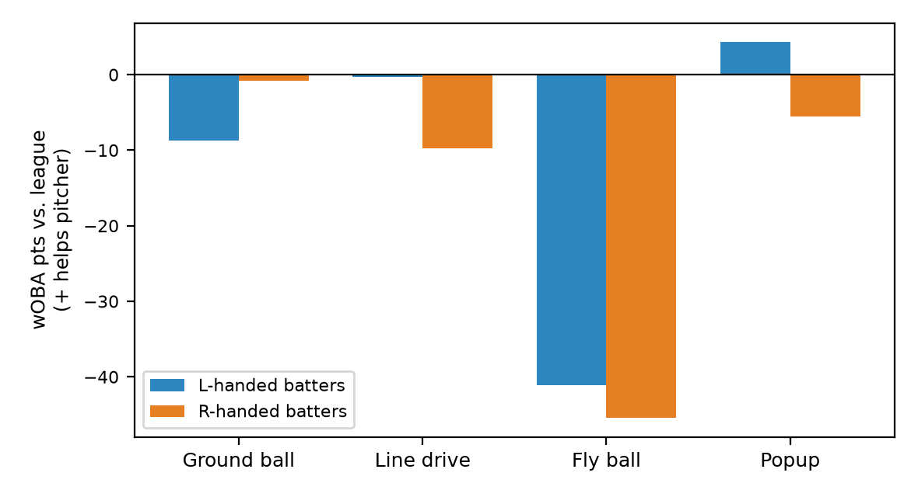
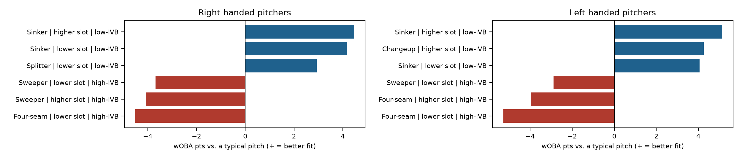
Citizens Bank Park
What this park does
Overall: -14 wOBA points per ball in play for pitchers (rank 27 of 30; 1 = most pitcher-friendly).
Biggest effect: fly balls by right-handed batters, 45 points against the pitcher.
Free agents with the lowest projected wOBA allowed here
1. Tarik Skubal (SP): .286 projected, .276 talent
2. Adrian Morejón (RP): .289 projected, .280 talent
3. Steven Okert (RP): .291 projected, .280 talent
Buy-low free agents here (recent results vs. projection)
Dustin May (SP): .338 recent, .344 projected (-5 pts)
David Peterson (SP): .331 recent, .339 projected (-8 pts)
Casey Mize (SP): .330 recent, .338 projected (-8 pts)
Pitch bars: how much better this park suits the pitch than a typical pitch (wOBA points on contact). Park effects are validated; the pitcher-specific fit is exploratory.

Slide 13
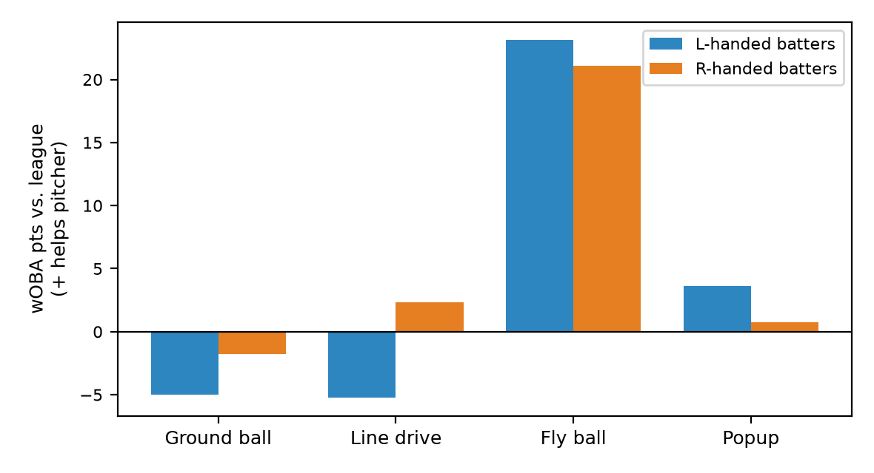
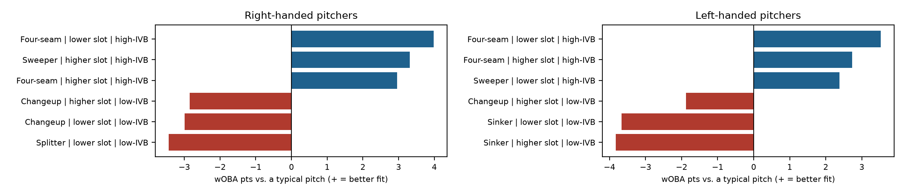
Comerica Park
What this park does
Overall: +4 wOBA points per ball in play for pitchers (rank 10 of 30; 1 = most pitcher-friendly).
Biggest effect: fly balls by left-handed batters, 23 points in the pitcher's favor.
Free agents with the lowest projected wOBA allowed here
1. Tarik Skubal (SP): .274 projected, .276 talent
2. Steven Okert (RP): .276 projected, .280 talent
3. Adrian Morejón (RP): .278 projected, .280 talent
Buy-low free agents here (recent results vs. projection)
Dustin May (SP): .338 recent, .332 projected (+7 pts)
Casey Mize (SP): .330 recent, .324 projected (+6 pts)
Foster Griffin (SP): .322 recent, .318 projected (+5 pts)
Pitch bars: how much better this park suits the pitch than a typical pitch (wOBA points on contact). Park effects are validated; the pitcher-specific fit is exploratory.

Slide 14
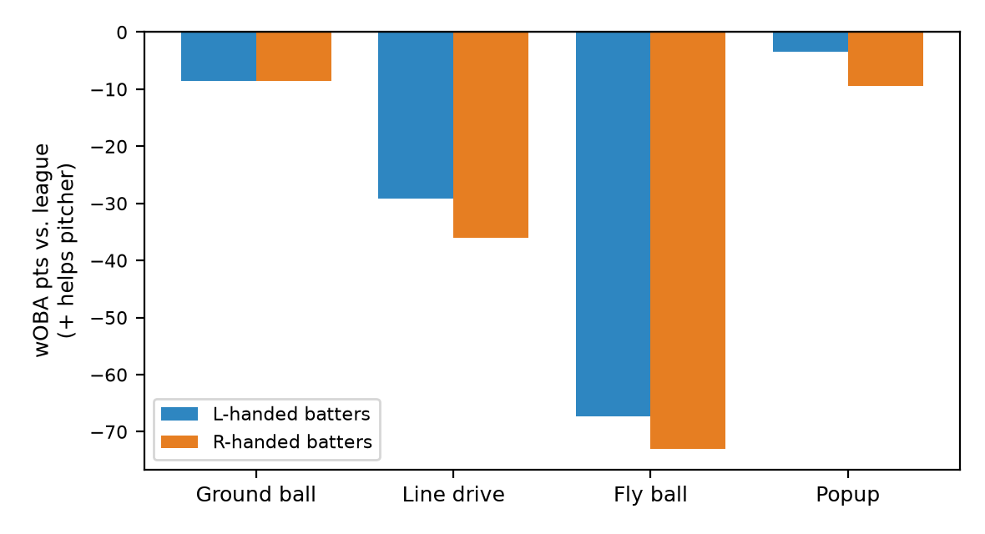
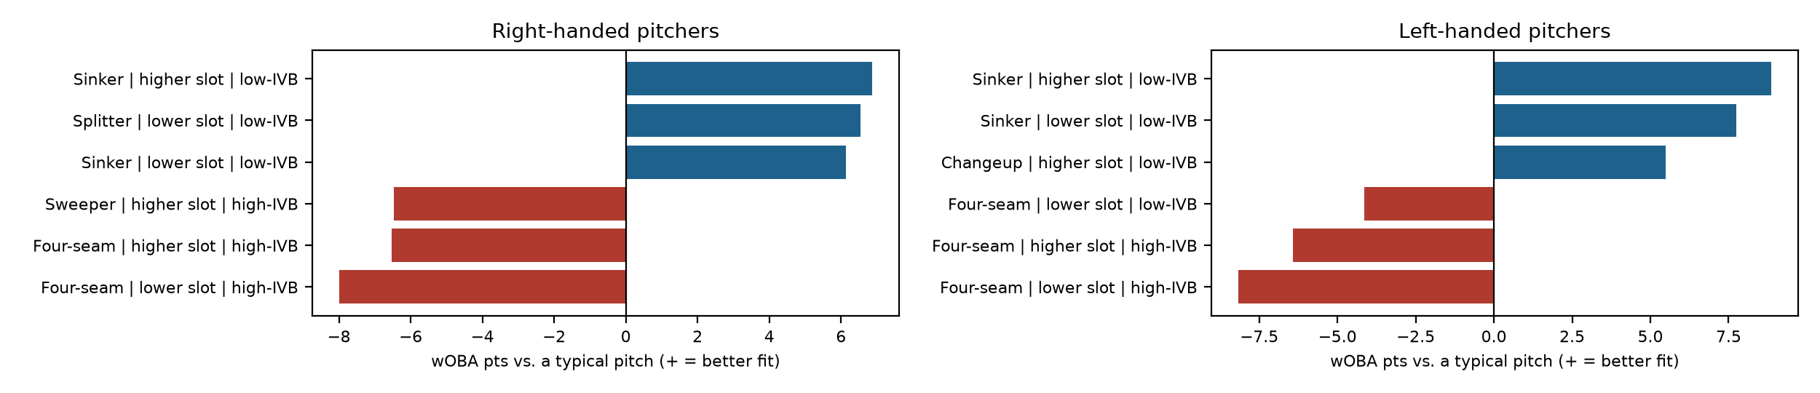
Coors Field
What this park does
Overall: -32 wOBA points per ball in play for pitchers (rank 29 of 30; 1 = most pitcher-friendly).
Biggest effect: fly balls by right-handed batters, 73 points against the pitcher.
Free agents with the lowest projected wOBA allowed here
1. Tarik Skubal (SP): .296 projected, .276 talent
2. Adrian Morejón (RP): .298 projected, .280 talent
3. Steven Okert (RP): .303 projected, .280 talent
Buy-low free agents here (recent results vs. projection)
Dustin May (SP): .338 recent, .354 projected (-16 pts)
David Peterson (SP): .331 recent, .349 projected (-18 pts)
Foster Griffin (SP): .322 recent, .342 projected (-20 pts)
Pitch bars: how much better this park suits the pitch than a typical pitch (wOBA points on contact). Park effects are validated; the pitcher-specific fit is exploratory.

Slide 15
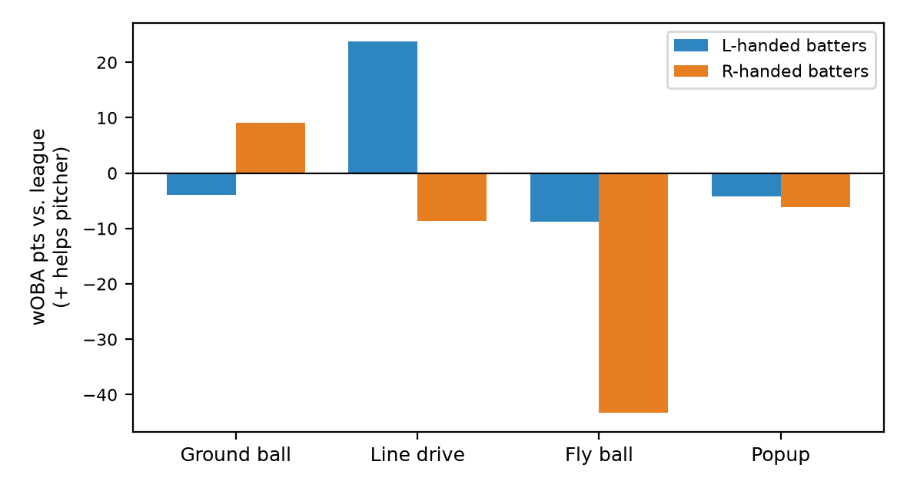
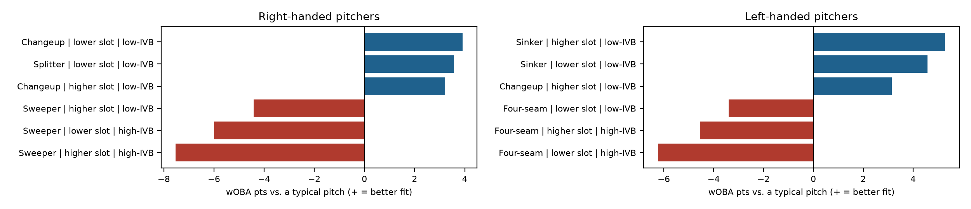
Daikin Park
What this park does
Overall: -6 wOBA points per ball in play for pitchers (rank 25 of 30; 1 = most pitcher-friendly).
Biggest effect: fly balls by right-handed batters, 43 points against the pitcher.
Free agents with the lowest projected wOBA allowed here
1. Tarik Skubal (SP): .281 projected, .276 talent
2. Adrian Morejón (RP): .284 projected, .280 talent
3. Steven Okert (RP): .286 projected, .280 talent
Buy-low free agents here (recent results vs. projection)
Dustin May (SP): .338 recent, .336 projected (+2 pts)
Casey Mize (SP): .330 recent, .330 projected (-0 pts)
David Peterson (SP): .331 recent, .334 projected (-2 pts)
Pitch bars: how much better this park suits the pitch than a typical pitch (wOBA points on contact). Park effects are validated; the pitcher-specific fit is exploratory.

Slide 16
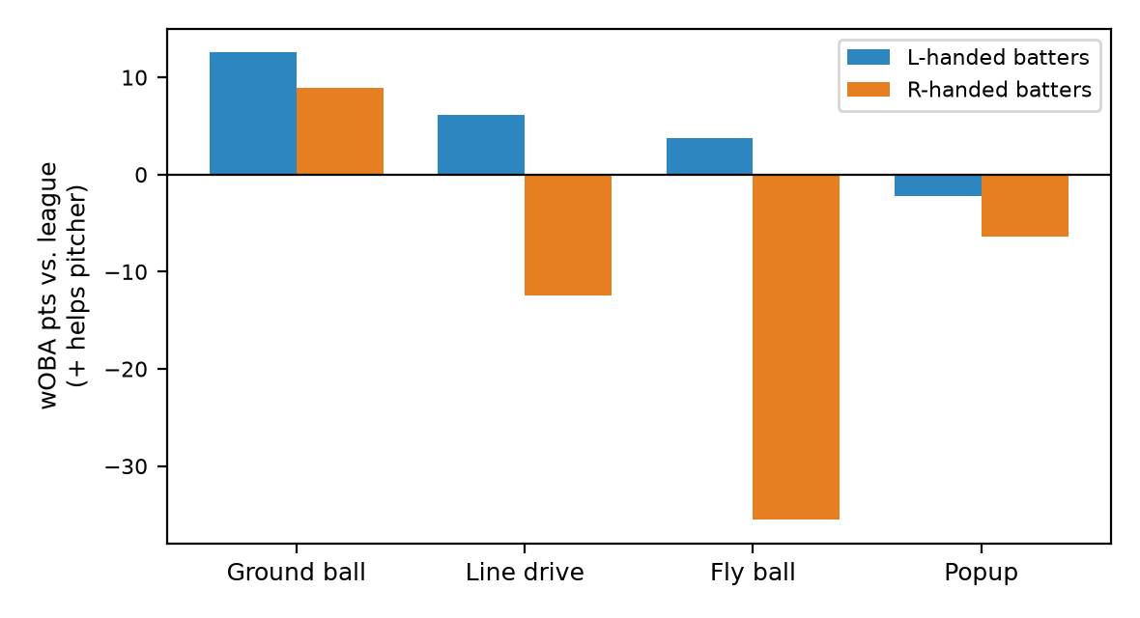
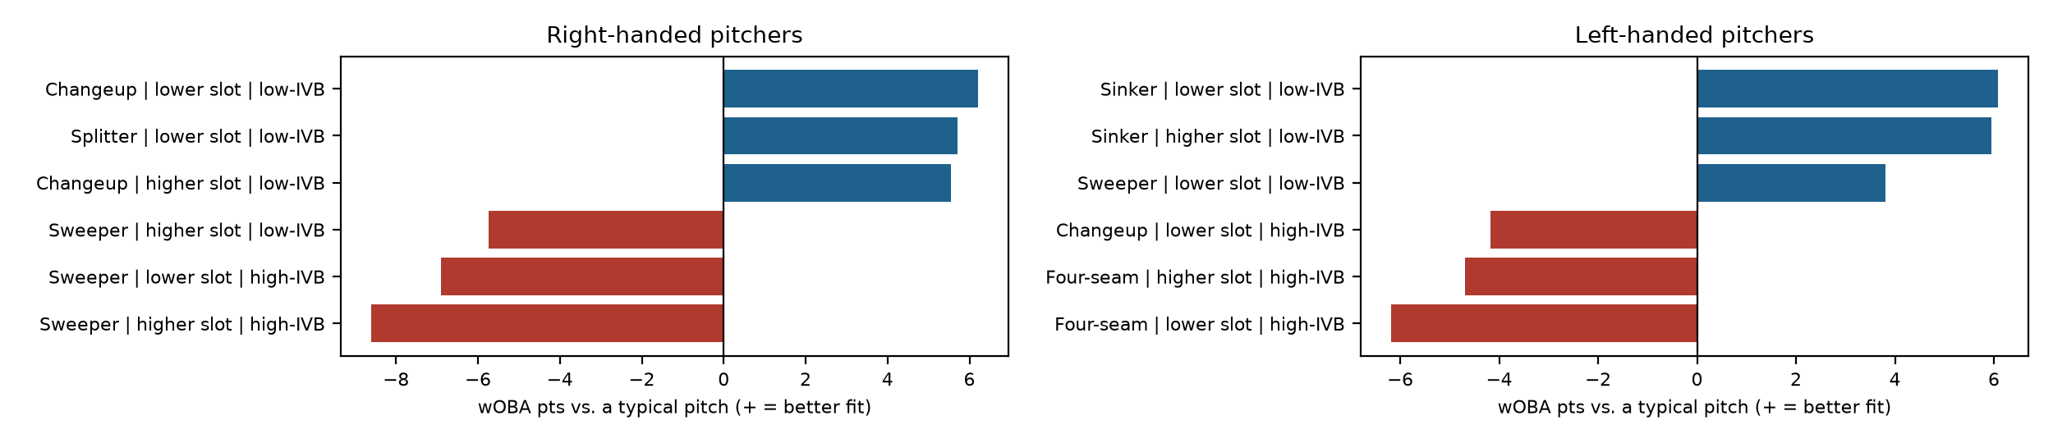
Dodger Stadium
What this park does
Overall: -3 wOBA points per ball in play for pitchers (rank 22 of 30; 1 = most pitcher-friendly).
Biggest effect: fly balls by right-handed batters, 36 points against the pitcher.
Free agents with the lowest projected wOBA allowed here
1. Tarik Skubal (SP): .280 projected, .276 talent
2. Adrian Morejón (RP): .281 projected, .280 talent
3. Steven Okert (RP): .284 projected, .280 talent
Buy-low free agents here (recent results vs. projection)
Dustin May (SP): .338 recent, .334 projected (+4 pts)
Casey Mize (SP): .330 recent, .327 projected (+2 pts)
Nick Martinez (SP): .309 recent, .309 projected (-0 pts)
Pitch bars: how much better this park suits the pitch than a typical pitch (wOBA points on contact). Park effects are validated; the pitcher-specific fit is exploratory.

Slide 17
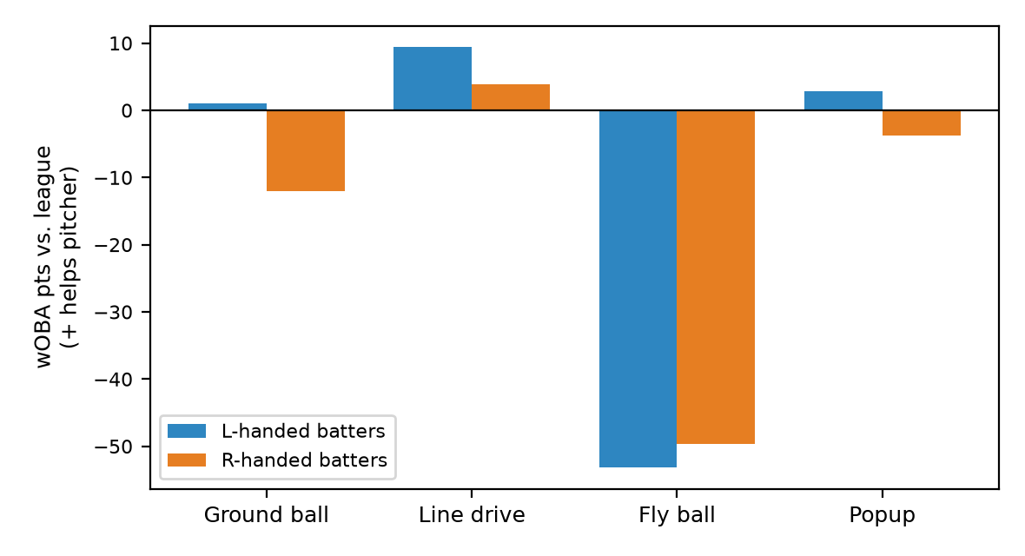
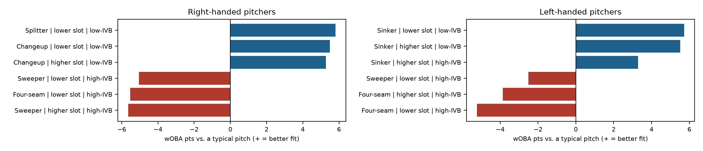
Fenway Park
What this park does
Overall: -14 wOBA points per ball in play for pitchers (rank 26 of 30; 1 = most pitcher-friendly).
Biggest effect: fly balls by left-handed batters, 53 points against the pitcher.
Free agents with the lowest projected wOBA allowed here
1. Tarik Skubal (SP): .286 projected, .276 talent
2. Adrian Morejón (RP): .289 projected, .280 talent
3. Steven Okert (RP): .291 projected, .280 talent
Buy-low free agents here (recent results vs. projection)
Dustin May (SP): .338 recent, .343 projected (-5 pts)
David Peterson (SP): .331 recent, .340 projected (-8 pts)
Casey Mize (SP): .330 recent, .338 projected (-8 pts)
Pitch bars: how much better this park suits the pitch than a typical pitch (wOBA points on contact). Park effects are validated; the pitcher-specific fit is exploratory.

Slide 18
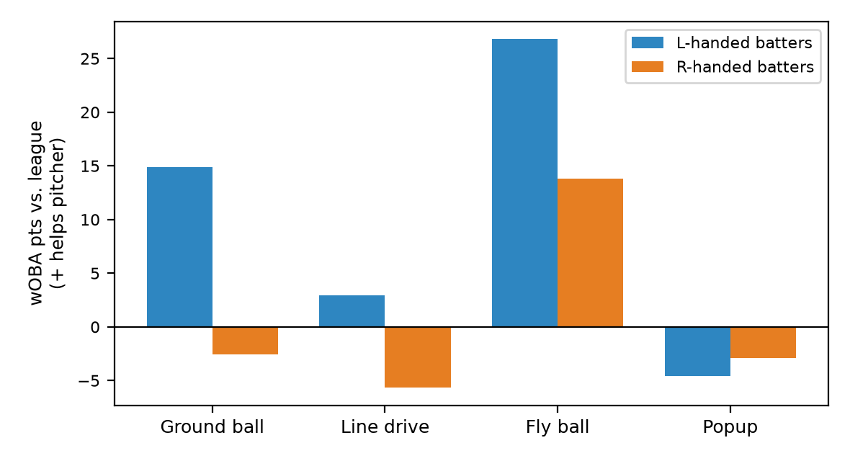
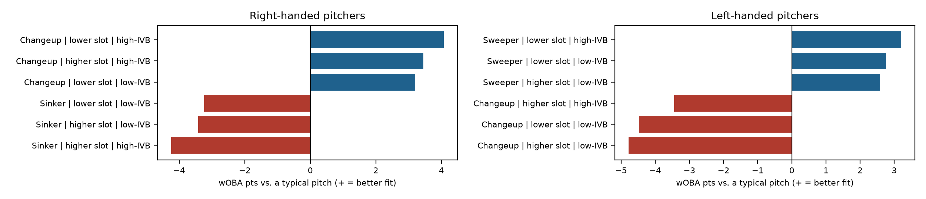
Globe Life Field
What this park does
Overall: +7 wOBA points per ball in play for pitchers (rank 7 of 30; 1 = most pitcher-friendly).
Biggest effect: fly balls by left-handed batters, 27 points in the pitcher's favor.
Free agents with the lowest projected wOBA allowed here
1. Tarik Skubal (SP): .274 projected, .276 talent
2. Steven Okert (RP): .276 projected, .280 talent
3. Adrian Morejón (RP): .276 projected, .280 talent
Buy-low free agents here (recent results vs. projection)
Dustin May (SP): .338 recent, .329 projected (+10 pts)
Casey Mize (SP): .330 recent, .321 projected (+8 pts)
Nick Martinez (SP): .309 recent, .302 projected (+6 pts)
Pitch bars: how much better this park suits the pitch than a typical pitch (wOBA points on contact). Park effects are validated; the pitcher-specific fit is exploratory.

Slide 19
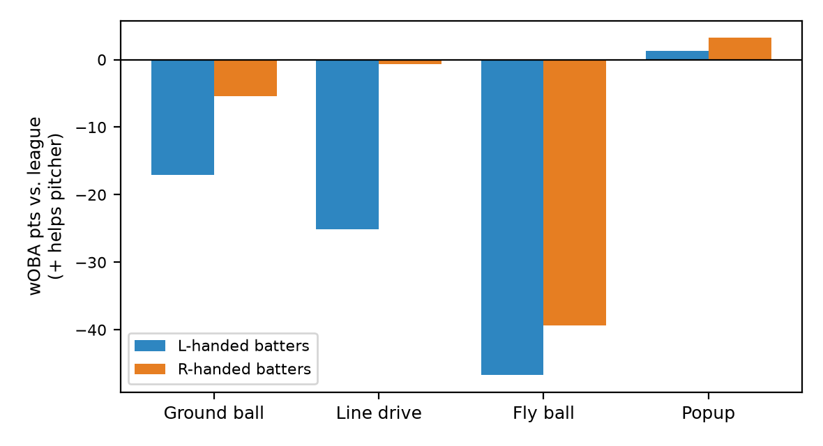
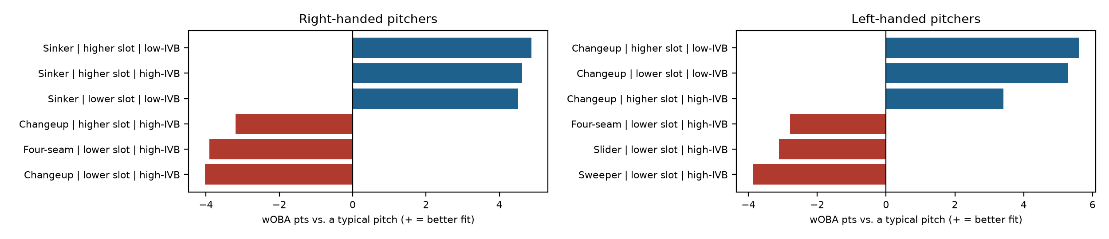
Great American Ball Park
What this park does
Overall: -18 wOBA points per ball in play for pitchers (rank 28 of 30; 1 = most pitcher-friendly).
Biggest effect: fly balls by left-handed batters, 47 points against the pitcher.
Free agents with the lowest projected wOBA allowed here
1. Tarik Skubal (SP): .286 projected, .276 talent
2. Adrian Morejón (RP): .291 projected, .280 talent
3. Steven Okert (RP): .293 projected, .280 talent
Buy-low free agents here (recent results vs. projection)
David Peterson (SP): .331 recent, .340 projected (-8 pts)
Dustin May (SP): .338 recent, .347 projected (-9 pts)
Foster Griffin (SP): .322 recent, .332 projected (-9 pts)
Pitch bars: how much better this park suits the pitch than a typical pitch (wOBA points on contact). Park effects are validated; the pitcher-specific fit is exploratory.

Slide 20
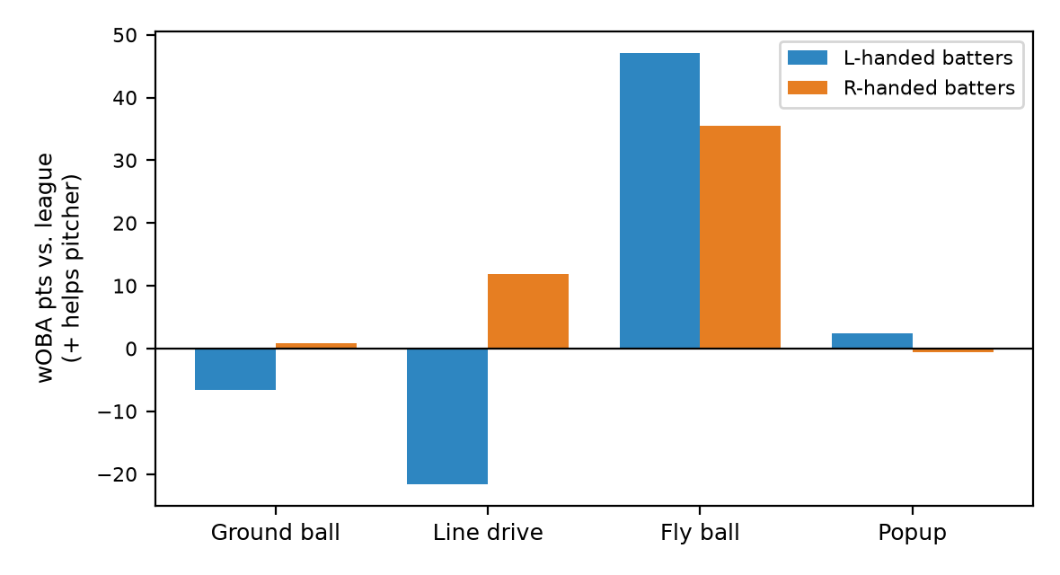
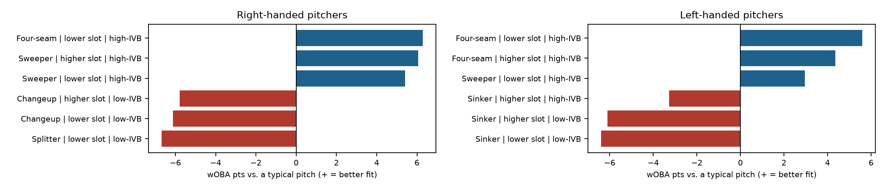
Kauffman Stadium
What this park does
Overall: +9 wOBA points per ball in play for pitchers (rank 5 of 30; 1 = most pitcher-friendly).
Biggest effect: fly balls by left-handed batters, 47 points in the pitcher's favor.
Free agents with the lowest projected wOBA allowed here
1. Tarik Skubal (SP): .270 projected, .276 talent
2. Steven Okert (RP): .272 projected, .280 talent
3. Adrian Morejón (RP): .275 projected, .280 talent
Buy-low free agents here (recent results vs. projection)
Dustin May (SP): .338 recent, .329 projected (+9 pts)
Casey Mize (SP): .330 recent, .320 projected (+9 pts)
Foster Griffin (SP): .322 recent, .314 projected (+9 pts)
Pitch bars: how much better this park suits the pitch than a typical pitch (wOBA points on contact). Park effects are validated; the pitcher-specific fit is exploratory.

Slide 21
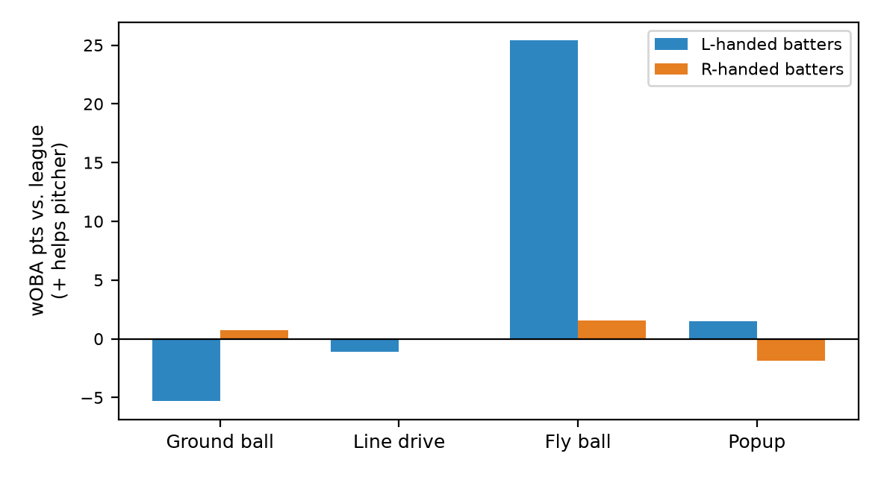
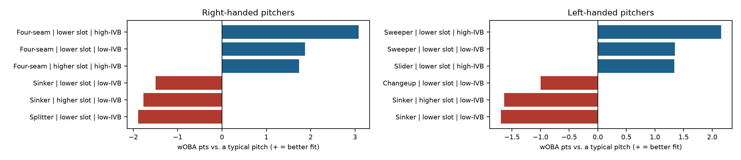
Nationals Park
What this park does
Overall: +2 wOBA points per ball in play for pitchers (rank 17 of 30; 1 = most pitcher-friendly).
Biggest effect: fly balls by left-handed batters, 25 points in the pitcher's favor.
Free agents with the lowest projected wOBA allowed here
1. Tarik Skubal (SP): .276 projected, .276 talent
2. Steven Okert (RP): .278 projected, .280 talent
3. Adrian Morejón (RP): .280 projected, .280 talent
Buy-low free agents here (recent results vs. projection)
Dustin May (SP): .338 recent, .333 projected (+6 pts)
Casey Mize (SP): .330 recent, .325 projected (+5 pts)
Nick Martinez (SP): .309 recent, .306 projected (+3 pts)
Pitch bars: how much better this park suits the pitch than a typical pitch (wOBA points on contact). Park effects are validated; the pitcher-specific fit is exploratory.

Slide 22
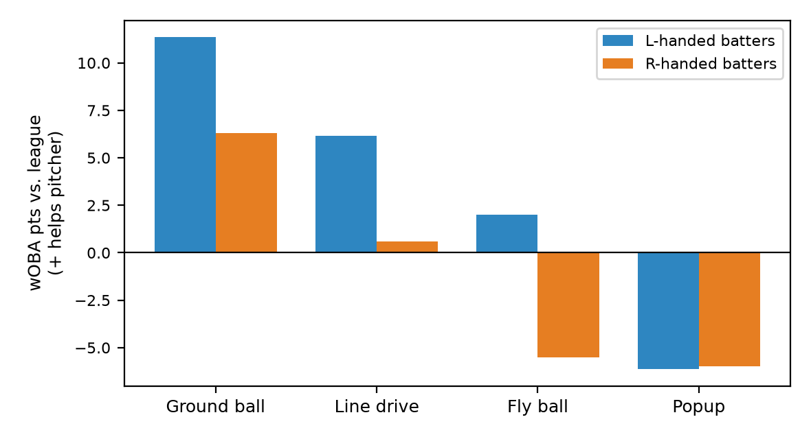
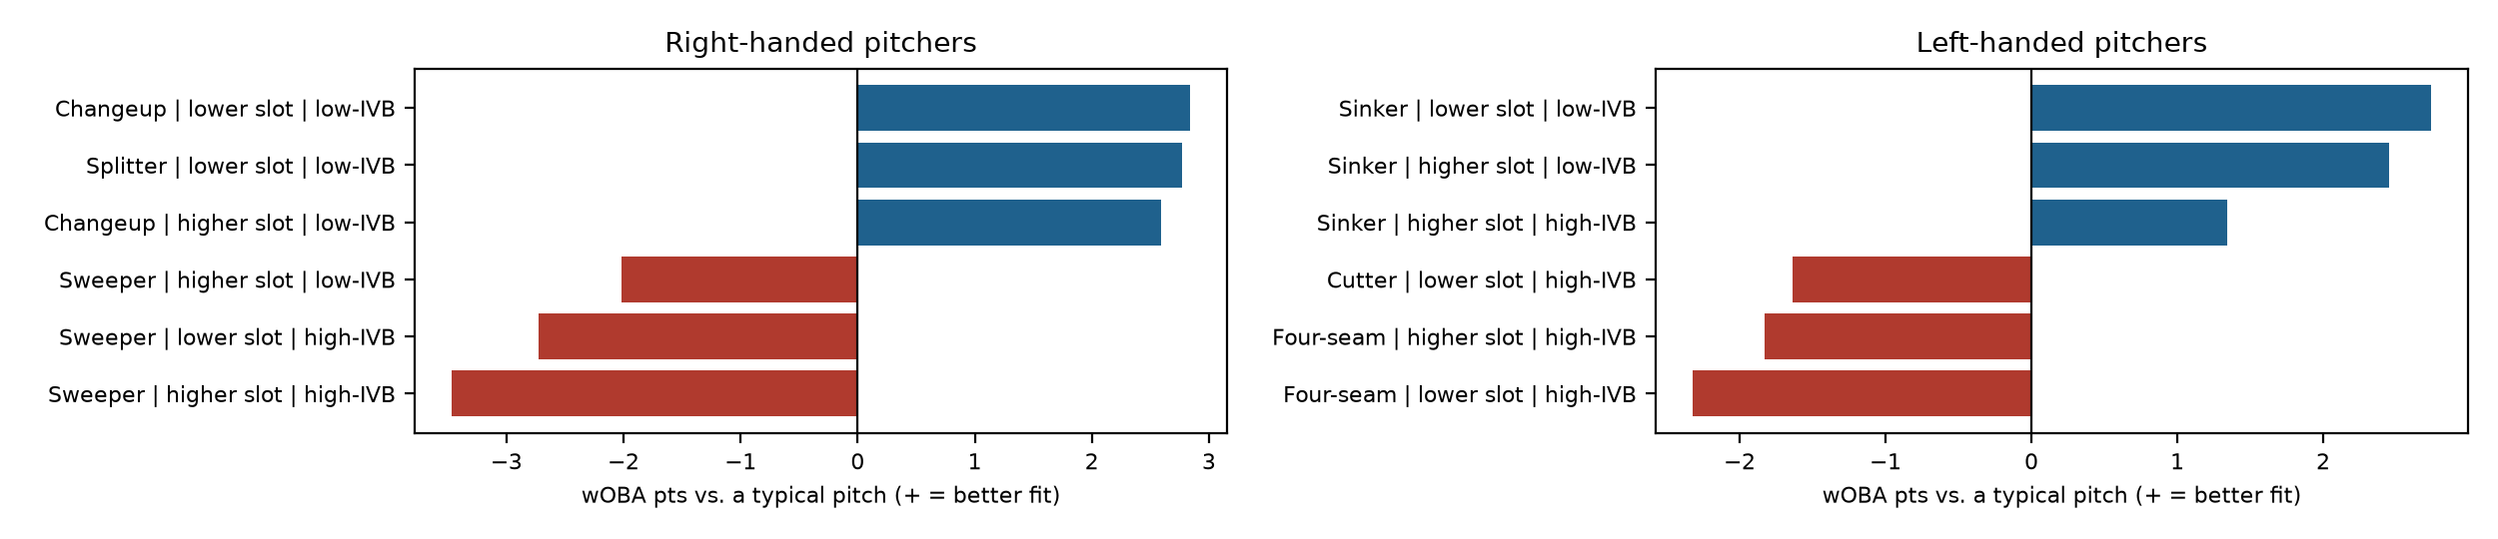
Oracle Park
What this park does
Overall: +4 wOBA points per ball in play for pitchers (rank 12 of 30; 1 = most pitcher-friendly).
Biggest effect: ground balls by left-handed batters, 11 points in the pitcher's favor.
Free agents with the lowest projected wOBA allowed here
1. Tarik Skubal (SP): .275 projected, .276 talent
2. Adrian Morejón (RP): .278 projected, .280 talent
3. Steven Okert (RP): .279 projected, .280 talent
Buy-low free agents here (recent results vs. projection)
Dustin May (SP): .338 recent, .331 projected (+7 pts)
Casey Mize (SP): .330 recent, .324 projected (+5 pts)
Foster Griffin (SP): .322 recent, .319 projected (+3 pts)
Pitch bars: how much better this park suits the pitch than a typical pitch (wOBA points on contact). Park effects are validated; the pitcher-specific fit is exploratory.

Slide 23
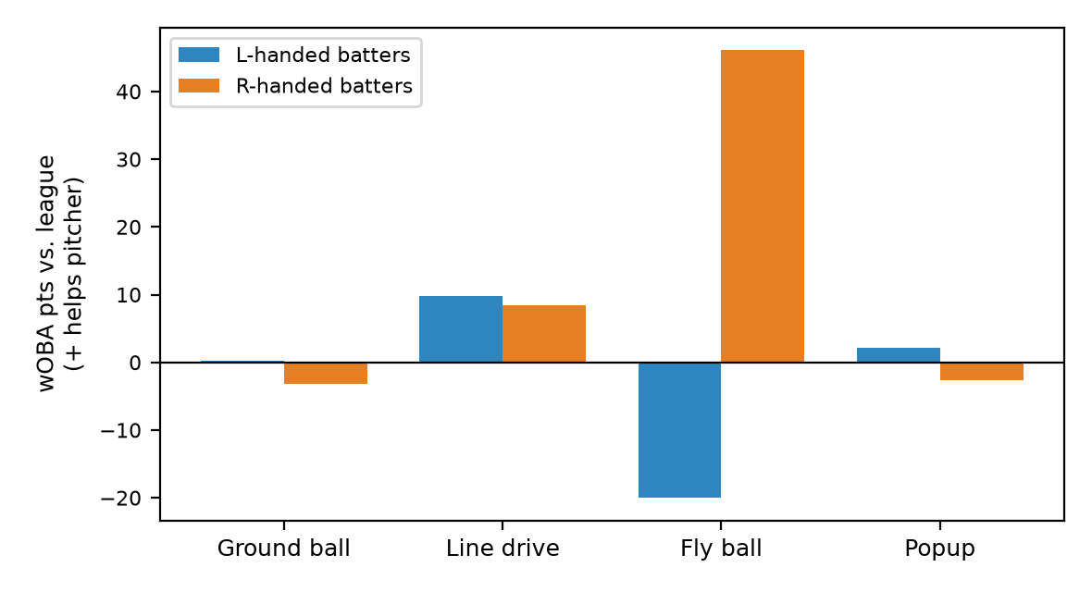
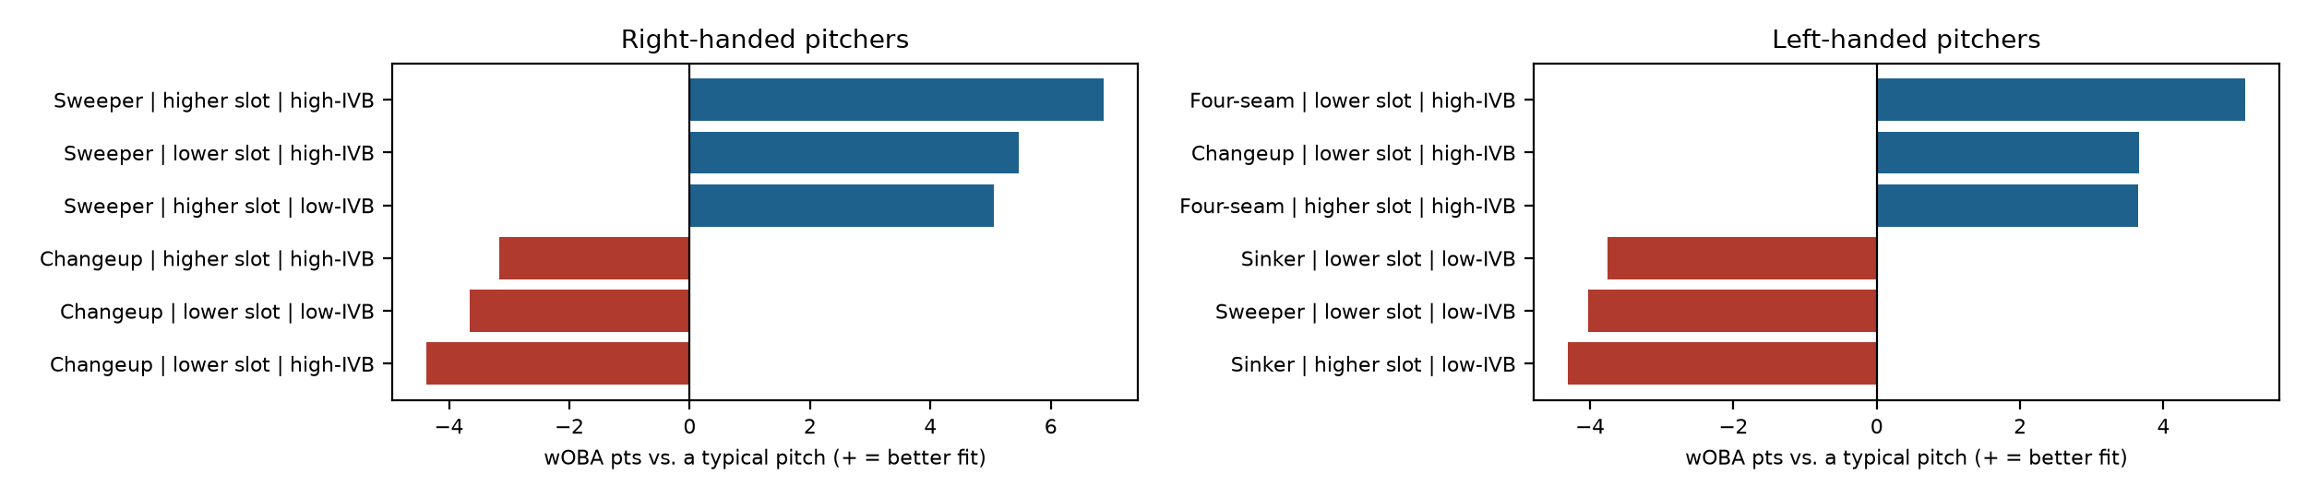
Oriole Park at Camden Yards
What this park does
Overall: +6 wOBA points per ball in play for pitchers (rank 9 of 30; 1 = most pitcher-friendly).
Biggest effect: fly balls by right-handed batters, 46 points in the pitcher's favor.
Free agents with the lowest projected wOBA allowed here
1. Tarik Skubal (SP): .270 projected, .276 talent
2. Steven Okert (RP): .274 projected, .280 talent
3. Adrian Morejón (RP): .276 projected, .280 talent
Buy-low free agents here (recent results vs. projection)
Dustin May (SP): .338 recent, .331 projected (+7 pts)
Foster Griffin (SP): .322 recent, .315 projected (+7 pts)
Robbie Ray (SP): .314 recent, .308 projected (+6 pts)
Pitch bars: how much better this park suits the pitch than a typical pitch (wOBA points on contact). Park effects are validated; the pitcher-specific fit is exploratory.

Slide 24
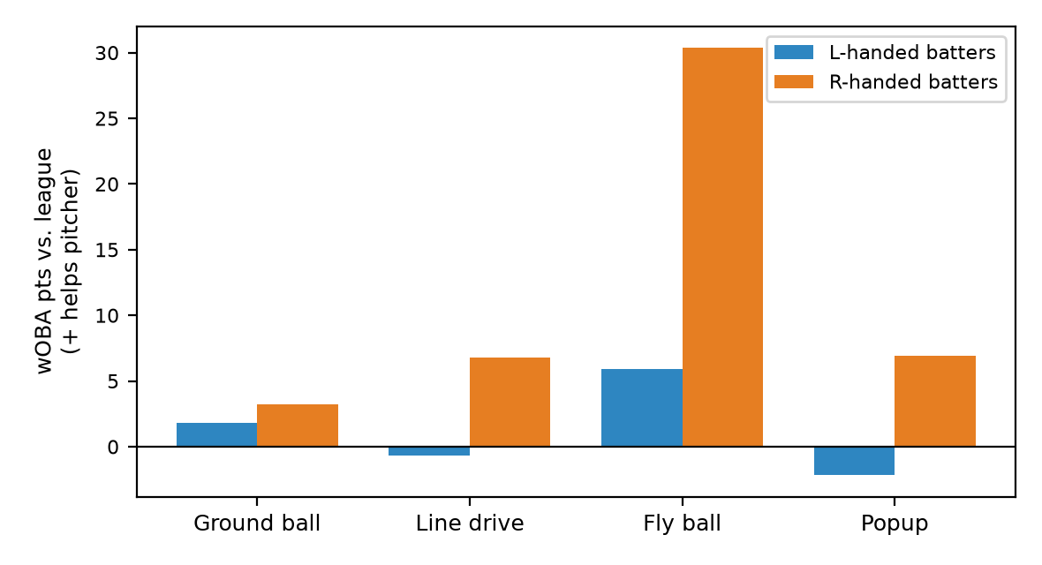
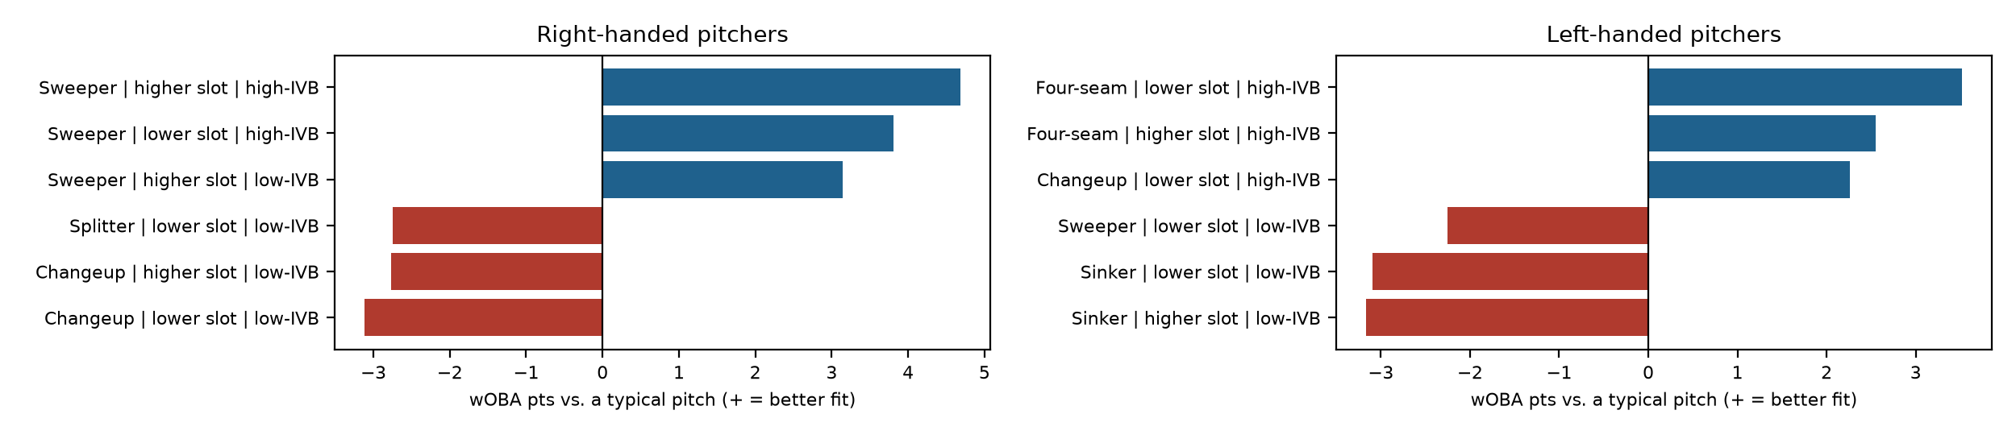
PNC Park
What this park does
Overall: +7 wOBA points per ball in play for pitchers (rank 8 of 30; 1 = most pitcher-friendly).
Biggest effect: fly balls by right-handed batters, 30 points in the pitcher's favor.
Free agents with the lowest projected wOBA allowed here
1. Tarik Skubal (SP): .270 projected, .276 talent
2. Steven Okert (RP): .274 projected, .280 talent
3. Adrian Morejón (RP): .275 projected, .280 talent
Buy-low free agents here (recent results vs. projection)
Dustin May (SP): .338 recent, .330 projected (+8 pts)
Foster Griffin (SP): .322 recent, .315 projected (+8 pts)
Casey Mize (SP): .330 recent, .322 projected (+7 pts)
Pitch bars: how much better this park suits the pitch than a typical pitch (wOBA points on contact). Park effects are validated; the pitcher-specific fit is exploratory.

Slide 25
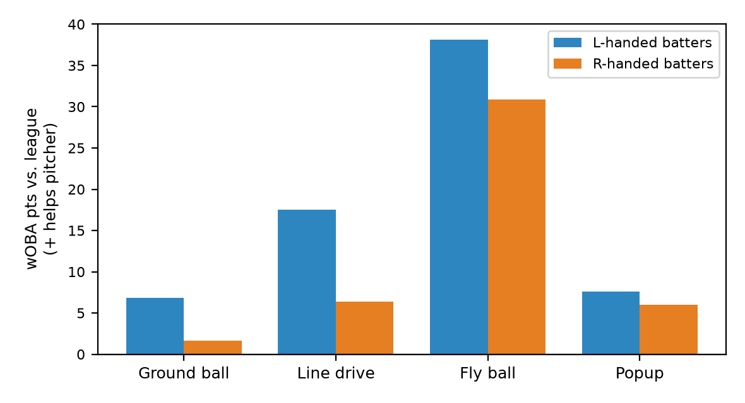
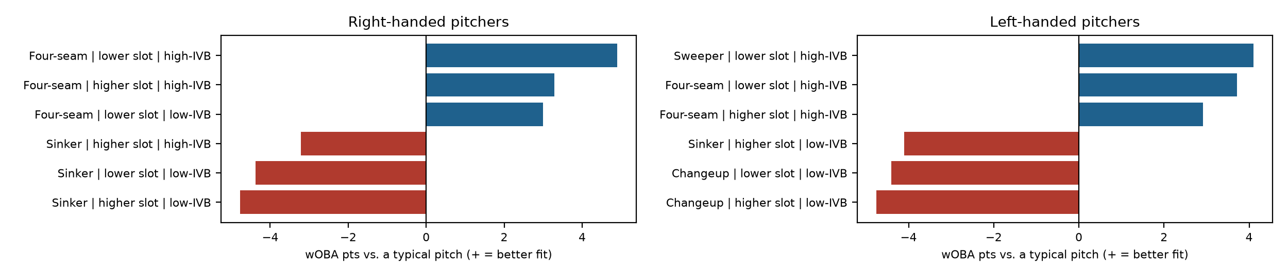
Petco Park
What this park does
Overall: +14 wOBA points per ball in play for pitchers (rank 2 of 30; 1 = most pitcher-friendly).
Biggest effect: fly balls by left-handed batters, 38 points in the pitcher's favor.
Free agents with the lowest projected wOBA allowed here
1. Tarik Skubal (SP): .269 projected, .276 talent
2. Steven Okert (RP): .270 projected, .280 talent
3. Adrian Morejón (RP): .272 projected, .280 talent
Buy-low free agents here (recent results vs. projection)
Dustin May (SP): .338 recent, .325 projected (+14 pts)
Casey Mize (SP): .330 recent, .316 projected (+13 pts)
Nick Martinez (SP): .309 recent, .297 projected (+12 pts)
Pitch bars: how much better this park suits the pitch than a typical pitch (wOBA points on contact). Park effects are validated; the pitcher-specific fit is exploratory.

Slide 26
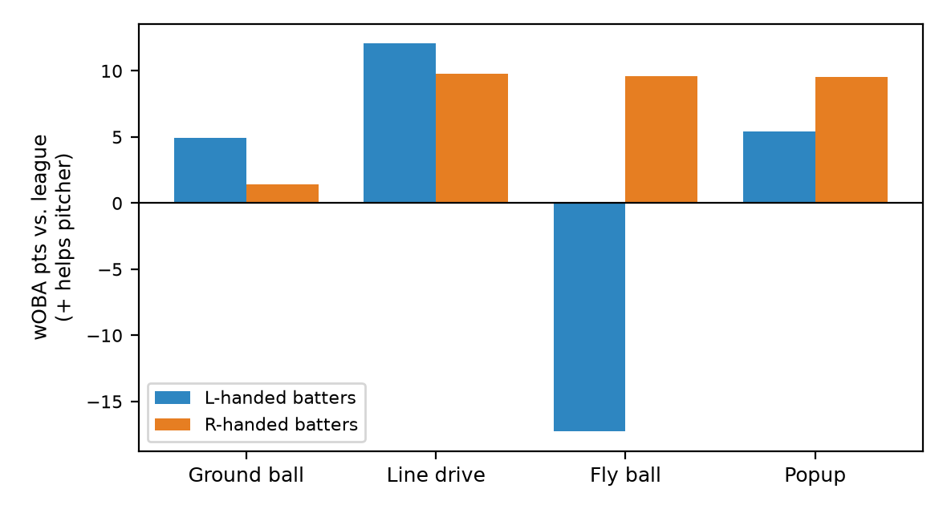
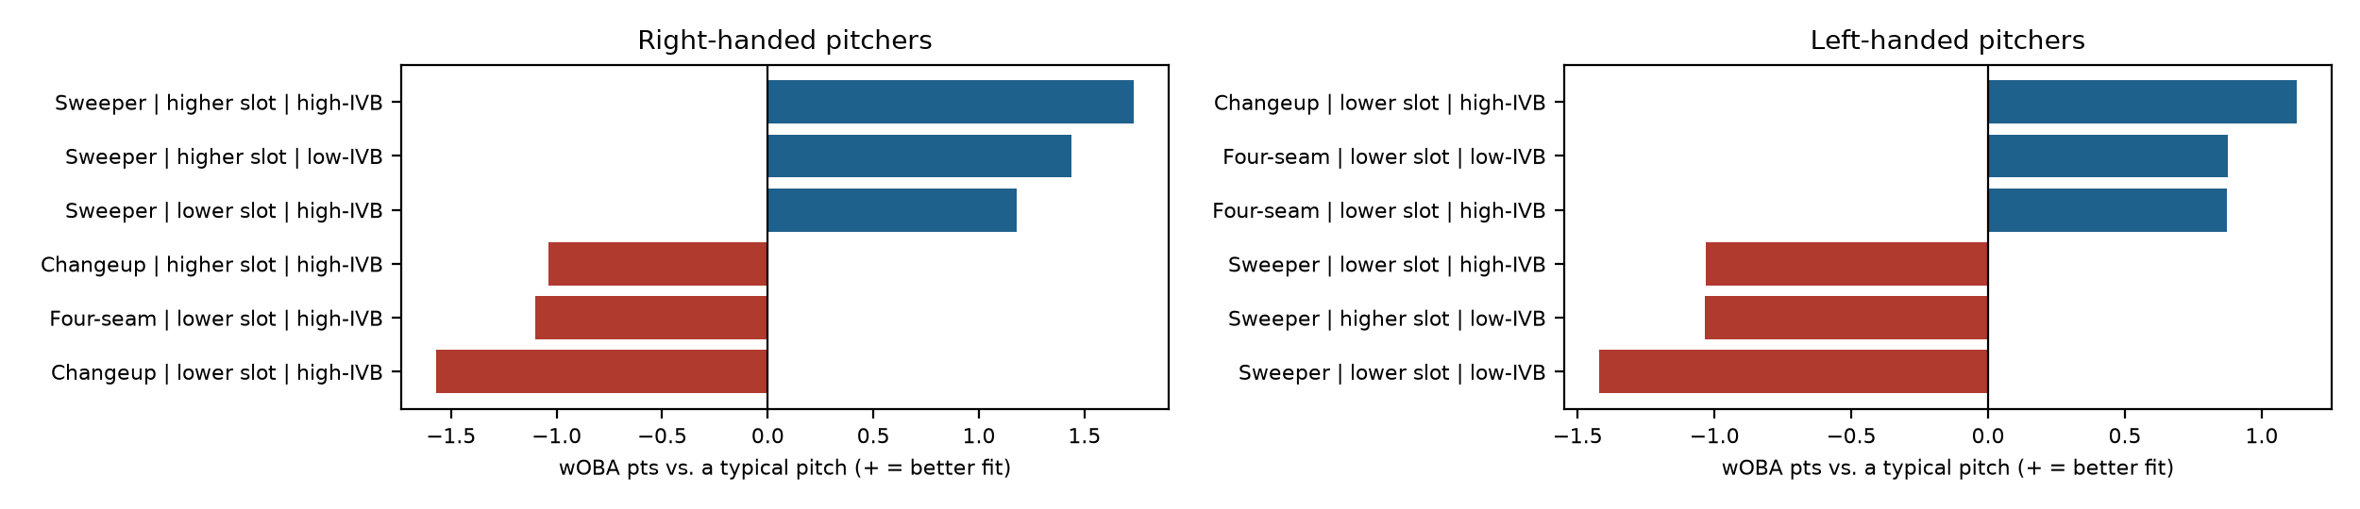
Progressive Field
What this park does
Overall: +3 wOBA points per ball in play for pitchers (rank 13 of 30; 1 = most pitcher-friendly).
Biggest effect: fly balls by left-handed batters, 17 points against the pitcher.
Free agents with the lowest projected wOBA allowed here
1. Tarik Skubal (SP): .273 projected, .276 talent
2. Adrian Morejón (RP): .277 projected, .280 talent
3. Steven Okert (RP): .277 projected, .280 talent
Buy-low free agents here (recent results vs. projection)
Dustin May (SP): .338 recent, .332 projected (+7 pts)
Foster Griffin (SP): .322 recent, .318 projected (+5 pts)
Casey Mize (SP): .330 recent, .325 projected (+5 pts)
Pitch bars: how much better this park suits the pitch than a typical pitch (wOBA points on contact). Park effects are validated; the pitcher-specific fit is exploratory.

Slide 27
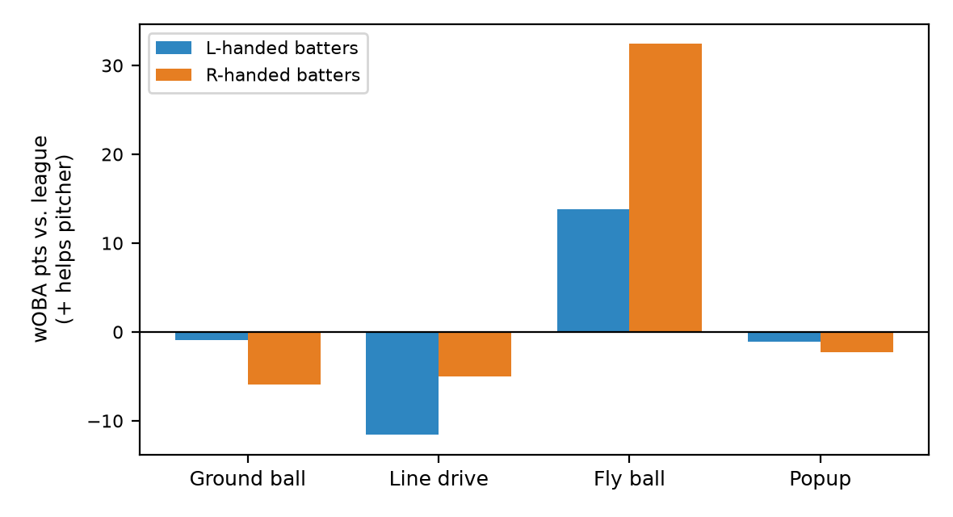
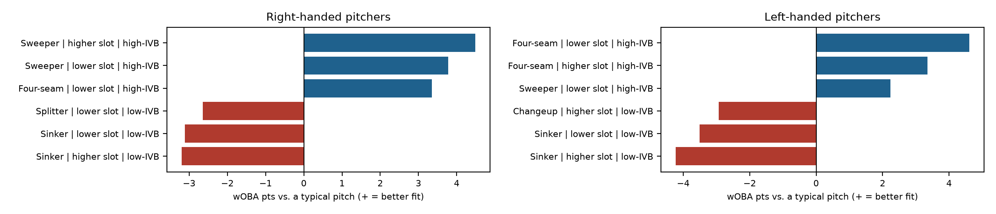
Rate Field
What this park does
Overall: +3 wOBA points per ball in play for pitchers (rank 14 of 30; 1 = most pitcher-friendly).
Biggest effect: fly balls by right-handed batters, 32 points in the pitcher's favor.
Free agents with the lowest projected wOBA allowed here
1. Tarik Skubal (SP): .274 projected, .276 talent
2. Steven Okert (RP): .277 projected, .280 talent
3. Adrian Morejón (RP): .279 projected, .280 talent
Buy-low free agents here (recent results vs. projection)
Dustin May (SP): .338 recent, .333 projected (+6 pts)
Casey Mize (SP): .330 recent, .325 projected (+4 pts)
Foster Griffin (SP): .322 recent, .319 projected (+4 pts)
Pitch bars: how much better this park suits the pitch than a typical pitch (wOBA points on contact). Park effects are validated; the pitcher-specific fit is exploratory.

Slide 28
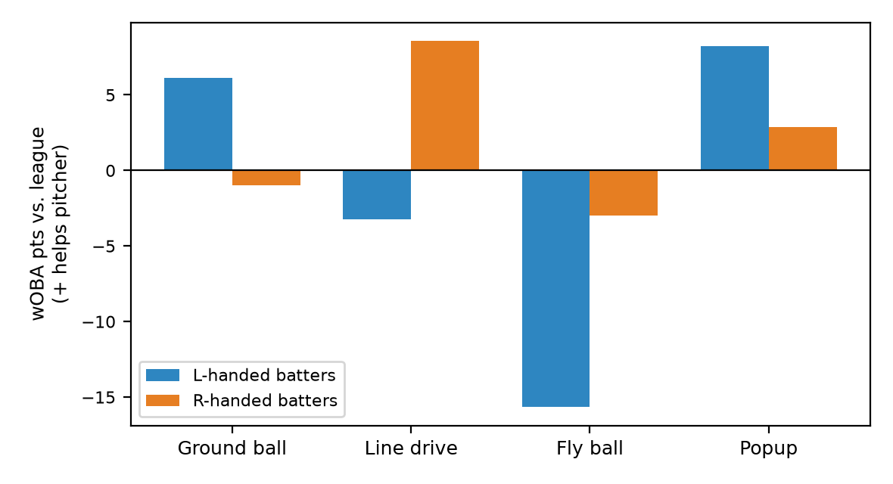
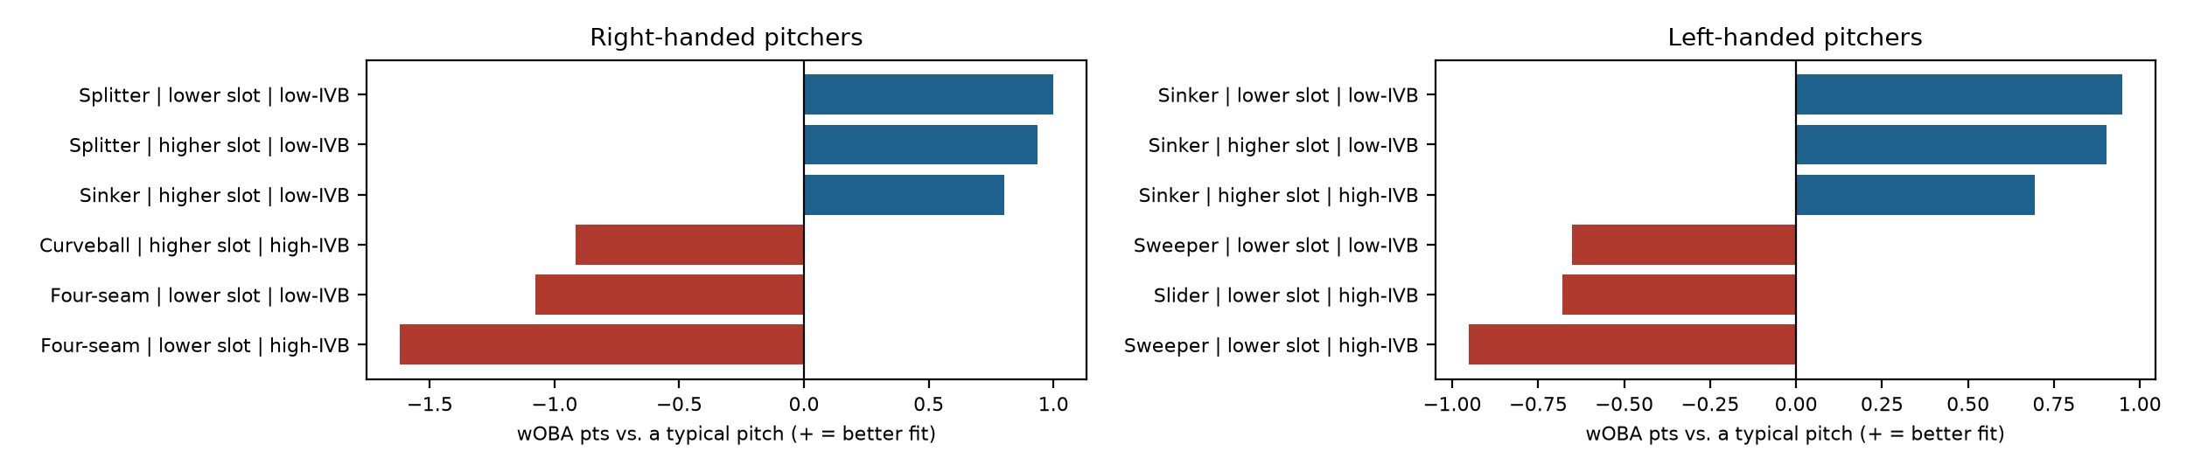
Rogers Centre
What this park does
Overall: +0 wOBA points per ball in play for pitchers (rank 19 of 30; 1 = most pitcher-friendly).
Biggest effect: fly balls by left-handed batters, 16 points against the pitcher.
Free agents with the lowest projected wOBA allowed here
1. Tarik Skubal (SP): .276 projected, .276 talent
2. Adrian Morejón (RP): .280 projected, .280 talent
3. Steven Okert (RP): .280 projected, .280 talent
Buy-low free agents here (recent results vs. projection)
Dustin May (SP): .338 recent, .335 projected (+4 pts)
Casey Mize (SP): .330 recent, .328 projected (+2 pts)
Foster Griffin (SP): .322 recent, .321 projected (+2 pts)
Pitch bars: how much better this park suits the pitch than a typical pitch (wOBA points on contact). Park effects are validated; the pitcher-specific fit is exploratory.

Slide 29
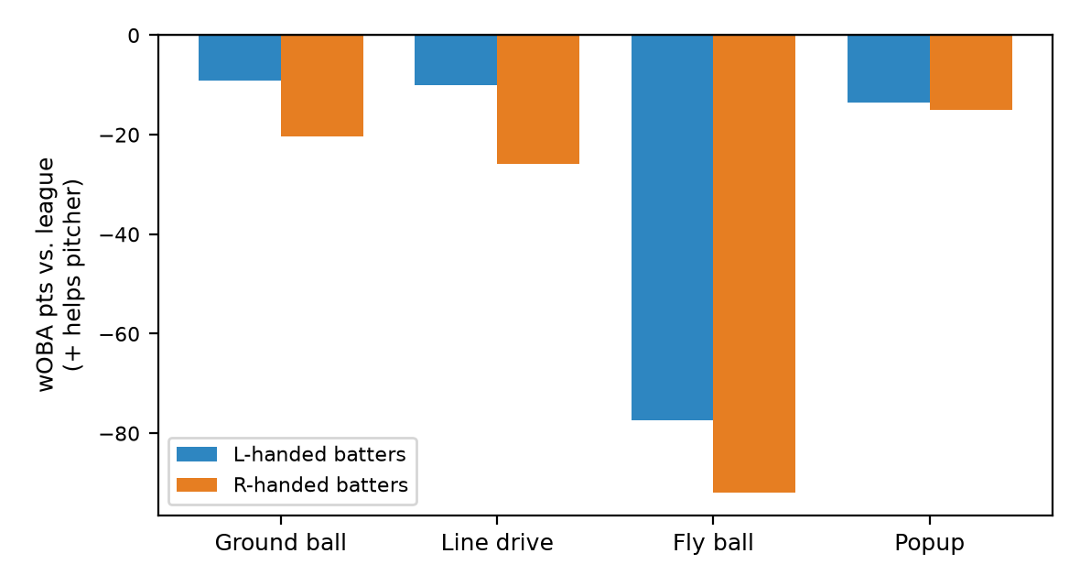
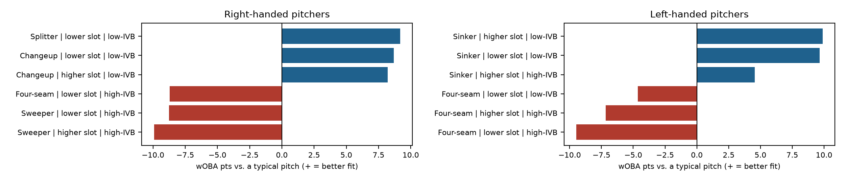
Sutter Health Park
Low confidence: 2 seasons of data
What this park does
Overall: -36 wOBA points per ball in play for pitchers (rank 30 of 30; 1 = most pitcher-friendly).
Biggest effect: fly balls by right-handed batters, 92 points against the pitcher.
Free agents with the lowest projected wOBA allowed here
1. Tarik Skubal (SP): .300 projected, .276 talent
2. Adrian Morejón (RP): .301 projected, .280 talent
3. Steven Okert (RP): .306 projected, .280 talent
Buy-low free agents here (recent results vs. projection)
Dustin May (SP): .338 recent, .356 projected (-18 pts)
David Peterson (SP): .331 recent, .353 projected (-21 pts)
Casey Mize (SP): .330 recent, .352 projected (-22 pts)
Pitch bars: how much better this park suits the pitch than a typical pitch (wOBA points on contact). Park effects are validated; the pitcher-specific fit is exploratory.

Slide 30
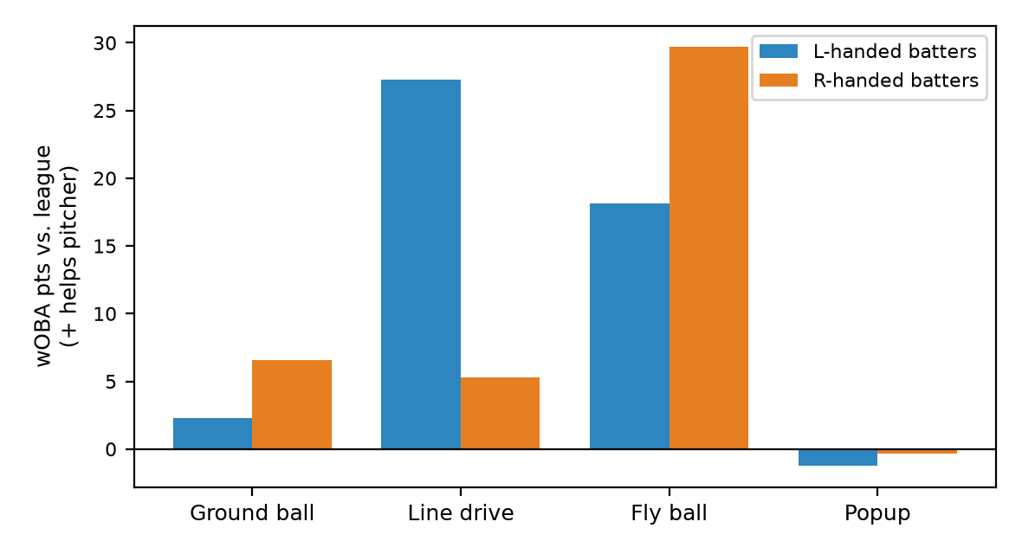
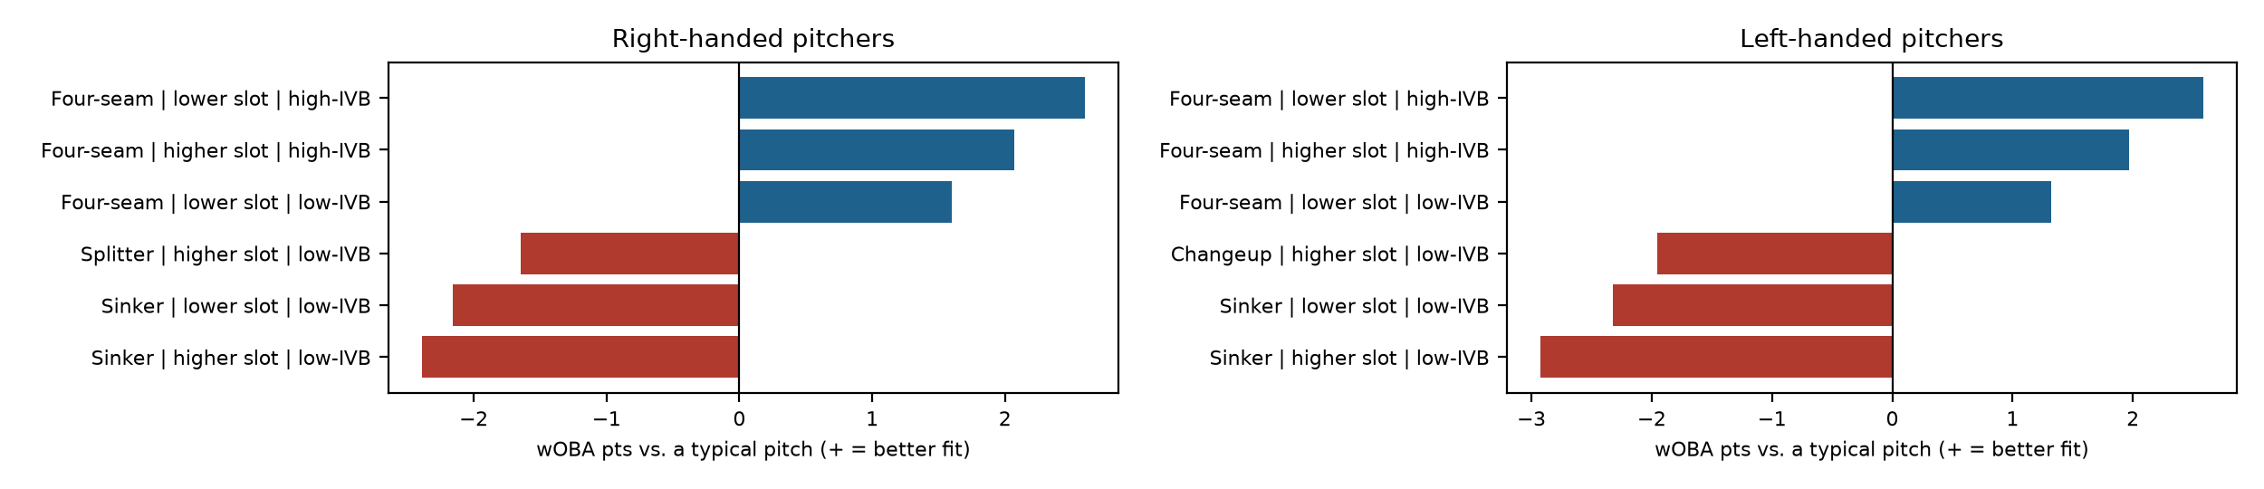
T-Mobile Park
What this park does
Overall: +12 wOBA points per ball in play for pitchers (rank 3 of 30; 1 = most pitcher-friendly).
Biggest effect: fly balls by right-handed batters, 30 points in the pitcher's favor.
Free agents with the lowest projected wOBA allowed here
1. Tarik Skubal (SP): .269 projected, .276 talent
2. Steven Okert (RP): .272 projected, .280 talent
3. Adrian Morejón (RP): .273 projected, .280 talent
Buy-low free agents here (recent results vs. projection)
Dustin May (SP): .338 recent, .326 projected (+12 pts)
Casey Mize (SP): .330 recent, .318 projected (+11 pts)
Nick Martinez (SP): .309 recent, .299 projected (+10 pts)
Pitch bars: how much better this park suits the pitch than a typical pitch (wOBA points on contact). Park effects are validated; the pitcher-specific fit is exploratory.

Slide 31


Target Field
What this park does
Overall: -2 wOBA points per ball in play for pitchers (rank 21 of 30; 1 = most pitcher-friendly).
Biggest effect: line drives by left-handed batters, 18 points in the pitcher's favor.
Free agents with the lowest projected wOBA allowed here
1. Tarik Skubal (SP): .279 projected, .276 talent
2. Steven Okert (RP): .281 projected, .280 talent
3. Adrian Morejón (RP): .283 projected, .280 talent
Buy-low free agents here (recent results vs. projection)
Dustin May (SP): .338 recent, .335 projected (+3 pts)
Casey Mize (SP): .330 recent, .328 projected (+1 pts)
Nick Martinez (SP): .309 recent, .310 projected (-1 pts)
Pitch bars: how much better this park suits the pitch than a typical pitch (wOBA points on contact). Park effects are validated; the pitcher-specific fit is exploratory.

Slide 32


Tropicana Field
What this park does
Overall: -4 wOBA points per ball in play for pitchers (rank 24 of 30; 1 = most pitcher-friendly).
Biggest effect: fly balls by left-handed batters, 18 points in the pitcher's favor.
Free agents with the lowest projected wOBA allowed here
1. Tarik Skubal (SP): .280 projected, .276 talent
2. Steven Okert (RP): .282 projected, .280 talent
3. Adrian Morejón (RP): .284 projected, .280 talent
Buy-low free agents here (recent results vs. projection)
Dustin May (SP): .338 recent, .336 projected (+2 pts)
Casey Mize (SP): .330 recent, .329 projected (+1 pts)
Nick Martinez (SP): .309 recent, .310 projected (-2 pts)
Pitch bars: how much better this park suits the pitch than a typical pitch (wOBA points on contact). Park effects are validated; the pitcher-specific fit is exploratory.

Slide 33


Truist Park
What this park does
Overall: +3 wOBA points per ball in play for pitchers (rank 16 of 30; 1 = most pitcher-friendly).
Biggest effect: fly balls by left-handed batters, 22 points against the pitcher.
Free agents with the lowest projected wOBA allowed here
1. Tarik Skubal (SP): .273 projected, .276 talent
2. Adrian Morejón (RP): .277 projected, .280 talent
3. Steven Okert (RP): .279 projected, .280 talent
Buy-low free agents here (recent results vs. projection)
Dustin May (SP): .338 recent, .333 projected (+6 pts)
Foster Griffin (SP): .322 recent, .318 projected (+4 pts)
David Peterson (SP): .331 recent, .327 projected (+4 pts)
Pitch bars: how much better this park suits the pitch than a typical pitch (wOBA points on contact). Park effects are validated; the pitcher-specific fit is exploratory.

Slide 34


Wrigley Field
What this park does
Overall: +4 wOBA points per ball in play for pitchers (rank 11 of 30; 1 = most pitcher-friendly).
Biggest effect: ground balls by right-handed batters, 21 points in the pitcher's favor.
Free agents with the lowest projected wOBA allowed here
1. Tarik Skubal (SP): .272 projected, .276 talent
2. Adrian Morejón (RP): .277 projected, .280 talent
3. Steven Okert (RP): .280 projected, .280 talent
Buy-low free agents here (recent results vs. projection)
David Peterson (SP): .331 recent, .325 projected (+7 pts)
Foster Griffin (SP): .322 recent, .316 projected (+6 pts)
Dustin May (SP): .338 recent, .333 projected (+6 pts)
Pitch bars: how much better this park suits the pitch than a typical pitch (wOBA points on contact). Park effects are validated; the pitcher-specific fit is exploratory.

Slide 35


Yankee Stadium
What this park does
Overall: +10 wOBA points per ball in play for pitchers (rank 4 of 30; 1 = most pitcher-friendly).
Biggest effect: ground balls by left-handed batters, 19 points in the pitcher's favor.
Free agents with the lowest projected wOBA allowed here
1. Tarik Skubal (SP): .268 projected, .276 talent
2. Adrian Morejón (RP): .272 projected, .280 talent
3. Steven Okert (RP): .275 projected, .280 talent
Buy-low free agents here (recent results vs. projection)
Dustin May (SP): .338 recent, .328 projected (+10 pts)
Foster Griffin (SP): .322 recent, .312 projected (+10 pts)
David Peterson (SP): .331 recent, .322 projected (+10 pts)
Pitch bars: how much better this park suits the pitch than a typical pitch (wOBA points on contact). Park effects are validated; the pitcher-specific fit is exploratory.

Slide 36


loanDepot park
What this park does
Overall: +3 wOBA points per ball in play for pitchers (rank 15 of 30; 1 = most pitcher-friendly).
Biggest effect: fly balls by right-handed batters, 36 points in the pitcher's favor.
Free agents with the lowest projected wOBA allowed here
1. Tarik Skubal (SP): .273 projected, .276 talent
2. Steven Okert (RP): .276 projected, .280 talent
3. Adrian Morejón (RP): .279 projected, .280 talent
Buy-low free agents here (recent results vs. projection)
Dustin May (SP): .338 recent, .333 projected (+5 pts)
Foster Griffin (SP): .322 recent, .318 projected (+4 pts)
Casey Mize (SP): .330 recent, .325 projected (+4 pts)
Pitch bars: how much better this park suits the pitch than a typical pitch (wOBA points on contact). Park effects are validated; the pitcher-specific fit is exploratory.

Slide 37
Limitations and next steps
What the model cannot do
Weather, defense, umpires, and lineups are not modeled; some leak into the park effect.
The pitcher-specific part of park fit is small (a few wOBA points) and could not be confirmed in the backtest.
Park effects use batter side and batted-ball type, not spray direction or the individual pitch.
Oakland Coliseum and Steinbrenner Field are excluded (no team plays there now); Sutter Health Park has only 2 seasons.
Projections use a judgment-call amount of shrinkage toward the league average and recent seasons only.
Next steps
Add contract projections to rank buy-low targets by value, not just talent.
Add spray direction and per-pitch data, and test movers (pitchers who changed parks).
Extend the same method to hitters and to trade targets.

