Slide 1
System Calls
1
Notes:
Simple Definition (
A system call is a way for a program to request the operating system to do something on its behalf.
Programs cannot directly access hardware, so they must ask the OS.
That “asking” is done using system calls.

Slide 2
Topics
System Calls
Calling Conventions
Kernel Designs
Notes:
Why Do System Calls Exist?
Explain this first, before technical details.
The Core Problem
Hardware is powerful and dangerous
If every program accessed hardware directly:
One bug could crash the entire system
Security would be impossible
The Solution
👉 The operating system sits in between and controls access.
System calls are the only legal entry point into the OS kernel.

Slide 3
Operating System Services
OS provides an environment to execute programs and provide services to programs and users
User interfaces: command line (CLI), graphical (GUI), batch
Program execution: loading program into memory, run program, end execution (normally or abnormally)
I/O operations: handle filesystem, networking, interprocess communication
Error detection: handle hardware failures, debugging
Resource allocation, accounting, protection, security
Notes:
A Very Simple Analogy
🔐 Bank Analogy
User program → Customer
Operating system → Bank manager
Hardware → Bank vault
System call → Request form
A customer cannot enter the vault directly. They must submit a request to the manager.
Same way:
Programs cannot access hardware directly — they must use system calls.

Slide 4
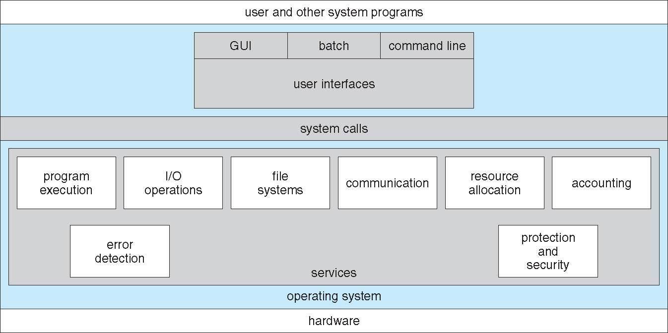
Operating System Services
Notes:
Explain the two worlds clearly:
🧑‍💻 User Space
Where applications run
Less privilege
Safe environment
🧠 Kernel Space
Where OS runs
Full hardware access
Very powerful
System calls switch the CPU from user space → kernel space → back.

Slide 5
System Calls
On modern operating systems, processes do not talk to hardware directly, but
must go through OS
System Call: request from a process for OS to do some kind of work on its behalf
Application Programming Interface (API): interface provided by OS, usually in a high-level language (C or C++), that is easier to work with than raw system calls
Win32 API for Windows, accessible through kernel32.dll
POSIX for macOS, Linux, and other Unix-like, accessible through libc.so
Notes:
Walk through what happens when a program runs:
Loaded into memory
Given CPU time
Executed
Terminated
Mention abnormal termination (crashes)
All of this is handled by OS via system calls

Slide 6
Why System Calls
Security
Prevents unauthorized hardware access
Stability
Faulty user programs cannot crash the kernel directly
Resource Control
Kernel manages CPU, memory, and I/O fairly
Hardware Abstraction
Programs need not know device details
Notes:
Explain that reading files, writing files, networking, IPC are OS responsibilities
Programs never access disk or network hardware directly
They must request the OS to do it

Slide 7
Common System Calls
System Call | Purpose
open() | Open a file
read() | Read data
write() | Write data
fork() | Create a process
exec() | Execute program
exit() | Terminate process
Notes:
OS detects:
Hardware failures
Memory errors
Invalid operations
Debugging support and error reporting are OS services
System calls return error codes for this purpose

Slide 8
System Call Execution Flow
User Program
↓
Library Function (glibc)
↓
System Call Instruction
↓
System Call Handler
↓
Service Routine
↓
Return to User Space
Notes:
1️⃣ Security
Prevents unauthorized hardware access
2️⃣ Stability
Buggy programs can’t crash OS
3️⃣ Resource Management
OS controls CPU, memory, devices
4️⃣ Hardware Independence
Programs don’t need device details

Slide 9
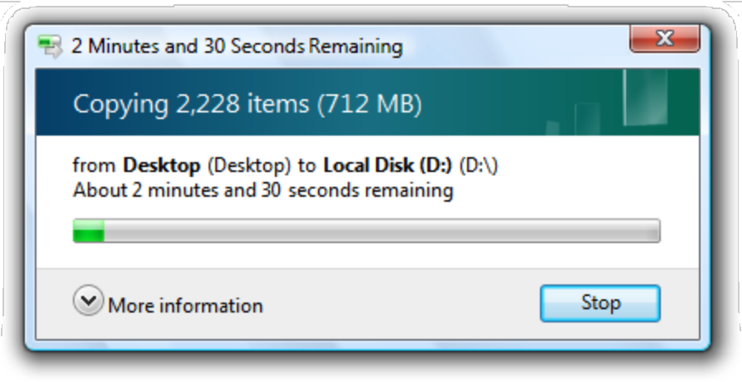
Example of System Calls
Example: Sequence of system calls to copy contents of one file to another
Display dialog to choose source file
Display dialog to choose destination folder
Display progress dialog
Open source file for reading
Open destination file for creating and writing
Loop while more source bytes remaining:
Read n bytes from source file
Write n bytes to destination file
Update progress dialog
Close source file
Close destination file
Close progress dialog
Terminate normally
Notes:
Clearly define:
A system call is a request made by a user program to the OS kernel
Stress:
User programs cannot talk to hardware directly
System calls are mandatory

Slide 10
Typical System Call Implementation
Each system call has a unique numeric identifier
OS has a system call table that maps numbers to functionality requested
When invoking a system call, user places system call number and associated parameters in an “agreed upon” location, then executes the trap instruction
OS retrieves system call number and parameters, then performs action
OS writes output data and return value to an “agreed upon” location, then resumes user process
Notes:
Explain difference:
API = programmer-friendly interface
System call = low-level kernel interface
APIs internally use system calls
Examples:
Windows: Win32 API
Linux/macOS: POSIX via libc

Slide 11
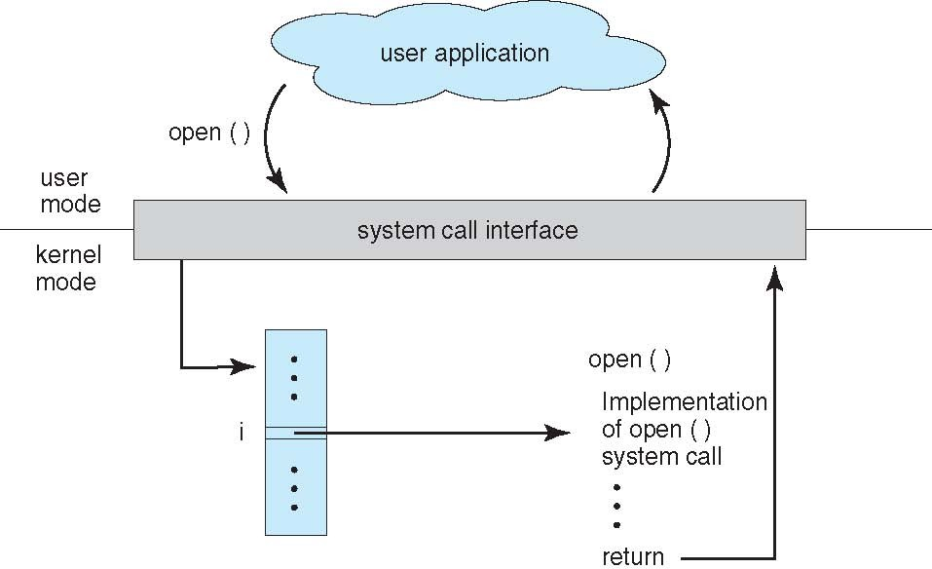
System Call Interface
Notes:
Explain each point slowly:
Security: prevents unauthorized access
Stability: faulty apps don’t crash kernel
Resource control: OS manages fairness
Abstraction: hides hardware details

Slide 12
Examples of System Calls
Process control: create process, terminate, load program, get process attributes, wait for time, wait for event, allocate memory, obtain locks, debugging support
I/O: create file, open file, read file, get file attributes
Device management: request device, release device, read data
Information maintenance: get system time, set system time
Communications: send message, receive message, share data with another process
Protection: get permissions, allow access, deny access

Slide 13
Parameter Passing
OS writer and user programs rely upon convention when choosing where to store parameters and return values:
Simplest: put all values in registers (hopefully there are enough!)
Memory region: write to memory, then store starting memory address in a register
Push values onto stack; OS will pop values off the stack (based upon stack register)
Usually, hardware constraints dictate which system call convention used

Slide 14
Linux x86-64 System Call Convention
User-level applications use as integer registers for passing the sequence %rdi, %rsi, %rdx,
%rcx, %r8 and %r9. The kernel interface uses %rdi, %rsi, %rdx, %r10, %r8 and %r9.
A system-call is done via the syscall instruction. The kernel destroys registers %rcx and
%r11.
The number of the syscall has to be passed in register %rax.
System-calls are limited to six arguments, no argument is passed directly on the stack.
Returning from the syscall, register %rax contains the result of the system-call. A value in the range between -4095 and -1 indicates an error, it is -errno.
Only values of class INTEGER or class MEMORY are passed to the kernel.
https://github.com/hjl-tools/x86-psABI/wiki/X86-psABI
11

Slide 15
Linux x86-64 System Call Numbers
#
# 64-bit system call numbers and entry vectors #
# The format is:
# <number> <abi> <name> <entry point> #
# The x64_sys_*() stubs are created on-the-fly for sys_*() system calls #
# The abi is "common", "64" or "x32" for this file. #
common
common
common
common
common
common
common
common
common
common
read write open close stat fstat lstat poll lseek mmap
x64_sys_read
x64_sys_write
x64_sys_open
x64_sys_close
x64_sys_newstat
x64_sys_newfstat
x64_sys_newlstat
x64_sys_poll
x64_sys_lseek
x64_sys_mmap
https://elixir.bootlin.com/linux/latest/source/ arch/x86/entry/syscalls/syscall_64.tbl
12

Slide 16
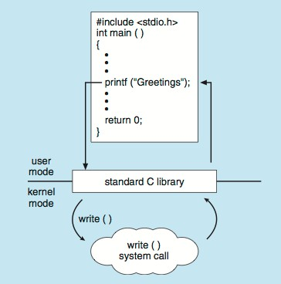
Standard C Library Example
Many standard C functions invoke underlying system calls
Example: on Linux x86-64, printf() internally invokes write() (syscall number 1)

Slide 17
Thank You!

