Slide 1
Operating System
System Calls

Slide 2
Outline
System Calls
System Programs
System Structure
Virtual Machines
System Design and Implementation
System Generation

Slide 3
System Calls
System calls provide the interface between a running program and the operating system.
  Generally available as assembly-language instructions.
  Languages defined to replace assembly language for systems programming allow system calls to be made directly (e.g., C, C++)

Slide 4
System Calls (Cont.)
Three general methods are used to pass parameters between a running program and the operating system.
  Pass parameters in registers.
  Store the parameters in a table in memory, and the table address is passed as a parameter in a register.
  Push (store) the parameters onto the stack by the program, and pop off the stack by operating system.

Slide 5

Passing of Parameters As A Table

Slide 6
Types of System Calls
Process control
File management
Device management
Information maintenance
Communications

Slide 7
Process Control
end, abort
Load, execute
create process, terminate process
get process attributes, set process attributes
wait for time
wait event, signal event
allocate and free memory

Slide 8
File Management
create file, delete file
open, close
read, write, reposition
get file attributes, set file attributes

Slide 9
Device Management
request device, release device
read, write, reposition
get device attributes, set device attributes
logically attach or detach devices

Slide 10
Information Maintenance
get time or date, set time or date
get system data, set system data
get process, file or device attributes
set process, file or device attributes

Slide 11
Communications
create, delete communication connection
send, receive messages
transfer status information
attach or detach remote devices

Slide 12
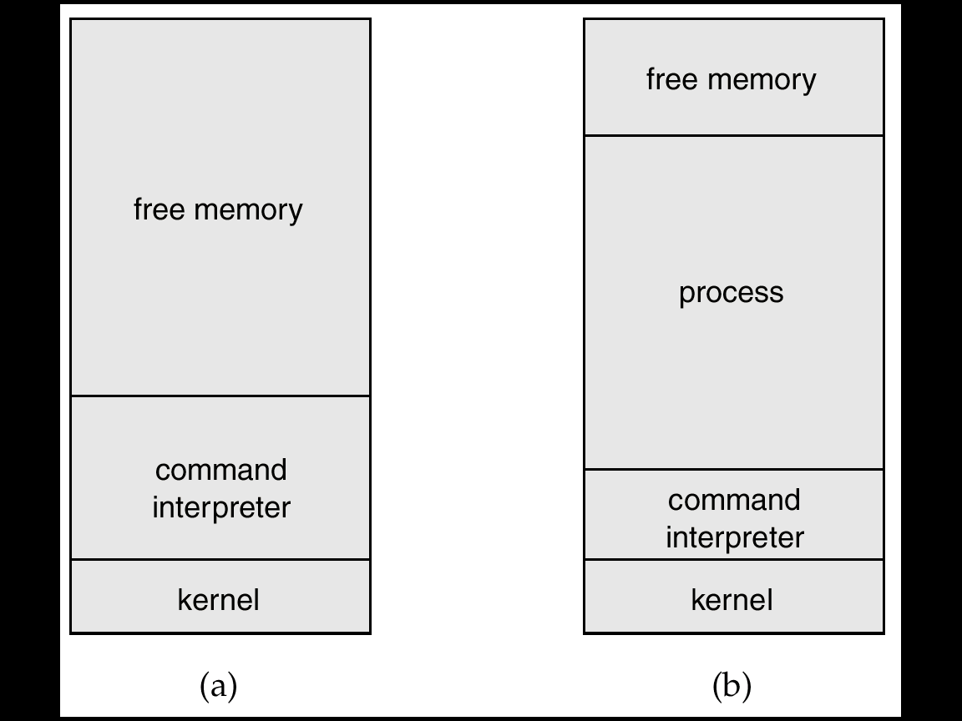
MS-DOS Execution
At System Start-up
Running a Program

Slide 13
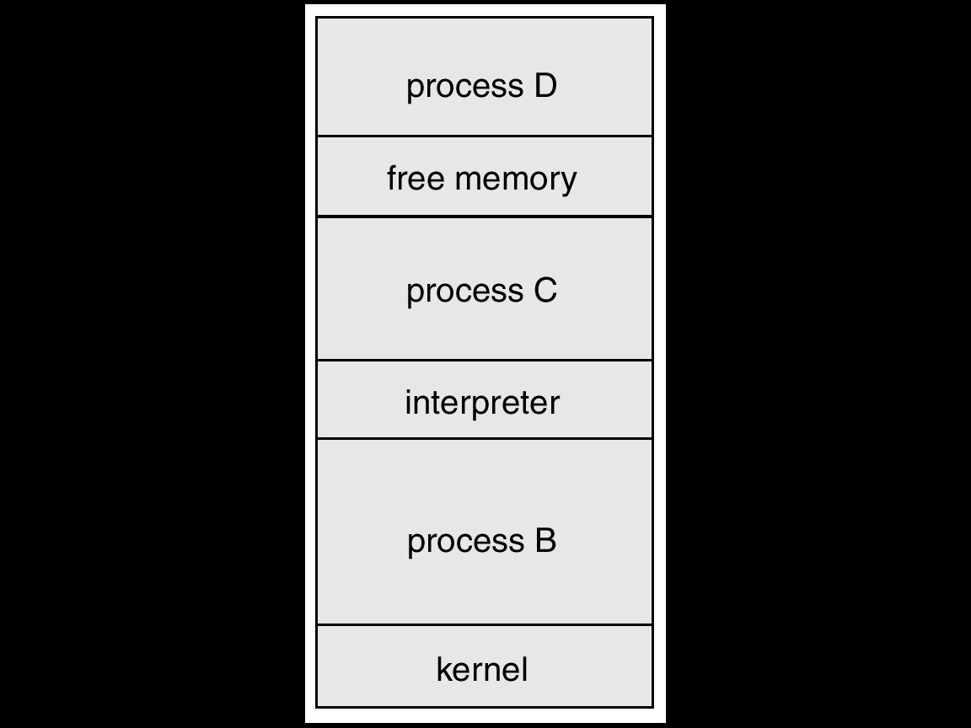
UNIX Running Multiple Programs

Slide 14

Communication Models
Communication may take place using either message passing or shared memory.
Msg Passing
Shared Memory

Slide 15
System Programs
System programs provide a convenient environment for program development and execution. The can be divided into:
  File manipulation
  Status information
  File modification
  Programming language support
  Program loading and execution
  Communications
  Application programs

Slide 16
System Programs (Cont.)
Most users’ view of the operation system is defined by system programs, not the actual system calls.

Slide 17
MS-DOS System Structure
MS-DOS – written to provide the most functionality in the least space
  not divided into modules
  Although MS-DOS has some structure, its interfaces and levels of functionality are not well separated

Slide 18

MS-DOS Layer Structure

Slide 19
UNIX System Structure
UNIX – limited by hardware functionality, the original UNIX operating system had limited structuring. The UNIX OS consists of two separable parts.
  Systems programs
  The kernel
    Consists of everything below the system-call interface and above the physical hardware
    Provides the file system, CPU scheduling, memory management, and other operating-system functions; a large number of functions for one level.

Slide 20

UNIX System Structure

Slide 21
Layered Approach
The operating system is divided into a number of layers (levels), each built on top of lower layers. The bottom layer (layer 0), is the hardware; the highest (layer N) is the user interface.
With modularity, layers are selected such that each uses functions (operations) and services of only lower-level layers.

Slide 22

An Operating System Layer

Slide 23
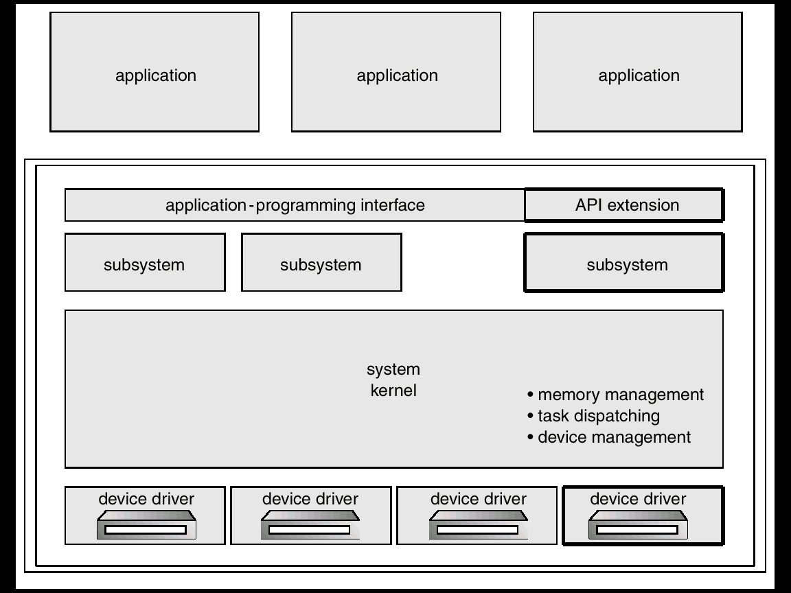
OS/2 Layer Structure

Slide 24
Microkernel System Structure
Moves as much from the kernel into “user” space.
Communication takes place between user modules using message passing.
Benefits:
- easier to extend a microkernel
- easier to port the operating system to new architectures
- more reliable (less code is running in kernel mode)
- more secure

Slide 25

Windows NT Client-Server Structure
It uses a hybrid structure.
Part of windows NT architecture uses layering.
Designed to run various applications, including Win32, OS/2 and POSIX.
It provides a server that runs in user space for each application type.
The kernel coordinates the message passing between client applications
and application servers.

Slide 26
Virtual Machines
A virtual machine takes the layered approach to its logical conclusion. It treats hardware and the operating system kernel as though they were all hardware.
A virtual machine provides an interface identical to the underlying bare hardware.
The operating system creates the illusion of multiple processes, each executing on its own processor with its own (virtual) memory.

Slide 27
Virtual Machines (Cont.)
The resources of the physical computer are shared to create the virtual machines.
  CPU scheduling can create the appearance that users have their own processor.
  Spooling and a file system can provide virtual card readers and virtual line printers.
  A normal user time-sharing terminal serves as the virtual machine operator’s console.

Slide 28

System Models
Non-virtual Machine
Virtual Machine

Slide 29
Adv./Disadv. of Virtual Machines
The virtual-machine concept provides complete protection of system resources since each virtual machine is isolated from all other virtual machines. This isolation, however, permits no direct sharing of resources.
A virtual-machine system is a perfect vehicle for operating-systems research and development. System development is done on the virtual machine, instead of on a physical machine and so does not disrupt normal system operation.

Slide 30
Adv./Disadv. of Virtual Machines (Cont.)
The virtual machine concept is difficult to implement due to the effort required to provide an exact duplicate to the underlying machine.

Slide 31
Java Virtual Machine
Compiled Java programs are platform-neutral bytecodes executed by a Java Virtual Machine (JVM).
JVM consists of
- class loader
- class verifier
- runtime interpreter
Just-In-Time (JIT) compilers increase performance

Slide 32

Java Virtual Machine

Slide 33
System Design Goals
User goals – operating system should be convenient to use, easy to learn, reliable, safe, and fast.
System goals – operating system should be easy to design, implement, and maintain, as well as flexible, reliable, error-free, and efficient.

Slide 34
Mechanisms and Policies
Mechanisms determine how to do something, policies decide what will be done.
The separation of policy from mechanism is a very important principle, it allows maximum flexibility if policy decisions are to be changed later.

Slide 35
System Implementation
Traditionally written in assembly language, operating systems can now be written in higher-level languages.
Code written in a high-level language:
  can be written faster.
  is more compact.
  is easier to understand and debug.
An operating system is far easier to port (move to some other hardware) if it is written in a high-level language.

Slide 36
System Generation (SYSGEN)
Operating systems are designed to run on any of a class of machines; the system must be configured for each specific computer site.
SYSGEN program obtains information concerning the specific configuration of the hardware system.
Booting – starting a computer by loading the kernel.
Bootstrap program – code stored in ROM that is able to locate the kernel, load it into memory, and start its execution.

Slide 37
Thanks

