Slide 1
Linux Kernel Module Programming

Slide 2
Kernel Modules
Kernel modules are piece of code, that can be loaded and unloaded from kernel on demand.
Kernel modules offers an easy way to extend the functionality of the base kernel without having to rebuild or recompile the kernel again. Most of the drivers are implemented as a Linux kernel modules. When those drivers are not needed, we can unload only that specific driver, which will reduce the kernel image size.
The kernel modules will have a .ko extension. On a normal linux system, the kernel modules will reside inside
/lib/modules/<kernel_version>/kernel/ directory.

Slide 3
Examples:
Typical modules:
Device drivers
File system drivers
System calls

Slide 4
Advantages
There is no necessity to rebuild the kernel, when a new kernel option is added.
Modules help find system problems (if system problem caused a module just don't load it).
Modules are much faster to maintain and debug.
Modules once loaded are in as much fast as kernel.

Slide 5
Utilities to manipulate kernel modules
•
•
•
•
•
lsmod insmod modinfo rmmod modprobe

Slide 6
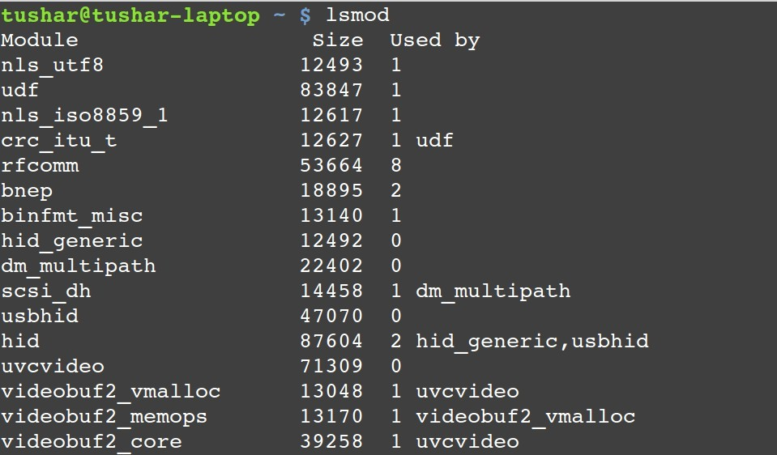
lsmod
•
Lists modules that are loaded already.
•
Check the command:
cat /proc/modules

Slide 7
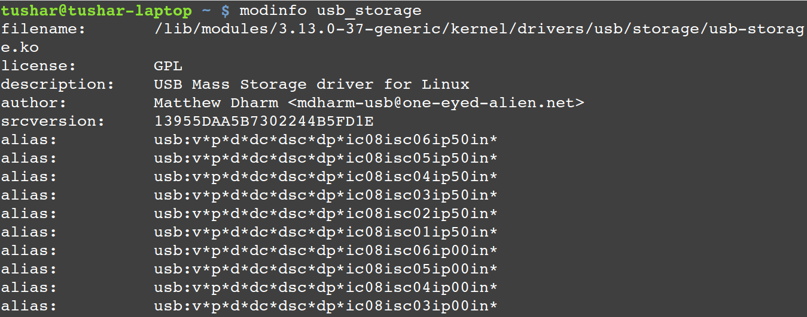
modinfo
•
Display module information.

Slide 8
insmod
Insert module into kernel.
Syntax:
– insmod <module_name>.ko

Slide 9
rmmod
Removes module from kernel. You cannot remove a module which is already used by any program.
Syntax:
– rmmod <module_name>.ko

Slide 10
Kernel Module Implementation
•
The kernel considers only modules that have been
loaded into RAM by the insmod program and for each of them allocates memory area containing:
A module object.
Null terminated string that represents module's name.
The code that implements the functions of the module.

Slide 11
Linux Kernel Module Programming
Write a hello_proc.c program
Create a Makefile
The program and Makefile should be kept in a single folder.
Change directory to this folder and execute following:
make
insmod hello_proc.ko
•
dmesg (see the kernel buffer contents, reads the kernel log file /var/log/syslog)
lsmod
cat /proc/hello_proc

Slide 12
Files created after building the module
•
hello.o
Module object file before linking.
hello.mod.c
Contains module’s information.
hello.mod.o
After compilation and linking of hello.mod.c.
modules.order
The order in which two or three modules get linked.
Modules.symvers
Symbol versions if any.
hello.ko
A module kernel object file after linking hello.o and hello.mod.o
•
•
•
•
•

Slide 13
Example: hello.c
#include | <linux/module.h> | // | included | for | all kernel | modules
#include | <linux/kernel.h> | // | included | for | KERN_INFO
#include | <linux/init.h> | // | included | for | init and | exit macros
MODULE_LICENSE("GPL");
MODULE_AUTHOR("Trusted Author");
MODULE_DESCRIPTION("A Simple Hello World module"); static int init hello_init(void)
{
printk(KERN_INFO "Hello world!\n");
return 0; // Non­zero return means that the module couldn't be loaded.
}
static void exit hello_cleanup(void)
{
printk(KERN_INFO "Good Bye.\n");
}
module_init(hello_init); module_exit(hello_cleanup);

Slide 14
Makefile
obj­m += hello.o all:
make ­C /lib/modules/$(shell uname ­r)/build M=$(PWD) modules
clean:
make ­C /lib/modules/$(shell uname ­r)/build M=$(PWD) clean

Slide 15
Prerequisites
$ gcc --version
If it is less than v10, then run
On Linux/RHEL/EL versions
$ sudo dnf install gcc-toolset-12
$ scl enable gcc-toolset-12 bash
On Ubuntu
$ sudo apt install gcc-12
$ sudo update-alternatives --config gcc
Update the Kernel version
The kernel version should be > 10
$ sudo dnf install kernel-uek-devel-$(uname -r)

Slide 16
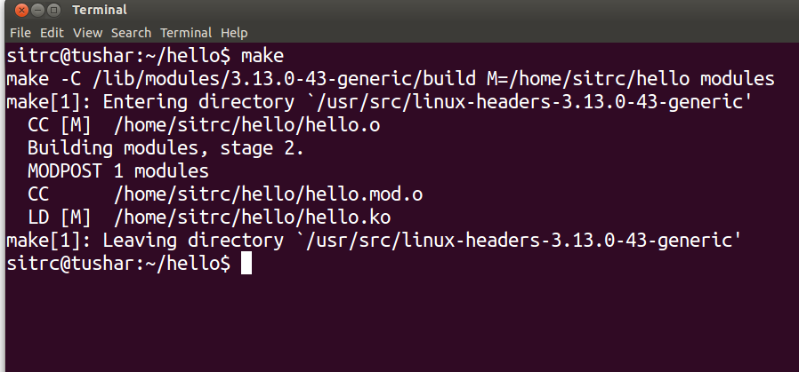
Compile the program
•
make

Slide 17
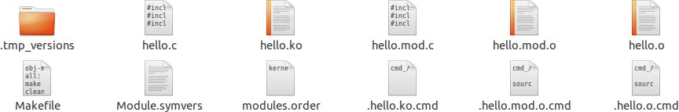
File generated

Slide 18
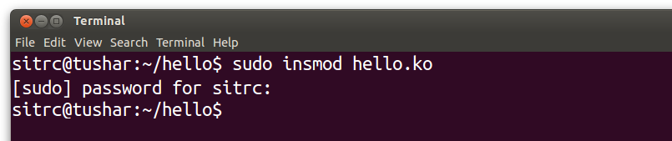
Insert the module
•
insmod hello.ko

Slide 19
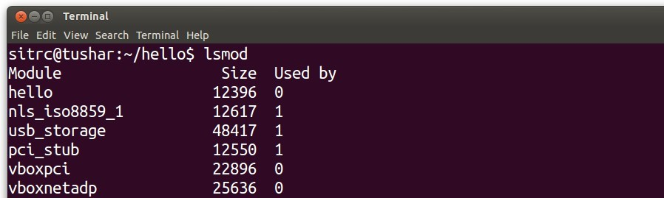
Check the module in the list
•
lsmod
hello module

Slide 20
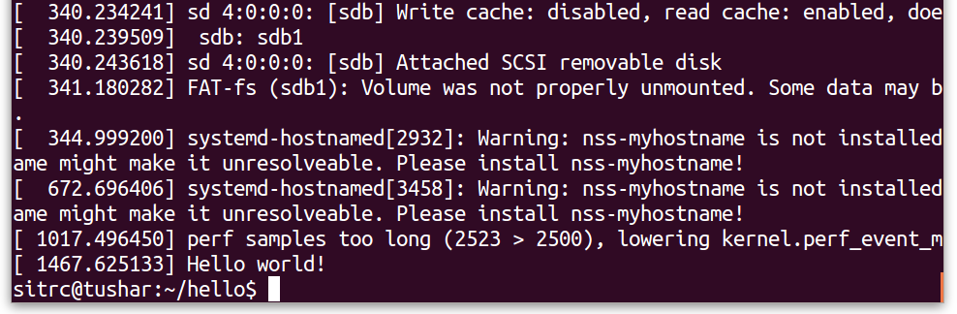
Check kernel ring buffer
•
dmesg
Output of hello module

Slide 21
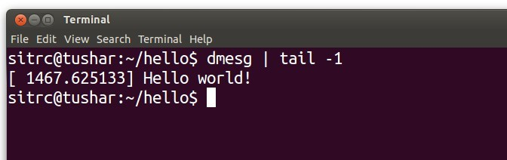
Check kernel ring buffer
•
dmesg | tail ­1

Slide 22
Removing the module
rmmod | hello.ko
dmesg |  | or
dmesg | | tail ­1

Slide 23
What is dmesg?
•
The dmesg command is used to write the kernel messages in Linux and other Unix-like operating systems to standard output (which by default is the display screen).
dmesg obtains its data by reading the kernel ring buffer. A buffer is a portion of a computer's memory that is set aside as a temporary holding place for data that is being sent to or received from an external device, such as a hard disk drive (HDD), printer or keyboard.
A ring buffer is a buffer of fixed size for which any new data added to it overwrites the oldest data in it.
•
•

Slide 24
What is printk?
•
The kernel print function, printk(), behaves almost identically to the C library printf() function.
printk( ) is simply the name of the kernel's formatted print function. It is callable from just about anywhere in the kernel at any time.
The major difference between printk() and printf() is the capability of the former to specify a loglevel.
The kernel uses the loglevel to decide whether to print the message to the console. The kernel displays all messages with a loglevel below a specified value on the console.
•
•
•

Slide 25
printk : example
printk(KERN_WARNING "This is a warning!\n"); printk(KERN_DEBUG "This is a debug notice!\n"); printk("I did not specify a loglevel!\n");

Slide 26

Code
Path: kernel_lecture/02_modules/hello

Slide 27
Thank you
Blogs http://digitallocha.blogspot.in http://kyamputar.blogspot.in

