Slide 1
Network Data –capture/Analysis 2018: 101
Jiří Pataj
Notes:
I would like to thank you Vaclav for his very good motivation speech and introduction. Today I will be talking Netowork Data Analysis 101. In other words basics.

Slide 2
Contents
Data Sources Introduction
Tcpdump
Wireshark
Tshark
ELK (SOF-ELK)
Notes:
I`ve divided my presentation into 4 main topics.
Network big data sources
How to capturing the data
How to Analyzing the data

Slide 3
Network DATA Sources
Network Architecture
Notes:
Question:
Can anybody tell what are typical network data sources we could use for data analysis?

Slide 4
Data sources
Network Equipment
Switches
Routers
Firewalls
Proxies
Load Balancers
Full Packer Capture
Computer
SPAN – Port mirroring
Network TAP
NetFlow
Notes:
First which usually come to mind is network equipment (switches, routers,firewalls, proxies and so on). One of the most interesting data from Swith, Router,FW for security oriented people are network access control list logs.
Question:
Does anybody know usual ACLs difference between switches, routers and firewalls?
Stalefull ACL keeps track of connection so returning traffic is also allowed with one ACL rule/line
Stateless requires ACLs in both ways.
The next is full packet capture which can be collected on almost any computer. ( You can do it at home anytime) Or using SPAN/TAP to mirror traffic to dedicated capture machine.
The last but not least on my list is NetFlow; Netflow is usually generated from Network devices, but can also be generated from pcap.

Slide 5
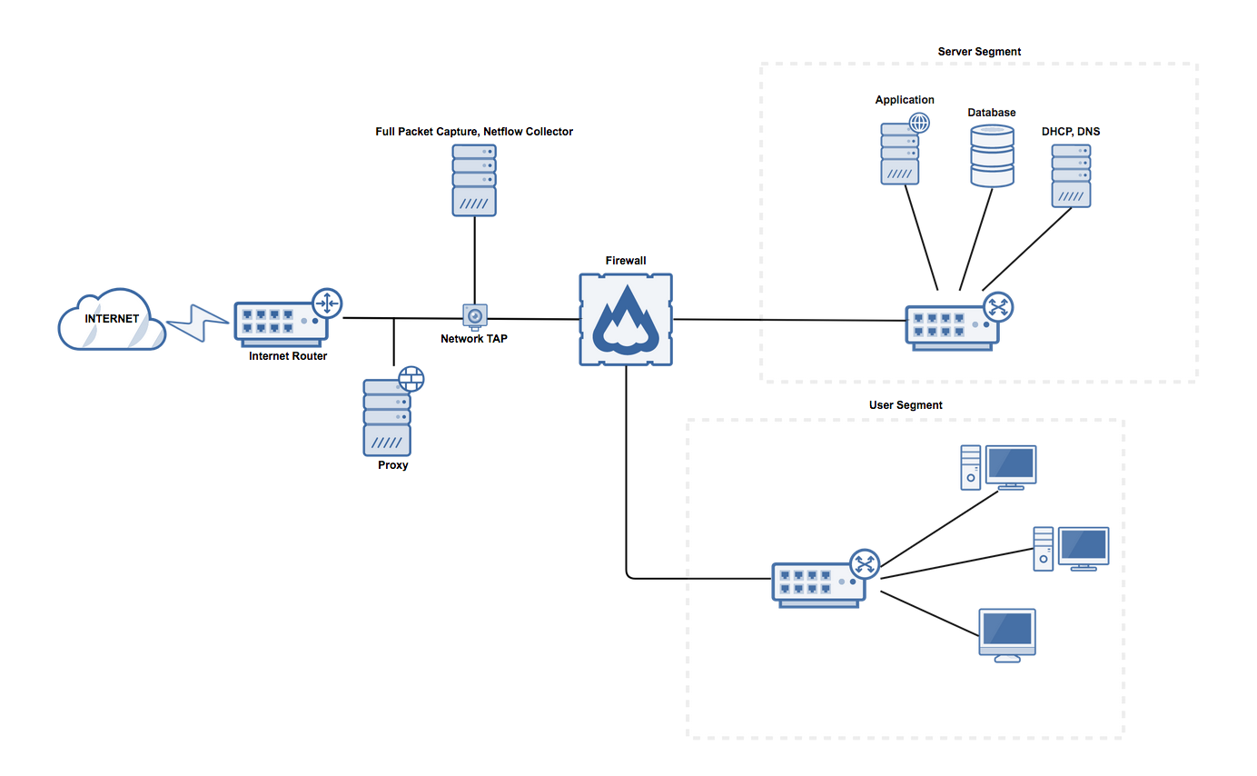
Network
Notes:
On this slide you can see pretty much standard small size network architecture. There is server as well as user segment segregated by firewall. Between IR and FW we can see services like proxy, network tap, pcap.
Question: I already mentioned packet capture a few times. Does anybody know is stored in pcap?

Slide 6
PCAP File header
 | 0 | 1 | 2 | 3
0x00 | Magic Number
0x04 | Major version |  | Minor version
0x08 | Time zone offset
0x0C | Time stamp accuracy
0x10 | Snapshot length
0x14 | Link-layer header type
Notes:
Before we start with capturing data we should understand two main point from Pcap file header.
Imagine that you have offices around the globe and need to investigate security issue spanning across more offices. Time is the key for collecting data across more timezones so it is very important to know in what timezone the data was captured. Security standad is to use UTC – 0 for everything.
Snapshot length affects size of each packet withi pcap. Again security the best practice is to capture whole packets which is another 0 (-n 0) in case of tcpdump.

Slide 7
TCPdump
Notes:
Real world example: IDS in offices or DCs
You have IDS on all of you data centers which are pretty much same. There are everywhere in the world. After deployment you find out that one of them does not work properly and generate almost no alerts.
How would you solve the issue after all involved teams reviewed the their part of work and say that the issue is the other part of the work?
You call security oriented big data analyst who roll up his sleeves, order shot of 20th years of old Irish Whiskey. BTW. Do you know why? Because as Data Analyst he can offer it. One the first things he is likely to do is data collection using Tcmdump.

Slide 8
Tcpdump
Most widely used capture tool
Open-sourced, cross-platform, comnand line-based
Based of libpcap
Uses Berkeley Packet Filter (BPF) syntax
Display details in terminal or save to pcap file on disk
Red from network or existing pcap file
Notes:
BPF handout: Here you have TCPDUMP cheasheet which help you with creating very useful and powerful BPF filters.

Slide 9
Tcpdump Basic usage
BPF allows capture minimization
$sudo tcpdump –n –s 0 -i eth0 -w output.pcap ’host 1.2.3.4 and port 80’
-n: Don`t do DNS lookup for each IP
-s 0: Snapshot length of zero (capture all bytes)
-i eth0: Capture from ”eth0” network interface
-w output.pcap: Write output to file
‘host 1.2.3.4 and port 80’: BPF to use
Notes:
Here is example of basic usage which you end up using very often. I`m talking about BPF filters where which allows capture minimization and filtering according to your needs.
So real quick the most important parts:
BPR filter
-n
-s 0

Slide 10
Tcpdump examples
Reduce data to what`s interesting
$tcpdump –n –r bigfile.pcap –w smallfile.pcap ’host 1.2.3.4 and port 443’
Capture 14 days of DNS traffic with one day of content per file
$sudo tcpdump –n –i eth0 –w dns-%F.%T.pcap –G 86400 –W14 ‘(tcp or udp) and port 53’
Notes:
Filtrovni, normalizace, priprava dat. Casto budte potrebovat neco takoveho…
Zeptat se na sudo a zminit (sudo neni potreba na zmenu velikosti pcapu)
Here we have another real world examples you might end up using very often.
Again real quick:
#1 Pcap reducing –r to –w
#2 –w with dynamic data/time name, -G every day (s)
Question:
Does anybody know why we use sudo in one case and not in the other?

Slide 11
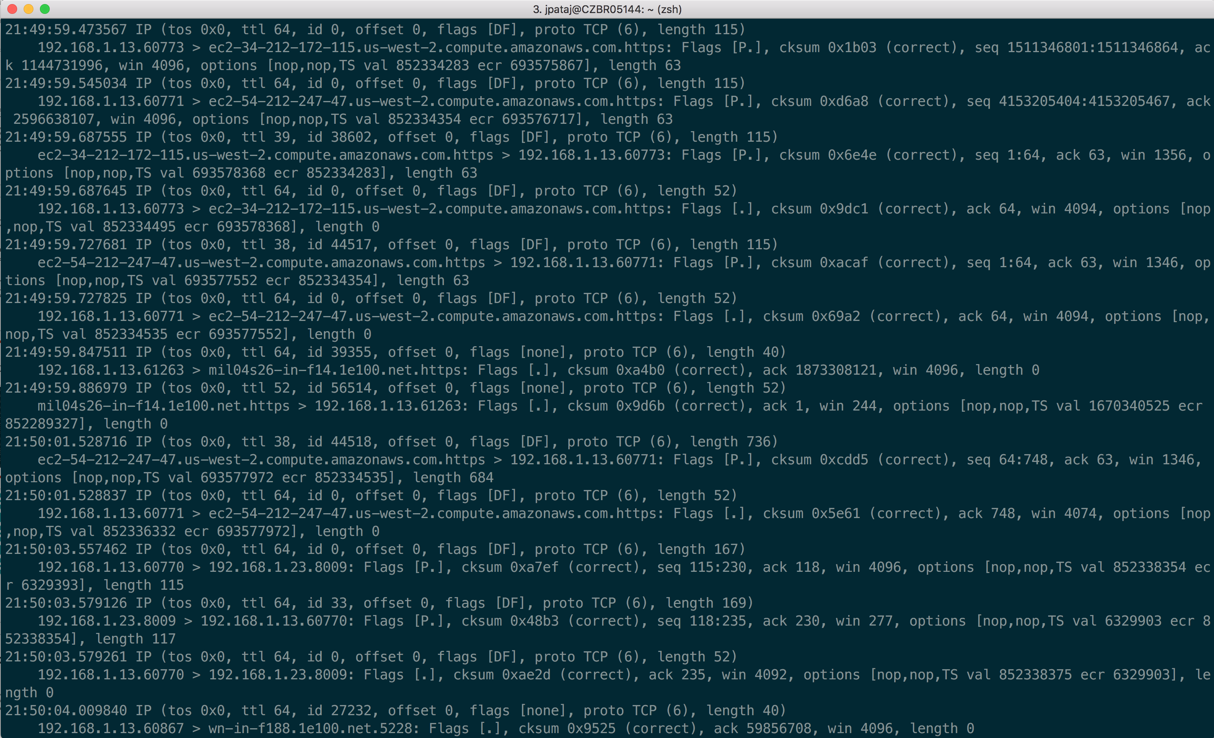
Notes:
Tcpdump is awesome, but how to effective this when it comes to IDS alerting troubleshooting? You can obviously confirm that the traffic is coming to the sensor, but it is very difficult to find the root cause just from looking at tcpdump output on the screen.
IDS TSHOOTIN with OUTPUT?
No we are getting into neext tool
NEXT SLIDE

Slide 12
Wireshark
Notes:
Then comes Wireshark into play…

Slide 13
Wireshark
Open-sourced, cross-platform
Powerful parsing for hundreds of protocols
Comes with tshark, a console-mode equivalent
Notes:
Simply said, wireshark GUI on top of Tcpdump topped with powerful parsing for hundreds of protocols. It`s open soure, cross-platform and comes with a console equivalent – tshark.
If you never tried Wireshark I recommend to install it on your machine and play…

Slide 14
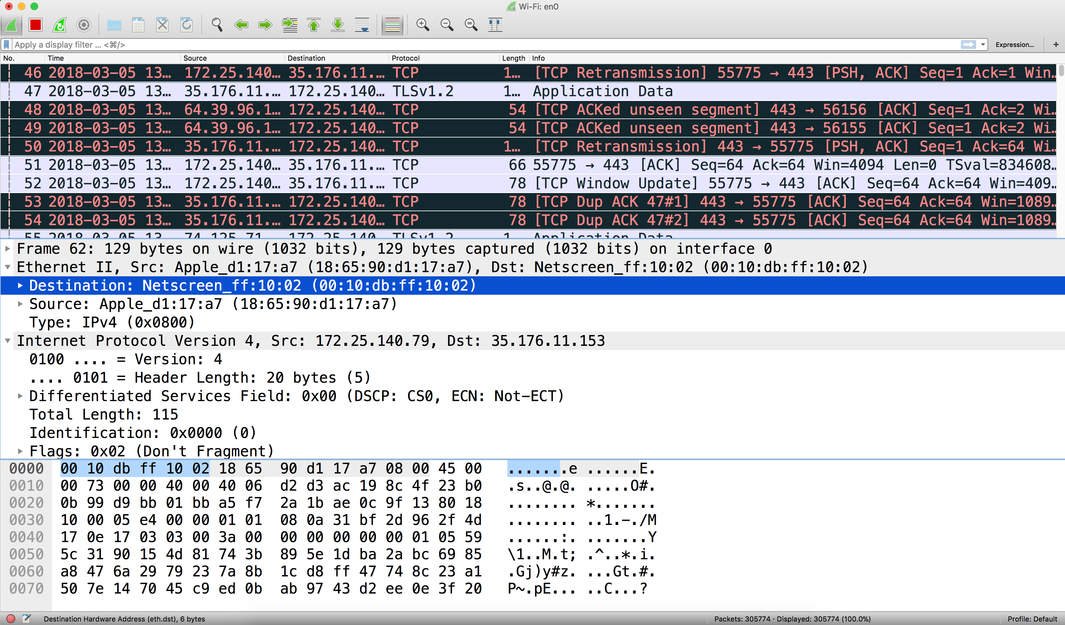
Notes:
Ziva ukazka. Jednoduchy na datobou analzu..Nikdo si nepamatuje query z hlavy, le wireshark lze pouzivat zcela jednoduse a dobrym vysledkem…
This is typical Wirehark screenshot showing captured packets, packet detail and hex`s view.

Slide 15
Wireshark DEMO
Notes:
How to start capturing
Describe all panes
Pro tips:
Time configuration – View -> Time display
Use captured DNS packet data for DNS -> Wireshark-> Preferences -> Name resolution
Search bar and how to search
Search bar suggestions
Bar colors
Prepare filter as
Follow stream
Statistics:
Resolved addresses
Protocol hierarchy
Conversation

Slide 16
Tshark

Slide 17
Tshark
Wireshark power in shell
Explore portion of data in GUI, use console to scale and script
Create repeatable processes
Data reduction using Wireshark`s like filters
However:
Tcpdump’s BPFs are much faster to filter on layers 3-4
Use tcpdump instead of tshark
Notes:
WHY TO USE TSHARK
Now anyne could ask, why would we want to use Tshark when we have Wireshark which is so convenient.
Tshark offers the same wireshark power in shell. Wireshark is limited based on you computer and usually handles pcaps up to 1GB. If you need to analyze anything bigger and repeatedly Tshark comes to play.
Pro tip:
Use wireshark on portion of data to prepare query and then apply it in tshark.
Question:
How do you get portion of data if you already have really huge pcap? Tcpdump to reduce pcaps, faster than tshark.

Slide 18
Tshark example
Reduce data to what`s interesting
$tshark –n –r bigfile.pcap –Y ‘http.server’ –T fields –e http.server –e http.user_agent| sort | uniq –c | sort -nr
-n: Don`t do DNS lookup for each IP
-r: read packet date from existing pcap
-Y: display filter using Wireshark syntax, enclose in single quotes
-T: Output mode: text, fields, pdml
-e: Select fields to display when –T fields used
Notes:
Describe the tshark command and NEXT SLIDe to show ouput

Slide 19
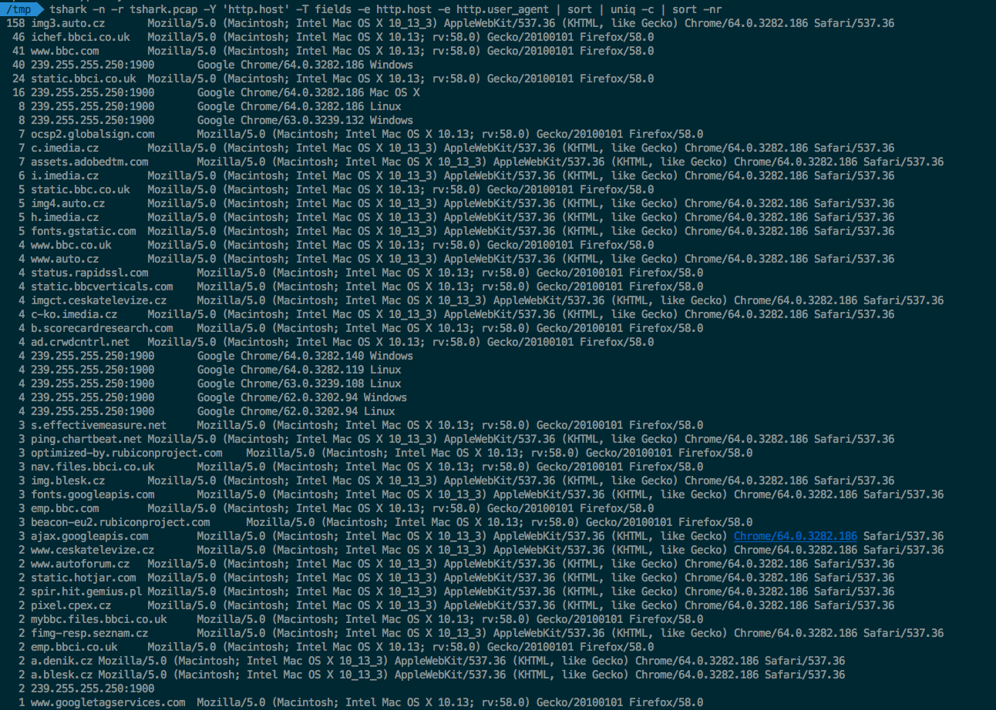
Tshark output screenshot

Slide 20
SOF-ELK
Notes:
So far all this was very nice, but how you can do
Big Data Analysis and visualization which scales quite easily?
The answer is SOF-ELK

Slide 21
SOF-ELK
Based on Elasticsearch, Logstash, Kibana
Security Operations and Forensics Platform
Pre-configured & Pre-loaded with parsers, dashboards
Syslog, HTTPD logs, Passive DNS, Netflow
Free and open source
The latest version at http://for572.com/sof-elk-vm
Notes:
Free and open source – one of the reasons why ELK is getting momentum for data analysis and visualisations

Slide 22
SOF-ELK DEMO
Notes:
To show:
SOF-ELK introduction dashboard, timespan, what is netflow.
Story: Neflow data are from real security incident where company was breach and data stolen. So imagine that company calls you as security expert to analyse the data they have to them what computers were compromised and how much data was stolen.
Swith to Netflow and Netfow demo
Describe Netflow dashboard and its seachers
Timespan to set April 2, 2012 to April 8, 2012
Search for source_ip:[10.3.0.0 TO 10.3.255.255] ← Traffi from internal Ips
Talk about amount top amount fo data, amount of packets and flows.
Talk about upload and download ratio.
Search for source_ip:[10.3.0.0 TO 10.3.255.255] AND !destination_ip:[10.3.0.0 TO 10.3.255.255] <-- Traffic from internal network to internet
Talk about 10.3.58.5 and volume/flows ration comparing to other Ips. Significantly higher amount of bytes per flow may suggest file transfer/extil data rather than beaconing or c2 traffic
Search ips:10.3.58.7 AND ips:199.73.28.114
Talk about S and AR –and then working state with full flags (AP.SF)

Slide 23
Questions & Answers
Questions
Answers
Comments

