Slide 1
Team Management Application for PED’s
Joshua Paterson

Slide 2
Problem Overview
Application cable of
co-ordinating/collaboration of teams
Aims to better
time management
better record keeping
Problems with current methods
Few options approved due to security
No standardised method
Updating information easily

Slide 3
Needs
Security
Capability

Slide 4
Security
Approved for classification of up to Official
Encryption algorithms used – top secret
RSA with 3072-bit key – key exchange
AES-256 – general network encryption
SHA-2-384 – one way information encryption
Sever self-hosting
Other security issues

Slide 5
Capability
Organising, sorting, and tracking projects
From wherever a user is.
Communication between users
Easy to navigate UI

Slide 6
Project Constraints
Issues with iOS kill codes
Will not be a web app

Slide 7
iOS kill codes
Devices with iOS 9 install
Can be remotely wiped

Slide 8
Security issues with Web Apps
Risks with web applications
Injection
Cross-Site Scripting XSS
logging and monitoring
Unsecure deserialization
Broken authentication and session management
Insecure direct object reference
Many more

Slide 9
Approach
Will be a Mobile application
Written in java programming language
Developed using a agile methodology

Slide 10
Milestones
Client to Server Database encrypted communication
User authentication / login
User registration
Home UI skeleton / app navigation
Feature 1 – team organiser
Feature 2 – group and individual messaging
Feature 3 – personalised check list
Feature 4 – team message board

Slide 11

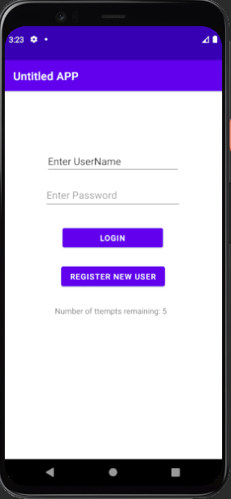
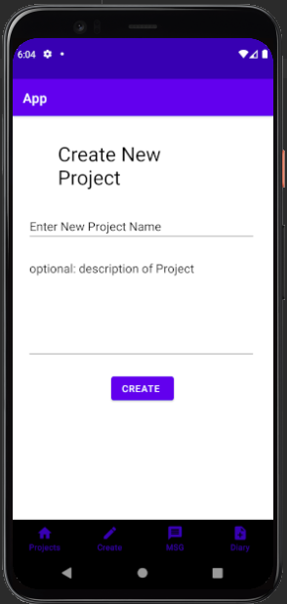
Completed milestones.
Client to Server Database encrypted communication
User authentication / login
User registration
Home UI skeleton / app navigation

Slide 12
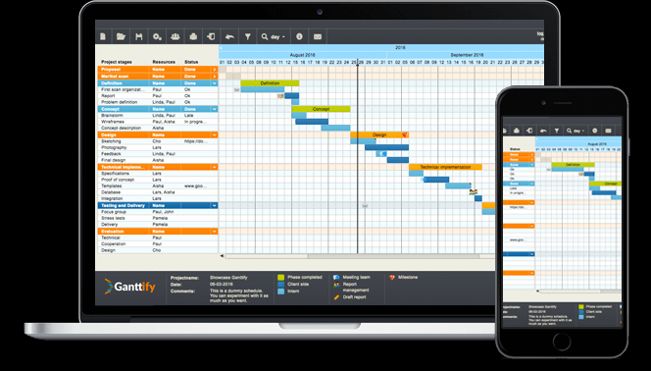
To be completed
Feature 1 – team organiser
Feature 2 – group and individual messaging
Feature 3 – personalised check list
Feature 4 – team message board

Slide 13
what have I learnt.
Mobile vs desktop programming
Increase code complexity
Research skills

Slide 14
Questions

