Slide 1
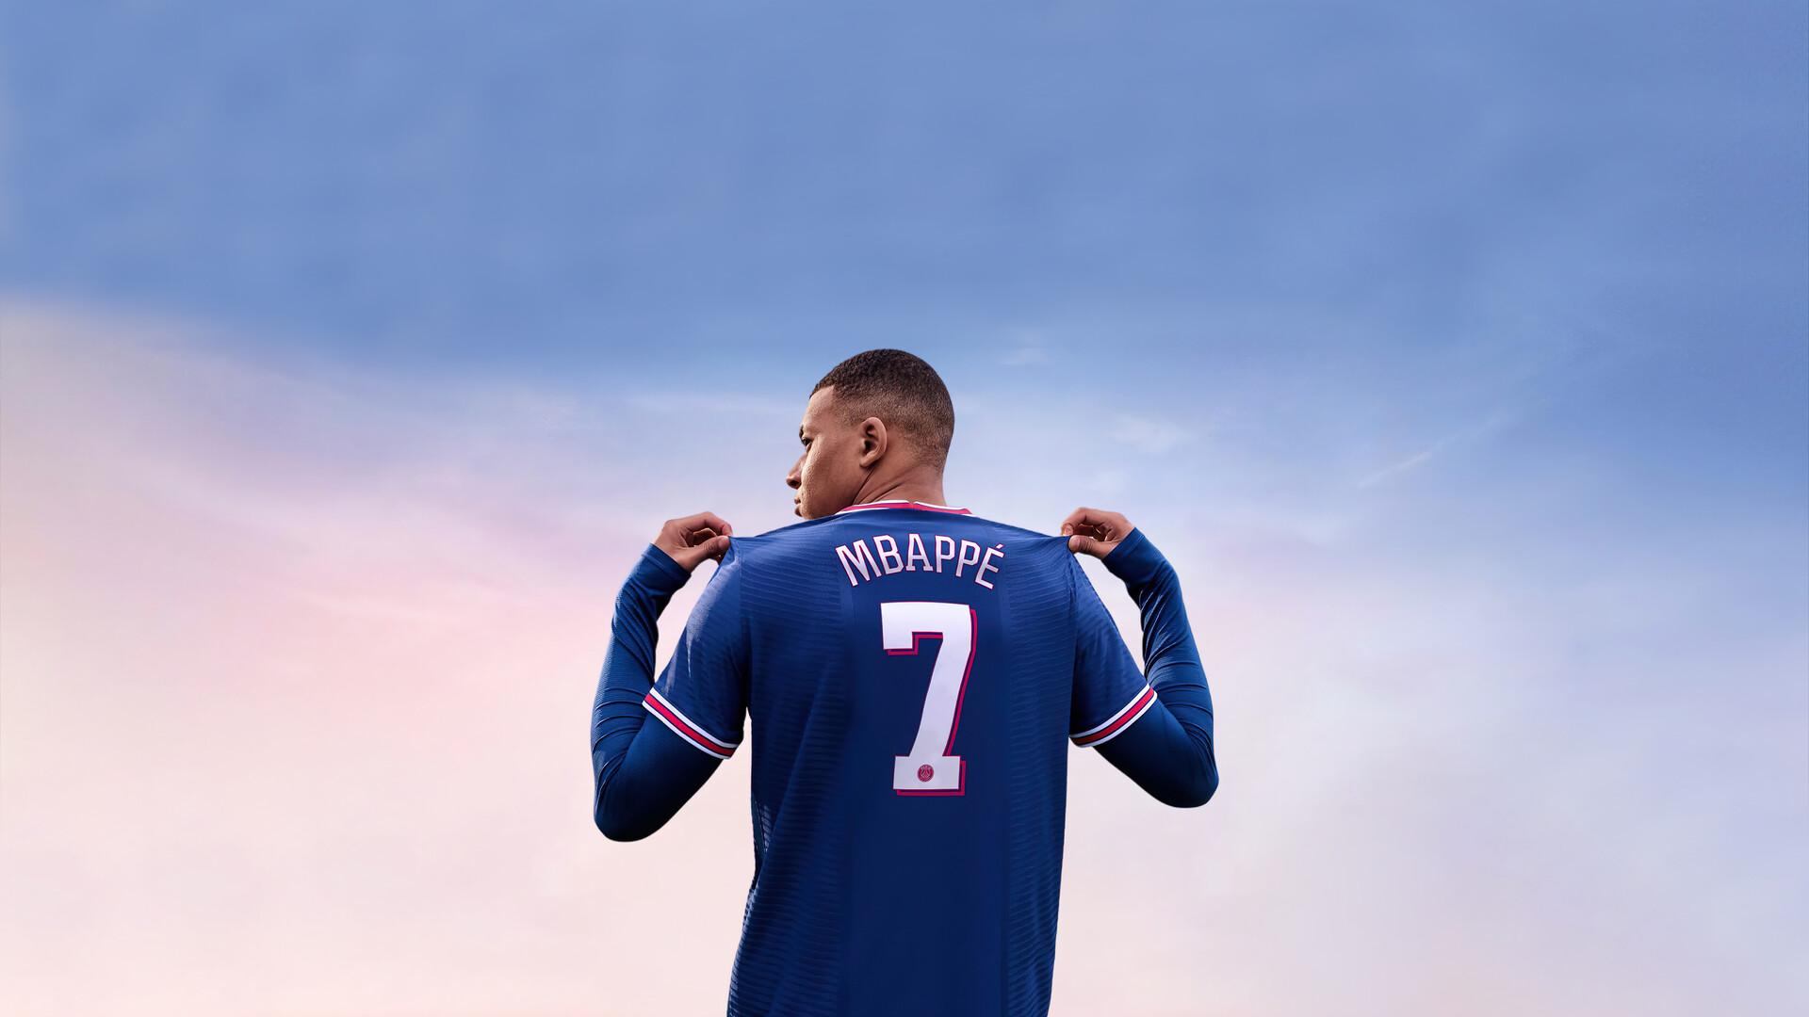
FIFA 22 PLAYER ANALYSIS PROJECT
By Data Pirates

Slide 2

What does our project do?
Based on the dataset of FIFA 22 that contains information of 19,239 male players with 110 different attributes.
Analyses the dataset and finds various correlations and connections between player attributes.
Supports a number of pre-selected queries you can run based on our analysis.
Has a main menu allowing you to pick from the list of queries.
Presents the results in textual and graphical manner.

Slide 3
EXAMPLES

Slide 4
Q: Which league has the most valuable players?

Slide 5
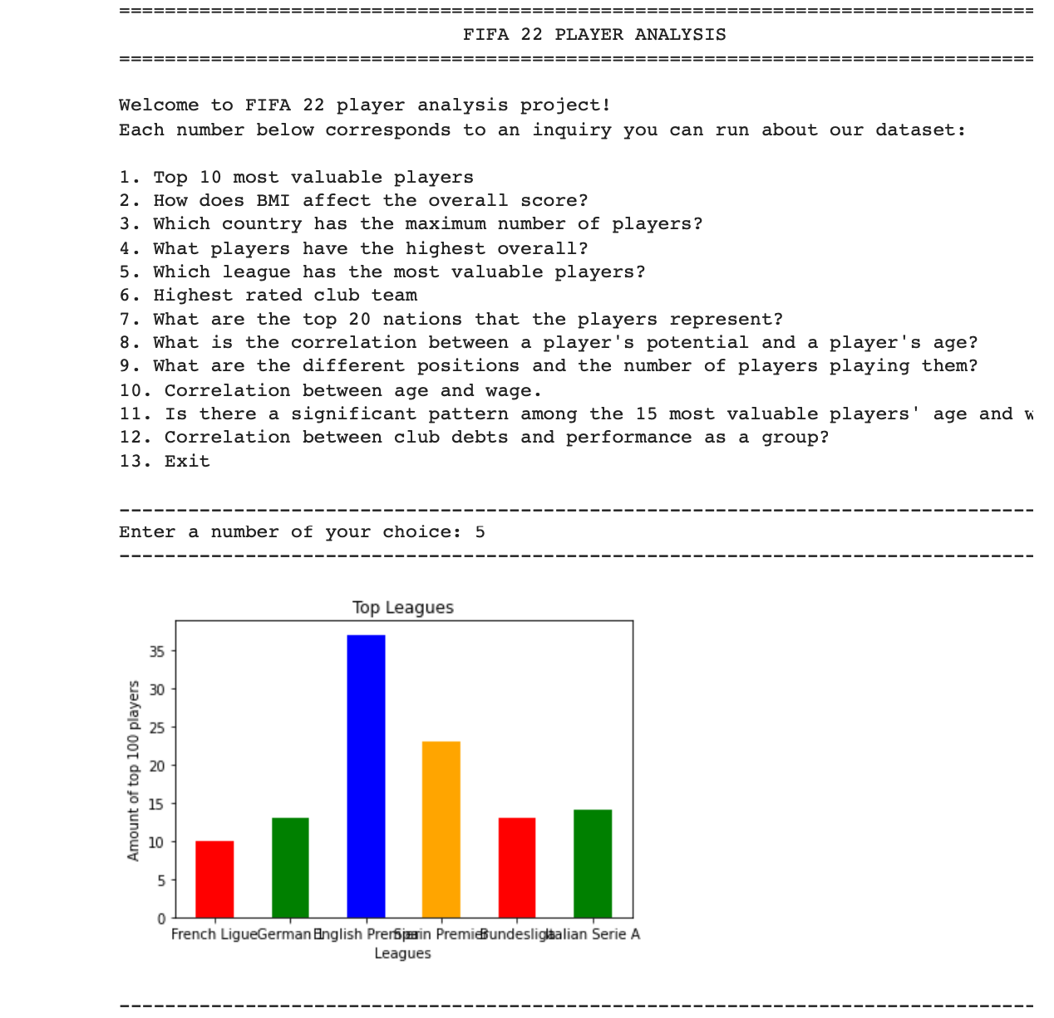
A:

Slide 6
Q: Who are the top 10 most valuable players?

Slide 7
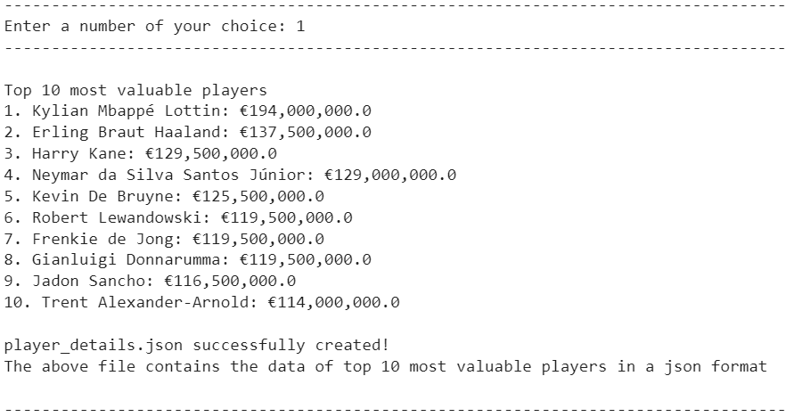
A:

Slide 8
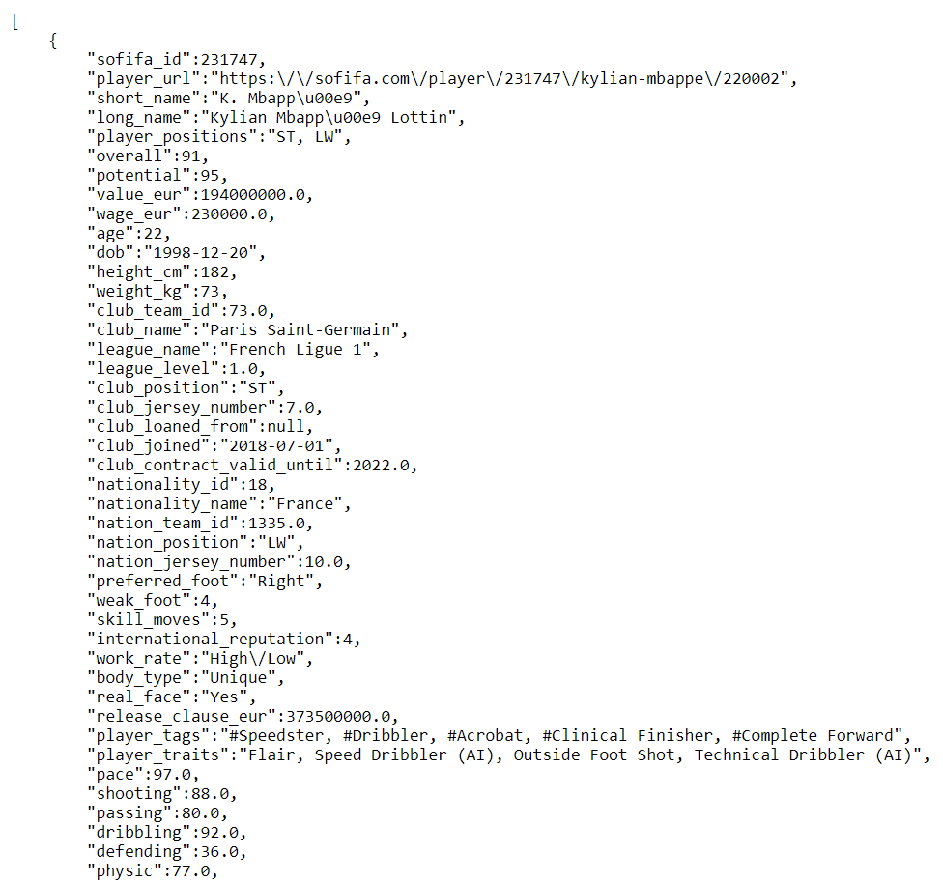
player_details.json

Slide 9
Q: What are the different positions and the number of players playing them?

Slide 10
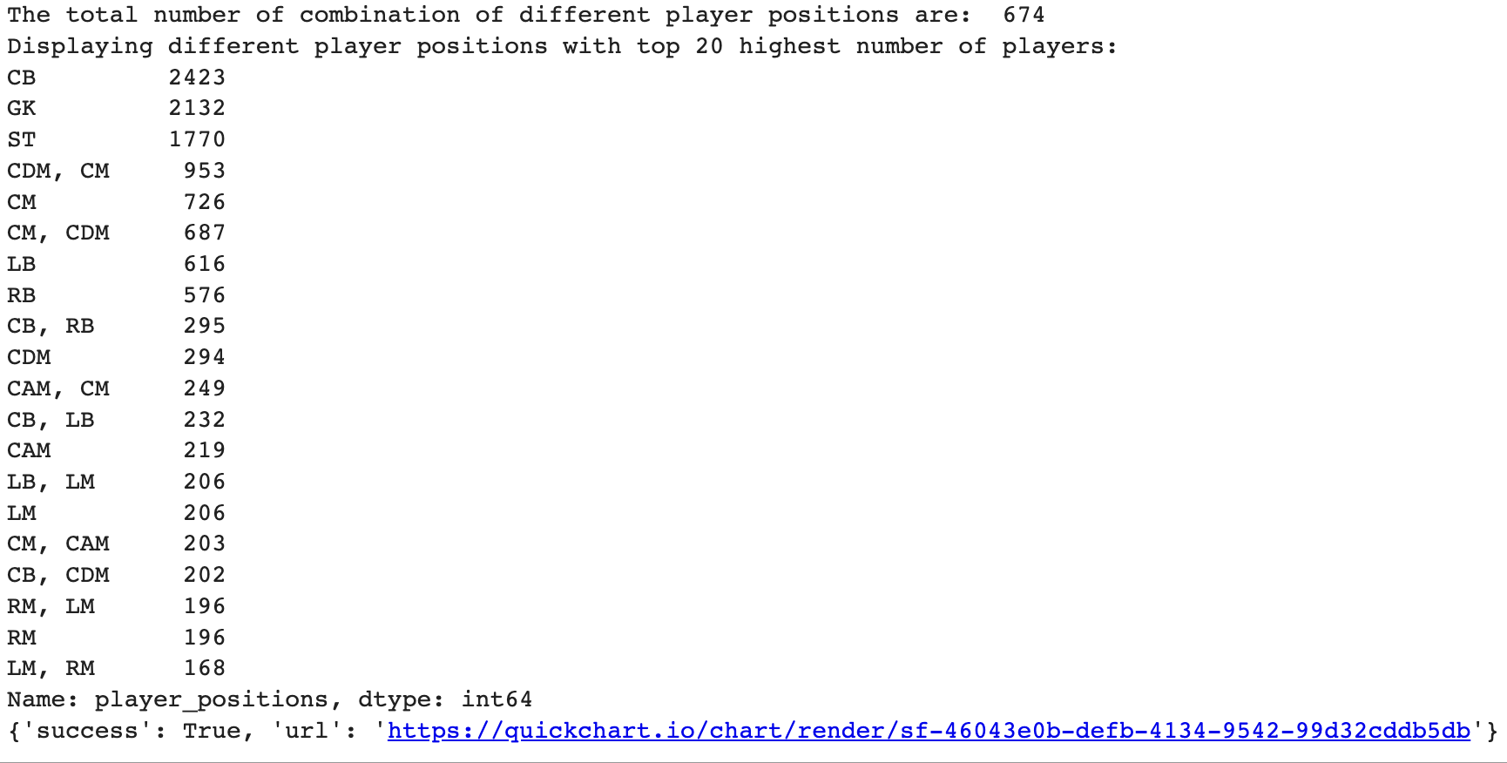
A:

Slide 11
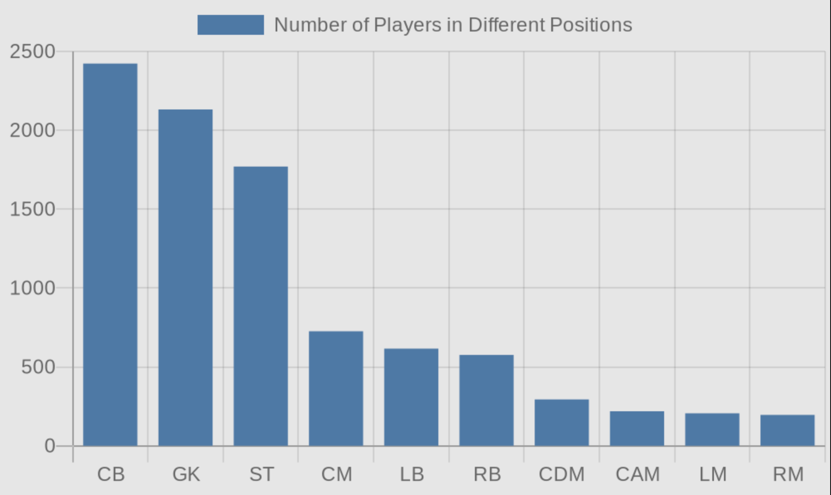

Slide 12
Q: Correlation between age and wage

Slide 13
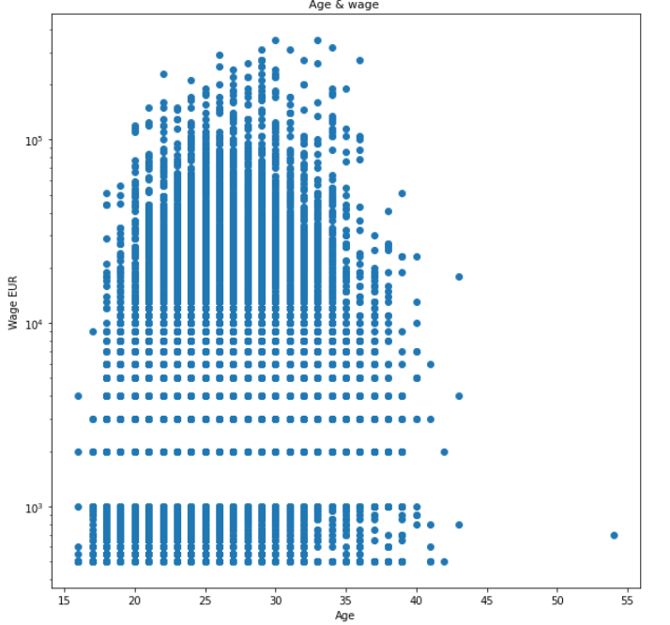
A:

Slide 14
How did we approach it?

Slide 15
We assigned each group member several tools to work with so that we can fulfill our minimum requirement of using 6 tools. However, everyone was free to utilize Pandas and Matplotlib.
The tools we used in our project are:
Pandas
Matplotlib
JSON
API
Web Scraping
Word Cloud

Slide 16
Thank You!

