Slide 1

Oil Sands Projects
Lessons Learned Overview
April 5, 2008
1 of 8

Slide 2

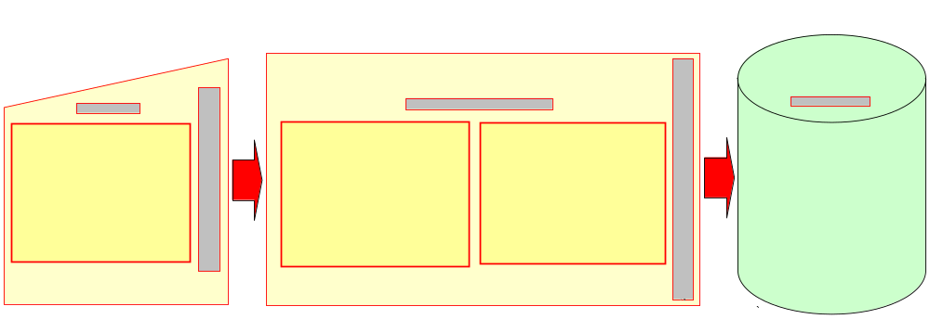
TLM Moment – Lessons Learned
Lessons Learned drive Continual Improvement and Cheaper, Better, Faster Oil Sands Projects
Continual Improvement is ongoing:
  Lessons Learned should be captured as experiences and learnings occur
  Stage Gate Process requires the capture of Lessons Learned
2 of 8

Slide 3




Lessons Learned System:
behavior (action), cycle (process), tools, value added items
Org improvement
Trends, reports
Search tools
Accessible
to users
Bulletins, temp. directives
Knowledge area repositories:
-> Prioritize content
-> Control shelf life
Repository
Standards, specs, procedures, PM@PC
Publish
Urgent
Holding tanks:
-> Extract useful knowledge
-> Update formal documents
-> Publish remainder in repositories
Main updates
User rating of LL
Work in
progress
Eng
TLM
SCM
Proj Con
Etc…
filter / clear / assign
Capture tools
Capture raw input
Apply LL
Publications
Execute tasks, processes, projects
Benchmarks
Associations
Search
3 of 8

Slide 4
Leveraging Lessons Learned for CBF
RESULTS
FOCUS & ACTION
REWARDS & RECOGNITION
LESSONS LEARNED ENABLERS
PEOPLE, PROCESSES AND SYSTEMS
THE OSP VISION
CHEAPER, BETTER, FASTER PROJECTS
POSITIVE CHANGES SUPPORTING THE CBF VISION
CONTINUAL IMPROVEMENT
4 of 8

Slide 5
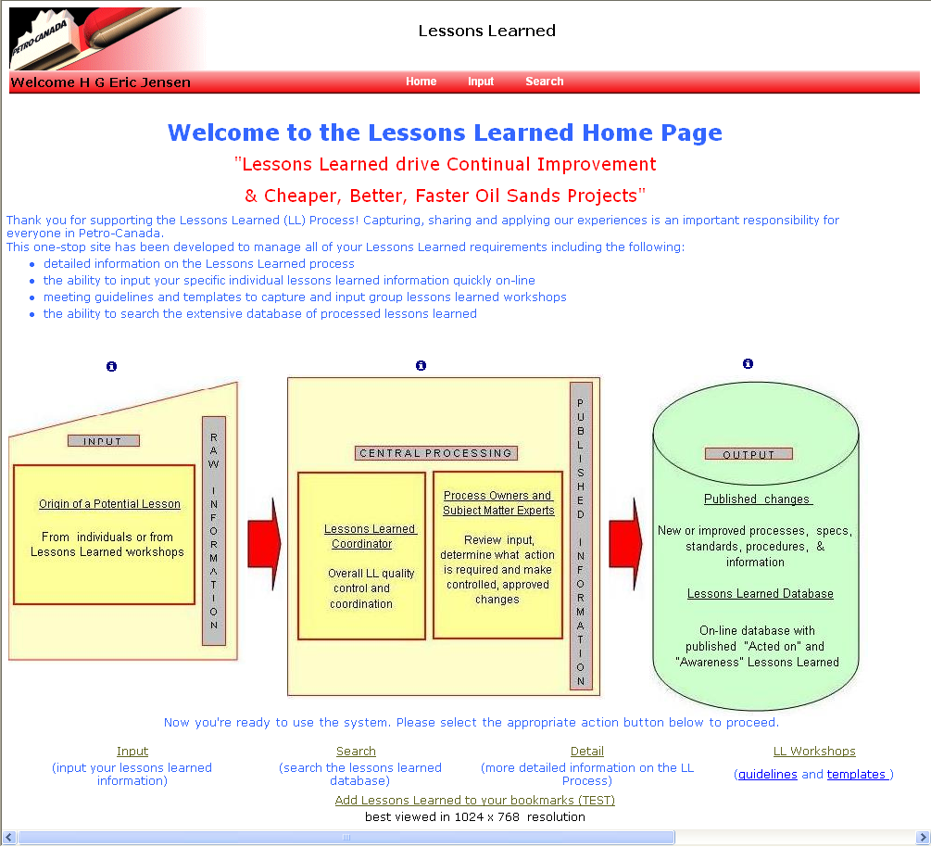
Lessons Learned Home Page
5 of 8

Slide 6
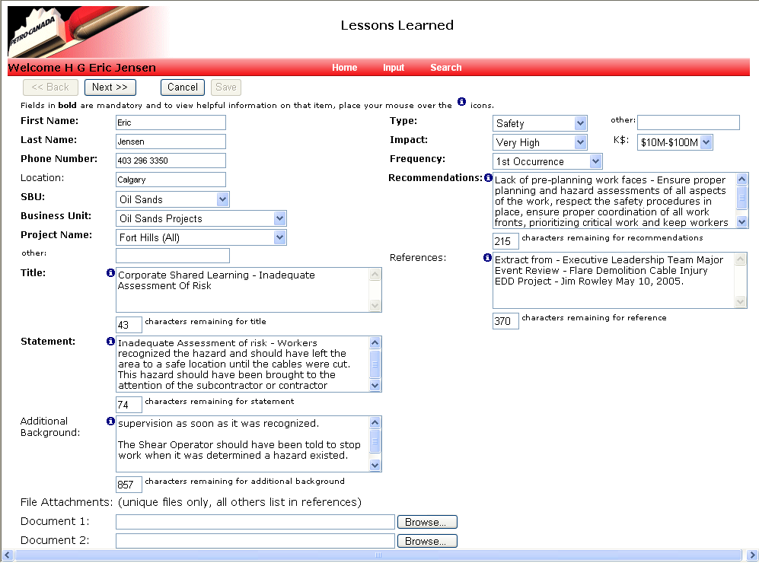
Lessons Learned Input Screen #1
6 of 8

Slide 7
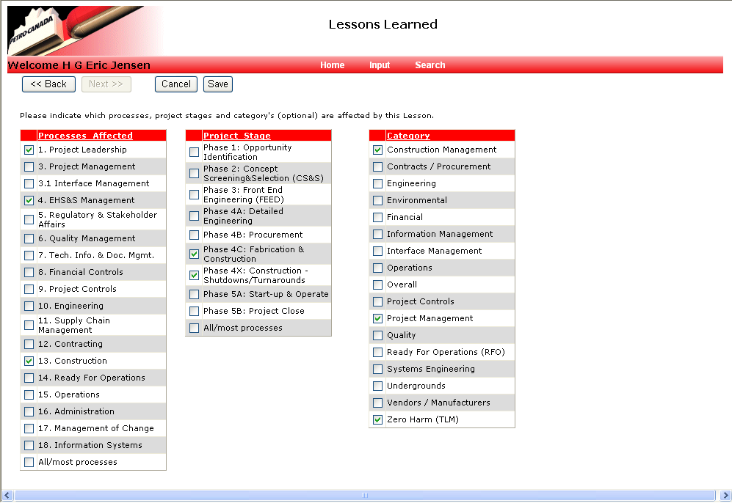
Lessons Learned Input Slide #2
7 of 8

Slide 8
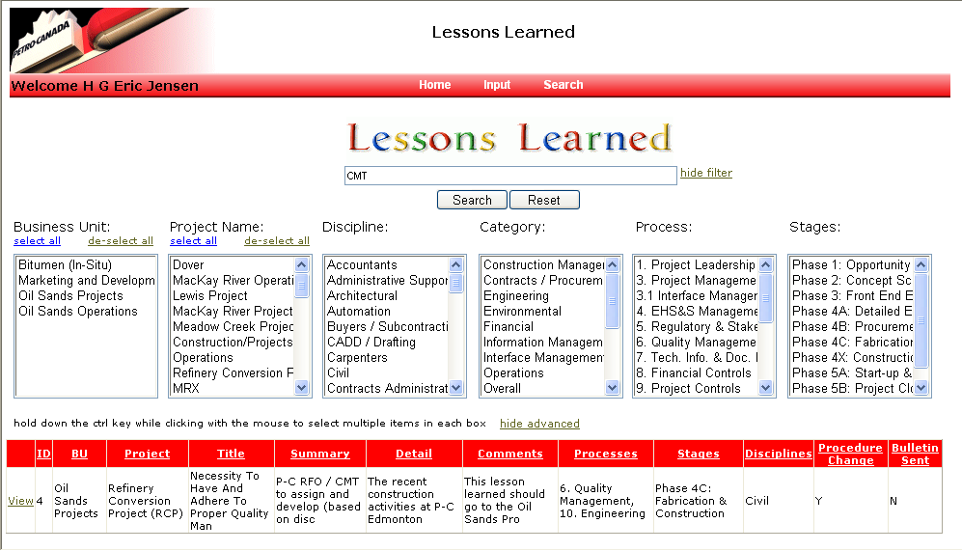
Lessons Learned Search Screen
8 of 8

