Slide 1

Oil Sands Projects
Lessons Learned (LL) Workshop Kit

Slide 2






Workshop Guidelines
Workshop objectives
  Capture Lessons Learned in a consistent, standardized format that will enable Oil Sands Projects to process and take action on the learnings to drive continual improvement
Housekeeping
  Safety, washrooms, refreshments and breaks
Rules of engagement
  Participate: it’s your workshop & there are “no dumb questions”
  Don’t overwork issues – use the parking lot
  Turn off cell phones & blackberries: minimize disruptions to others
  One person at a time – help the facilitator drive a good meeting
  Listen and learn – build off the energy and ideas of others - this is a continual improvement exercise, not to place blame or point fingers

Slide 3
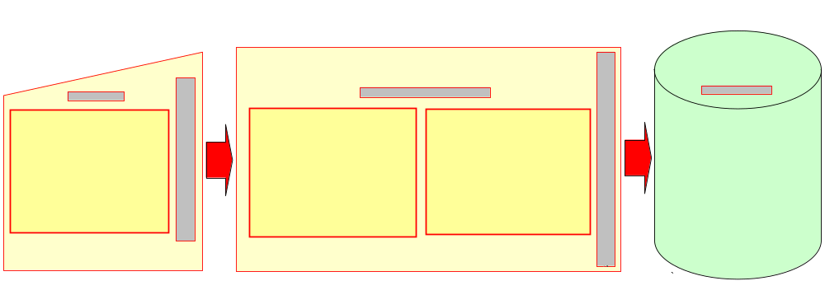
TLM Moment – Lessons Learned
Lessons Learned drive Continual Improvement and Cheaper, Better, Faster Oil Sands Projects
Continual Improvement is ongoing:
  Lessons Learned should be captured as experiences and learnings occur
  Stage Gate Process requires the capture of Lessons Learned
2 of 8

Slide 4
A Lesson Learned is…
Knowledge (based on experience) of a specific combination of factors (e.g. circumstances, requirements, capabilities, resources) that explains a cause and effect relationship
Which:
  is either positive (success) or negative (failure)
  is significant (beneficial, has an impact)
  is valid (confirmed to be accurate)
  is applicable (identifies a specific process, procedure, model, technology, etc.)
  is published and used on future projects - MOST IMPORTANT!!
    an “Action LL” where a change has been implemented (procedures, specs, process, standard, etc.)
        OR
    an “Awareness LL” to provide insights to future projects

Slide 5
A Lesson Learned System is……
A means (continuous cycle) of turning raw input (data) into useful knowledge (lessons learned) which:
  directly supports the organization’s ability to learn and continually improve (safety, cost, schedule, quality, etc.)
  is captured primarily in the formal documentation of the organization (e.g. standards, procedures, specifications, models, guidelines, practices, etc)
    captures major learnings in a readily accessible repository
  is supported by the individuals who contribute, participate and use the system and act upon lessons learned

Slide 6
New Lessons Learned Process
Lessons Learned (LL) are an important element of Continual Improvement
  Stage gate requirement
Current LL process needs improvement
  Decentralized, lacking a standard input format or process
  Information not processed centrally – difficult to act on or share
New LL process is standardized, centralized and consistent:
  Approved LL Workshop Kit & Excel workbook template
  Enables LL processing and follow up action
  Allows EPC’s and Contractors flexibility
    Can use their own processes & procedures if they prefer
    However, final LL must be submitted in the approved template
All details on the new self sustaining process are outlined in this kit and the LL MS Excel workbook
Any questions or concerns can be addressed to ospll@petro-canada.ca

Slide 7
On with the Workshop……
Lessons Learned MS Excel Workbook contains:
  Overall workbook guidelines and detailed information
  Summary Template to document workshop attendees, date, etc.
  MS Excel Template to record Lessons Learned
  Template to capture group comments on how to improve the process
  Parking Lot for follow up items
Suggested Workshop process:
      Review any pre-work (individual LL input ) with total group
        facilitator should solicit input from all attendees in advance
      Run a group exercise to identify things that:
        we should do more of,
        we should do less of,
        we should just stop doing
      Open group brainstorming (“trigger” categories and topics)

