Slide 1
CAIA NEPC Brief
J. Patrick Connor
G3 Gusev Lab

Slide 2
Outline
Section 1: Background on our model incorporating clinical text
into survival models
Section 2: NEPC-specific results using both PSA and text as
covariates

Slide 3
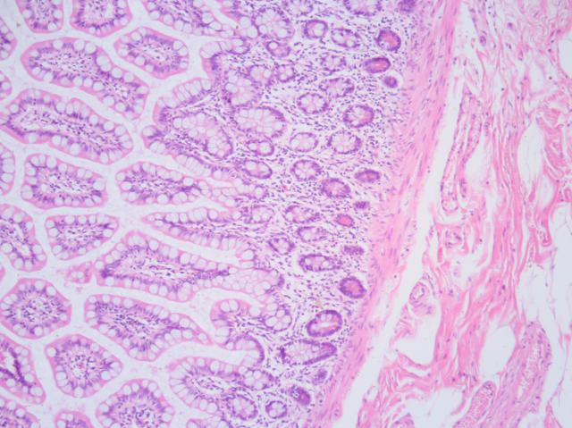
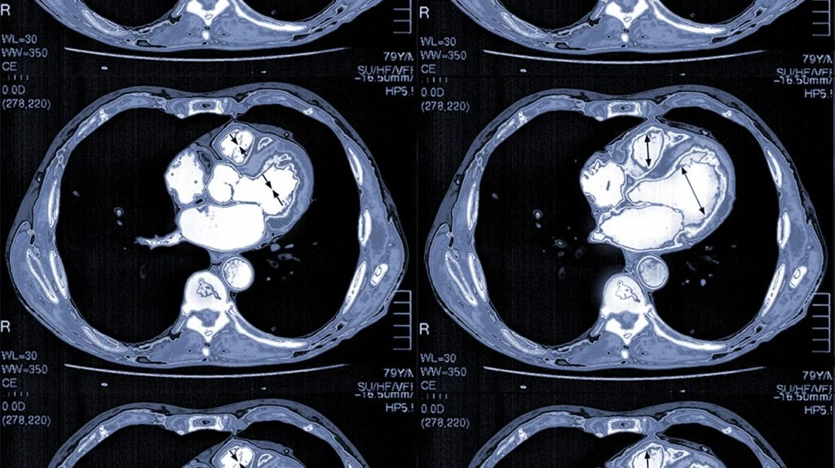

Clinical Text Project Overview
Pathology reports
Imaging reports
Clinical/Progress reports
S(t) ~ Age + Gender + Pathology text + Imaging text + Progress text
Where S(t) could be time to death, metastasis, or various diagnostics and the representation of the text contains more complete information of the patient’s record than just one note instance

Slide 4

Clinical Text Model Pipeline
Observation Window
1) Embed text with ClinicalLongformer
768 dimensional embedding
768 dimensional embedding
768 dimensional embedding
2) Perform time-decayed pooling
768 dimensional embedding
768 dimensional embedding
768 dimensional embedding
768 dimensional pooled embedding

Slide 5
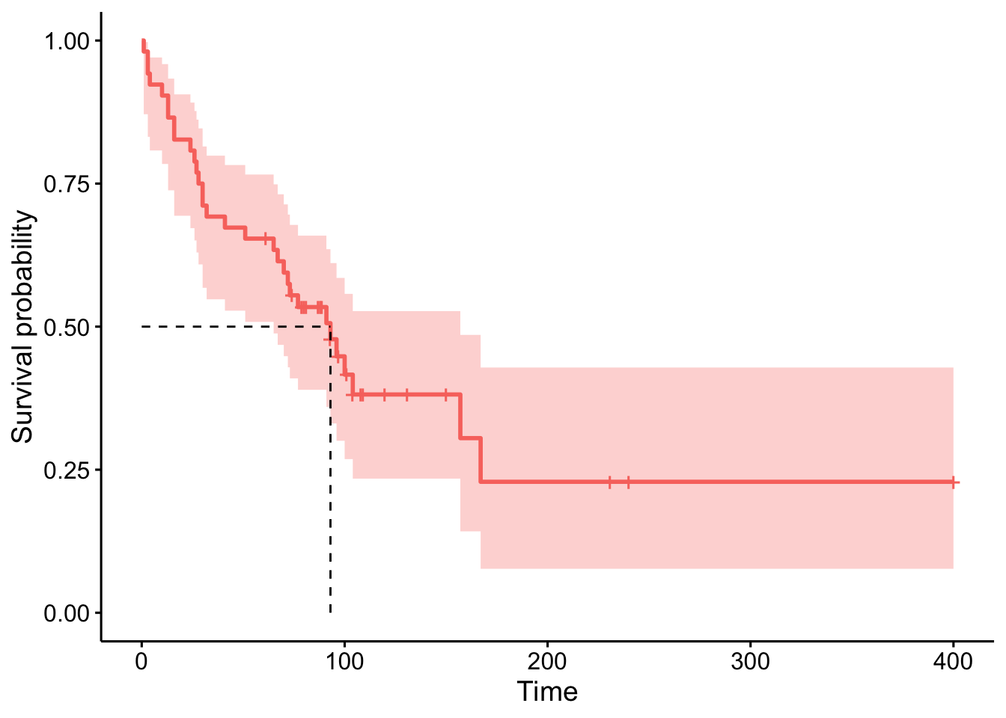
Clinical Text Model Pipeline
Observation Window
Prediction Window
768 dimensional pooled progress report embedding
768 dimensional pooled pathology report embedding
768 dimensional pooled radiology report embedding
Age
Gender
Survival
Model
3) Train survival model with the generated covariates

Slide 6
NEPC Data Curation (DFCI PROFILE)
Query for prostate cancer patients with:
>= 10 PSA tests
NEPC or censoring (e.g. death/lost-to-follow-up) occurring after the 10th PSA test
Annotate NEPC label as:
Initiation of platinum-based chemotherapy:
Carboplatin, etoposide, atezolizumab, cisplatin
Annotate time-to-event as:
Date of NEPC initiation as defined by medication
Time of death or last contact
1049 patients in the cohort
190 patients have an NEPC event (18.11% of the cohort)

Slide 7
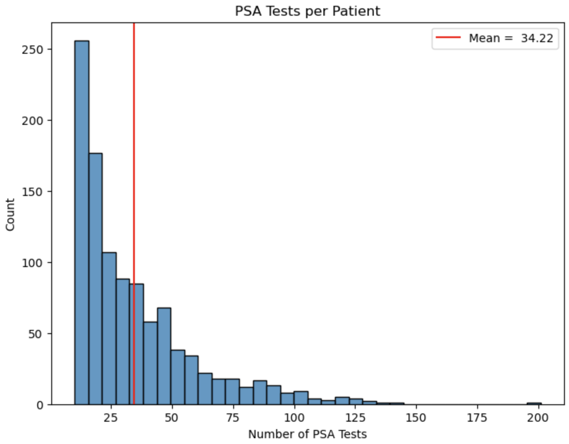
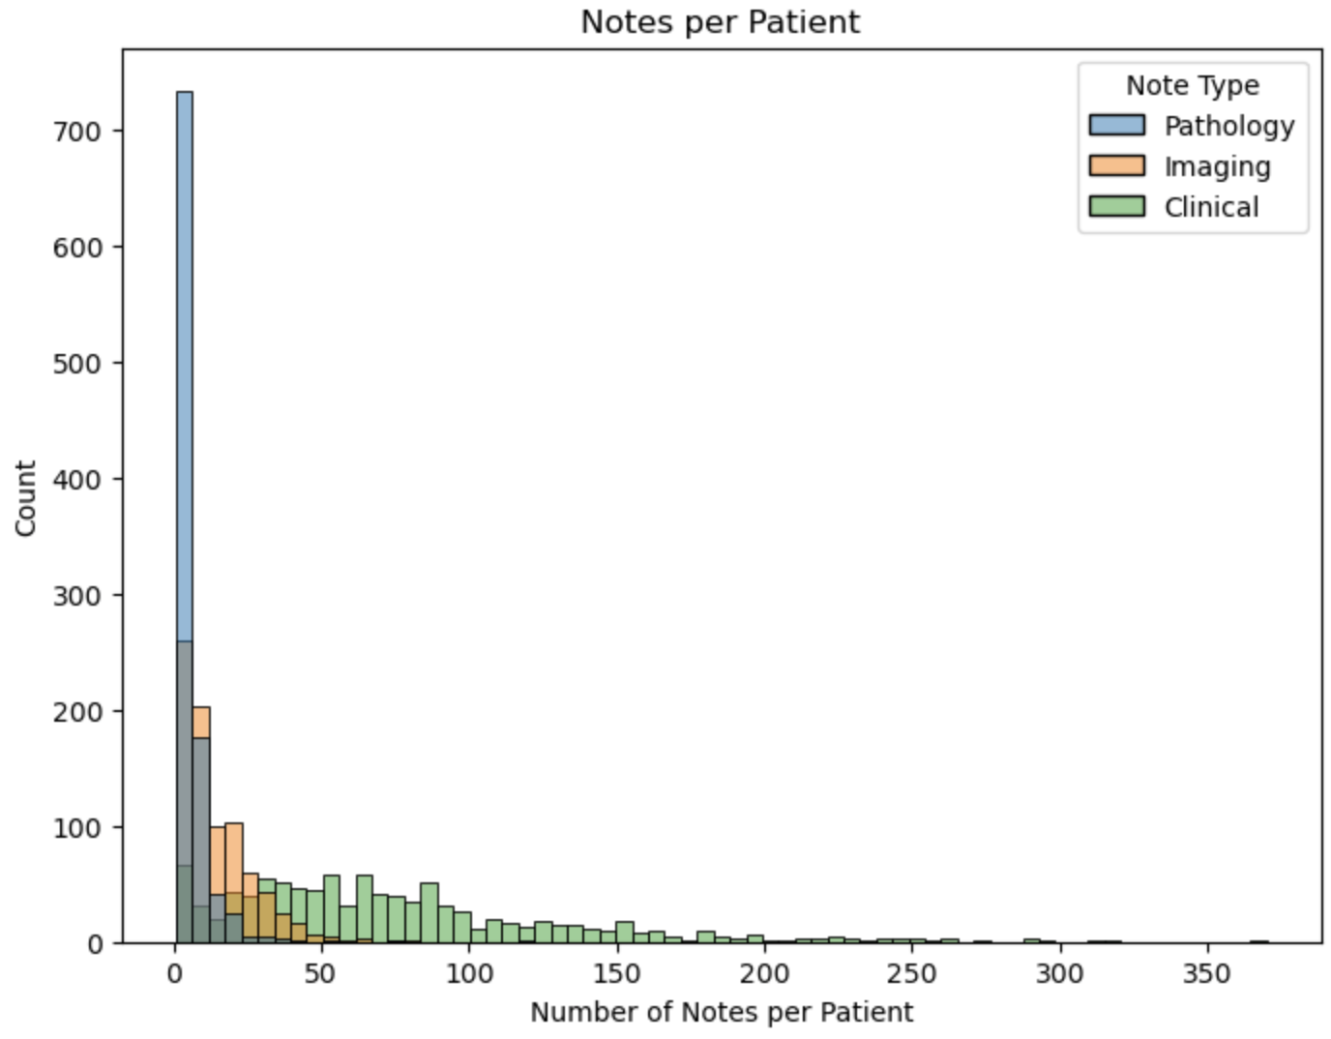
NEPC Data Curation (DFCI PROFILE)

Slide 8
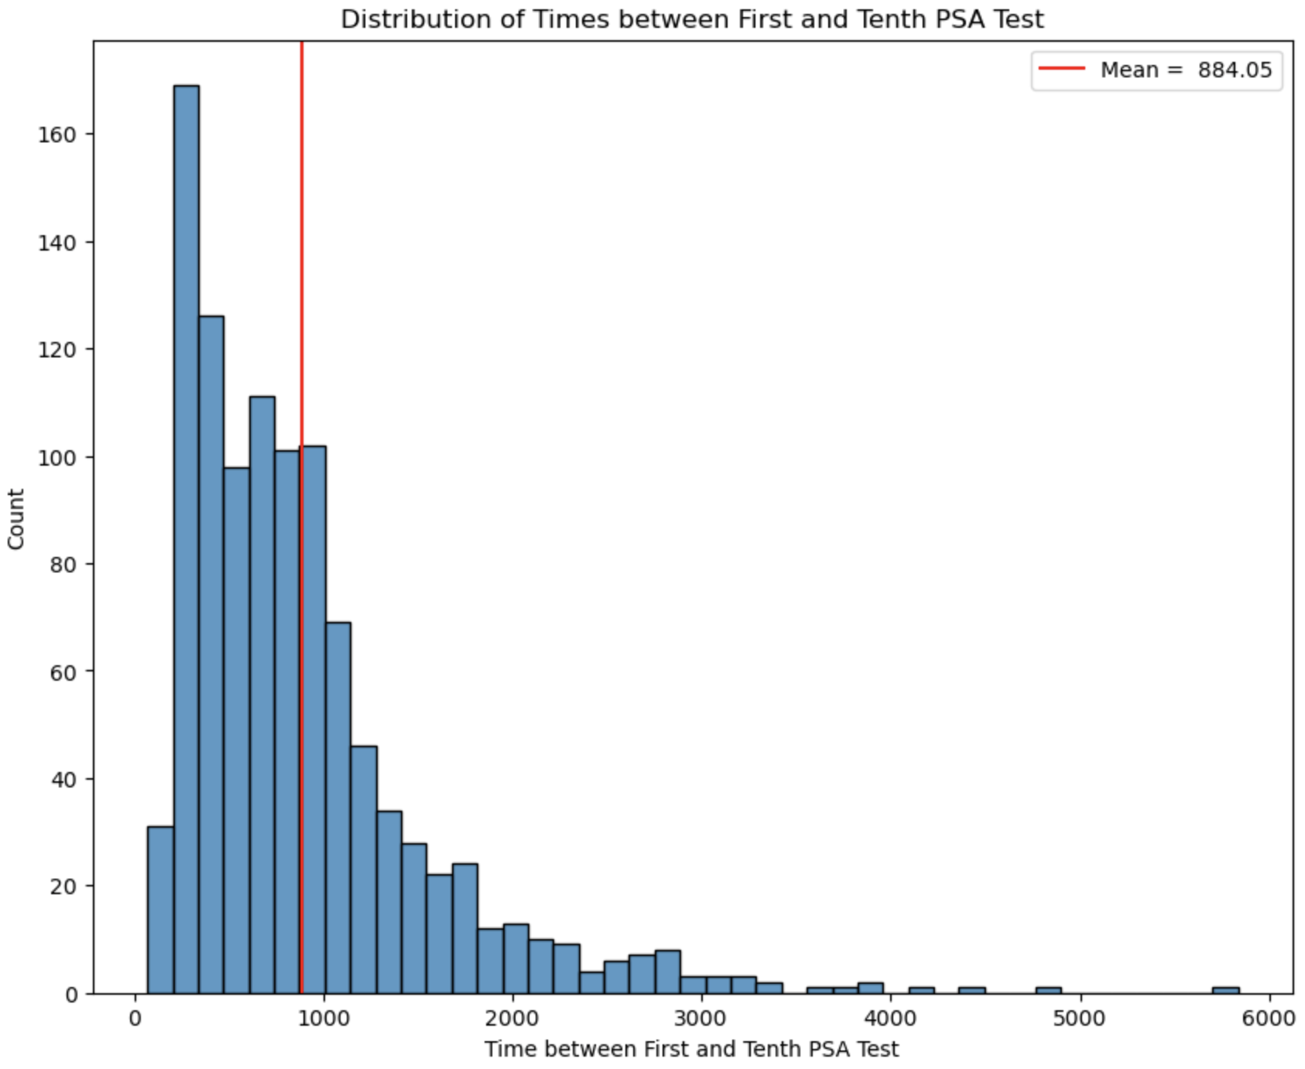
NEPC Data Curation (DFCI PROFILE)

Slide 9
NEPC Survival Models
Define 10 separate prediction windows:
Predict time-to-NEPC from first PSA test, second PSA test, etc.
Consider both text and PSA measurements
For PSA measurements use either:
Sequential measurements within the observation window
Mean and standard deviation of the measurements within the observation window
Generate the following models:
Mean + Stddev PSA
Sequential PSA
Text
Text with mean + stddev PSA
Text with sequential PSA
Report 5-fold CV c-index for each model

Slide 10
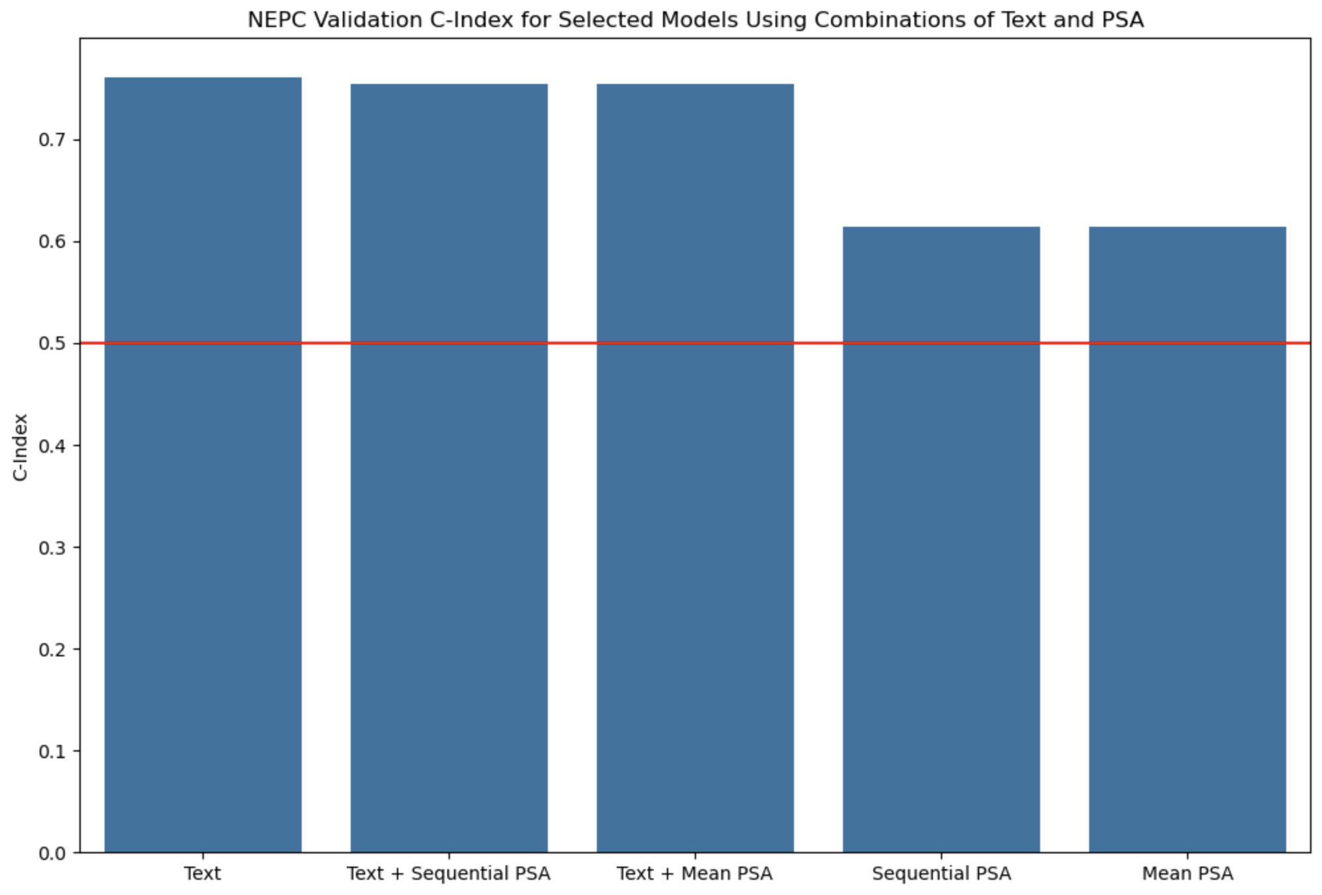
NEPC Prediction Results

