Slide 1
CAIA Technical Brief (09/19/2025)
J. Patrick Connor
G3 Gusev Lab

Slide 2
Outline
Preliminary NEPC prediction workflow
Elastic-net CoxPH models using mean PSA, sequential PSA, and clinical text embeddings
Preliminary IO toxicity prediction workflow
Elastic-net CoxPH models using monthly clinical labs and ICD codes
Overview of SurvLatentODE method (proposed method for lab/structured EHR predictions)
Example notebook from SurvLatentODE

Slide 3
NEPC Data Curation (DFCI PROFILE)
Query for prostate cancer patients with:
>= 10 PSA tests
NEPC or censoring (e.g. death/lost-to-follow-up) occurring after the 10th PSA test
Annotate NEPC label as:
Initiation of platinum-based chemotherapy:
Carboplatin, etoposide, atezolizumab, cisplatin
Annotate time-to-event as:
Date of NEPC initiation as defined by medication
Time of death or last contact
1049 patients in the cohort
190 patients have an NEPC event (18.11% of the cohort)

Slide 4
NEPC Survival Models
Define 10 separate prediction windows:
Predict time-to-NEPC from first PSA test, second PSA test, etc.
Consider both text and PSA measurements
For PSA measurements use either:
Sequential measurements within the observation window
Mean and standard deviation of the measurements within the observation window
Generate the following models:
Mean + Stddev PSA
Sequential PSA
Text
Text with mean + stddev PSA
Text with sequential PSA
Report 5-fold CV c-index for each model

Slide 5
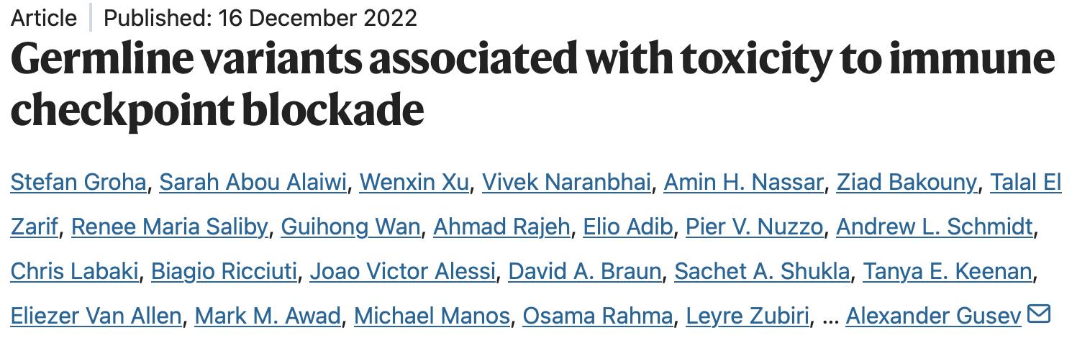
IO Data Curation + Models (DFCI PROFILE)
Dealing with a cohort of ~2k patients with annotated event data
Extracting the 25 most common ICD codes and the clinical labs most prevalent in the patient population:
Binarizing the ICD codes for 12 months before IO start and 3 months after
Interpolating the clinical labs in that same period and taking mean values of the interpolation on a month-to-month basis
Final prediction data should have monthly information for each ICD code and clinical lab
Additional base variables include AGE, GENDER, IO type, and TMB
Use elastic-net CoxPH model on the resulting data

Slide 6
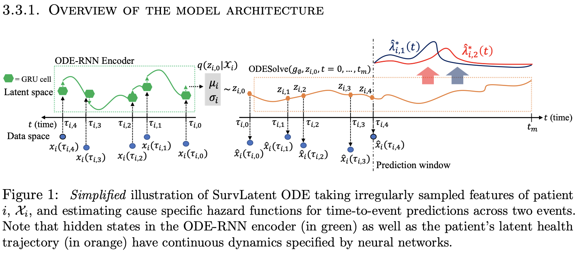
SurvLatentODE

Slide 7
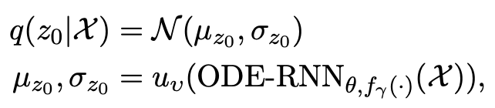
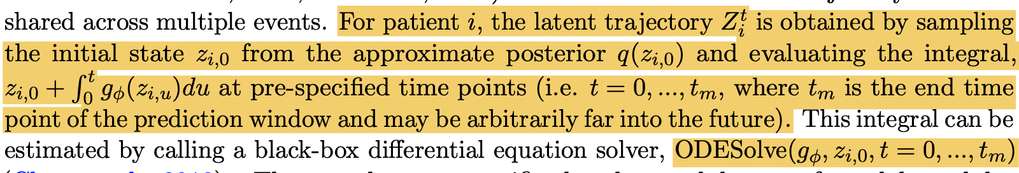
SurvLatentODE

Slide 8
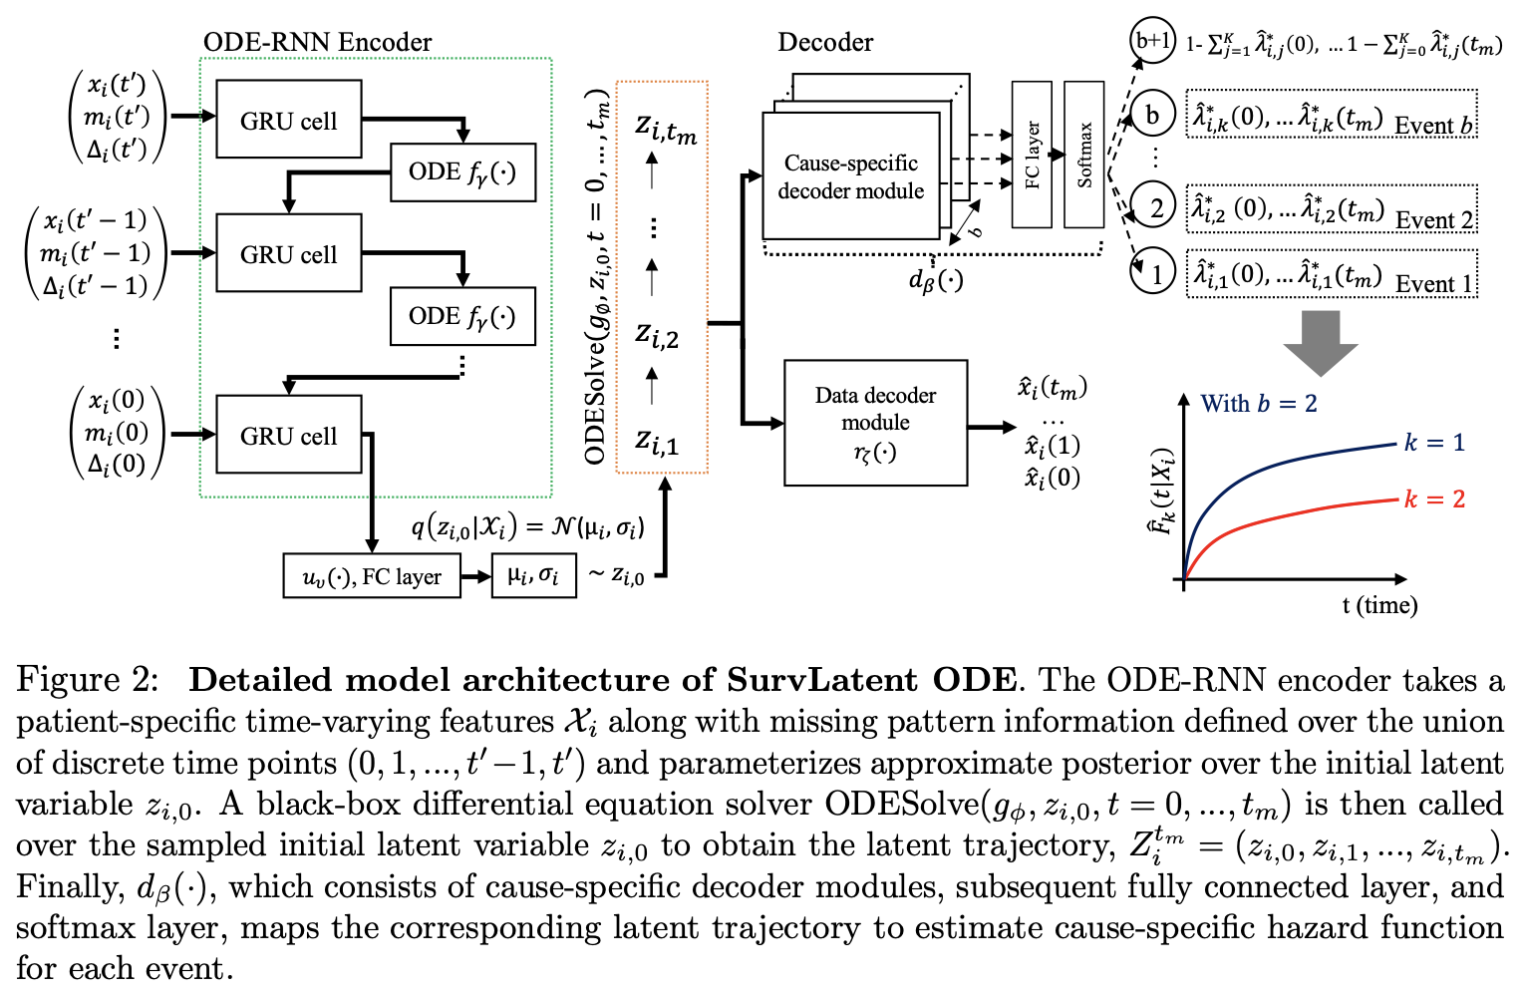
SurvLatentODE

Slide 9
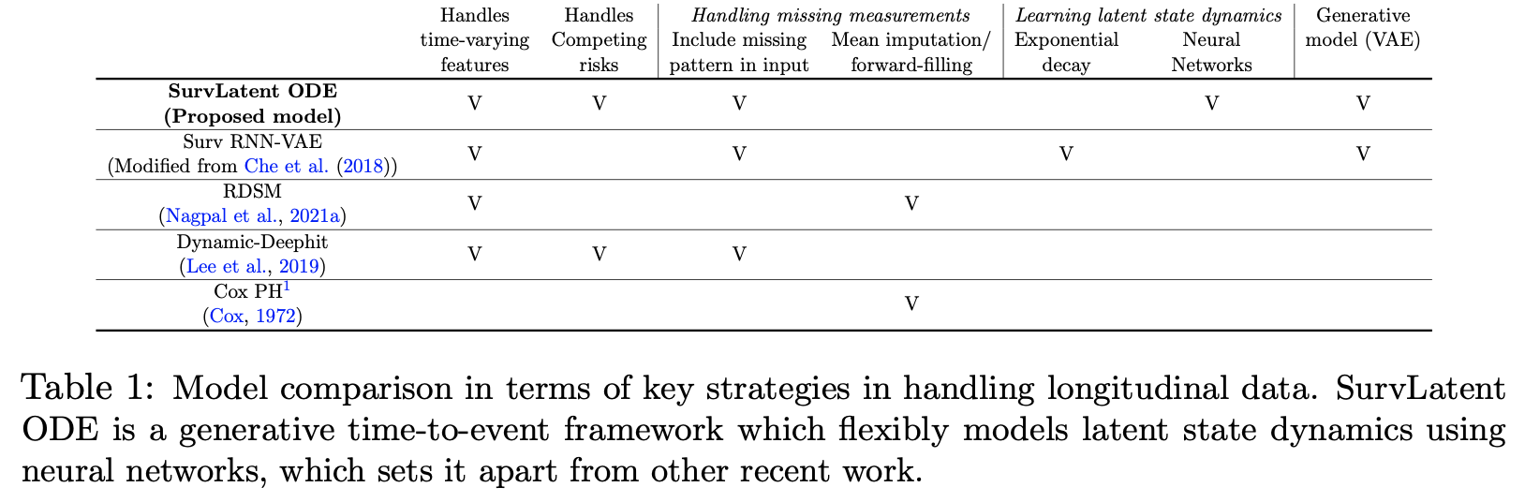
SurvLatentODE

Slide 10
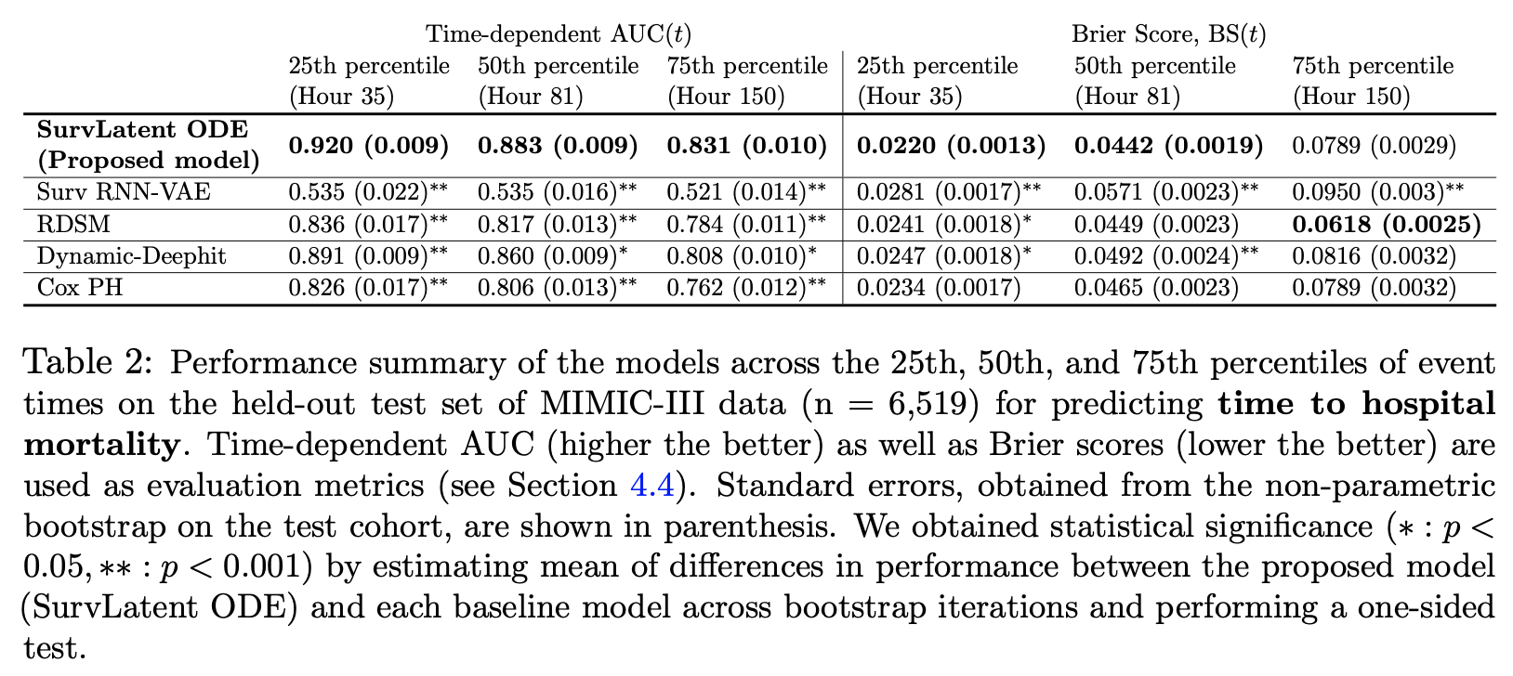
SurvLatentODE

