Slide 1
NEPC Grant Data

Slide 2
Filtering Steps
Query for prostate cancer patients with:
>= 10 PSA tests
NEPC or censoring event (e.g. death or lost-to-follow-up) occurring after the 10th PSA test
Annotate NEPC label as:
Initiation of platinum-based chemotherapy:
Carboplatin, etoposide, atezolizumab, cisplatin
Annotate time-to-event as:
Date of NEPC initiation as defined by medication
Time of death or last contact

Slide 3
Summary Data
1049 patients in the cohort
190 patients have an NEPC event (18.11% of the cohort)
Average of 2401.44 days from first PSA measurement to NEPC
Mean PSA of:
61.39 across all measurements (stddev of 308.01)
Check for outliers in the first ten
17.51 in first ten tests (stddev of 8.21)

Slide 4
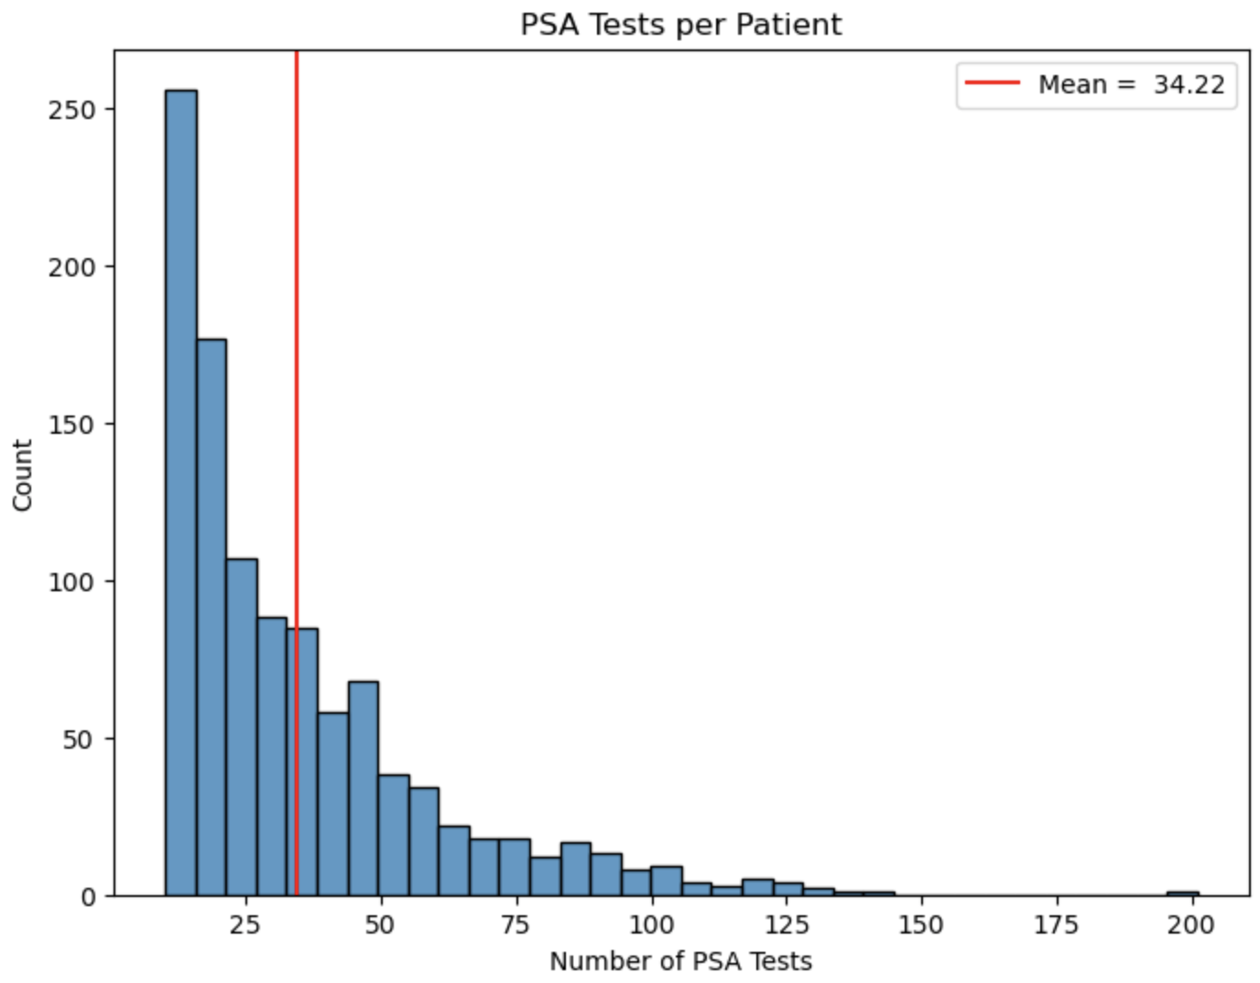
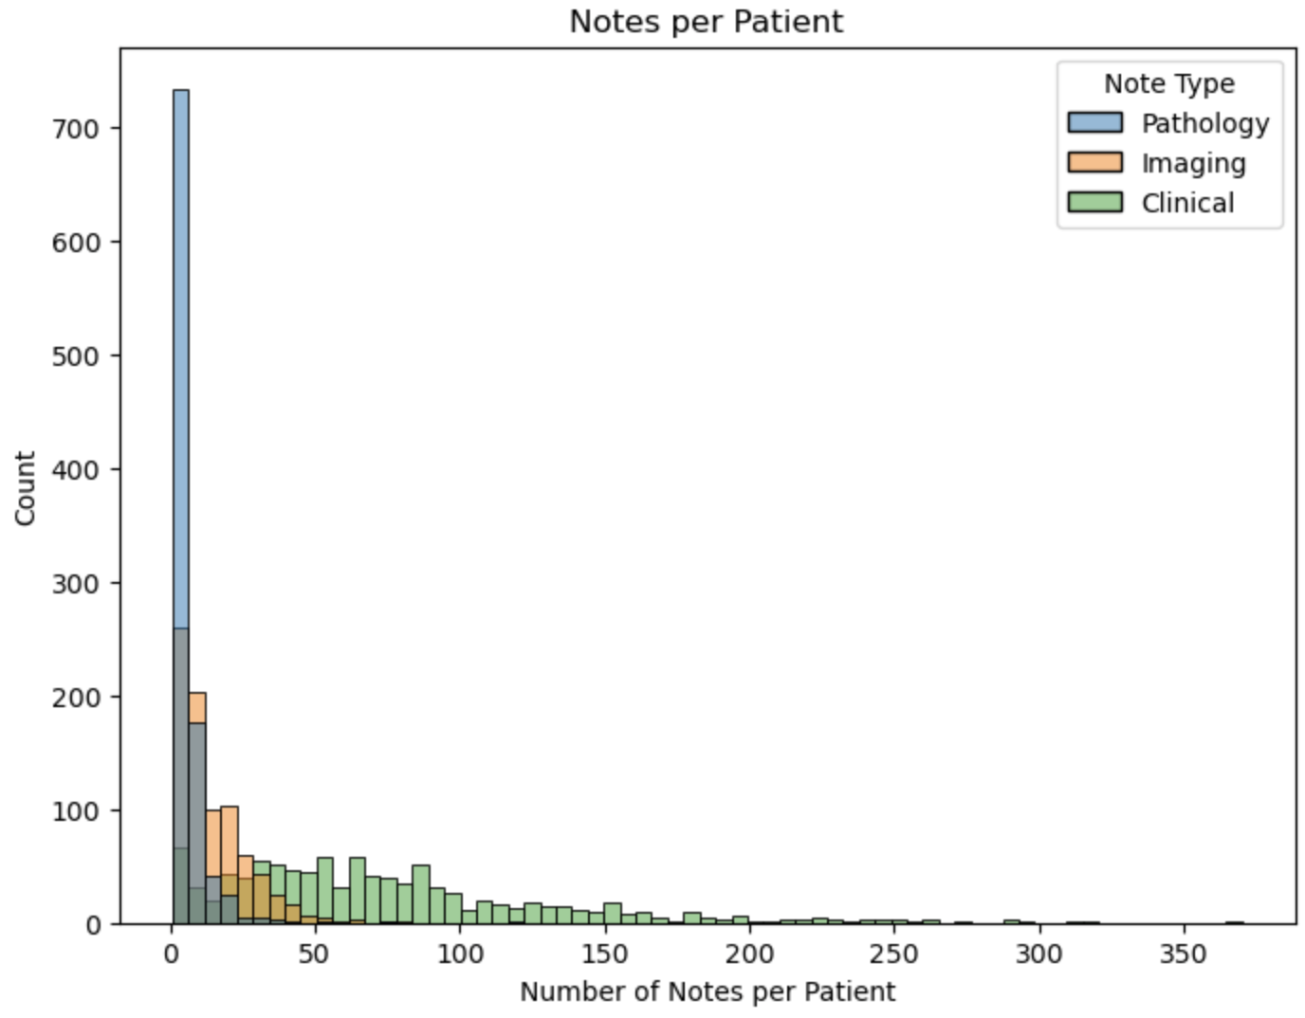
Patient-level Data Availability

Slide 5
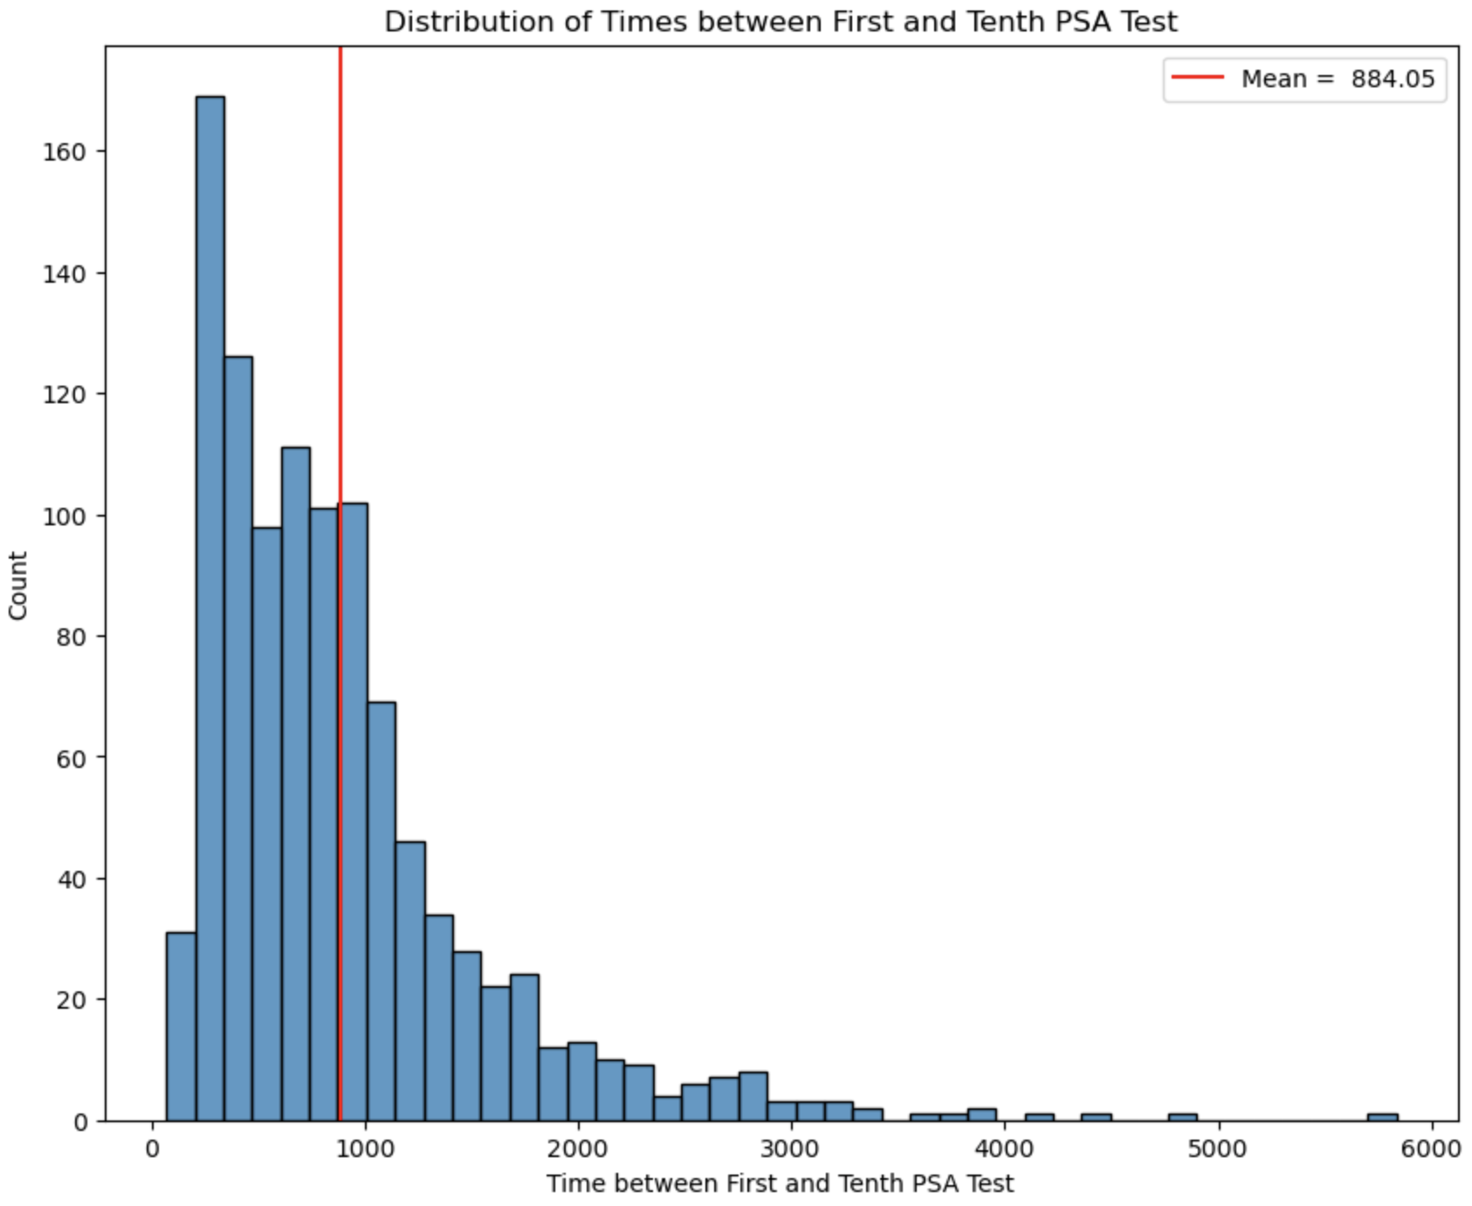
Patient-level Data Availability

Slide 6
Survival Modeling (PSA as covariate)
Since we have 10 PSA tests for each patient, define 10 separate prediction windows to perform analysis
Predict from first test, second test, third test, etc.
Two ways to input PSA:
Sequential
Predict from first test with first test, second test with first TWO tests, etc.
Mean + Stddev
Predict from first test with first test, second test with mean + stddev of first TWO tests, etc.
Wanted to compare lifelines vs. sksurv as well
Extract model results from sksurv and visualize using R or lifelines
Reported mean CV c-index

Slide 7
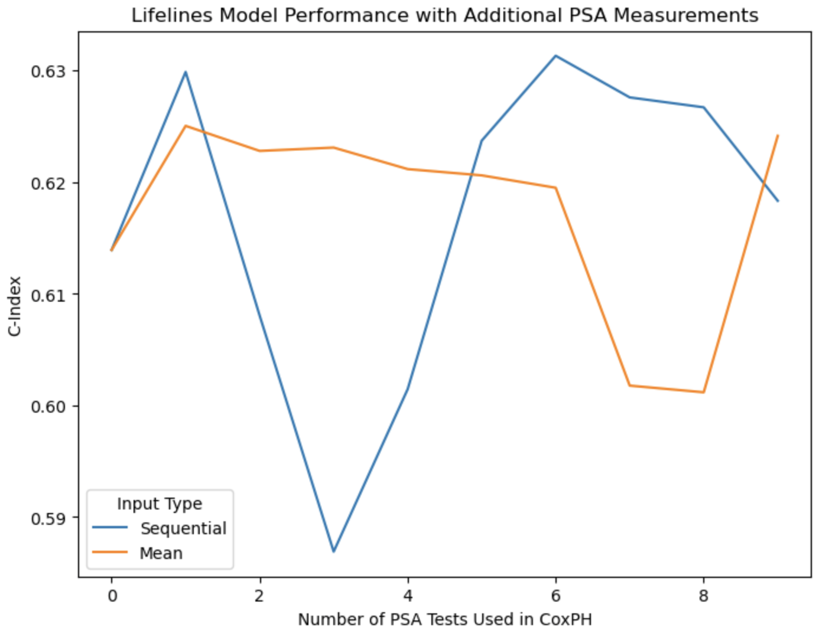
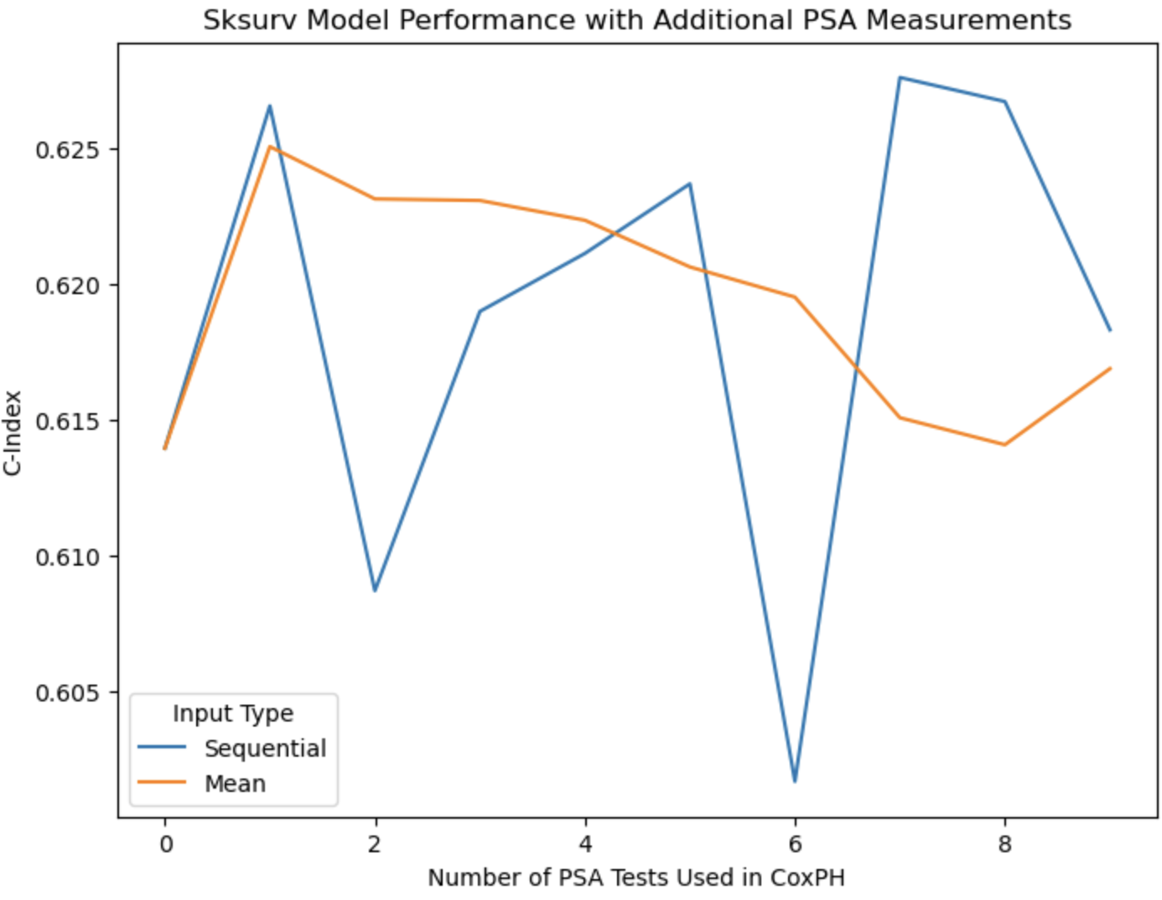
Survival Modeling (PSA as covariate)

Slide 8
Survival Modeling (embeddings as covariates)
Selected the same 10 sets of predictions windows, including text prior to the selected test cutoff date
Ran only sksurv implementation as lifelines cannot handle such a number of covariates
Lifelines is implemented solely in python (no C backend) and is apparently well-known to fail to converge in adequate timeframe on larger datasets
Reported C-index on 5-fold CV data and held out test across the different prediction windows

Slide 9
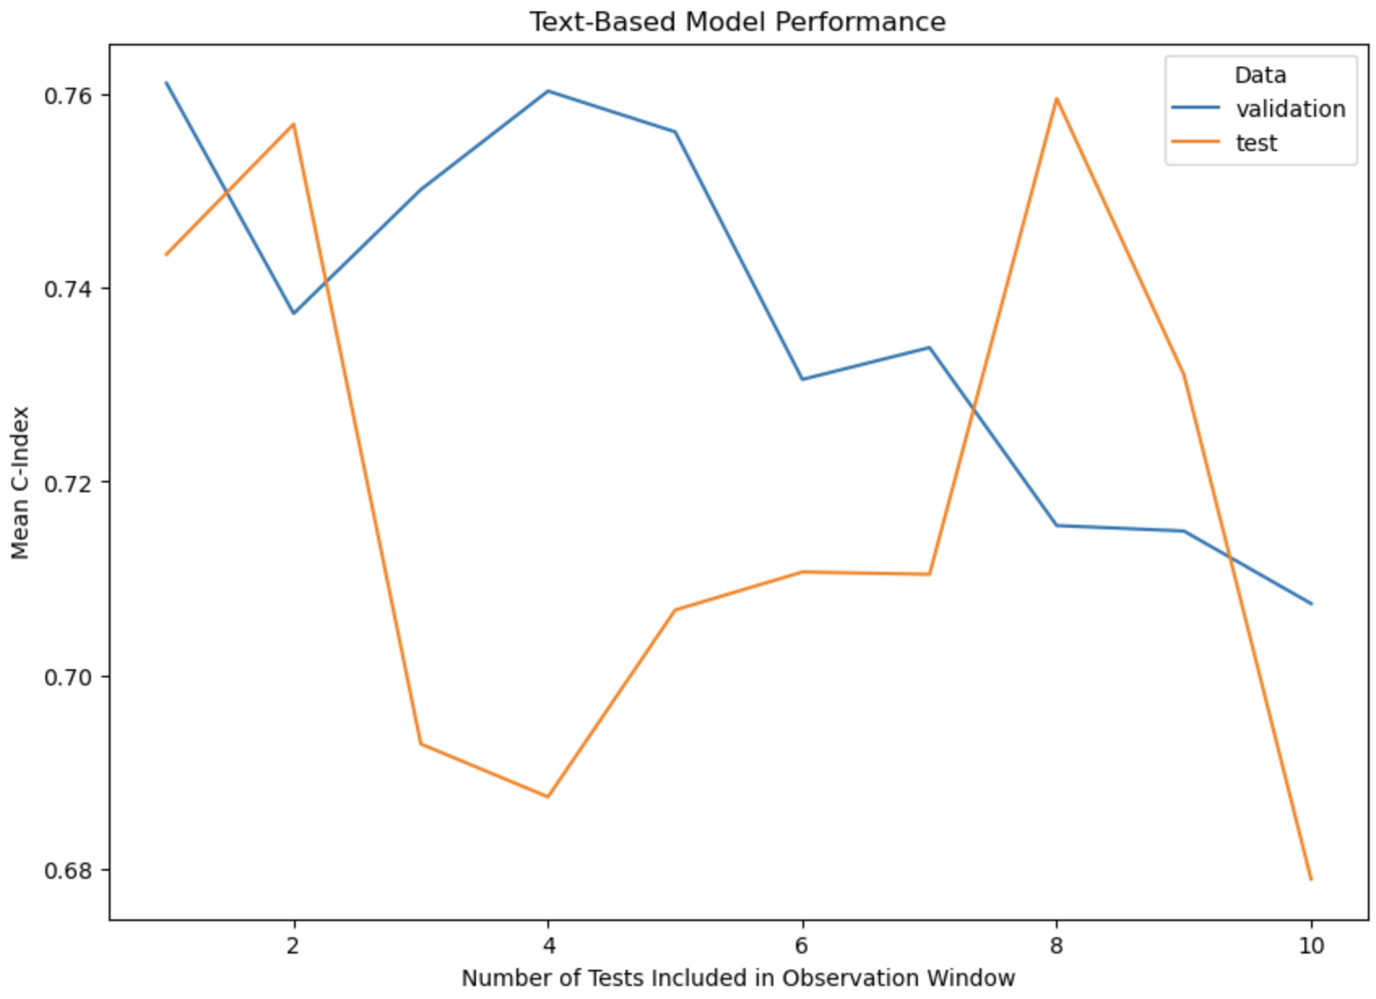
Survival Modeling (embeddings as covariates)

Slide 10
Things to add to NEPC
Text + PSA vs. Just Text vs. Just PSA
Look at the coefficients in the sequential model
Generate a table for each model
Which measurements are the model using to drive predictions?
Where do they fall temporally?
Any other metrics?

Slide 11
Other week updates
Find a proper visualization approach using a combination of sksurv and R
Regenerate last week’s figures and send them to you
Once that is finalized, run joint feature modeling
Last bit of wrap up
Primer for 8/25?
Looking for a review paper in either generative AI in medicine or something of that ilk
Interpretability paper from Anthropic

