Slide 1
Final Project: TNC Fare Modeling
Joe Paul

Slide 2
Introduction
Project Background:
Increase the usage of pooled ridesharing
Human factors
National Surveys
Safety
Demographics/Choices
Engineering
Fleet control algorithms

Slide 3
Transportation Network Company
Uber/Lyft
Contracted drivers
Level of service
Wait time
Travel time
Fares
Discounts
Expectations

Slide 4
Progress
Assignment Algorithm
Matching vehicles to requests
Repositioning Algorithm
Moving empty vehicles to more optimal locations

Slide 5
Task
Update fare model utilizing latest available data
Explore model structure
Understand predictive power of model
Original Model:
Base rate: $7.27
Per mile: $1.22
Per minute: $0.27
$$fare=base rate+per mile ∗trip miles+per minute∗trip minutes$$

Slide 6
Analysis Plan
Collect data
Summarize data
Significance
Cleaning
Exploratory Analysis
Subset regression
Stepwise regression
Principal component Analysis

Slide 7
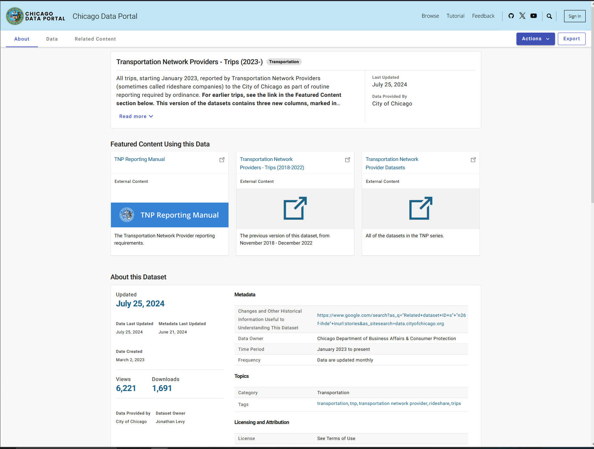
Collecting/Processing
Data Collection
2000 samples drawn randomly
90/10 test train split
Sqlite processing
Cleaning/preprocessing
DOW columns
Sum column check
Removal of columns
Geographic data
ID columns
Chicago specific columns
Tip column
NA rows
[1] Levy J. Transportation Network Providers-Trips (2018-2022)[supporting dataset]; 2023.

Slide 8
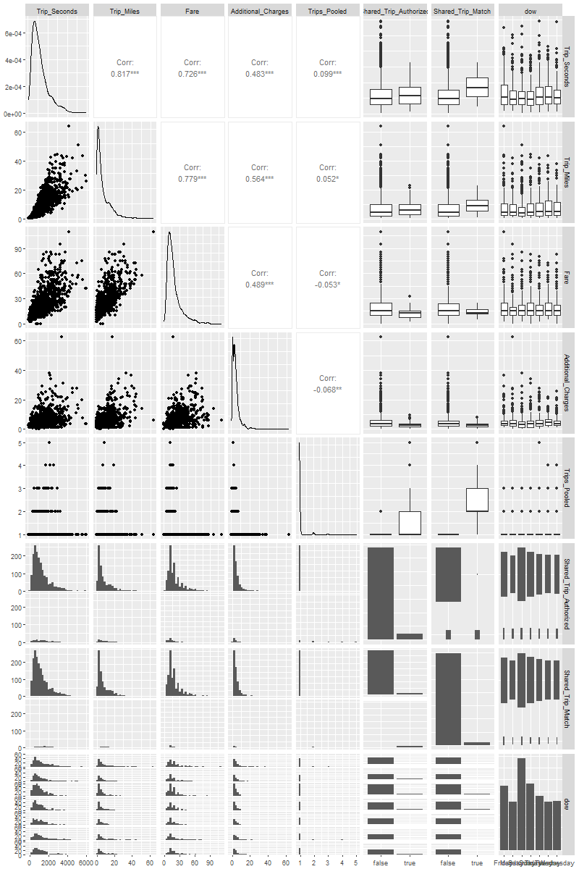
Exploratory Analysis
Summary
Data types, distributions
GG Pairs

Slide 9
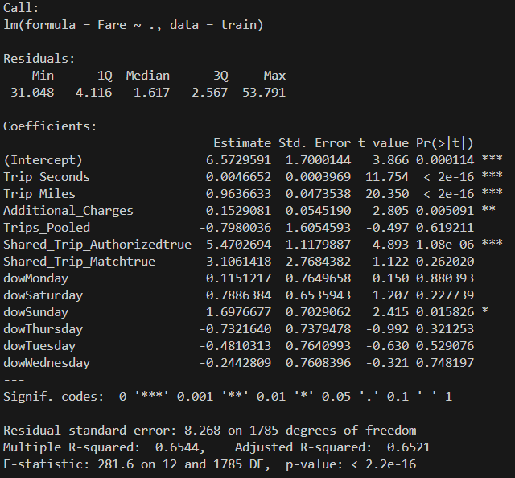
Exploratory Analysis
Initial LM
Tip and additional charges not useful for my work
Tip also highly colinear with fare (correlation matrix)
LM with dow, shared trip authorized, minutes and miles
Rsqr = 0.65
MSE = 52.22

Slide 10
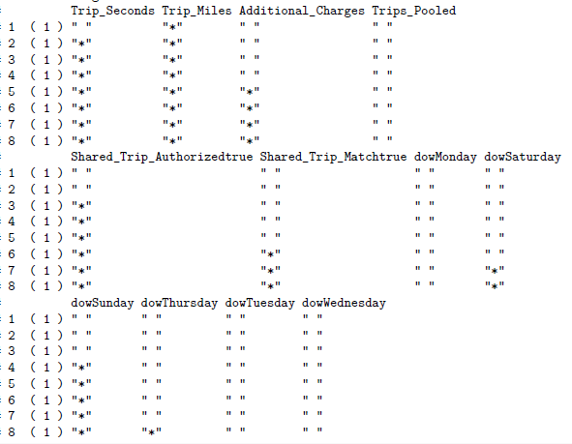
Subset Regression

Slide 11

CV Stepwise Regression
Valley at 3 subset
K= 10
Rsqr = 0.63
MSE = 51.64

Slide 12
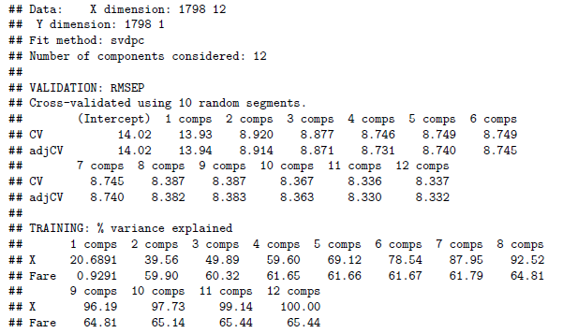
PCR
MSE: 52.07

Slide 13
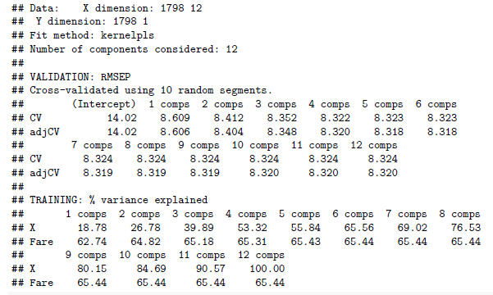
PLS
MSE = 52.57
2 principal comps

Slide 14
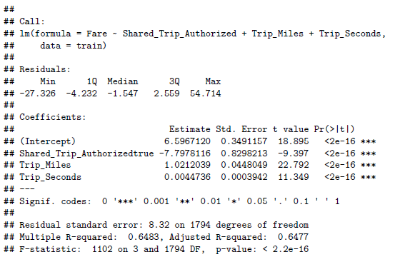
Final Model
Remove DOW
Refit

Slide 15
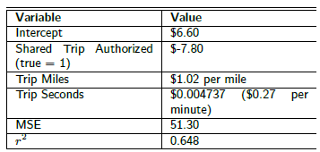

Explanation/Conclusion
Reasons for choice
Predictive accuracy
Interpretability
Simplicity
Increased confidence in model
New pooled factor
Updated coefficients
Confidence in 3 predictors
Original Model:
Base rate: $7.27
Per mile: $1.22
Per minute: $0.27

