Slide 1
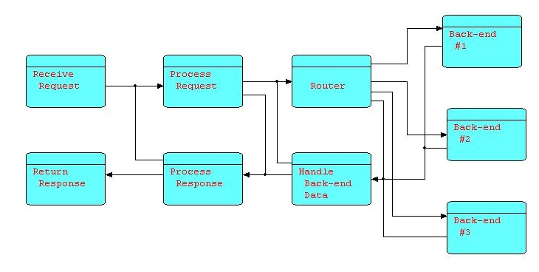
FLOW-BASED PROGRAMMING
J.Paul Morrison
J.P. Morrison Enterprises Ltd.

Slide 2
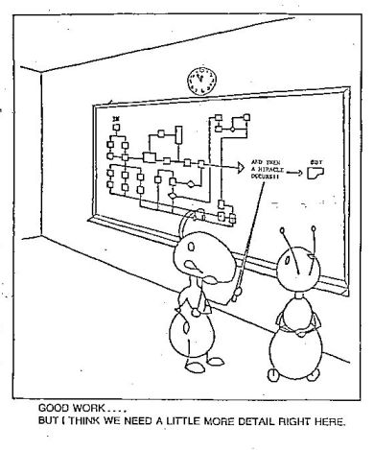

Slide 3
Symptoms of the Problem
Missed deadlines; budget overruns
"Hidden" application backlog
Fads and "snake-oil salesmen"
Endless number of “new”, incompatible,
tools and languages to be learned
"Reinventing the wheel"
Hard-to-maintain systems

Slide 4
The Real Cause of the Problem:
The von Neumann Model
Inappropriate for application design:
- Code is procedural, sequential
- One-step-at-a-time view of processing
- Hierarchic structure of code
- Subroutine call as building block
- Uniform array of read/write memory cells
- Programmer has to control exact sequence
of events
Procedural approach is rare in real life...
and always difficult
Real life is asynchronous, cooperative

Slide 5
Maintainable Systems
Express problem in terms of transforms on
streams of data
Most design technologies describe applications
this way – then design has to be converted to
procedural code
“Unit Record” had these characteristics
Precoded, pretested black-box (“LEGO”)
components have long been IT goal

Slide 6
FBP Characteristics
Asynchronous processes communicating
via streams of data packets
Data packets with a lifetime of their own
Definition of connections external to
components
Consistent view from macro to micro, and
from design to maintenance

Slide 7
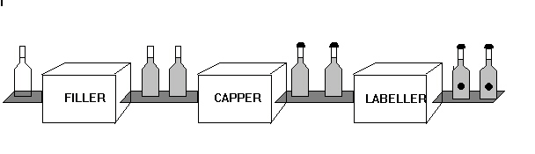
Soft Drink Bottling Factory
Independent well-defined functions
Clean interfaces
Simple to reconfigure
Minimizes side-effects
Designer can sit at one “station”, or can
follow an item through system
Notes:
2

Slide 8
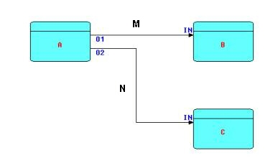
Elements of FBP
Processes (A, B, C)
Connections (M, N) - “bounded buffers”
Ports (O1, O2, IN of B, IN of C)
Connections defined externally to processes
Streams of data chunks (Information Packets)

Slide 9
Traditional “Update” Application

Slide 10
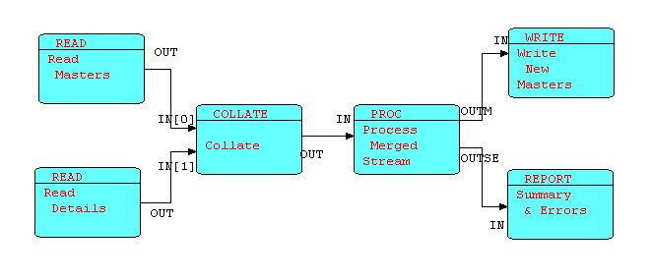
FBP “Update” Application
complementary components
could be subnet
( m1 d11 d12 ) ( m2 ) ( m3 d31)

Slide 11
“Coordination Language” (*)
Flow-Based Programming is a “coordination
language”, not a programming language
FBP is language-independent
One language doesn't have to do everything
(*) Term borrowed from “Linda” (Gelernter &
Carriero - Yale)
FBP is visual and component-oriented
“Utilities” can be turned into components

Slide 12
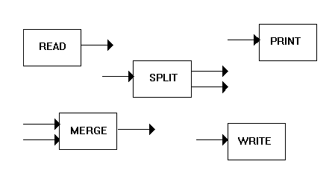
“Configurable Modularity”
“Characteristic of any engineered system”
(Nate Edwards, IBM)

Slide 13
Component-Oriented
“Black boxes”
Parametrization using “IIPs”
Ports
Parameters may be mini-language
Compatible with:
Finite State Machines (PDAs)
Structured Analysis
Step-wise decomposition

Slide 14
Scheduling Rules
Process only terminates when no more data, although it may suspend or go dormant
Process can suspend on receive or send (connections are “bounded buffers”)
This allows large amounts of data to be processed using finite resources
Typically only one process suspended waiting for an event – not whole program

Slide 15
Design for an E-Brokerage Application
Notes:
You may recognize this!

Slide 16
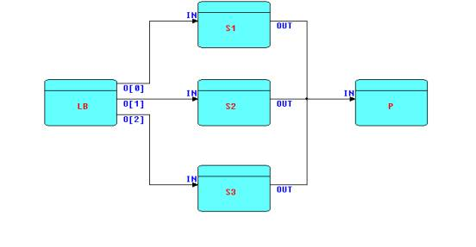
Load Balancing
Sn is instance of “S”
LB assigns on basis of least backlog
“O[n]” is element of array port

Slide 17
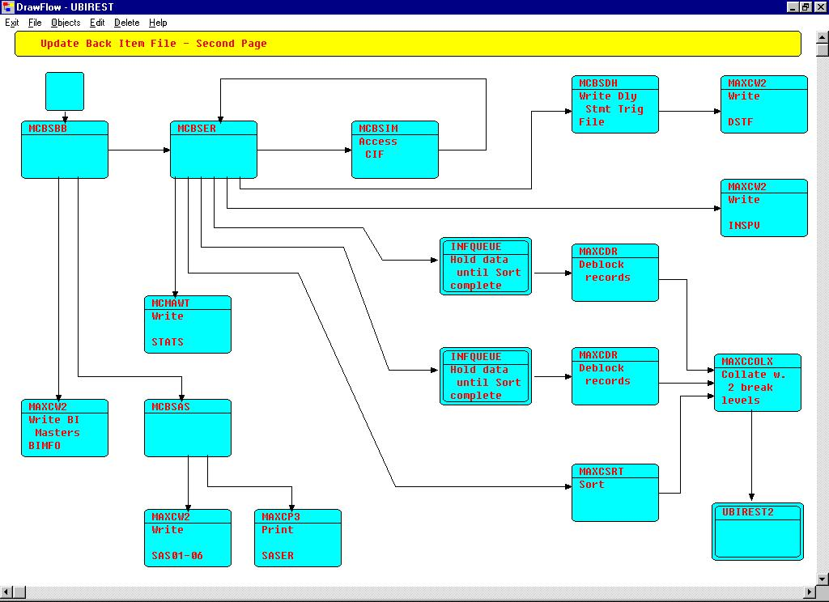

Slide 18



Testing
Look at data passing across connection
Test one process at a time
“Scaffolding”
Rapid Prototyping
Go from simulation to working code
Cleave network as desired – multiple job
steps, regions, machines, etc.

Slide 19
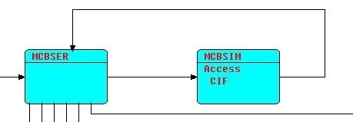
Simulating Subroutines
Subroutine can be simulated using Send/Receive
MCBSIM can also be used in “flow-through” mode
“There is no reason we know of, however, to base an entire parallel language on this one easily programmed but not crucially important special case [calls]." Gelernter

Slide 20
“Active” vs. “Passive” Objects
FBP processes are “active objects” (*)
Information packets (IPs):
- have a definite lifetime
- have only one owner at a time (or are
on a connection)
- “passive” objects
5 types of “encapsulation”
(*) Ellis & Gibbs (1989)

Slide 21

FBP Implementations
AMPS z90 Assembler (IBM Canada – ca. 1970)
(in continuous, daily use since then)
DFDM Assembler / PL/I (IBM Canada, Japan)
THREADS written in C (JPM)
- just ported to C++ fibers
JavaFBP Java (J. Cowan, JPM, now at 5.0)
C#FBP C# (Amanda Ge, JPM)
CppFBP C++ (using Boost)
“language-agnostic” - interface is data

Slide 22
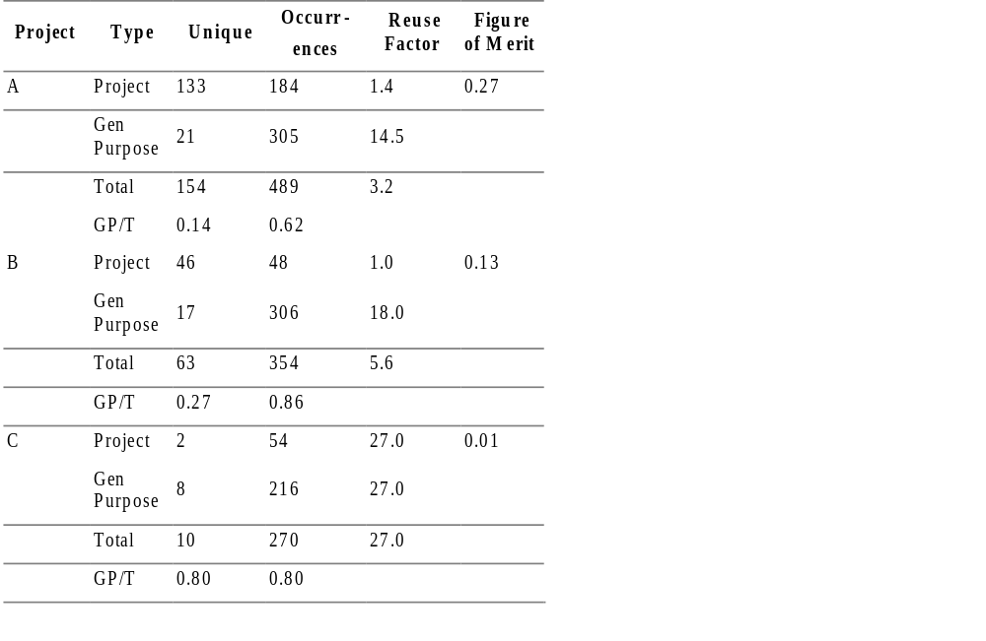
3 Projects
Figure of Merit = Project Unique / Total Occurrences

Slide 23
Inter-language communication
Sockets
can be used between languages on
same machine, or
to communicate between different
machines
MQSeries, ActiveMQ, TIBEMS, AMQP, etc.

Slide 24
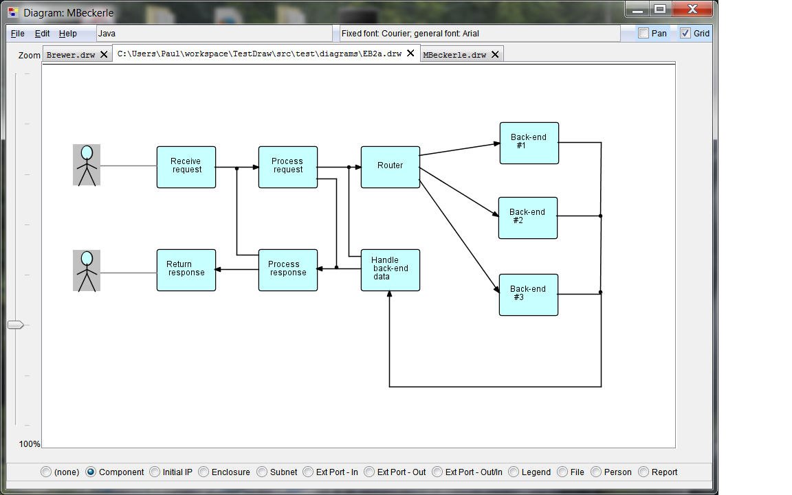
DrawFBP Diagramming Tool

Slide 25
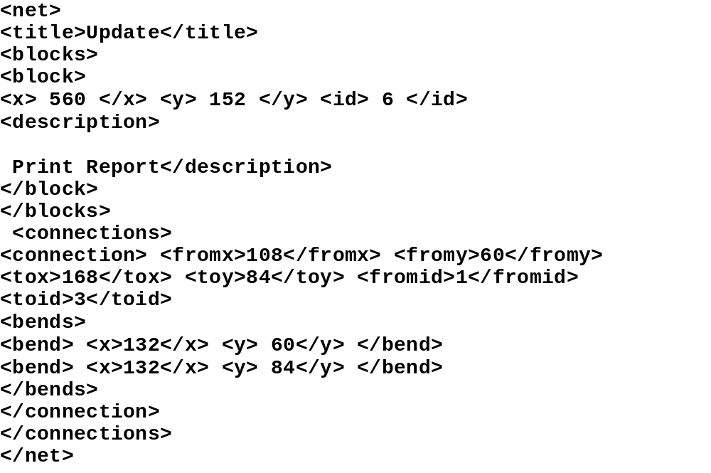
Data format for DrawFBP

Slide 26
Related Concepts
MASCOT (RSRE, UK)
Linda - Gelernter & Carriero (Yale)
A'UM - Yoshida & Chikayama (Japan)
BSP - Valiant
NIL/Hermes - Rob Strom (IBM)
“Media Objects” / KNOs - Nierstrasz etc.
“Active Objects” - Ellis & Gibbs
IBM’s MQSeries
Message-driven EJBs
Trelliswerk, ProtoSW
Pervasive, Ascential (now IBM)
Visual Frameworks
etc., etc., etc.

Slide 27
FBP Summary
Flow-Based Programming: effective way to
produce reliable, maintainable, large
business applications
Consistent view across all levels
Better way to program multiprocessor
computers, distributed systems
Increasing interest world-wide
It’s taken 35+ years, but we’re getting there!

Slide 28
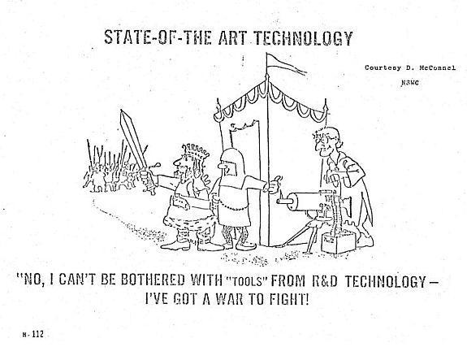
“State of the Art”

