Slide 1

The Open Standard for Heterogeneous Parallel Programming

Slide 2

The Kronos Group
https://www.khronos.org

Slide 3
Open means…

Slide 4
Many languages…
C/C++ - https://www.khronos.org/opencl/
.NET - http://openclnet.codeplex.com/
Python - http://mathema.tician.de/software/pyopencl/
Java - http://www.jocl.org/
Julia - https://github.com/JuliaGPU/OpenCL.jl

Slide 5
Many platforms…
AMD - CPUs, APUs, GPUs
NVIDIA - GPUs
INTEL - CPUs, GPUs
APPLE - CPUs
SAMSUMG - ARM processors
OTHERS - https://www.khronos.org/conformance/adopters/conformant-products#opencl

Slide 6
Why GPUs?
Designed for Parallelism - Supports thousands of threads with no thread management cost
High Speed
Low Cost
Availability

Slide 7
How does it work?
Host code - Runs on CPU
Serial code (data pre-processing, sequential algorithms)
Reads data from input (files, databases, streams)
Transfers data from host to device (gpu)
Calls device code (kernels)
Copies data back from device to host
Device code - Runs on GPU
Independent parallel tasks called kernels
Same task acts on different pieces of data - SIMD - Data Parallelism
Different tasks act on different pieces of data - MIMD - Task Parallelism

Slide 8
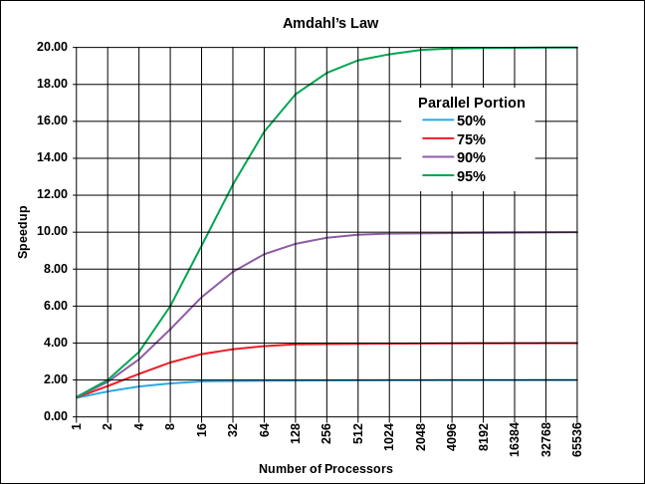
Speed up - Amdahl’s Law

Slide 9
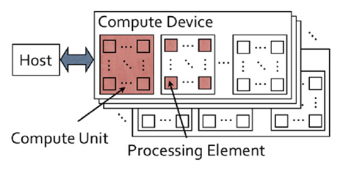
Computing Model

Slide 10
Computing Model
Compute Device = GPU
Compute Unit = Processor
Compute/Processing Element = Processor Core
A GPU can contain from hundreds up to thousands cores

Slide 11
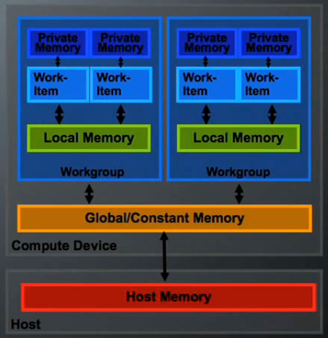
Memory Model

Slide 12
Work-items/Work-groups
Work-item = Thread
Work-items are grouped into Work-groups
Work-items in the same Work-group can:
Share Data
Synchronize
Map work-items to better match the data structure

Slide 13
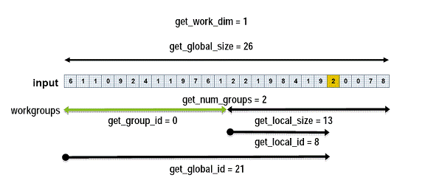
Work-items 1D Mapping

Slide 14
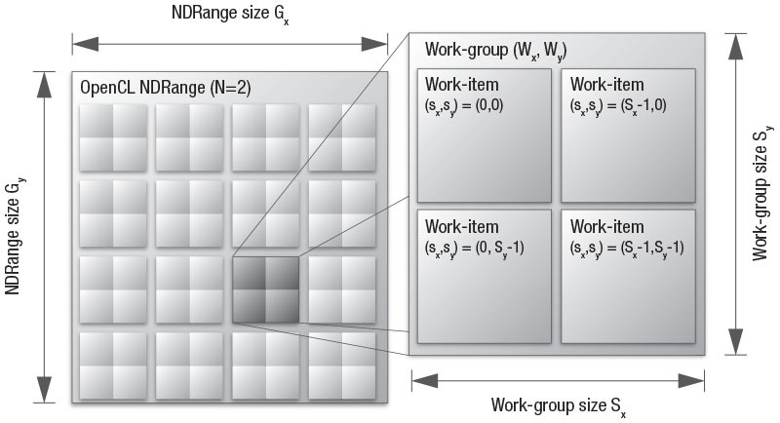
Work-items 2D Mapping

Slide 15
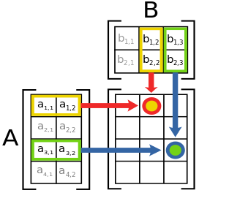
Matrix Multiplication
Matrix A[4,2]
Matrix B[2,3]
Matrix C[4,3] = A * B

Slide 16
Matrix Multiplication
For matrices A[128,128] and B[128,128]
Matrix C will have 16384 elements
We can launch 16384 work-items (threads)
The work-group size can be set to [16,16]
So we end up with 64 groups of 256 elements each

Slide 17
Kernel Code
__kernel
void matrixMultiplication(__global float* A, __global float* B, __global float* C, int widthA, int widthB )
{
//will range from 0 to 127
int i = get_global_id(0);
//will range from 0 to 127
int j = get_global_id(1);
float value=0;
for ( int k = 0; k < widthA; k++)
{
value = value + A[k + j * widthA] * B[k*widthB + i];
}
C[i + widthA * j] = value;
}

Slide 18
Host Code
/* Create Kernel Program from the source */
program = clCreateProgramWithSource(context, 1, (const char **)&source_str, (const size_t *)&source_size, &ret);
/* Build Kernel Program */
ret = clBuildProgram(program, 1, &device_id, NULL, NULL, NULL);
/* Create OpenCL Kernel */
kernel = clCreateKernel(program, "matrixMultiplication", &ret);
/* Set OpenCL Kernel Arguments */
ret = clSetKernelArg(kernel, 0, sizeof(cl_mem), (void *)&memobjA);
ret = clSetKernelArg(kernel, 1, sizeof(cl_mem), (void *)&memobjB);
ret = clSetKernelArg(kernel, 2, sizeof(cl_mem), (void *)&memobjC);
ret = clSetKernelArg(kernel, 3, sizeof(int), (void *)&row);
ret = clSetKernelArg(kernel, 4, sizeof(int), (void *)&col);
/* Execute OpenCL Kernel */
size_t globalThreads[2] = {widthA, heightB};
size_t localThreads[2] = {16,16};
clEnqueueNDRangeKernel(command_queue, kernel, 2, 0, globalThreads, localThreads, 0, 0, 0);
/* Copy results from the memory buffer */
ret = clEnqueueReadBuffer(command_queue, memobjC, CL_TRUE, 0, widthA * heightC * sizeof(float),Res, 0, NULL, NULL);

Slide 19
Limitations
Number of work-items (threads)
Group size (# of work-items, memory size)
Data transfer bandwidth
Device memory size

Slide 20
Be careful with…
Uncoalesced memory access
Branch divergence
Access to global memory
Data transfer between host and device

Slide 21
Demo

Slide 22
Thanks!

