Slide 1
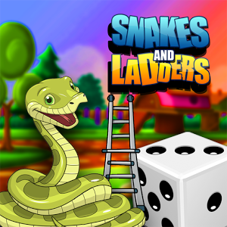

fttttL
Snakes And Ladders
fttttLLearn with Fun

Slide 2
Introduction
Get ready to re-live your all time favorite game Snake and Ladder . The perfect Education board game that assures you won’t get bored. The game goal is very simple to climb up to 100 and each move their will be one question . You will have to answer of these questions correctly in minimum time. If you give correct answer of that question you will get some score and according to this score you will move into the next number and if your answer will be wrong then unless and until you will give correct answer you will stuck over their.
Hope for best, the player who will give correct answers of maximum questions in minimum time those will win the game and will become champion.

Slide 3
Rules of the game….
Start the Game…..
Follow the numbers….
To continue…………..Question page will open………
Give answer of Question………….
If answer is write then move out of this page and also move to next number….
If answer is wrong then it will be invalid and player unable to move out from this page ....
Whenever you hit a snake……….you slide down….
Whenever you hit a ladder……….you go up!

Slide 4
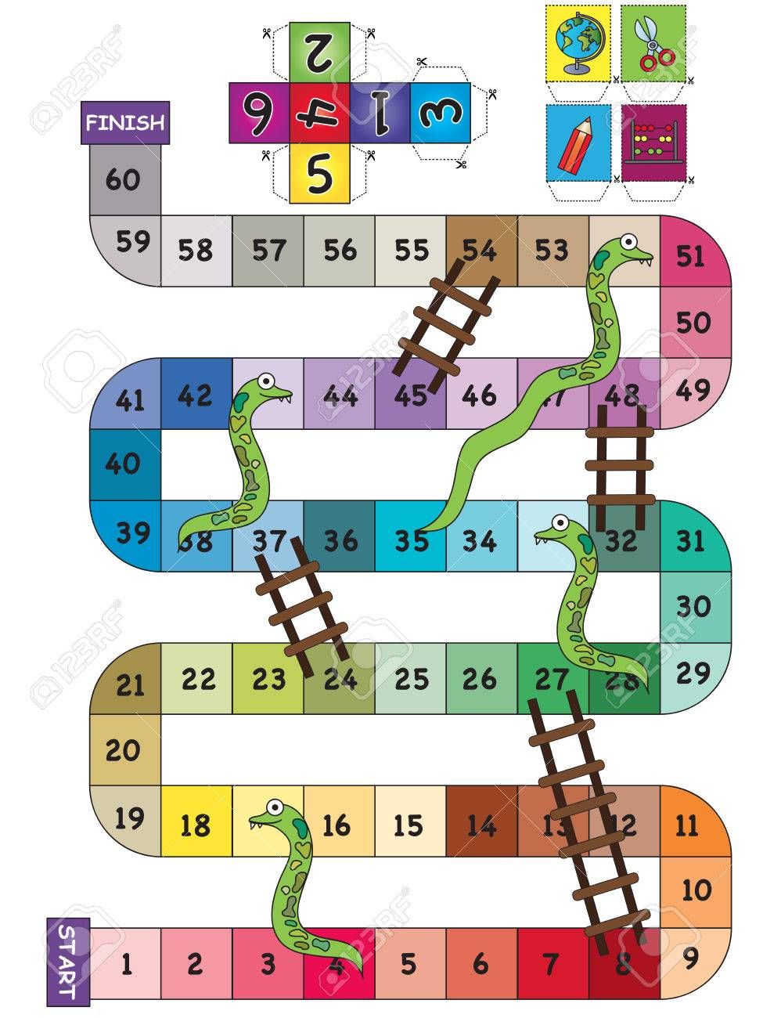
Technologies
JSP
Servlet
Hibernate

Slide 5
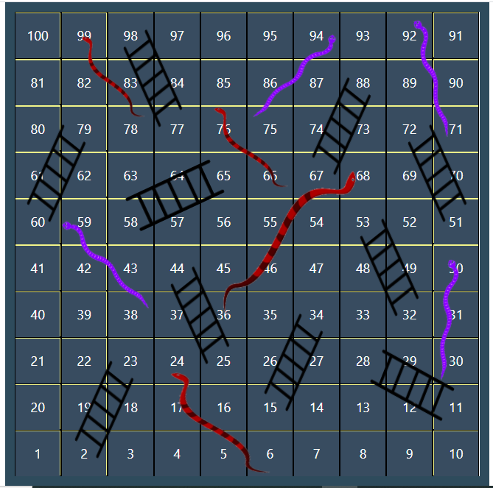
Screenshots
game Board

Slide 6
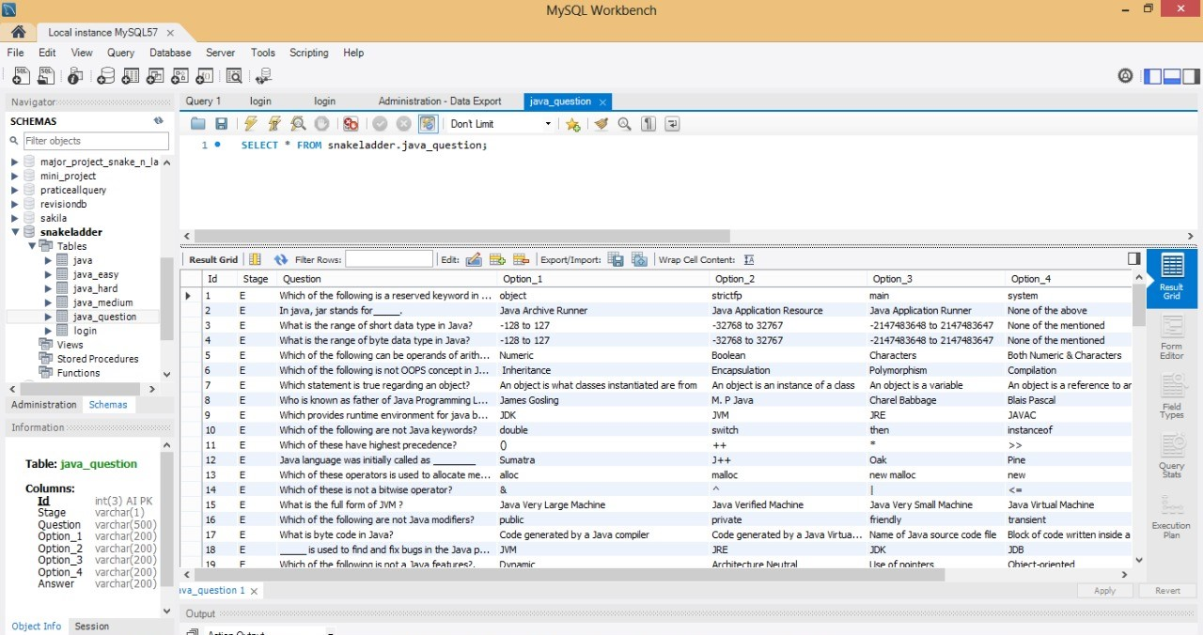
Screenshots
Database

Slide 7

Thank You

