Slide 1
Diet Manager V2 Project Presentation
GROUP G2
Noa Mišić, Josip Pavlinić, Domagoj Dušić, Franko Fišter, Denny Lulak

Slide 2
OUTLINE
Diet Manager in Action
Diet Manager Explained
Final Notes
Part of the Solution We Are Most Proud of
What Could Have Been Done Better?

Slide 3
Diet Manager in Action

Slide 4
Diet Manager Explained

Slide 5
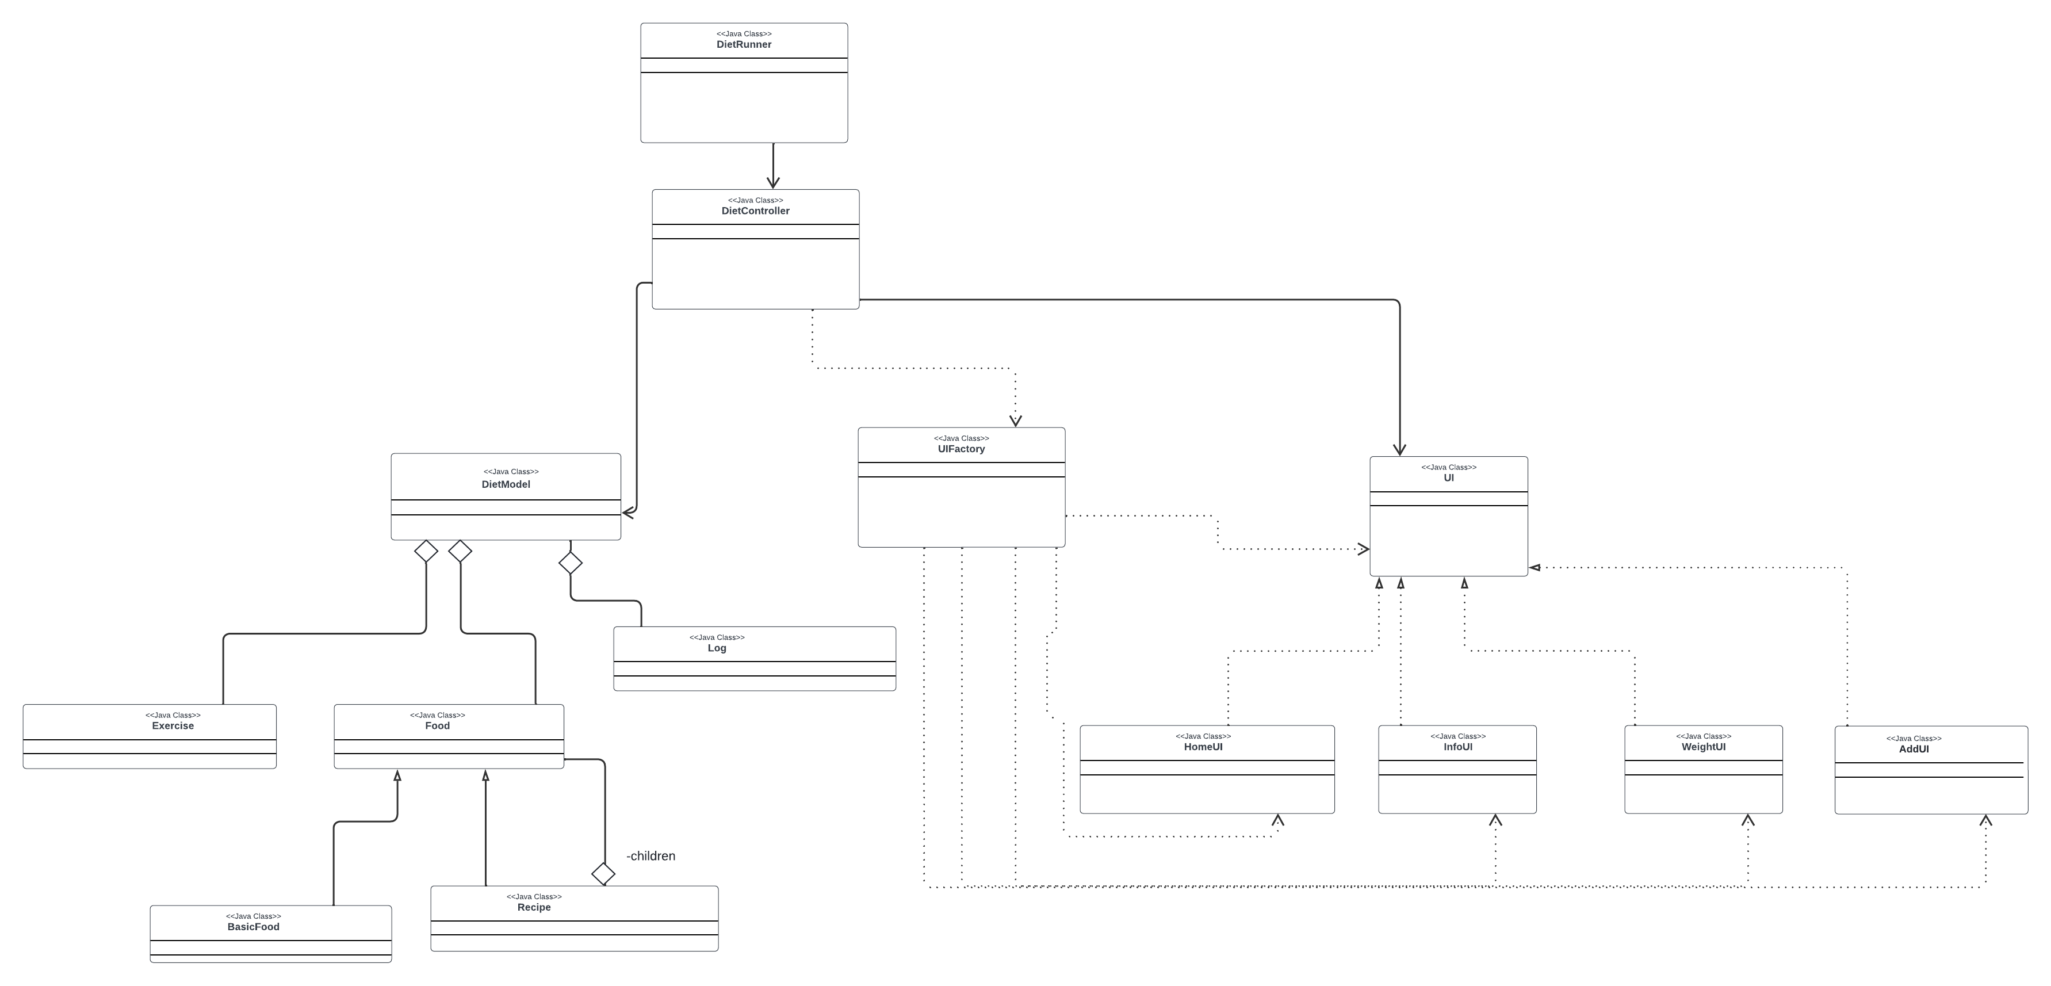
System Overview – mvc pattern

Slide 6
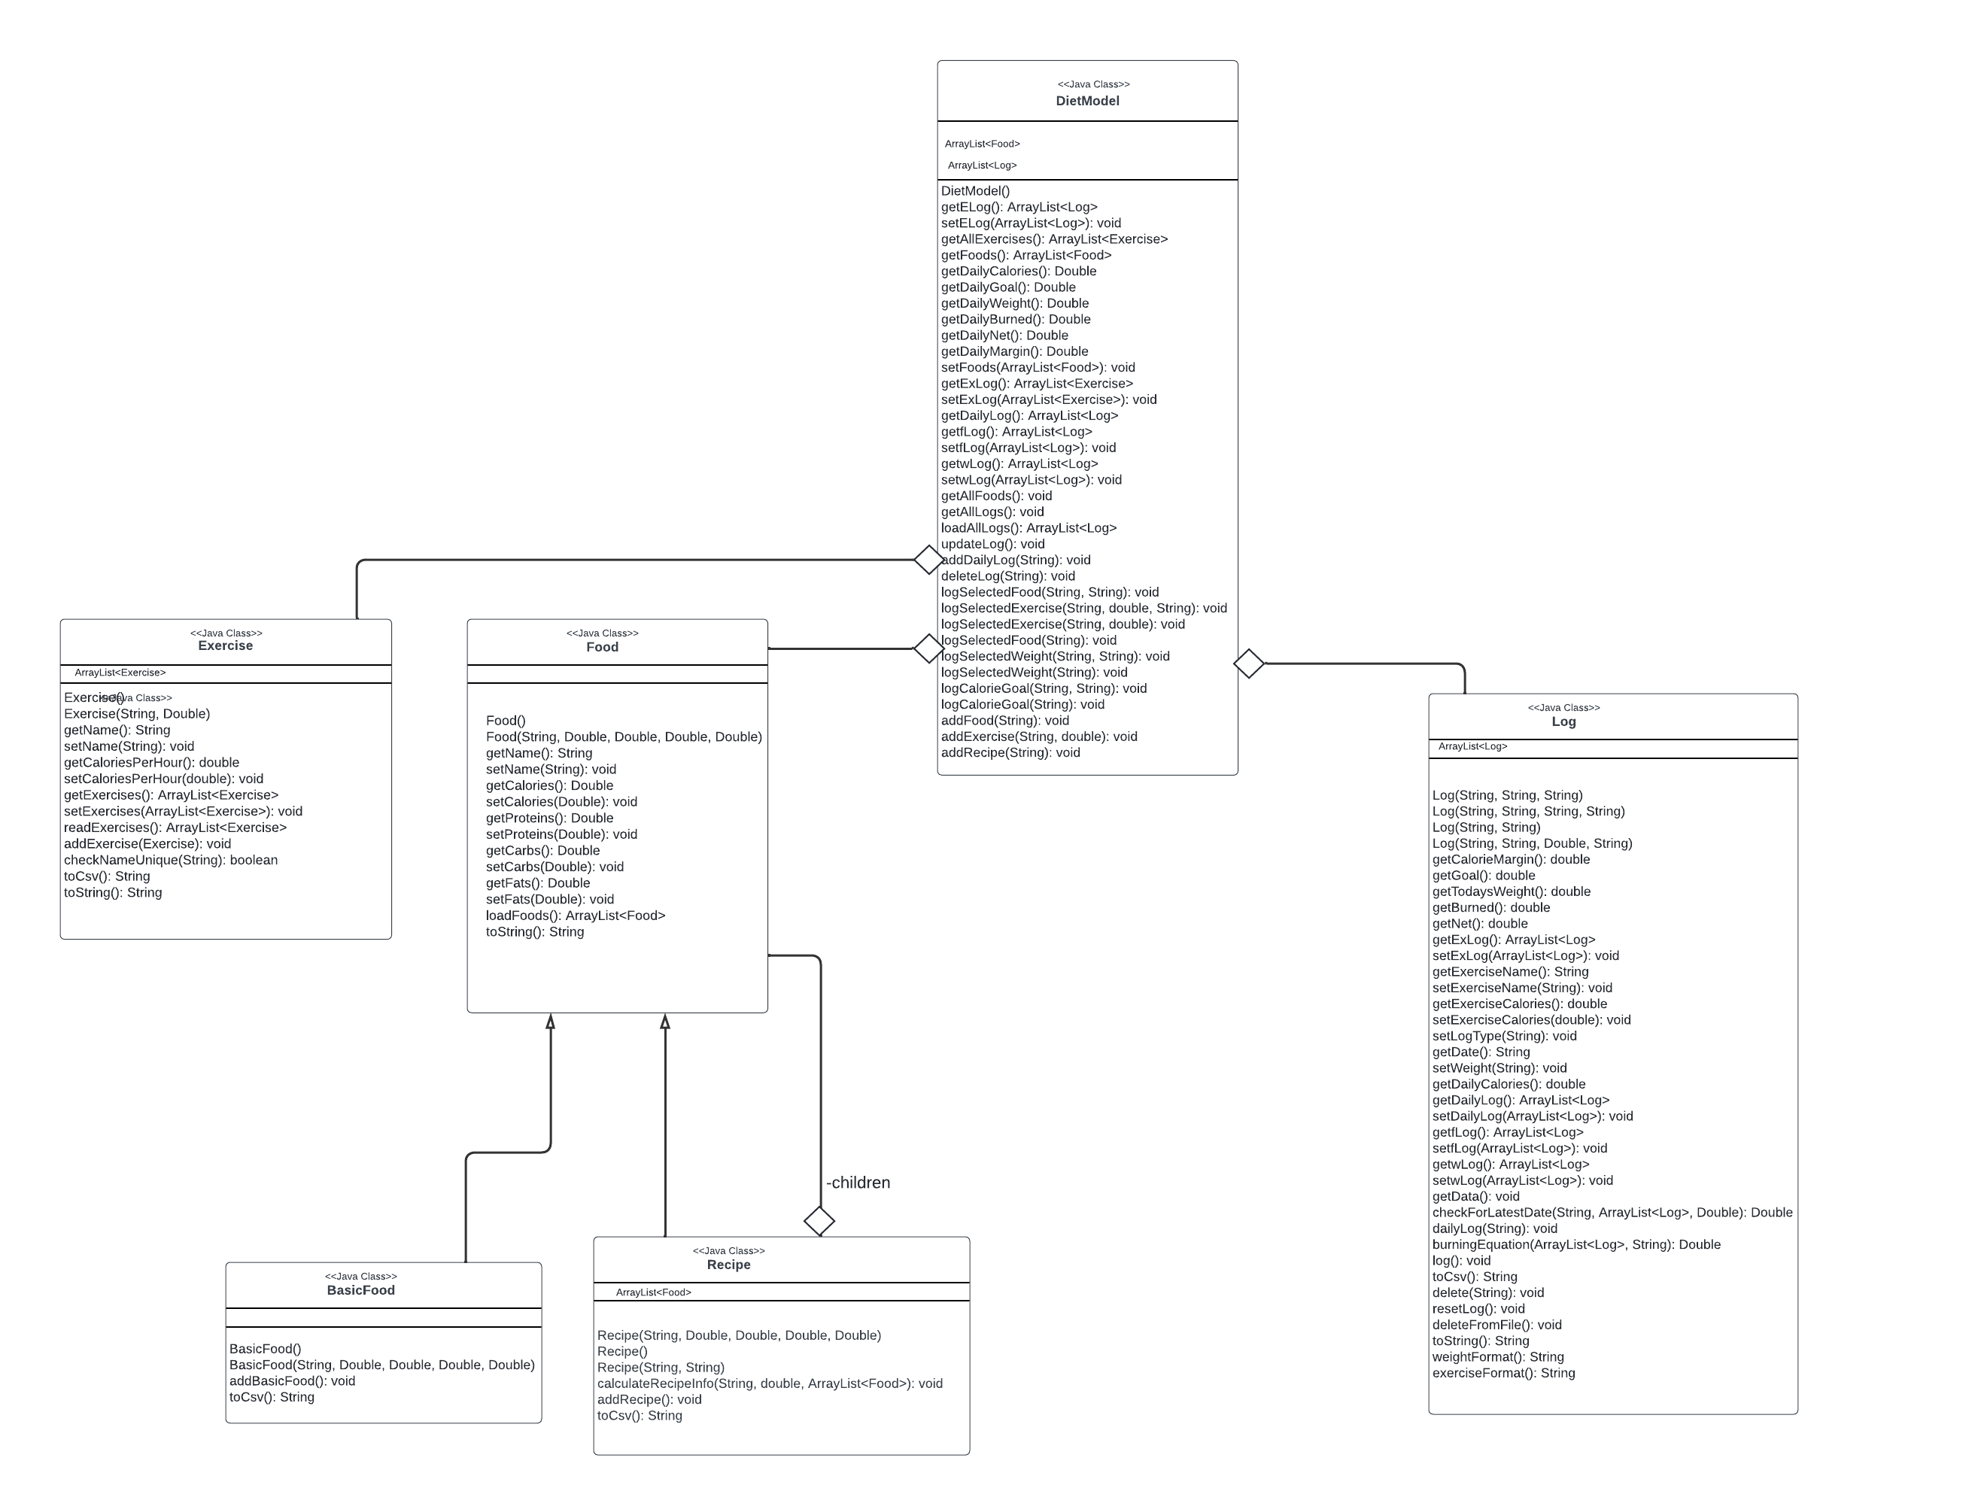
Model Subsystem – composite pattern

Slide 7
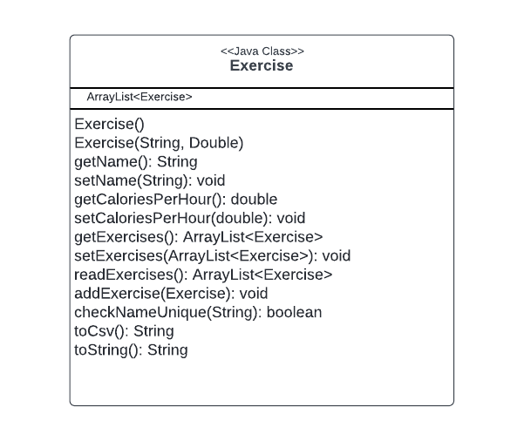
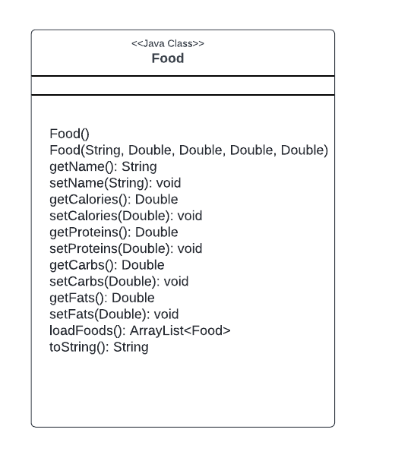
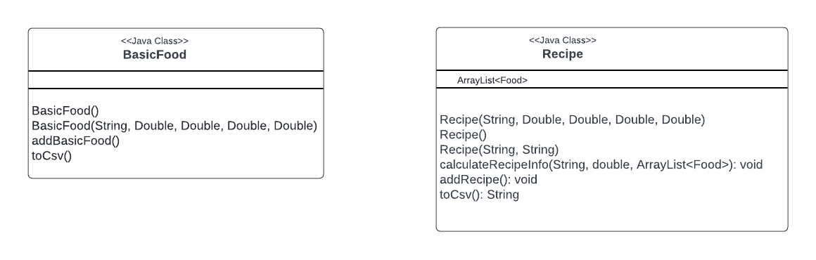
Model Subsystem – classes

Slide 8
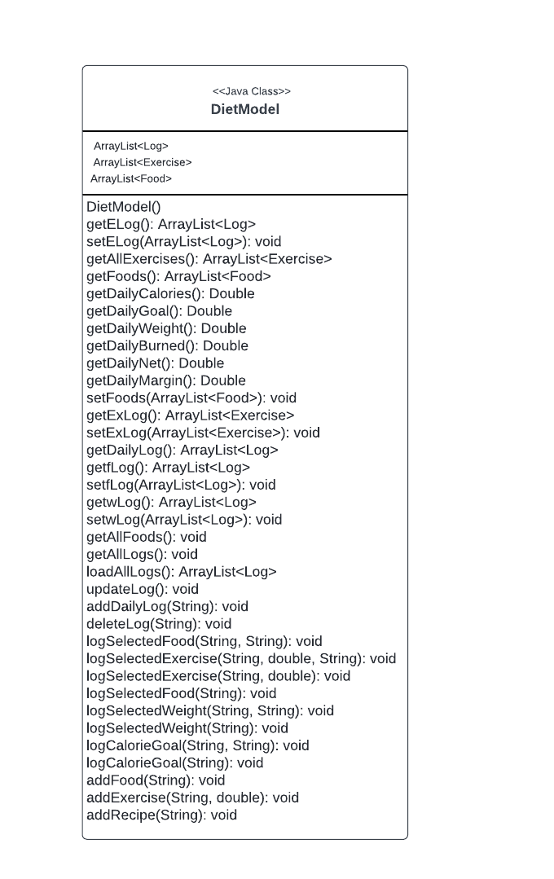
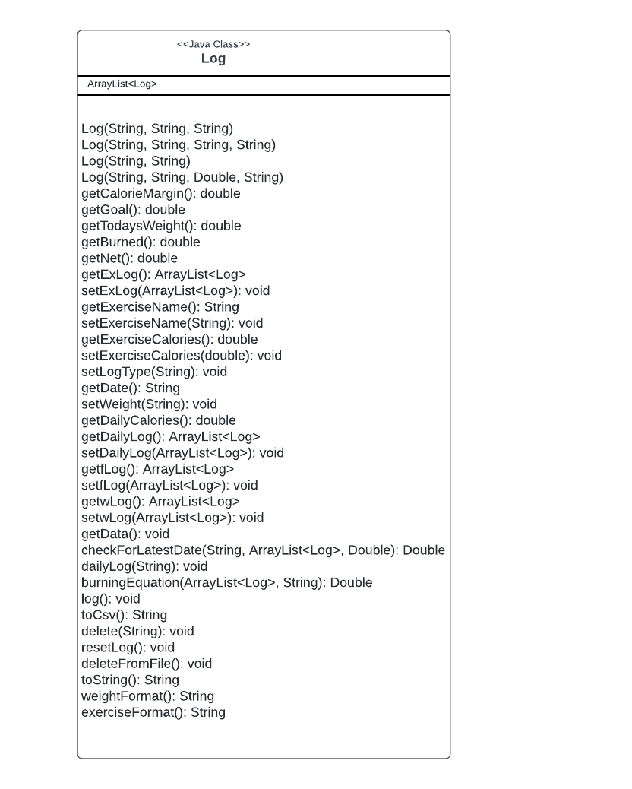
Model Subsystem – classes

Slide 9
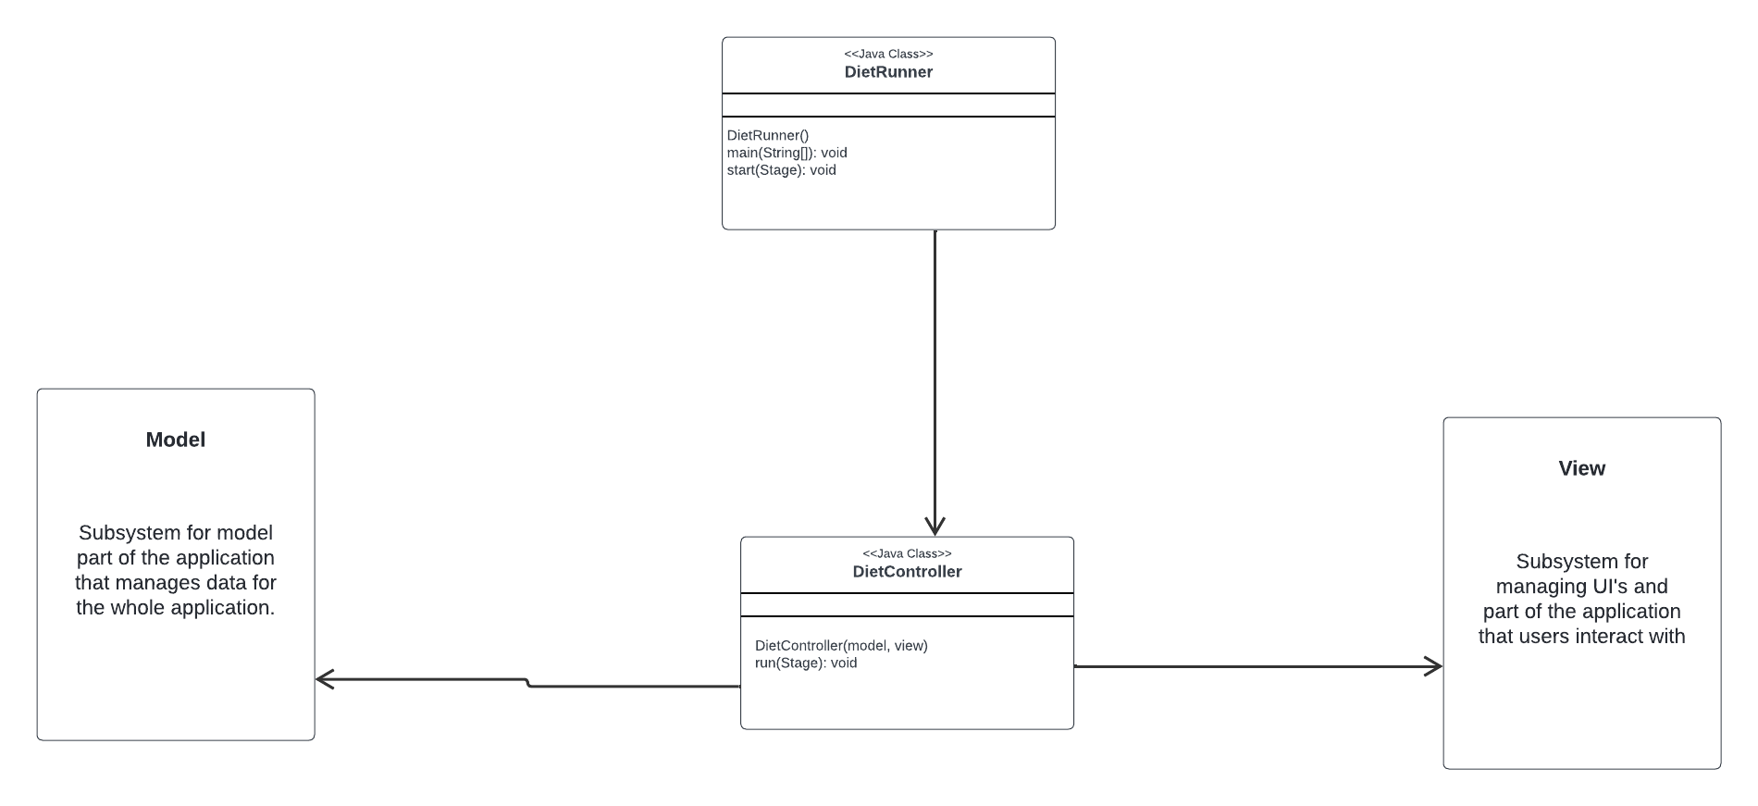
Controller Subsystem

Slide 10
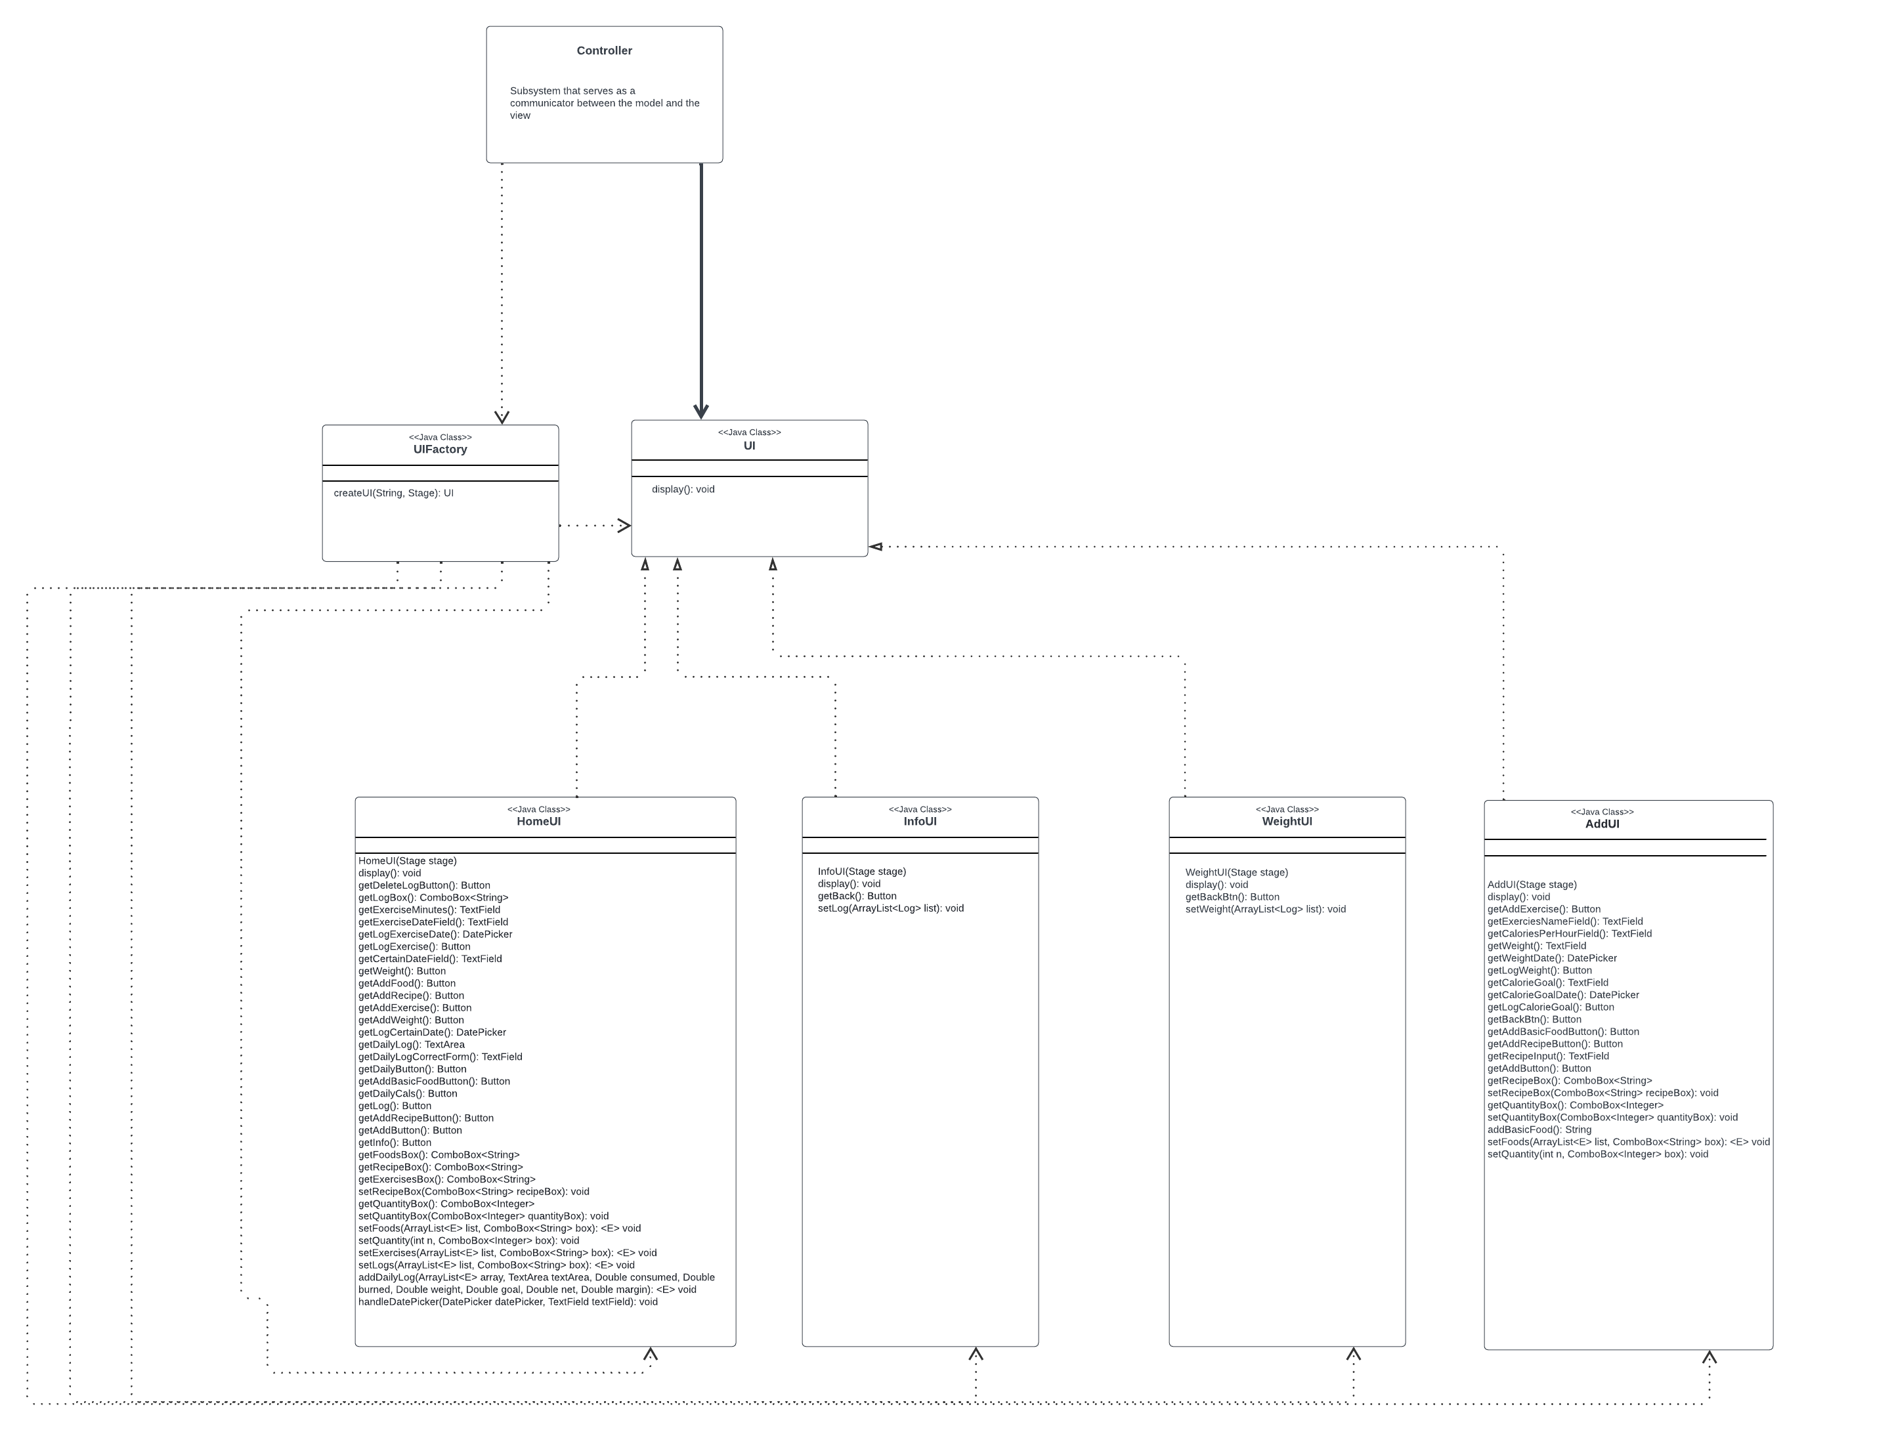
View Subsystem – factory pattern

Slide 11
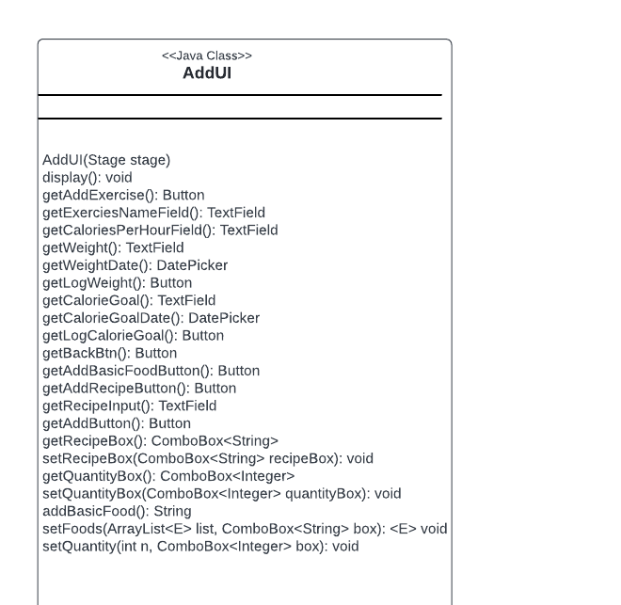
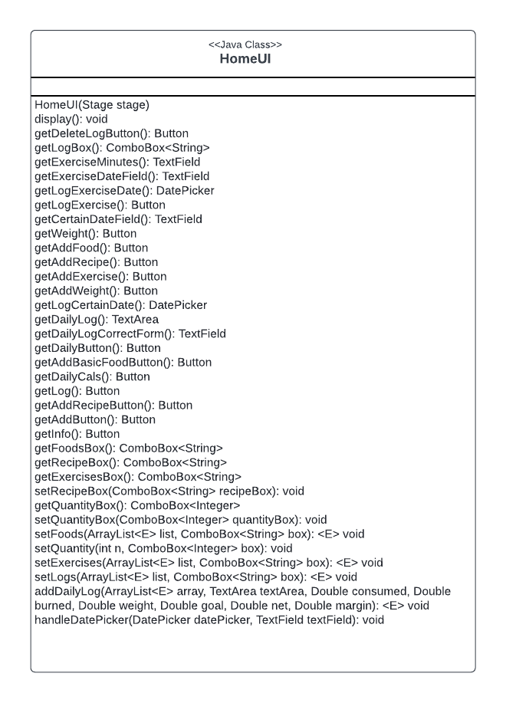
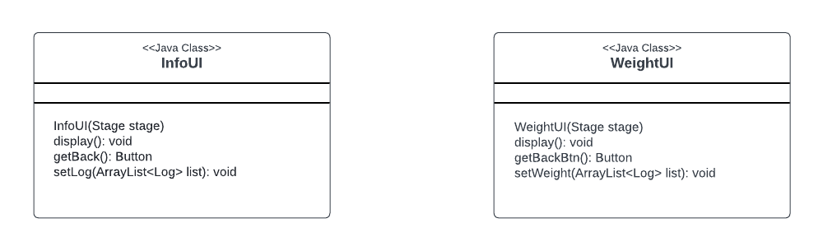
View Subsystem – classes

Slide 12
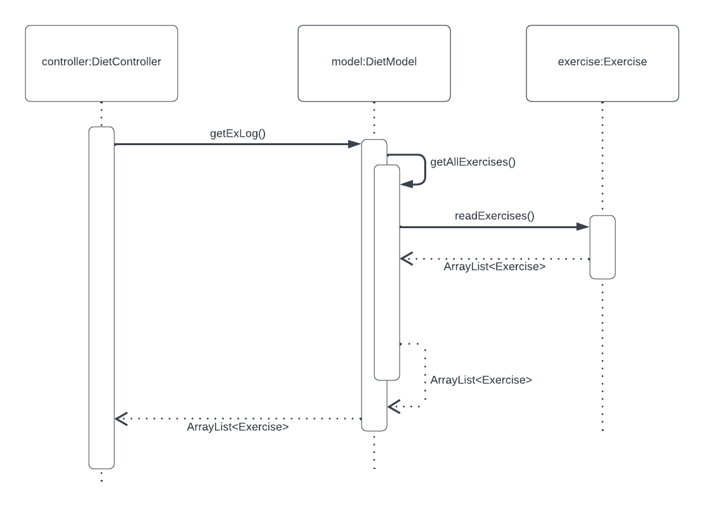
Loading exercises into internal data structure

Slide 13
Loading exercises into internal data structure
On start of the program, DietController calls getExLog() method from the DietModel, that returns the ArrayList of Exercises. The getExLog method is calling the getAllExercises() method, that is calling the readExercises() method from the Exercise class. readExercises() method is responsible for reading the exercises.csv file, create the Exercise objects, load the Exercises into the ArrayList and return the ArrayList to the DietModel. That way, on the start of the program, exercises are loaded from exercises.csv into an internal data structure – ArrayList. That ArrayList is then passes to DietModel and DietController for further use, data manipulation, and injection into the view.

Slide 14
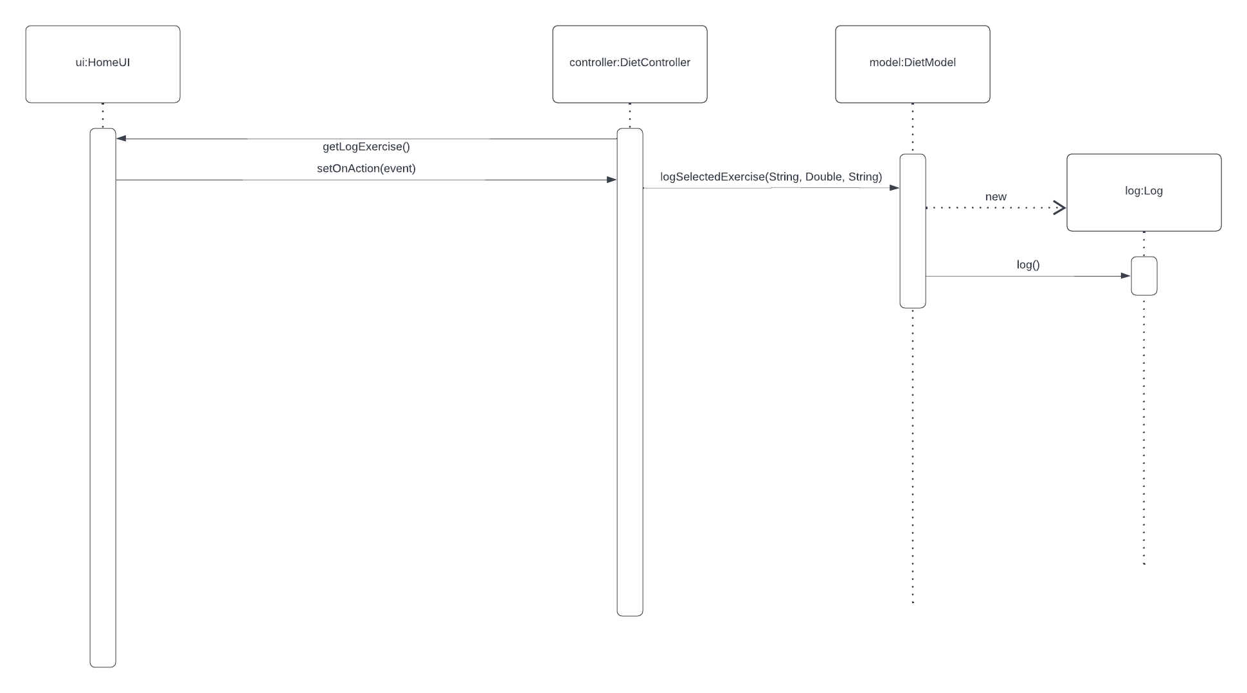
Exercise is selected and recorded into log.csv

Slide 15
Exercise is selected and recorded into log.csv
When a log Exercise button is clicked on the view, the setOnAction method is triggered in the DietController class. That method is responsible for logging that exercise by calling the logSelectedExercise on the DietModel, passing the name of the exercise, the number of minutes exercised, and the date on which the exercise occurred as parameters. DietModel is then creating a Log object, and calling the log method on that object. The log method is logging the toCsv() method of that object to the logs.csv file.

Slide 16
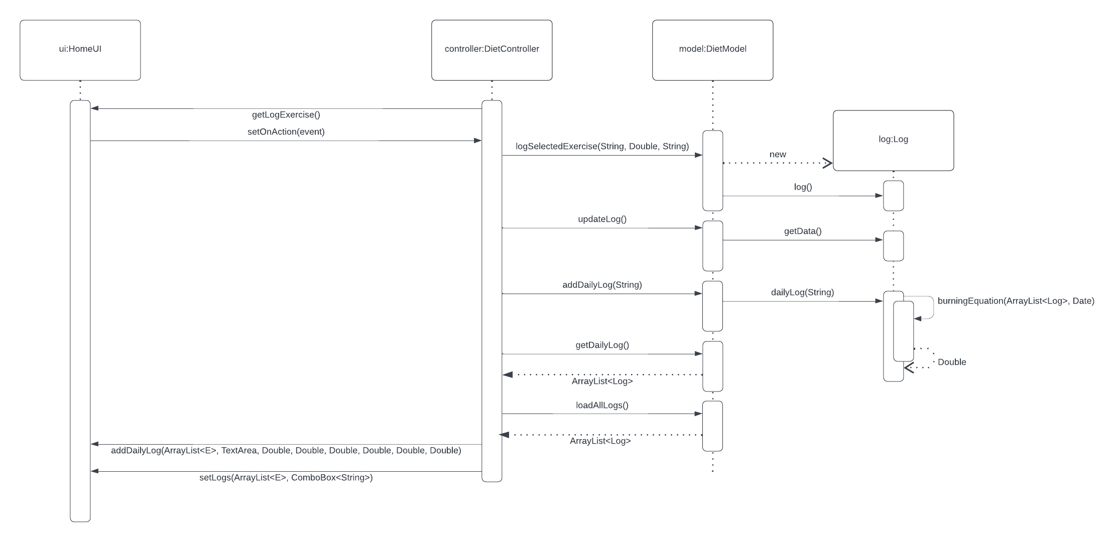
Log view update relating to calories expended

Slide 17
Log view update relating to calories expended
When the Log Exercise button is clicked, the exercise is logged into the csv file like explained in the previous sequence diagram. After that, DietController calls the updateLog method, that is calling getData method from the Log class. That updateLog method is responsible for loading the new data from the csv into the internal data structure. After that, DietController also calls addDailyLog from the DietModel, passing String of a date as a parameter, and the dailyLog() method is called on the Log, which is populating an ArrayList of Logs that happened on that particular date passed as a string. The dailyLog() method is calling the burningEquation() method to calculate the calories burned based on the weight, minutes, and calores per hour per kg of that exercise. After that, using getters getDailyLog(), and loadAllLogs() the DietController gets the ArrayLists of Logs with the updated exercises, and displays that data, along with the data from the burningEquation() method to inject into the view, and show that new logs to the user.

Slide 18
Final Notes

Slide 19
Final Notes
We are most proud of the project architecture and implementation
We could have done a better job with the sequence diagrams

