Slide 1
Diet Manager Project Presentation
GROUP G2
Noa Mišić, Josip Pavlinić, Domagoj Dušić, Franko Fišter, Denny Lulak

Slide 2
OUTLINE
Diet Manager in Action
Diet Manager Explained
Final Notes
Part of the Solution We Are Most Proud of
What Could Have Been Done Better?

Slide 3
Diet Manager in Action

Slide 4
Diet Manager Explained

Slide 5
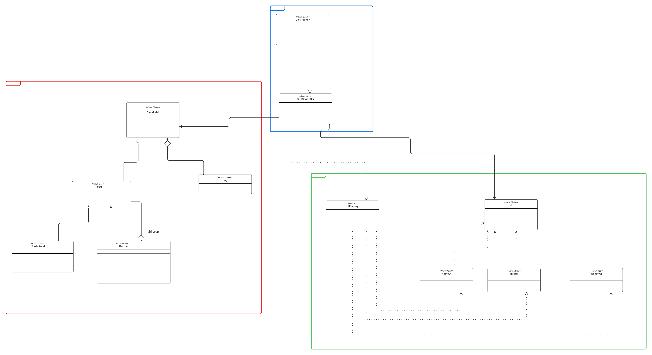
System Overview – mvc pattern

Slide 6
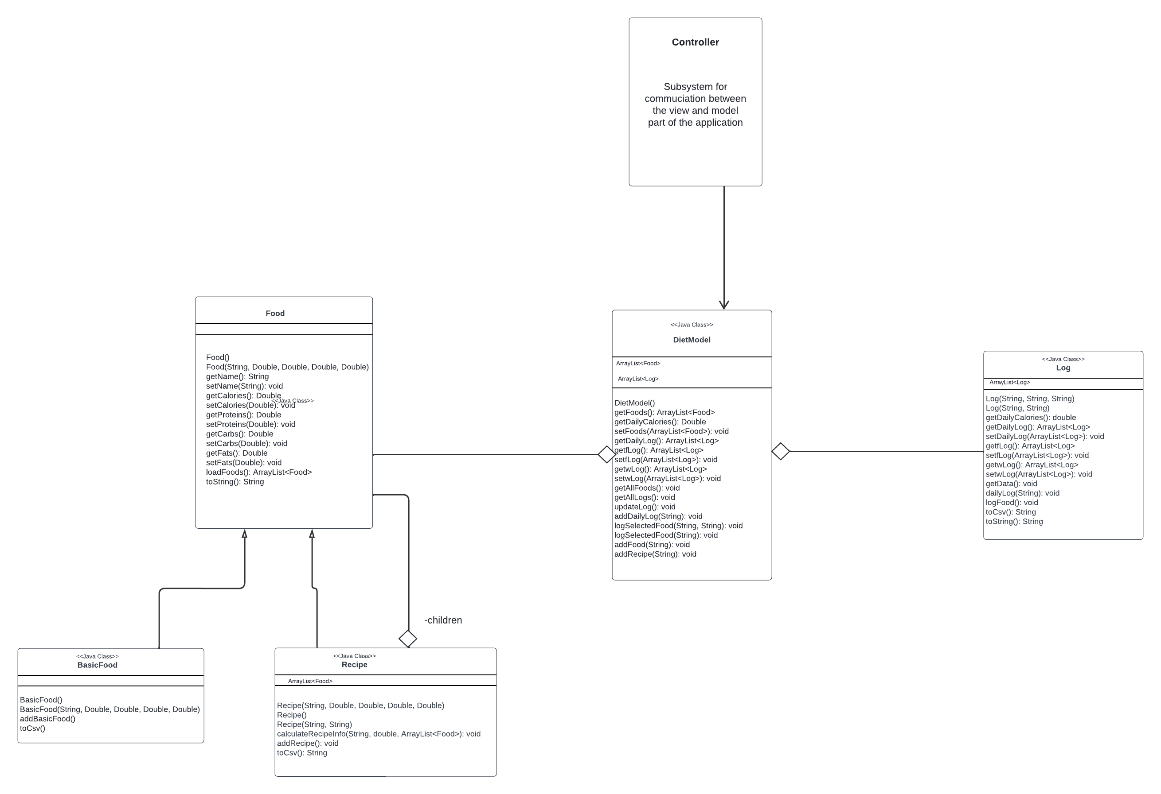
Model Subsystem – composite pattern

Slide 7
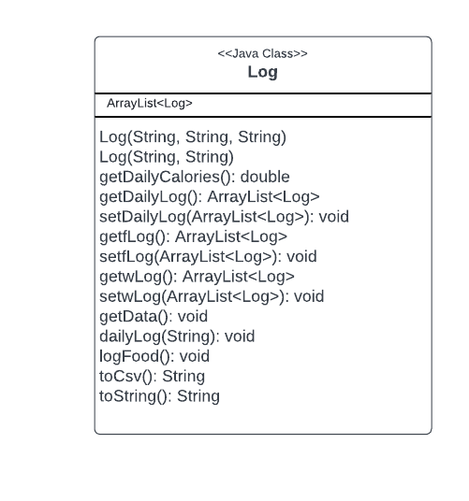
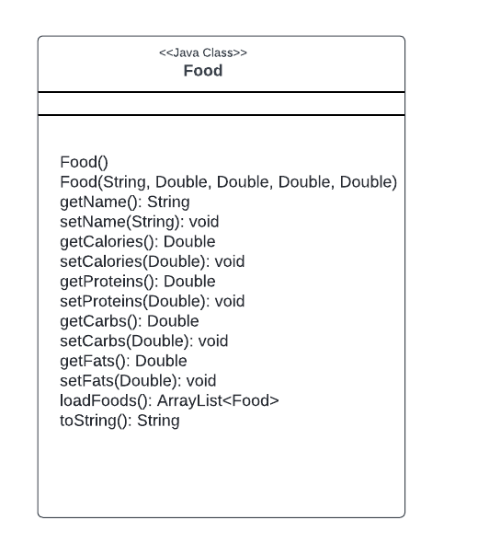
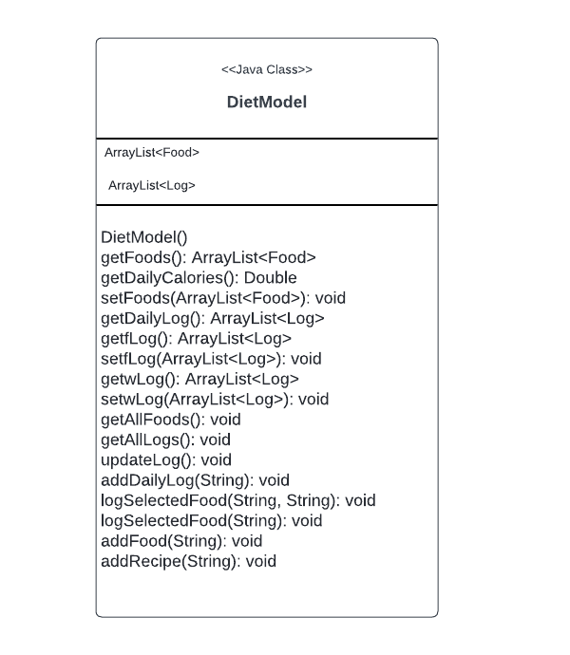
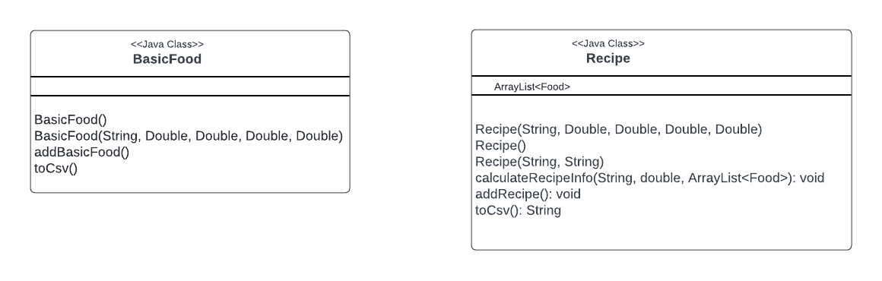
Model Subsystem – classes

Slide 8
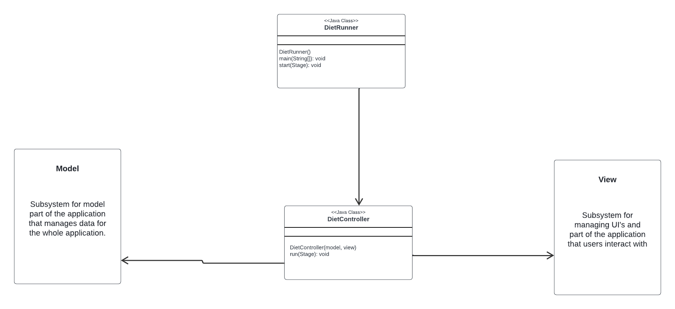
Controller Subsystem

Slide 9
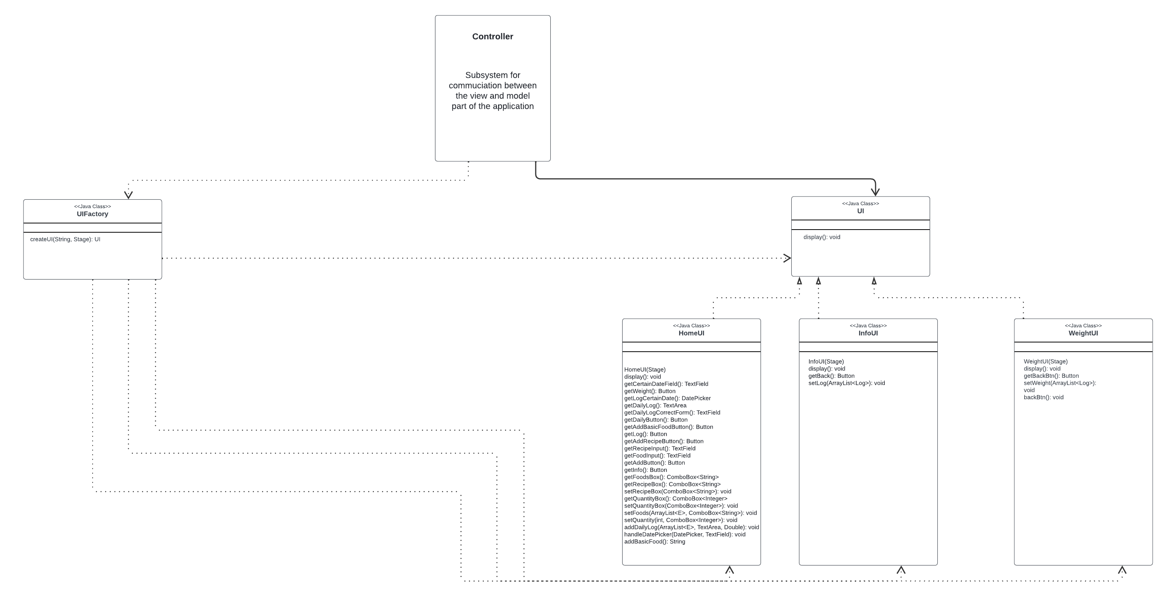
View Subsystem – factory pattern

Slide 10
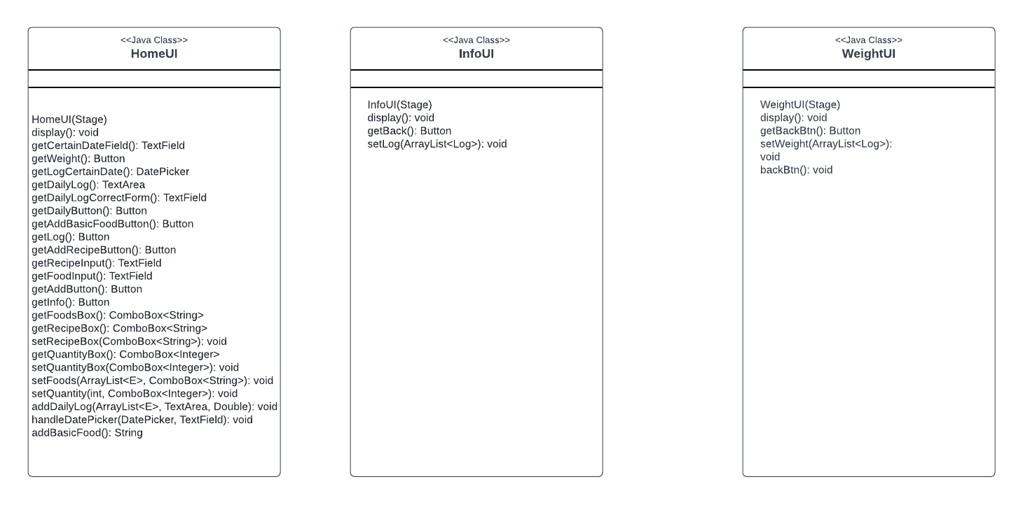
View Subsystem – classes

Slide 11
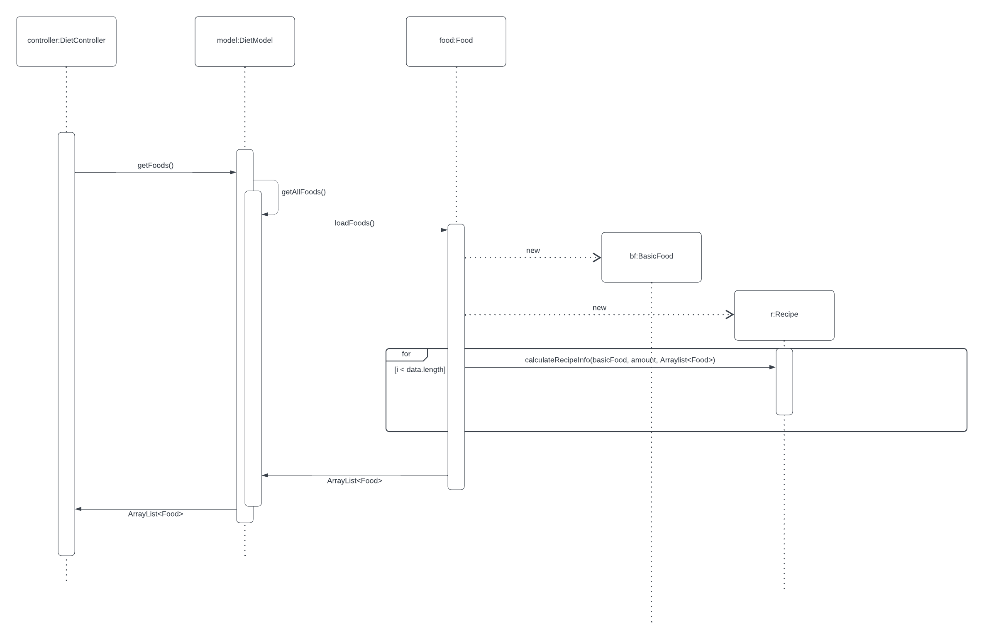
Loading data for 1 basic food

Slide 12
Loading data for 1 basic food
On start of the program, DietController calls getFoods method of DietModel. That method is calling getAllFoods method that is calling the loadFoods method. LoadFoods method is loading foods from the food.csv (not visible on the diagram because of lack of space). In the while nextLine that method is creating either BasicFood or Recipe and adding those foods to the ArrayList<Food> of foods. At the end, that method returns that ArrayList<Food> and the DietController gets a collection of all foods (1 basic food and 1 recipe in this case), later showing it in the view.

Slide 13
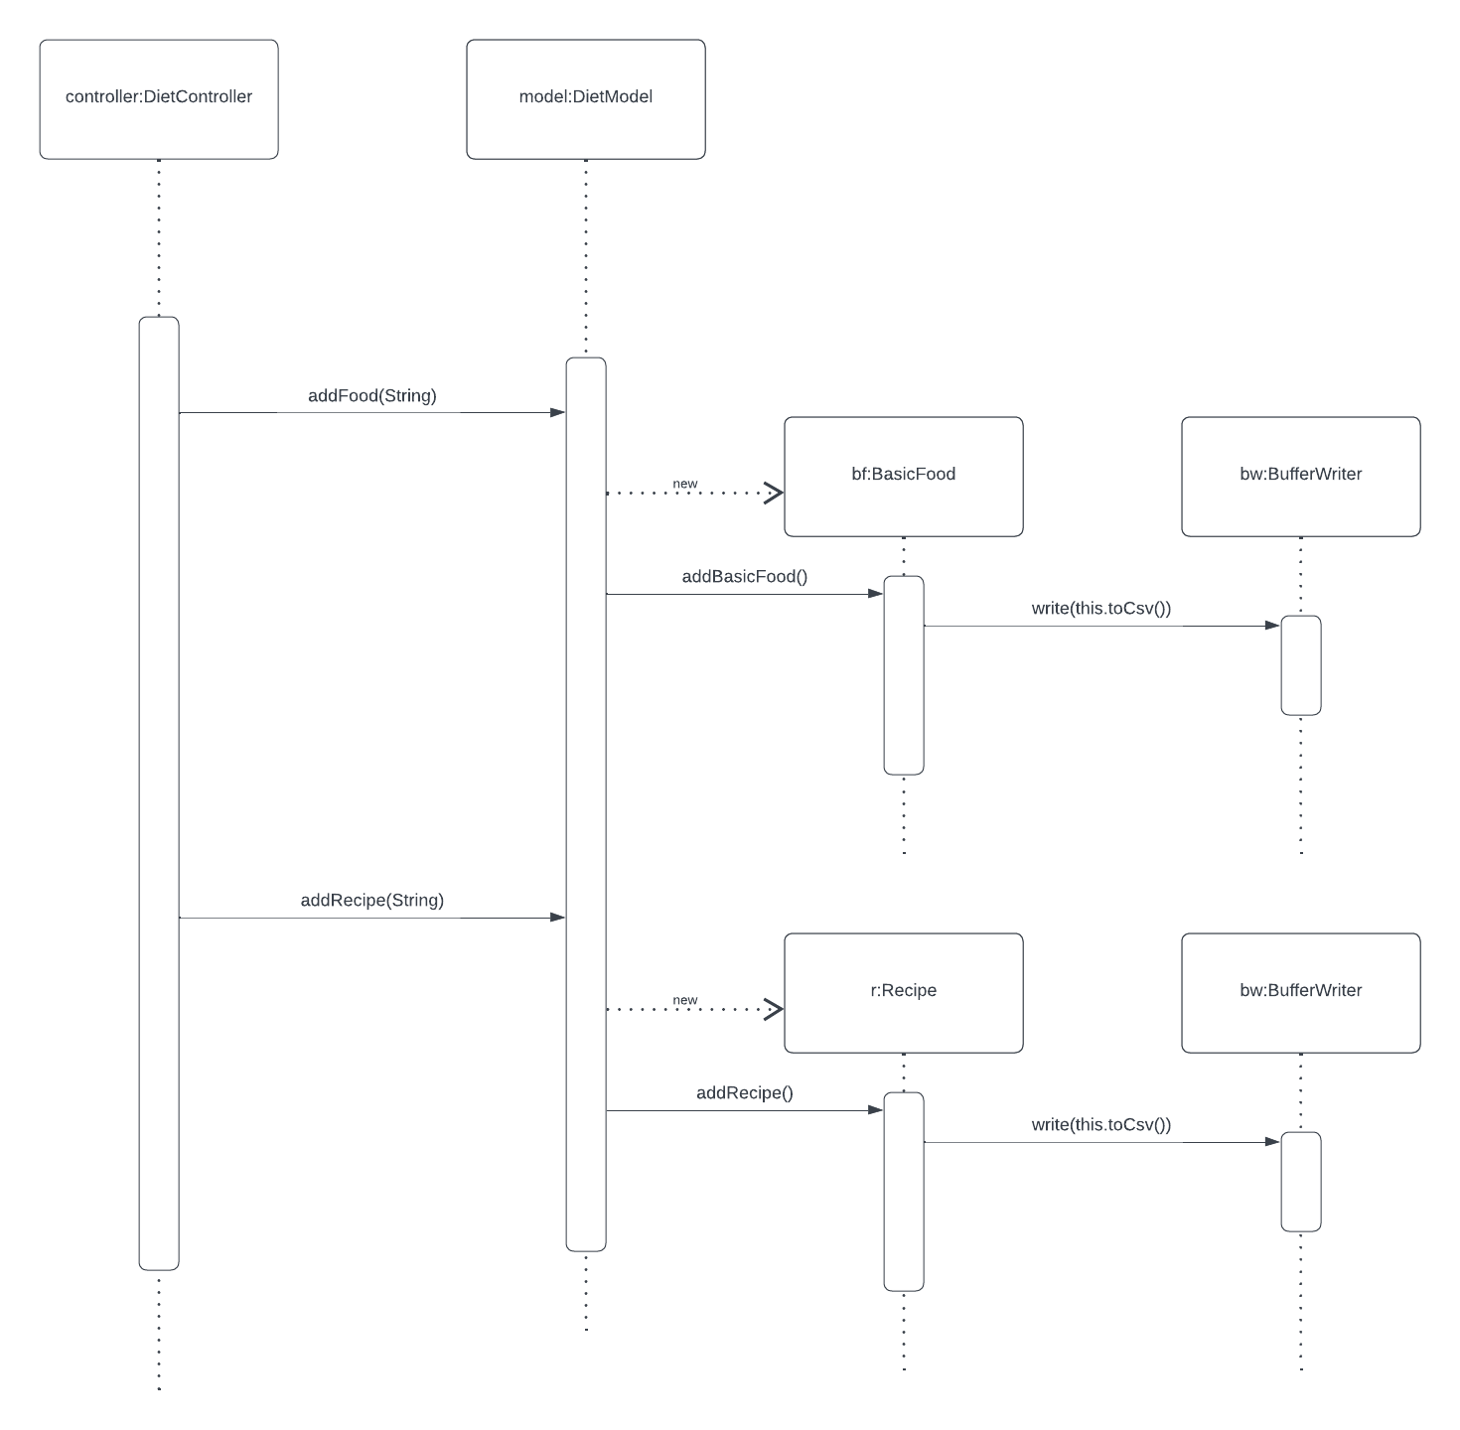
Logging food

Slide 14
Logging food
When a button is clicked on the view, DietController calls addFood method with the String as a parameter. That method creates a new BasicFood object and calls addBasicFood method that is writing that food in the log.csv file using the toCsv method of BasicFood. For Recipe the process is similar, but it creates a Recipe object and also writes that in the foods.csv file using the toCsv method.

Slide 15
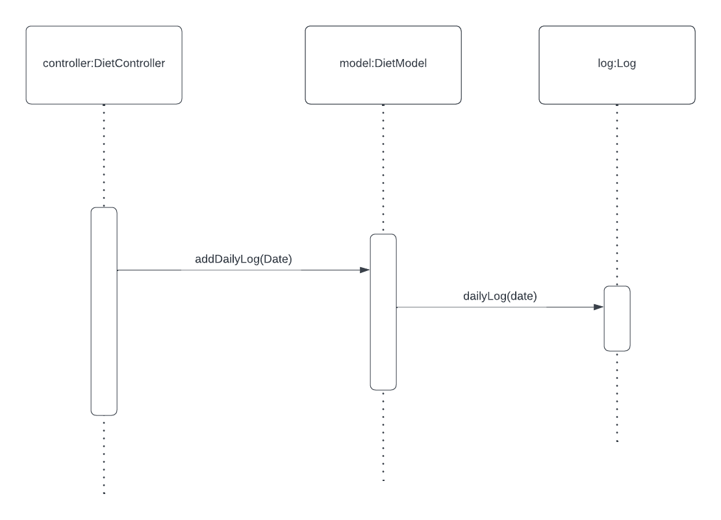
Computing the total number of calories

Slide 16
Computing the total number of calories
For computing total number of calories, we call the addDailyLog with the Date as a parameter, that is calling dailyLog method of the Log class. That method goes through the collection of logs, and for every log that is logged on the date provided in the parameter, it adds it to the collection of logs for that date and adds ­(+=) the calories of that log to the totalCalories integer.

Slide 17
Final Notes

Slide 18
Final Notes
We are most proud of pattern usage – mvc, composite and factory
We could have done a better job with the UI’s

