Slide 1

Hotel Manager
Josef Ariaetes, Noa Mišić, Kristijan Ninčević, Josip Pavlinić

Slide 2

Hotel Manager in Action – Live Demo

Slide 3

Hotel Manager Arhitecture

Slide 4
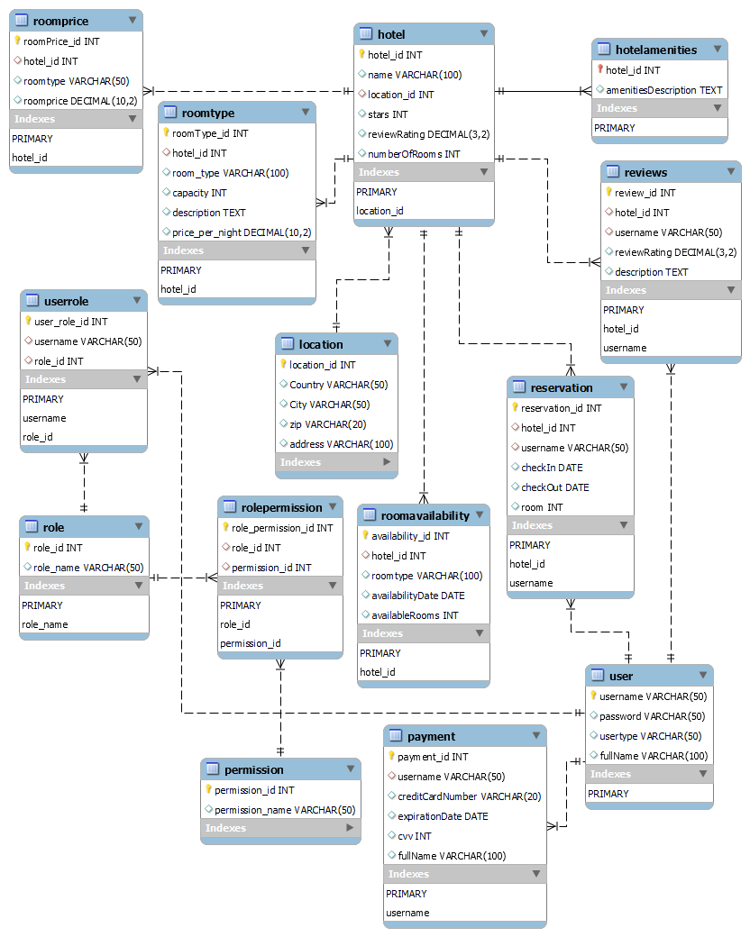
Database Layer
Tables for hotels, users, reservations, reviews, payments…

Slide 5

Data Persistance Layer
Database class for CRUD operations
Custom Exception class for logging and handling exceptions

Slide 6
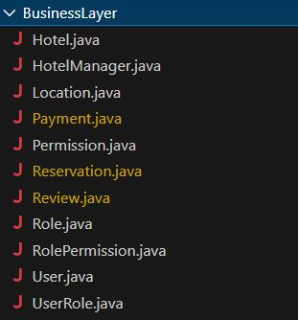
Business Layer
Classes for database tables
Methods based on functional requirements
Communicating with Presentation Layer

Slide 7
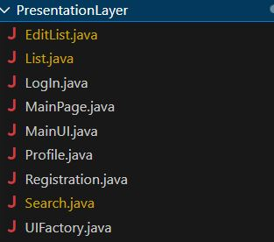
Presentation Layer
Different UI’s for different screens
UI’s for Regular users, Listing users and Admin users
Factory Pattern

Slide 8

Conclusion
We are most proud of our teamwork and application workflow
We could have done a better job on UI’s

Slide 9

Thank you for your attention!

