Slide 1
Formal Verification of Quantum Programs
Jennifer Paykin
Pacific Northwest National Labs
October 26, 2018

Slide 2
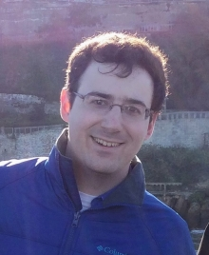
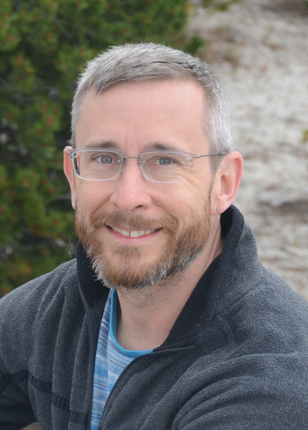
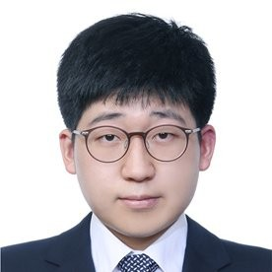
About me…
PhD from University of Pennsylvania 2018
Now at Galois Inc in Portland OR
Interested in programming language design, applications, & verified software
Started working on quantum computing 2015, no physics background
With...
Robert Rand
University of Maryland
Steve Zdancewic
Dong-Ho Lee
University of Pennsylvania
Supported in part by AFRL MURI No. FA9550-16-1-0082

Slide 3
Quantum
Computer
circuits
|0〉
H
{
0 with probability 1/2
1 with probability 1/2
}
results

Slide 4
Features of Circuits
gates applied to wires
|0〉
H

Slide 5
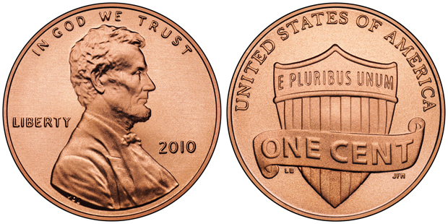
Features of Circuits
gates applied to wires
classical control
|0〉
H
|0〉
H

Slide 6
Features of Circuits
gates applied to wires
classical control
|0〉
H
|0〉
H

Slide 7
Features of Circuits
gates applied to wires
classical control
compositional/modular
|0〉
H
|0〉
H

Slide 8
Features of Circuits
gates applied to wires
classical control
compositional/modular
families of circuits
|0〉
H
|0〉
H
|0〉
H
flip n
|0〉
H
|0〉
H
{
}
{
}
{
}
|0〉
H
{
0 with probability (2^{n}-1)/2^{n}
1 with probability 1/2^{n}
}
0 with probability 1/2
1 with probability 1/2
0 with probability 3/4
1 with probability 1/4
0 with probability 7/8
1 with probability 1/8

Slide 9
Features of Circuits
gates applied to wires
classical control
compositional/modular
families of circuits
semantics—mathematical meaning
(
)
(
)
flip n
=

Slide 10
Quantum Circuit Languages
Low-level – limited types, composition, and/or circuit families
  PyQuil – Python framework for constructing Rigetti Quil circuits
  QisKit – Python framework for constructing IBM QASM circuits
  ProjectQ – open source framework for converting between low-level circuit languages, shared benchmarking, etc

Slide 11
Quantum Circuit Languages
High level – types, composition, circuit families
  Q# – standalone Microsoft language with simulation, optimization, debuggers
  Quipper – functional language for circuit families embedded in Haskell
  QWIRE – Strong type system with semantics embedded in Coq proof assistant

Slide 12
Syntax of Circuits in QWIRE
q
q'
b
r
r'
output of gate
name of gate
input to gate
(q',r') ← gate CNOT (q,r);
b ← gate meas q';
output (b,r')
output of circuit

Slide 13
What could go wrong?
Mismatched composition
qubit
bit
|0〉
H
bit
|0〉
H
type systems

Slide 14
What could go wrong?
Mismatched composition → type system
Algorithm is wrong → pen & paper proof
Implementation doesn’t mach specification → ??
(
)
(
)
flip n
=

Slide 15
Implementation vs Specification
Test it?
  Probabilistic results require many tests
  Limitations of current-gen quantum hardware
  Cannot “debug” in the classical way
Simulate it?
  Only feasible for small inputs, by definition
Prove it?
  Pen & paper proofs often miss implementation details

Slide 16
Formal Verification
Formal proof system based on small trusted core
Formalize semantics of circuits inside proof system
Prove statements about circuits
C : Circuit ρ : Density_Matrix
--------------------------------------
⟦C⟧ρ : Density_Matrix

Slide 17
Trade-offs of Formal Verification
Proofs directly connect code to spec
  If code changes, proof changes
Specifications are executable
Proofs are formal
  Don’t let you skip any important details
  Can use high-level reasoning techniques
It’s a lot of work!
Efficiency...

Slide 18

Formal Verification in Coq
Formal proof system based on small trusted core
Formalize semantics of circuits inside proof system
Prove statements about circuits
QWIRE in Coq
https://github.com/inQWIRE/QWIRE

Slide 19
Formal Verification
|0〉
H
(
)
Lemma fair_toss : ⟦coin_flip⟧ = .
Proof.
Qed.
}
tactics
}
============================
⟦ init true ⟧ I = fair_coin
goal

Slide 20
Formal Verification
|0〉
H
(
)
Lemma fair_toss : ⟦coin_flip⟧ = .
Proof.
matrix_denote. (* unfold definitions *)
Qed.
============================
(I × I ⊗ I) × ((I ⊗ |0⟩⟨0| ⊗ I) × ((I ⊗ hadamard ⊗ I) × ((I ⊗ |0⟩) × I × ((I ⊗ |0⟩)) †) × (I ⊗ hadamard ⊗ I) †) × (I ⊗ |0⟩⟨0| ⊗ I) † .+ (I ⊗ |1⟩⟨1| ⊗ I) × ((I ⊗ hadamard ⊗ I) × ((I ⊗ |0⟩) × I × ((I ⊗ |0⟩)) †) × (I ⊗ hadamard ⊗ I) †) × (I ⊗ |1⟩⟨1| ⊗ I) †) × (I × I ⊗ I) † = fair_coin
* simplified for readability

Slide 21
Formal Verification
|0〉
H
(
)
Lemma fair_toss : ⟦coin_flip⟧ = .
Proof.
matrix_denote. (* unfold definitions *)
Msimpl. (* simplify using known identities *)
Qed.
============================
|0⟩⟨0| × (hadamard × |0⟩⟨0| × hadamard) × |0⟩⟨0|
.+ |1⟩⟨1| × (hadamard × |0⟩⟨0| × hadamard) × |1⟩⟨1|
= fair_coin

Slide 22
Formal Verification
|0〉
H
(
)
Lemma fair_toss : ⟦coin_flip⟧ = .
Proof.
matrix_denote. (* unfold definitions *)
Msimpl. (* simplify using known identities *)
solve_matrix. (* brute force *)
Qed.
============================
No more subgoals.

Slide 23
Rule #1: Only rely on brute force for small cases
Fixpoint flip (n : Nat) :=
match n with
| 0 ⇒
| S n' ⇒
end.
1
flip n'
H
|0〉
(
)
(
)
flip n
=

Slide 24
Rule #2: Use induction to prove correctness of circuit families
Lemma flip_corect : forall n,
Proof.
induction n.
(
)
(
)
flip n
=
1
flip n'
H
|0〉

Slide 25
Rule #2: Use induction to prove correctness of circuit families
Lemma flip_corect : forall n,
Proof.
induction n.
- (* n = 0 *) (* easy brute force *)
(
)
(
)
1
=
flip n'
H
|0〉

Slide 26
Rule #2: Use induction to prove correctness of circuit families
Lemma flip_corect : forall n,
Proof.
induction n.
- (* n = 0 *) (* easy brute force *)
- (* n = n’+1 *) (* use IH to complete proof *)
Qed.
(
)
(
)
(
)
flip n'
=
|0〉
H

Slide 27
Rule #3: Use equational reasoning
U
U†
≡
Lemma unitary_adjoint_id : ∀ n (U : Unitary n),
unitary_adjoint U ≡ id n.
(* C1 ≡ C2 := ∀ ρ, ⟦C1⟧ρ = ⟦C2⟧ρ *)

Slide 28
QWIRE: circuit language in Coq
Minimal circuit language that has desired features
  Not meant for production systems
  Implemented in Coq—interactive theorem prover
Strong type system prevents ill-formed circuits
Denotational semantics
  Formalized in Coq

Slide 29
QWIRE: circuit language in Coq
https://github.com/inQWIRE/QWIRE
Verify particular circuits & protocols
  teleportation, Deutsch’s algorithm
Verify entire families of circuits
  Inductively-defined circuits,
Verified compiler & compiler optimizations
  Boolean expressions to quantum oracles

Slide 30
QWIRE: circuit language in Coq
Current developer: Robert Rand at University of Maryland
There are always trade-offs, but verification is often worthwhile!

