Slide 1

Investigating the Impact of Data Quality & Data Drift on ML Performance
An Intelligent Monitoring Framework · Final Year Data Science Project Proposal

Slide 2

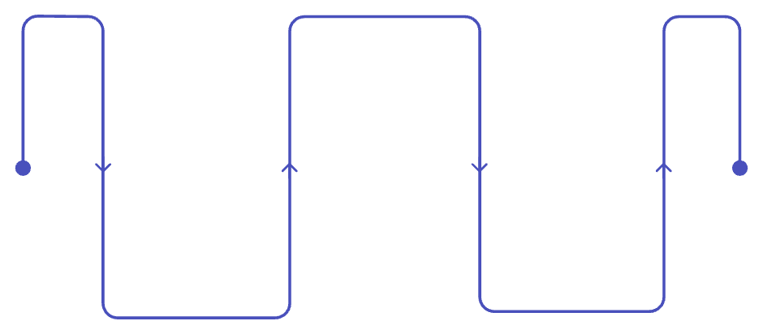

The Problem: Models Don't Live in a Stable World
Why It Matters
ML models trained on historical data face continuously shifting production inputs — missing values, outliers, new categories, distribution shifts.
Changing Production
New inputs: shifts, missing values
Detecting change ≠ knowing whether performance is harmed
Historical Training
Model Degradation
Past data used to train models
Performance may decline over time
Organisations need to distinguish harmful drift from harmless variation — and know when retraining is justified.

Slide 3
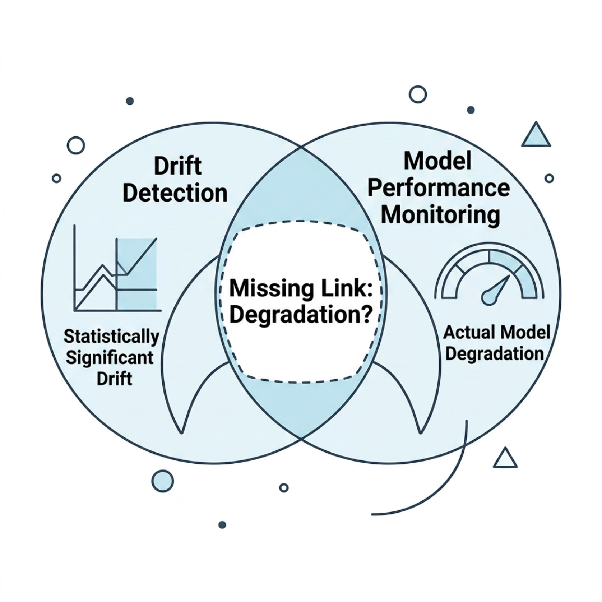
Research Gap & Central Question
The Gap
Data-quality monitoring, drift detection, and performance monitoring are treated as separate tasks. Statistically significant drift does not necessarily imply meaningful degradation.
"How does data-quality degradation and feature drift affect ML performance — and can combining these signals identify harmful changes more effectively?"

Slide 4
Objectives & Scope
01
02
03
Baseline Model
Detect & Quantify
Controlled Experiments
Train on clean, high-quality data to establish performance benchmarks
Measure data-quality issues and feature drift with statistical tests
Introduce degradation systematically; measure performance impact
04
05
Compare Signals
Framework
Identify which monitoring signals best indicate harmful changes
Develop an intelligent monitoring framework grounded in findings
Scope: Tabular ML · Public datasets · Controlled production simulations · Quantitative analysis

Slide 5
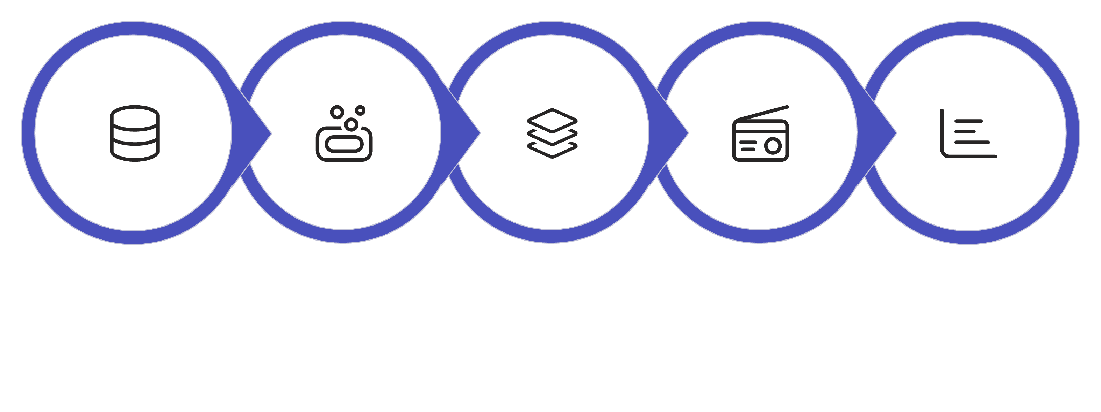
Methodology & Experimental Design
Data Collection
Data Preparation
Baseline Model
Controlled Changes
Drift & Quality
Controlled Scenarios
Statistical Tests
Increasing missingness & outliers
New unseen categories
Gradual & sudden feature drift
KS Test · Chi-Square
PSI · Jensen-Shannon Divergence
Detection accuracy, false alarms, timing

Slide 6
SMART Implementation Plan
Investigating the Impact of Data Quality & Data Drift on ML Performance: An Intelligent Monitoring Framework
S — SPECIFIC
End-to-End Monitoring Workflow
Build a complete pipeline for one tabular ML use case:
Automated data ingestion → validation → baseline model training
Production-data simulation → quality monitoring → drift detection
Model-performance monitoring → impact analysis → dashboard
Monitor: missing values, outliers, invalid/unseen categories, gradual drift, sudden drift
M — MEASURABLE
Concrete Metrics at Every Stage
Data quality: missing-value %, duplicate %, invalid-value %, outlier %
Drift: KS statistic/p-value (numerical), Chi-square (categorical), PSI / Jensen-Shannon divergence
ML impact: F1, precision, recall, ROC-AUC, % performance degradation
Framework: detection rate, false-positive rate, detection delay, drift-score vs. degradation correlation
A — ACHIEVABLE
Focused, Controlled Experiment
One well-defined tabular ML use case
One primary public dataset (+ optional supplementary dataset)
Three baseline models: Logistic Regression, Random Forest, XGBoost
Small set of statistical drift methods; controlled simulations replace real production access
Contribution = rigorous analysis and evaluation, not a full enterprise MLOps platform
R — RELEVANT
Actionable Business Interpretation
Every step connects to a real-world production problem: which detected changes threaten model reliability?
High statistical drift + little model impact → lower priority
Moderate drift + substantial degradation → immediate investigation or retraining
Outputs actionable signal prioritisation, not merely drift alerts
T — TIME-BOUND
Sequential Project Phases
Phase 1: Data acquisition, cleaning, validation & EDA
Phase 2: Feature engineering, model training & evaluation
Phase 3: Controlled degradation & drift experiments
Phase 4: Statistical analysis — data changes vs. model degradation
Phase 5: Monitoring framework, dashboard, evaluation & final findings
Research Output: Empirical evidence identifying which data changes matter most, which monitoring signals are genuinely useful, and a lightweight prioritisation framework for distinguishing harmful drift from benign distributional shifts.

Slide 7
Expected Insights & Contribution
🔍 Empirical Evidence
📊 Signal Reliability
Which degradation types cause the largest performance loss?
Does significant drift actually predict harmful model degradation?
⏱ Early Detection
🛠 Practical Framework
How early can harmful changes be identified before impact is severe?
Prioritise impactful changes — not every detected statistical deviation
Detect the change → Measure the impact → Understand whether it matters.
Clear industry problem · Measurable objectives · Quantitative experimental methodology

