Slide 1
ABC Bank
Customer Propensity to Purchase a Product

Slide 2
Methodology
Objective/Goals: Create model to predict likelihood of customer purchase
Acquire data: Collected data with 41k data points
Prepare & transform the data
Model selection, assessment, & validation
Deploy (at a later time)

Slide 3
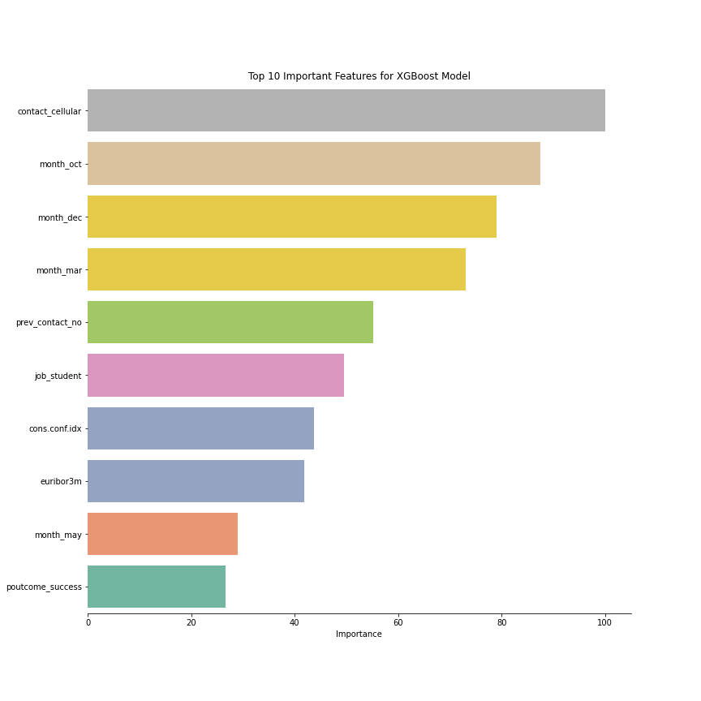
Ways to Increase Success
Marketers should:
Attempt to contact through a cellular phone first
Contact a potential customer prior to campaign
Contact previous customers who have purchased a product
Remember to contact students, more likely to purchase

Slide 4
Moving Forward
Further analysis of features collected
Costs of acquiring more customer-specific traits
Deployment
Monitoring model in production

Slide 5
Questions?

