Slide 1
The Actor Model
Towards Better Concurrency
By: Dror Bereznitsky

Slide 2

Warning: Code Examples

Slide 3
Agenda
Agenda
The end of Moore law?
Shared state concurrency
Message passing concurrency
Actors on the JVM
More concurrency models
Summary

Slide 4
The End of Moore Law ?

Slide 5
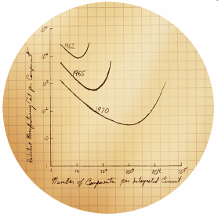
The End of Moore Law ?
Moore's law
The number of transistors on a chip will double approximately every 18 months
Gordon E. Moore, 1965

Slide 6
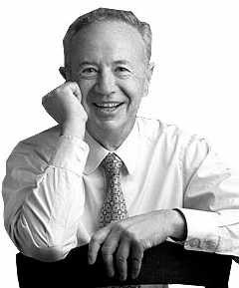

The End of Moore Law ?
Andy Giveth, and Bill Taketh away
No matter how fast processors get, software finds new ways to eat up the extra speed
Notes:
They used to say "Andy Giveth and Bill Taketh away," meaning despite CPU advances by Andy Grove's Intel — Bill Gate's Microsoft would effectively make sure you would spend the same amount of time to accomplish the same task

Slide 7
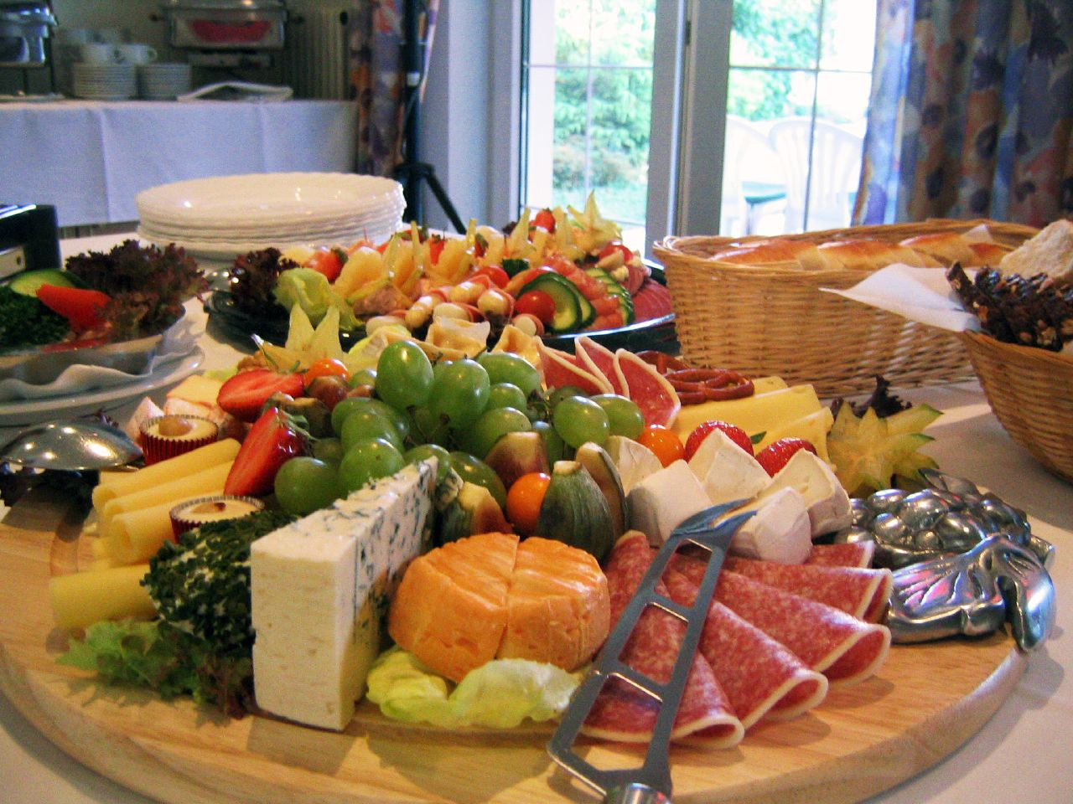
The End of Moore Law ?
The Free Lunch
Free and regular performance gains, even without releasing new versions or doing anything special

Slide 8
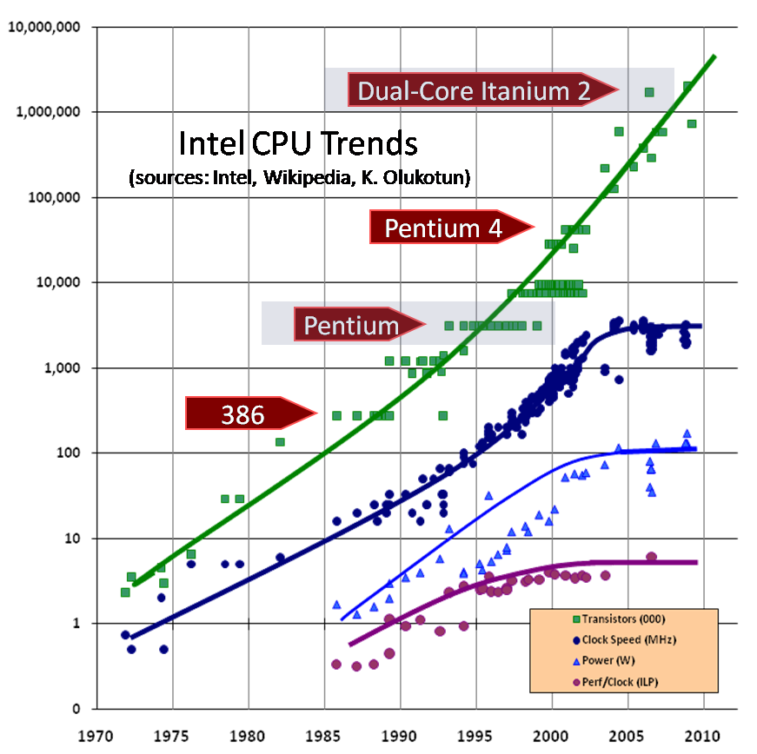
The End of Moore Law ?
The End of Moore Law ?

Slide 9
The End of Moore Law ?
Why You Don’t Have 10GHz Today
Hardware crossed a boundary in the early 2000s:
chips got big enough, cycle speed got fast enough
a signal can no longer reach the whole chip in a clock cycle
problems with heat dissipation

Slide 10
The End of Moore Law ?
The Multicore Era
Processor manufacturers have turned towards multi-core processors
Capable of doing multiple calculations in parallel
CPU speeds are likely to stay relatively flat in the near future

Slide 11
The End of Moore Law ?
The Concurrency Revolution
The performance lunch isn’t free any more
Want to benefit from the continued throughput advances in new processors?
You will need to develop well-written concurrent applications

Slide 12
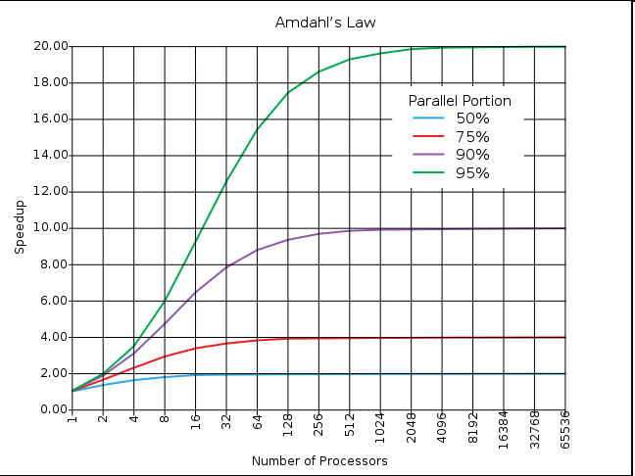
The End of Moore Law ?
Amdahl’s Law
GParallelizer

Slide 13
Shared State Concurrency

Slide 14
Shared State Concurrency
Shared State Concurrency
Shared mutable state
Locking mechanism

Slide 15
Shared State Concurrency
Threads
Threads concurrently execute code sections
Contains resources that must be shared
Synchronized in order to guarantee
Correct ordering
Visibility
Data consistency

Slide 16




Shared State Concurrency
The Popular Choice
C#
C/C++

Slide 17

Shared State Concurrency
Why Threads are Evil
http://www.flickr.com/photos/amagill/235453953/

Slide 18
Shared State Concurrency
Not Convinced Yet ?
“Non-trivial multi-threaded programs are incomprehensible to human …”
Edward A. Lee, The Problem with Threads

Slide 19
Shared State Concurrency
Alternative Concurrency Models
Message Passing Concurrency (Actors)
Software Transactional Memory
Dataflow Concurrency

Slide 20
Message Passing Concurrency

Slide 21
Message Passing concurrency
Message Passing concurrency
1973, paper by Carl Hewitt
Avoid the problems caused by threading and locking
Implemented in Erlang, Oz, Occam

Slide 22
Message Passing Concurrency
Key Principals
Actors instead of objects
No shared state between actors
Asynchronous message-passing
Mailboxes to buffer incoming messages

Slide 23
Message Passing Concurrency
Actors
React to received messages by executing a behavior function
can only change the state of the actor itself
can send messages to other actors
Actors never share state and thus never need to compete for locks for access to shared data

Slide 24
Message Passing Concurrency
Messages
Actors exchange data by sending immutable messages
Messages are sent asynchronously
Actors do not block waiting for responses to their messages

Slide 25

Message Passing Concurrency
Mailbox
Messages buffered in an actor's mailbox
A mailbox is a queue with multiple producers and a single consumer
Also known a channel

Slide 26

Message Passing Concurrency
Erlang
A pure functional, dynamically typed language invented in 1986 at Ericsson
Designed for concurrency, distribution and scalability
Actors are part of the language
No Mutable state

Slide 27
Message Passing Concurrency
Hello World in Erlang
loop() -> receive hello -> io:format("Hello, World!~n"), loop(); goodbye -> ok end.

Slide 28
Actors on the JVM

Slide 29
Actors on the JVM
Actors on the JVM
JVM languages actors implementations available for
Java
Scala
Groovy
Fantom

Slide 30
Java Actors
Java Actor Libraries
Actor’s Guild
Akka
ActorFoundry
Actorom
Functional Java
Kilim
Jetlang

Slide 31
Java Actors
Actors Guild
Experimental Java framework
make concurrent programming easier
Annotation based approach
Messages handlers are implemented as Java methods
Uses a request/response pattern for messages
Not a pure Actors implementation
No special pre-processing

Slide 32
Java Actors
Actors Guild Hello World: Actor Implementation
public abstract class HelloActor extends Actor {
@Prop
public abstract String getName();
@Message
public AsyncResult<String> sayHello(String name) {
return result(
String.format("Hello %s, my name is %s",
name, getName())););
}
}

Slide 33
Java Actors
Actors Guild Hello World: Actor Usage
Agent agent = new DefaultAgent();
HelloActor hello = agent.create(HelloActor.class, new Props("name", "Hamlet"));
AsyncResult<String> asyncResult = hello.sayHello("Claudius");
System.out.println(asyncResult.get());
agent.shutdown();

Slide 34
Java Actors
Thread Usage Pattern
@Message
@Usage(ThreadUsage.IO)
public AsyncResult<Void> writeFile(...) throws Exception {
FileOutputStream fos = new FileOutputStream(name);
fos.write(content.getBytes());
fos.close();
return noResult();
}
@Message
@Usage(ThreadUsage.Waiting)
public AsyncResult<Void> waitForKeyPrompt() throws Exception {
System.in.read();
return noResult();
}

Slide 35
Java Actors
Concurrency Model Annotations
@Model(ConcurrencyModel.Stateless)
class MultiplicatorActor extends Actor {
@Message
public AsyncResult<Integer> mul(int a, int b) {
return result(a * b);
}
}

Slide 36
Scala Actors
Scala Actors
Scala actors combine the powers of functional programming along with the flexible type-system of Scala

Slide 37
Scala Actors
Share Nothing, Asynch Message Passing
Encourages shared-nothing process abstractions
mutable state - private
shared state - immutable
Asynchronous message passing
Pattern matching
Fork/Join as the underlying implementation

Slide 38
Scala Actors
Thread-based vs. Event-based Actors
Thread-based actors - each run in its own JVM thread
Overhead in case of large amount of actors
full stack frame suspension (receive)
Event-based actors run on the same thread
Use a react block instead of a receive block

Slide 39
Scala Actors
Lightweight Event Based Actors
Lightweight event objects
Executed on an underlying worker thread pool
automatically resized when all threads block on long running operations
Suspension mechanism based on a continuation closure (react)

Slide 40
Scala Actors
The Actor and Messages
case class Name(name: String)
case class Greet();
object HelloWorld extends Actor {
def act = {
var myName = "Incognito"
loop {
react {
case Name(name) => myName = name
case Greet =>
reply("Hello, my name is " + myName); exit
}
}
}
}

Slide 41
Scala Actors
Interacting with the Actor
object Greetings extends Application {
HelloWorld.start
HelloWorld ! Name("foo")
HelloWorld !? Greet match {
case result: String => println(result);
}
}

Slide 42
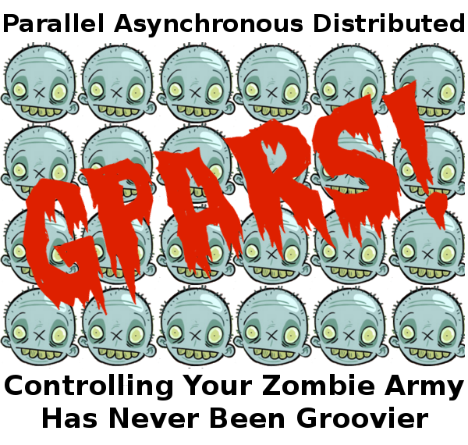
Groovy Actors

Slide 43
Groovy Actors
GPars
GPars = Groovy Parallel Systems
Formerly known as GParallelizer
Handle tasks concurrently, asynchronously, and distributed
Concurrent collection processing
Actor programming model
Dataflow concurrency constructs
Safe - an mt-safe reference to mutable state

Slide 44
Groovy Actors
Gpars Actors
Inspired by the Actors library in Scala
Event driven actors
concurrent actors that share a single pooled thread
Using fork/join under the hood
Supports distributed actors

Slide 45
Groovy Actors
GPars Actors Hello World: Actor Implementation
class HelloWorld extends AbstractPooledActor {
String name
void act() {
loop {
react {
switch (it) {
case 'hello': println "Hello, my name is $name"; break
}
}
}
}
}

Slide 46
Groovy Actors
GPars Actors Hello World: Actor Usage
def actor = new HelloWorld(name : "Charlie").start();
actor.send('hello')

Slide 47
Actors in the Real World

Slide 48
Actors in the Real World
Erlang Actors in the Real World
Ericson AXD 301 switch
millions of calls per ,99.9999999 percent uptime
Facebook chat application
70 million concurrent users
RabbitMQ
high-performance AMQP, 400,000 messages per second.
Apache CouchDB
distributed, fault-tolerant document-oriented database
Ejabberd XMPP server – jabber.org

Slide 49
Actors in the Real World
Actor Benefits
Easier to reason about
Higher abstraction level
Easier to avoid
Race conditions
Deadlocks
Starvation
Live locks
Distributed computing

Slide 50
Actors in the Real World
Problems with Actors
Actors don’t work well when
Shared state is needed F.e. bank account
Need to achieve global consensus
Synchronous behavior is required
It is not always trivial to break the problem into smaller problems

Slide 51
More Concurrency Models

Slide 52
More Concurrency Models
Software Transactional Memory
1995 Nir Shavit and Dan Touitou
Memory as a transactional data set
Alternative to lock based synchronization
Similar to database transactions
Optimistic Approach
a thread completes modifications to shared memory without regard for what other threads might be doing

Slide 53
More Concurrency Models
Deuce
Java STM framework by Guy Korland (TAU, GigaSpaces)
@Atomic methods
Field based access
More scalable than Object bases.
More efficient than word based.
No reserved words
No need for new compilers (Existing IDEs can be used)
Using bytecode instrumentation (ASM)

Slide 54
More Concurrency Models
Duece Example
public class Bank{
private double commission = 0;
@Atomic(retries = 64)
public void transaction( Account ac1, Account ac2, double amount){
ac1.balance -= (amount + commission);
ac2.balance += amount;
}
@Atomic
public void update( double value){
commission += value;
}
}

Slide 55
More Concurrency Models
Deuce Example Under the Hood
public void update( double value){
Context context = ContextDelegetor.getContext();
for( int i = retries ; i > 0 ; --i){
context.init();
try{
update( value, context);
if(context.commit()) return;
}catch ( TransactionException e ){
context.rollback();
continue;
}catch ( Throwable t ){
if( context.commit()) throw t;
}
}
throw new TransactionException();
}

Slide 56
More Concurrency Models
STM Pros and Cons
Pros
Performance gains on multi processor machines
Simple approach to concurrency
No deadlocks or livelocks
Cons
Transactions cannot perform any operation that cannot be undone

Slide 57
Summary

Slide 58
Summary
Summary
The free lunch is over
Applications must be built for concurrency
Shared state concurrency is hard
Alternative concurrency models
Message passing concurrency
Shared Transactional Memory

Slide 59
Summary
Resources
The free lunch is over
State: You're Doing It Wrong
Edward A. Lee, The Problem with Threads (PDF)
Alex Miller – Actor Concurrency
Deuce STM

Slide 60
Thank You :-)

