Slide 1
Data Science 5K Challenge Remote Wave 1 Lending Club: Loan Analysis Predicting Loan Payoff or Default
Part 5: Capstone Presentation
Joanne Hayashi
05-October-2017

Slide 2
Photo: Brendan Bailey (09/21/2017)
Notes:
1) Lending Club is an online peer lending marketplace – where individual borrowers or small businesses can borrow money. LC leverages online data to quickly assess an applicant’s credit worthiness and assign an interest rate. Qualified applicants receive offers and options within minutes, and these loans have no impact on their credit score.
Individual or institutional investors can earn risk assessed and adjusted returns. LC has practices transparency, so data since its inception in 2007 is available on their website. Borrowers are assigned grades that determine their assigned interest rate as well as provide a level of risk to the lender. An investor receives monthly cash flow and may also invest in partial loans, portfolios, and/or with qualified retirement accounts.
LC considers itself “frictionless, transparent, and a highly efficient digital experience. “ They indicate over $28 billion has been funded since 2007.
2) My interest in this dataset is to examine the effectiveness of LC’s ability to provide sufficient returns to investors as well as provide funding to those who might not otherwise qualify for loans at traditional institutions.
My project attempts to predict whether a borrower will pay off a loan or default with the KNN model.
3) BTW: this photo was taken by Brendan on his recent trip to CA. Thank you Brendan!

Slide 3
Dataset Intro, Challenges, and Remedies
Introduction of dataset
The Lending Club dataset is available on Kaggle.com (2007-2015)
Includes 74 fields, of which I have selected 13 based on the assessment of others who have analyzed this dataset
The Kaggle csv file is about 88MB and contains over 887,000 records
The data available directly from LC contains all 137 fields and includes data up to 2017.
Dataset and Data Challenges
Deciding which fields to keep was a great challenge
In the end, I decided to trust in their complex grading system and was able to eliminate most of the fields
Mostly empty fields or columns were automatically removed with this decision
N/A’s were converted to NaN, or 0 where appropriate
Note: I did not think those eliminated fields were irrelevant!
Also added several fields to convert categorical fields values to numeric values
Indicated with an ‘_clean’ suffix
Notes:
In 2007-2008 time period, losses due to default 14% - beginning, and unusually economy
2009, recovery period – new leadership decided to lower the average FICO score requirements to 700 (from 714), and raise interest rates
Loss percentage has dropped steadily through the years to 4-6% since. This decision has also given enabled LC to exceed earnings of its competitor, Prosper.

Slide 4
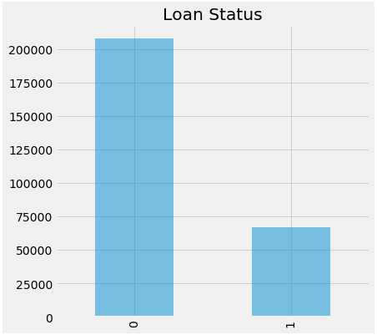
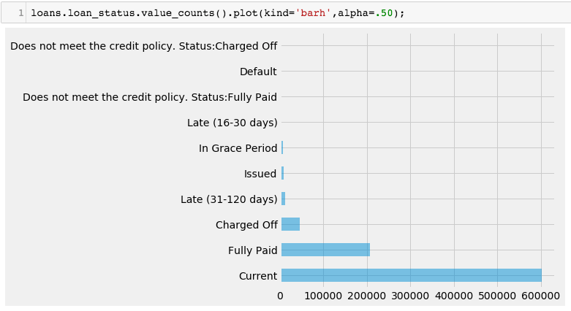
Feature and Target Selections
Success:
- Fully Paid
Default or Delinquent:
- Default
- Late (both)
- In Grace
- Charged Off
Removed:
- Issued
- Current
- Policy
207,723
66,668
Target Value:
Class 0 = Success
Class 1 = Default
Notes:
Simple loss calculation – funded, one time fee and late fees
Originally used only Default value, which yielded 1200 / 200,000 defaults to successes.
Consensus revealed above breakdown.
0 207,723
1 66,668

Slide 5
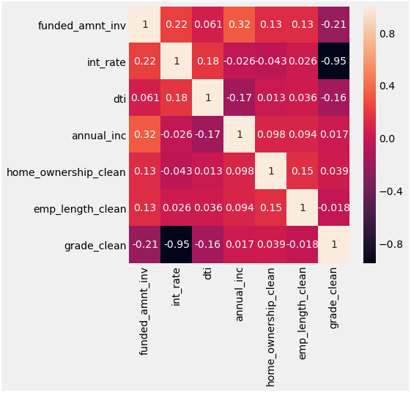
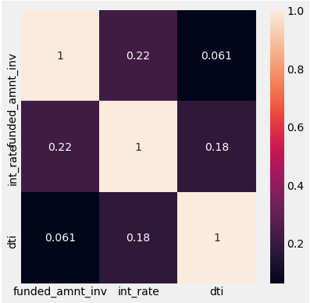
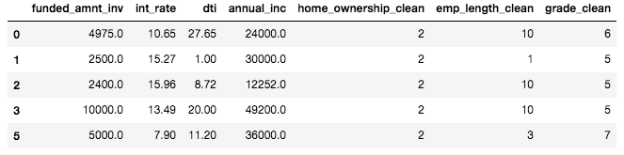
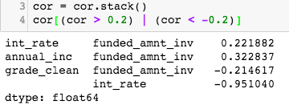
Notes:
Heatmap!
Inverse correlation due to grade assignment A-G as 7-1

Slide 6
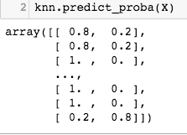
Train Test and Predict
Raw Shape: (887379, 74)
Clean Data: X: (274391, 3), y: (274391,)
KNN Baseline Accuracy = 0.756305
Standard Split (80/20):
Accuracy for K=1 Neighbor = 0.662118429109
50/50 Split:
Accuracy for K=1 Neighbor = 0.664210326832
Accuracy for K=50 Neighbors = 0.755984139479
Tuning Model:
Accuracy for K=5 Neighbors = 0.7992499754
Standardized Predictor Matrix (for best K):
0.748369917455, 25
Accuracy Score K=25: 0.348727368145* Testing Error = 0.247164640369
Predicted Probabilities of Class Membership
Notes:
* Ran twice to be sure
Training over the entire dataset was taking over 1.5 hours, so did not collect that metric.
0 207723 1 66668

Slide 7
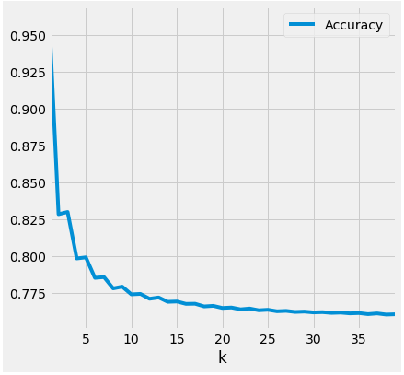
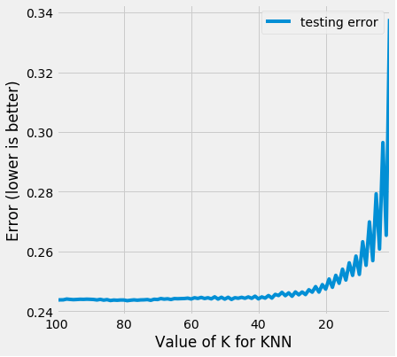
Evaluation
Maximum Testing Accuracy
Minimum Testing Error
Accuracy, K = (0.99738694053376387, 1)
Error, K = (0.24364412956645964, 93)

Slide 8
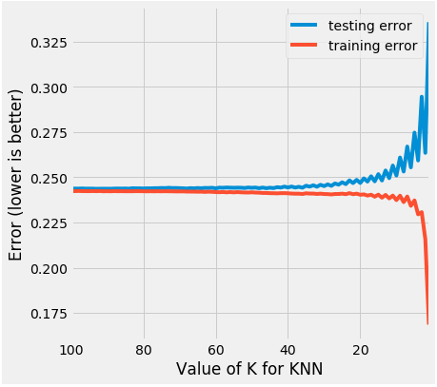
Evaluation
K vs Training Error and Testing Error
Converges approximately about K=60 vs, K=25

Slide 9
References:
Kaggle.com original dataset, kernel, general dataset information
https://www.kaggle.com/wendykan/lending-club-loan-data/data
Lending Club Information, Dataset, and Statistics
https://www.lendingclub.com/info/statistics.action
General Assembly Lesson Notebooks (Code)
https://git.generalassemb.ly/ds-virtual-1-bah-08-2017
Loan Data (2007-2011) From Lending Club (Code)
http://nbviewer.jupyter.org/gist/odubno/0b767a47f75adb382246
Machine Learning and Statistics Blog - Lending Club Data Analysis Revisited with Python
http://kldavenport.com/lending-club-data-analysis-revisted-with-python/
Default Rates at Lending Club & Prosper: When Loans Go Bad
http://www.lendingmemo.com/lending-club-prosper-default-rates/
Predicting Defaults of Loans using Lending Club’s Loan Data
http://res.cloudinary.com/general-assembly-profiles/image/upload/v1416535475/uwumoooppttsmpgu1goo.pdf
Notes:
What I could improve on – more in depth analysis and compare results to other models such as Logistic Regression and Decision Trees,
What I am curious about pursuing - apply to the remaining 2016 and 2017 data available (up to >1.5 million records). LC has done quite well with their grading system, but to those who lend, there is always room for improvement reducing the loss percentage.
Future Potential of further study – how this affects commercial banking and lending, if at all - system replication, ways to improve commercial lending process
Apply similar analysis to the FFIEC data of all banking institutions
Combination with other peer lending companies, such as Prosper, and out of country, such as Kiva
Investor analysis weighing lender sets (weighing net return = expected success – expected default – lower with time

Slide 10
Conclusion
Notes:
What I could improve on
What I am curious about pursuing in the future
Future Potential of further study – how this affects commercial banking and lending, if at all - system replication, ways to improve commercial lending process
Combination with other peer lending companies, such as Prosper, and out of country, such as Kiva
Investor analysis weighing lender sets (weighing net return = expected success – expected default – lower with time

