Slide 1
git with bind
DNS zones and revision control

Slide 2
Git with bind
Manage your bind DNS zones and configuration with git.
How I learned simply checking in the zone files is insufficient.
How I harnessed git-hooks to enforce the use of revision control and automate checking configuration and zone files.

Slide 3
J.P. McGlinn
System Administration
Extensive K-12 Environment Experience
Data Management and Data System Integration
Software Defined Storage

Slide 4
BIND
Sample Workflow

Slide 5
BIND
Domain Name System server
Lots of choices, Microsoft, Appliances, etc.
Internet Systems Consortium

Slide 6
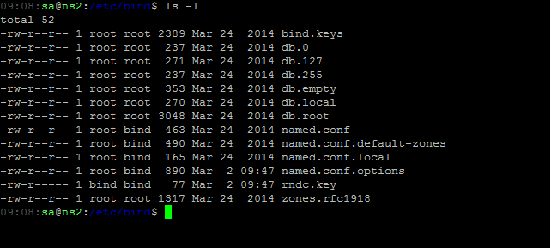
Bind Sample Workflow
Notes:
Default zonefiles and config files with a fresh install of bind (Ubuntu 12.04)

Slide 7
Bind Sample Workflow
When(request)
edit named.conf
edit zonefile(s)
restart bind9
Celebrate with a walk to the coffee shop

Slide 8
Bind Sample Workflow
When(request)
edit named.conf
edit zonefile(s)
restart bind9
Celebrate with a walk to the coffee shop
Receive call while walking to the coffee shop
Notes:
Zonefiles with errors aren’t loaded, check your files before restarting bind. Named.conf with errors causes bind not to load or not load zones.

Slide 9
Bind Sample Workflow
When(request)
edit named.conf
edit zonefile(s)
run named-checkconf
run named-checkzone
restart bind9
test name server availability locally and from remote shell
check secondary servers updated
Celebrate with a walk to the coffee shop

Slide 10
Bind Sample Workflow
Service Owner: Can you change that back? My servers weren’t ready.
Application Owner: You changed the wrong name, change it back right away.
IT Director: What server were we using for mail 27 months ago?

Slide 11
Revision Control Systems
Keeping files safe

Slide 12
Revision control systems
In computer software engineering, revision control is any kind of practice that tracks and provides control over changes to source code.

Slide 13
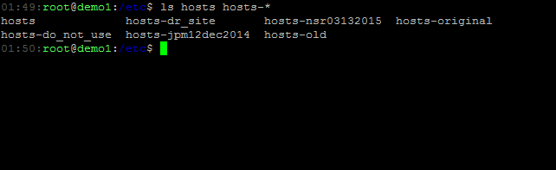
Revision Control Systems
Notes:
Changing the names of files is one way, not very much metadata, log, file date/time might not be useful

Slide 14
Revision Control Systems
SCCS
RCS
CVS
Perforce
SVN
BZR
Git
TFS
Mecurial
Bitbucket
CodePlex
GitHub
Google Code
SourceForge
Notes:
Some examples of SCM/VCS/RCS
Also hosted options – probably not for you dns environment…

Slide 15
Revision Control Systems
SCCS, 1972
RCS, 1982
CVS, 1990
Perforce, 1995
SVN, 2000
BZR, 2005
Git, 2005
TFS, 2005
Mecurial, 2005
Bitbucket
CodePlex
GitHub
Google Code
SourceForge
Notes:
Intro dates

Slide 16
git
Git is a distributed revision control system with an emphasis on speed, data integrity, and support for distributed, non-linear workflows. Git was initially designed and developed by Linus Torvalds for Linux kernel development in 2005, and has since become the most widely adopted version control system for software development.

Slide 17
git
Easy to create a repository out of an existing directory
git init
git add <file>
git commit –m ‘Initial Commit’
Distributed, anyone who clones the repository is a backup of the entire repository.

Slide 18
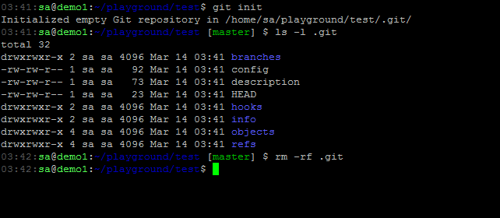
GIT
Notes:
Easy to start, remove .git directory if you no longer want to have revision control.

Slide 19
BIND + GIT
Sample Workflow

Slide 20
Bind + GIT SETUP
# cd /etc/bind
# git init
# git add *
# git commit –m ‘WOOHOO, finally have version control!’
Notes:
Initial stab at using git to track changes. Just check in all the things.

Slide 21
Bind + Git Workflow
When(request)
edit named.conf
edit zonefile(s)
run named-checkconf
run named-checkzone
git add <changed files>
git commit
restart bind9
test name server availability locally and from remote shell
check secondary servers updated
Celebrate with a walk to the coffee shop
Notes:
Workflow modified to add and commit files to Git.
[19-mar-2015] FIXED: named-checkconf/checkzone before git add/commit

Slide 22
Bind + Git Workflow
When(request)
edit named.conf
edit zonefile(s)
run named-checkconf
run named-checkzone
git add <changed files>
git commit
restart bind9
test name server availability locally and from remote shell
check secondary servers updated
Celebrate with a walk to the coffee shop
Notes:
Steps that are not essential to having bind serve the updates, easily omitted when distracted, or hurried.
[19-mar-2015] FIXED: named-checkconf/checkzone before git add/commit

Slide 23
Bind + Git Workflow
Service Owner: Can you change that back? My servers weren’t ready.
Application Owner: You changed the wrong name, change it back right away.
git revert HEAD
update serial (maybe change the correct RR)
restart bind9
IT Director: What server were we using for mail 27 months ago?
git log
git checkout <commit from 30 months ago>
git checkout masster
Notes:
Can answer questions about the past (if all the steps were taken) and can go revert quickly.

Slide 24

Bind + Git Workflow downfalls
Easy to fall back to no revision control
Using /etc/bind directory to browse history is dangerous
Checked in secrets
Notes:
Too easy to omit essential steps of the workflow – no immediate gain to using Git. Checking out old version in the /etc/bind directory is a bad practice – use diff or clone to another directory for research. Probably didn’t want the keys in there. bind.keys is updated by the distribution or updates to bind – used for DNSSEC. rndc.key is used for remote control of the named (bind server) process and shouldn’t be stored in revision control.

Slide 25
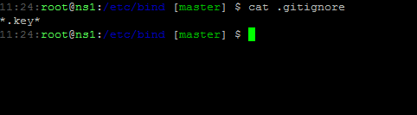
.gitignore
.gitignore file tells Git to ignore files based on a list of patterns
Notes:
Short .gitignore file to leave keys out.

Slide 26
GIT HOOKS
Workflow helpers

Slide 27
Git Hooks
Git hooks are scripts that run automatically every time a particular event occurs in a Git repository. They let you customize Git’s internal behavior and trigger customizable actions at key points in the development life cycle.

Slide 28
Git Hooks
Hooks are scripts that live in .git/hooks
do not get cloned when cloning the repo
Samples (*.sample)
pre-commit
Check that my files are valid
post-commit
Reload bind

Slide 29
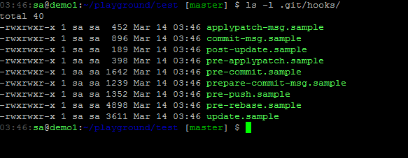
Git hooks
http://www.git-scm.com/book/en/v2/Customizing-Git-Git-Hooks

Slide 30
Git Hooks pre-commit
#!/bin/sh
#
# Redirect output to stderr.
exec 1>&2
named-checkconf -z named.conf > /dev/null
if [ $? -ne 0 ]; then
named-checkconf -z named.conf
echo "\n=================================================================="
echo "Configuration or zonefiles don't pass named-check. Commit Canceled"
echo "=================================================================="
exit 1
fi
Notes:
`named-checkconf –z` runs named-checkzone on zonefiles listed in the configuration.

Slide 31
Git Hooks pOST-commit
#!/bin/sh
#
# Redirect output to stderr.
exec 1>&2
service bind9 reload
if [ $? -eq 0 ]; then
echo "\n=================================================================="
echo "=================================================================="
echo " New Configuration Loaded"
echo "=================================================================="
echo "=================================================================="
exit 0
fi
exit 1
Notes:
Once committed reload the bind service. Doing this post-commit allows a commit to be aborted (no commit message for example) and not load the new config.

Slide 32
Bind + Git + HOOKS Workflow
When(request)
edit named.conf
edit zonefile(s)
run named-checkconf
run named-checkzone
git add <changed files>
git commit
restart bind9
test name server availability locally and from remote shell
check secondary servers updated
Celebrate with a walk to the coffee shop
Notes:
Highlighted steps that were easily omitted as shown in earlier slides, the steps with strikethrough are now taken care of by the hooks, no need to run these steps.
[19-mar-2015] FIXED: named-checkconf/checkzone before git add/commit

Slide 33
Bind + Git + HOOKS Workflow
When(request)
edit named.conf
edit zonefile(s)
run named-checkconf
run named-checkzone
git add <changed files>
git commit
restart bind9
test name server availability locally and from remote shell
check secondary servers updated
Celebrate with a walk to the coffee shop
Notes:
Highlighted steps that are taken care of by the hooks, no longer need to run these steps.
[19-mar-2015] FIXED: named-checkconf/checkzone before git add/commit

Slide 34
Next Steps
Now that we have a good workflow, what else can we do?
More strict checking, running checkconf doesn’t stop on zone warnings
Check for updated serial number in changed zones
Remote Checkout
Store Secondary configs, update secondary server configs automatically
Email the team
Slack/HipChat/IRC updates
Notes:
[19-mar-2015] ADDED: suggest checking for incremented serial number

Slide 35
Resources
etckeeper
http://etckeeper.branchable.com/
GitZone
https://www.dyne.org/software/gitzone/
Notes:
etckeeper for /etc revision control
GitZone project to manage DNS with Git, maybe better – but I wanted to learn by doing and had evolutionary change instead of adopting someone else’s workflow all at once.

Slide 36
Resources
http://en.wikipedia.org/wiki/Revision_control
http://en.wikipedia.org/wiki/Git_(software)
http://www.git-scm.com/book/en/v2
https://www.atlassian.com/git/tutorials/
https://help.github.com/

Slide 37
J.P. McGlinn
github.com/jpbot
@pilotlamp

