Slide 1

Database Design Proposal
John Boyle

Slide 2
Table of contents
Executive Summary 3
ER Diagram 4
Create Table 5-12
Insert Into 13
Views 14-15
Sample Queries 16-17
Triggers 18
Security 19
Implementation, problems, enhancements 20

Slide 3
Executive Summary
This document is a representation of all of the data stored within
the Netflix database. Netflix is a corporation that started off renting out
movie DVD’s and VHS tapes by sending them to the customers home to be returned by a certain date. However, by 2007 Netflix started to move into the direction of streaming movies from the convenience of the customers own home.
In 2016, there was an estimated 98.75 million subscribers to Netflix,
and this is continuously growing. This database holds the information for all Movies, TV Shows, Actors, Membership and Employee’s that are affiliated with the corporation. This database is specifically designed to hold large scale data, and to make it as simple as possible to navigate throughout the database. There are some records within this database that are fictional, such as a persons name or Email, and there are some legitimate names in there as well.

Slide 4
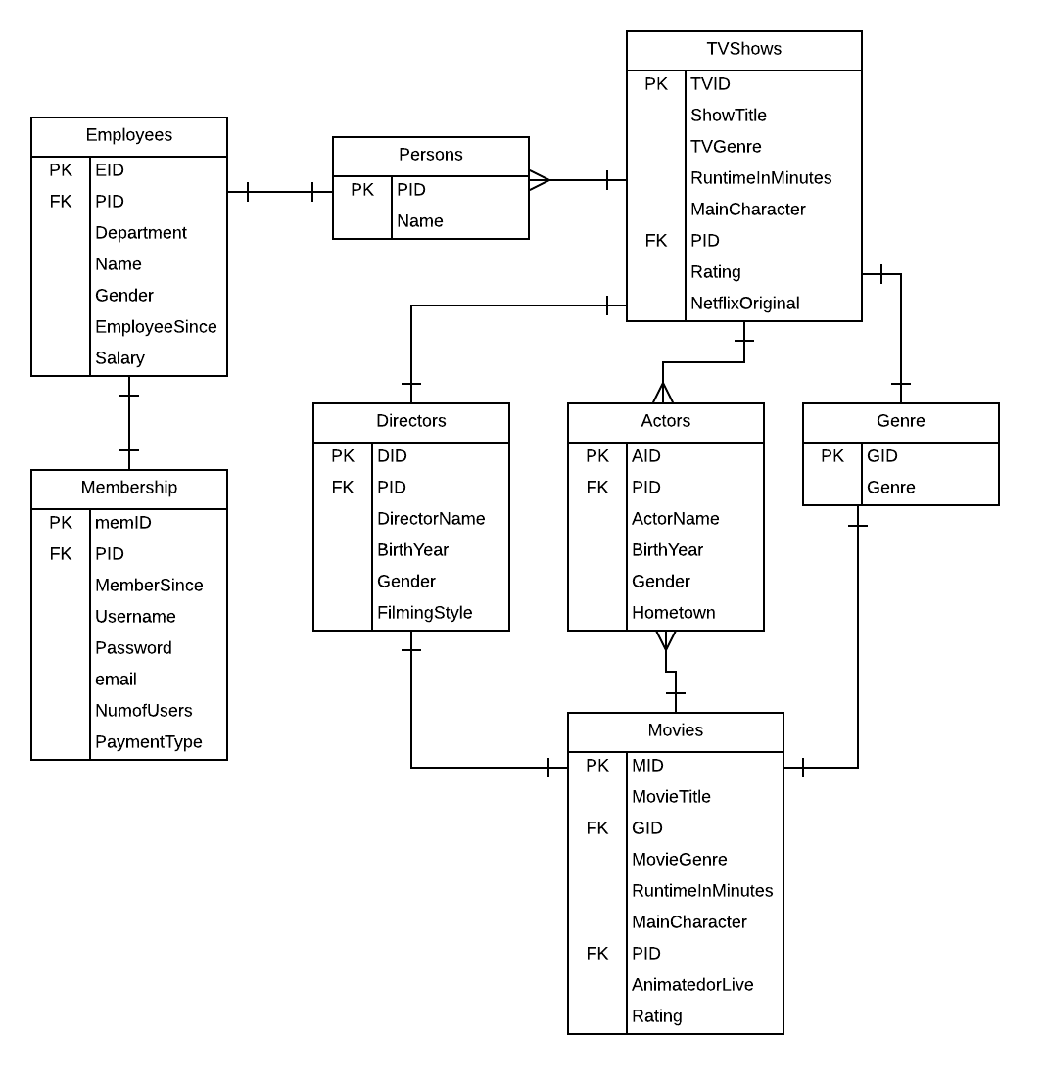
ER Diagram

Slide 5
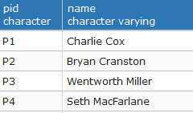
Create Table Statements: Persons
The Persons table is a table that assigns a certain PID to every person within the database.
CREATE TABLE IF NOT EXISTS PERSONS (
PID CHAR(9) NOT NULL UNIQUE,
NAME VARCHAR NOT NULL,
PRIMARY KEY(PID)
);
Functional Dependencies:
PID > Name

Slide 6
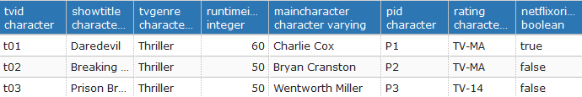
Create Table Statements: TVShows
The TVShows table has all of the generic parameters that a TV show pertains, such as Title, genre, rating, runtime, the main character and their PID, added is the true or false value of being a Netflix Original (a show that was created by Netflix). It also has a unique TID.
CREATE TABLE IF NOT EXISTS TVShows (
TVID char(50) NOT NULL unique,
ShowTitle VARCHAR (50) NOT NULL,
TVGenre VARCHAR (10) NOT NULL,
RuntimeInMinutes INTEGER NOT NULL,
MainCharacter VARCHAR NOT NULL,
PID CHAR(9) NOT NULL,
Rating VARCHAR NOT NULL,
NetflixOriginal BOOLEAN,
primary key(TVID),
Foreign key (PID) References Persons(PID)
);
Functional Dependencies:
TID > ShowTitle, Genre, Rating

Slide 7
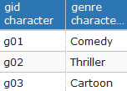
Create Table Statements: Genre
The Genre table is a simple table that has a unique GID that specifies what Genre the certain TV Show or movie is.
CREATE TABLE IF NOT EXISTS Genre ( Functional Dependencies:
GID char (10) NOT NULL unique, GID > Genre
Genre VARCHAR NOT NULL,
primary key(GID)
);

Slide 8
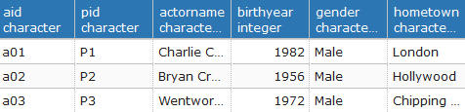
Create Table Statements: Actors
The Actors table contains information about actors that appear on Netflix shows such as: aID, Name, Birth Year, Gender, and their hometown.
CREATE TABLE IF NOT EXISTS Actors (
AID char (5) NOT NULL unique,
PID CHAR(9) NOT NULL,
ActorName VARCHAR NOT NULL,
BirthYear integer NOT NULL,
Gender VARCHAR NOT NULL,
Hometown VARCHAR NOT NULL,
primary key(AID),
foreign key (PID) References PERSONS(PID)
);
Functional Dependencies:
AID >ActorName, Gender

Slide 9
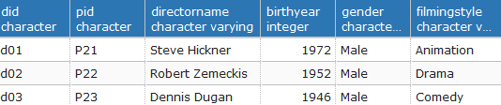
Create Table Statements: Directors
The Directors table is similar to the Actors table with the information it presents, the DID, PID, Name, Birth Year, and Gender. This one includes the Director filming style.
CREATE TABLE IF NOT EXISTS Directors (
DID char (5) NOT NULL UNIQUE,
PID CHAR(9) NOT NULL,
DirectorName VARCHAR NOT NULL,
BirthYear integer NOT NULL,
Gender VARCHAR NOT NULL,
FilmingStyle VARCHAR NOT NULL,
primary key (DID),
foreign key (PID) References PERSONS(PID) );
Functional Dependencies:
DID > DirectorName, Gender, BirthYear

Slide 10
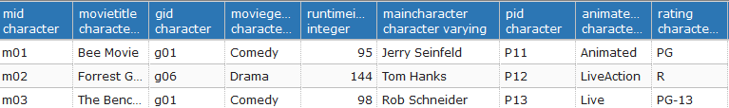
Create Table Statements: Movies
The Movies table containt information pertaining to certain Netflix movies, such as MID, Movie Title, genreID, genre, run time, the main character, etc…
CREATE TABLE IF NOT EXISTS Movies (
MID char (5) NOT NULL unique,
MovieTitle VARCHAR (50) NOT NULL,
GID char (10) NOT NULL,
MovieGenre VARCHAR (10) NOT NULL,
RuntimeInMinutes INTEGER NOT NULL,
MainCharacter VARCHAR NOT NULL,
PID CHAR(9) NOT NULL,
AnimatedOrLive VARCHAR NOT NULL,
Rating VARCHAR NOT NULL,
primary key(MID),
foreign key (GID) References Genre(GID),
FOREIGN KEY(PID) REFERENCES PERSONS(PID)
);
Functional Dependencies:
MID > MovieTitle, RuntimeInMinutes, Rating

Slide 11
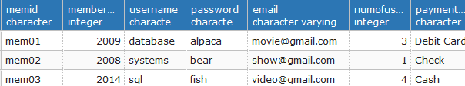
Create Table Statements: Membership
The Membership table has the information from a users account, such as their membership start year, username, password, email, how many users are on the account, and their payment type.
CREATE TABLE IF NOT EXISTS Membership (
memID char (10) NOT NULL unique,
MemberSince integer Not Null,
Username VARCHAR NOT NULL unique,
password varchar not null,
email varchar not null unique,
NumOfUsers integer not null,
PaymentType char (15) not null,
primary key(memID) ,
Foreign key (PID) references Persons(PID) );
Functional Dependencies:
memID > Username, Password,
Email

Slide 12
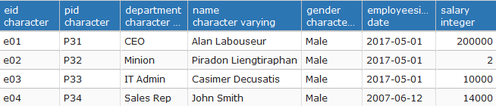
Create Table Statements: Employees
The employees table contains very basic information of the employees, like their department, name, and how long they’ve been working there.
CREATE TABLE IF NOT EXISTS Employees (
EID char (10) not null unique,
PID CHAR(9) NOT NULL,
Department varchar not null,
Name varchar not null,
Gender varchar not null,
EmployeeSince date not null,
Salary integer not null,
primary key(EID),
FOREIGN KEY(PID) REFERENCES PERSONS(PID)
);
Functional Dependencies:
EID > Name, Department,
EmployeeSince

Slide 13
Insert Statement
Insert Into: TVShows table:
This is a sample of the insert into statements used for all of the tables.
You specify the columns in the first half of the statement, then state the field vlaues in the values section of the statement.
INSERT INTO TVShows
( TVID, ShowTitle, TVGenre, RuntimeInMinutes, MainCharacter, PID, Rating, NetflixOriginal )
VALUES
('t01', 'Daredevil', 'Thriller', 60, 'Charlie Cox', 'P1', 'TV-MA', 'True'),
……etc

Slide 14
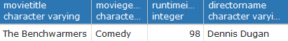
Views
MovieInfo View
This view will show the selected movie information from any movie Directed
by Dennis Dugan.
CREATE VIEW MovieInfo AS
Select M.MovieTitle, m.movieGenre, m.RuntimeInMinutes, m.DirectorName
From Movies m, persons p
where m.pid = p.pid
and p.name = 'Dennis Dugan'
This will display the view, named MovieInfo:
select*
from MovieInfo

Slide 15
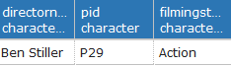
Views
DirectorName View:
This view shows the director information who direct action movies that are 100+ minutes in length.
CREATE VIEW DirectorName AS
select d.directorname, d.pid, d.filmingstyle
from directors d, movies m
where d.directorname = m.directorname
and m.gid = 'g07'
and m.runtimeinminutes > 100;
select*
from directorname

Slide 16
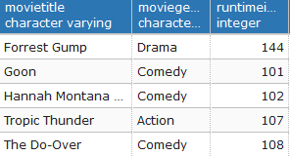
Sample Queries
This is a simple query that displays the movies that are more than 100 mintes
in length.
select movietitle, moviegenre, runtimeinminutes
from movies
where runtimeinminutes > 100

Slide 17
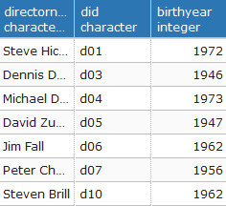
Sample Queries
This query shows the information about directors who have directed comedies.
select d.directorname, d.did, d.birthyear
from directors d inner join movies m on d.directorname = m.directorname
where m.moviegenre = 'Comedy'

Slide 18
Triggers
CREATE OR REPLACE FUNCTION newUser() RETURNS trigger AS $$
BEGIN
IF NEW.memID is null THEN
raise exception 'No pid';
END IF;
IF NEW.userName IS NULL THEN
raise exception 'Please make a Username';
END IF;
IF NEW.password IS NUL THEN
raise exception 'Please set a password';
END IF;
INSER INTO Membership(pID, MemberSince, UserName, password, email, NumofUsers, PaymentType)
values (NEW.memID, NEW.username, NEW.password, NEW.email ,NEW.numofusers, NEW.PaymentType);
RETURN new; END;
$$ language plpgsql;
This trigger is for a new user is registered into the database.

Slide 19
Security
CREATE role CEOAlan
GRANT SELECT, INSERT, UPDATE, DELETE
On all tables in schema public to CEOAlan
This security measure insures that only the CEO, Alan Labouseur, has permission to make any changes to the database.

Slide 20
Implementation, Problems, Enhancements
This database was implemented with little to no problems.
This database can be used to easily analyzed the data within the Netflix corporation, as it is constantly evolving and expanding.
The actors, movies, and Tvshows tables can all be expanded, with numerous different parameters from the Tvshow can be added, as there are countless different operations and information utilized within.

