Slide 1
Linear Regression Results
One America Works Capstone Team

Slide 2
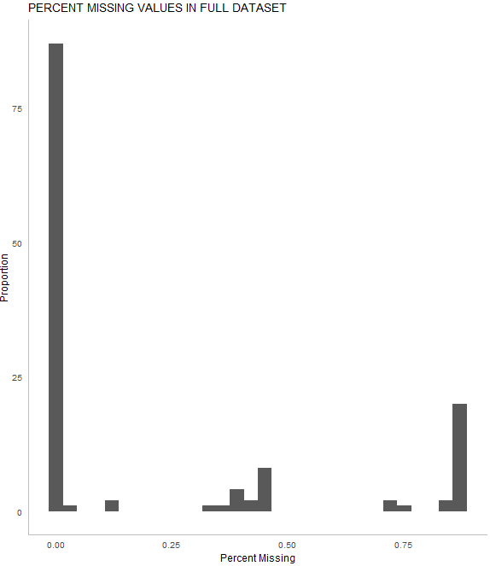
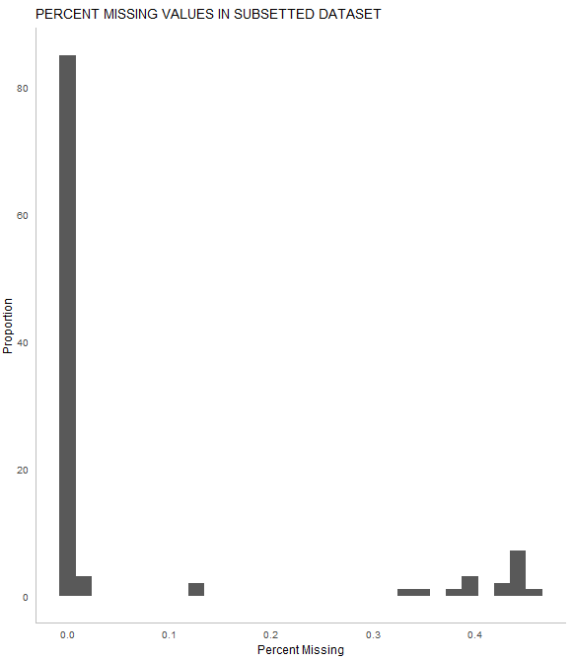
Missing Data
#Only impute for variables that have greater than a 50% fill rate
#not using CBRE data, qualityoflife, cpiindex, purchasingpower
Note: I’m sure we can find data with more coverage for CPIIndex. This is a future enhancement possibility.
Full dataset
After removing variables, this is missing data distribution for all remaining variables

Slide 3
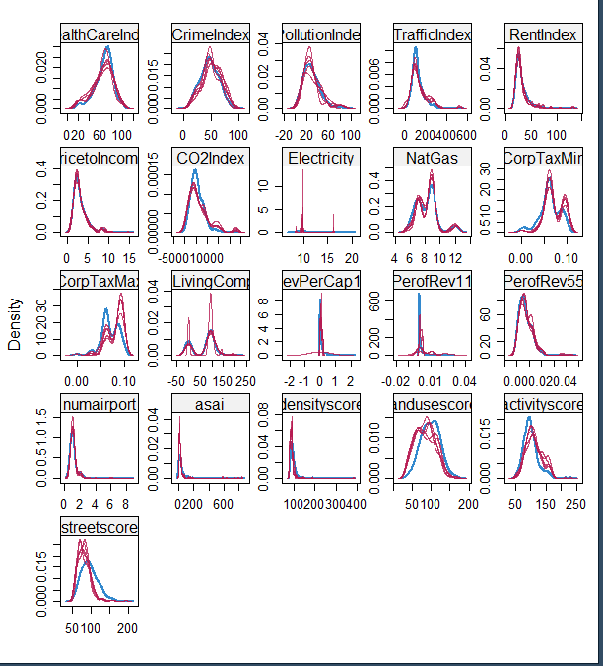
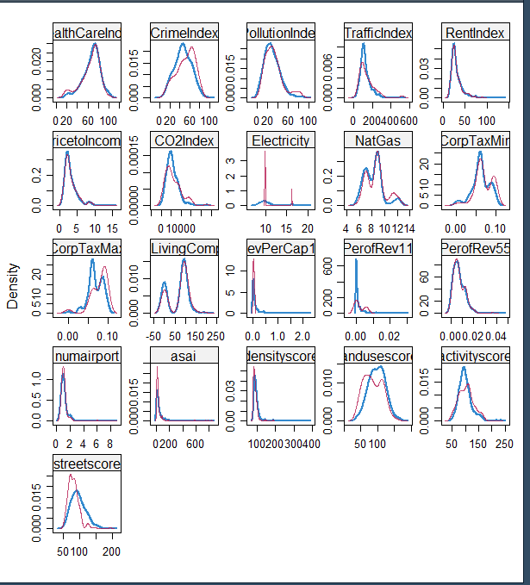
Imputation Results – CART Mult Imputation
5 imputations, all very close to each other
Almost all variables look good.
Electricity looks strange though. Probably best to not use this variable?
The selected imputation (of the 5)

Slide 4
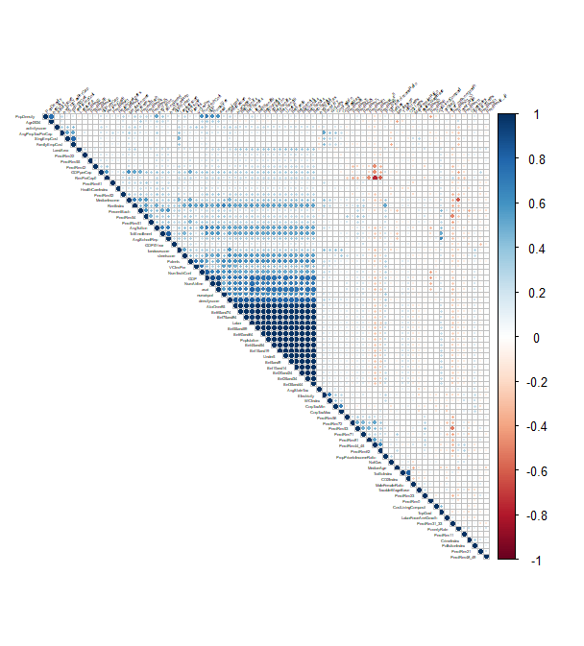
Original correlation matrix (r-code):
correlation.matrix <- corrplot(M, type="upper", order="hclust", tl.col="black", tl.srt=90, tl.cex = .28)

Slide 5
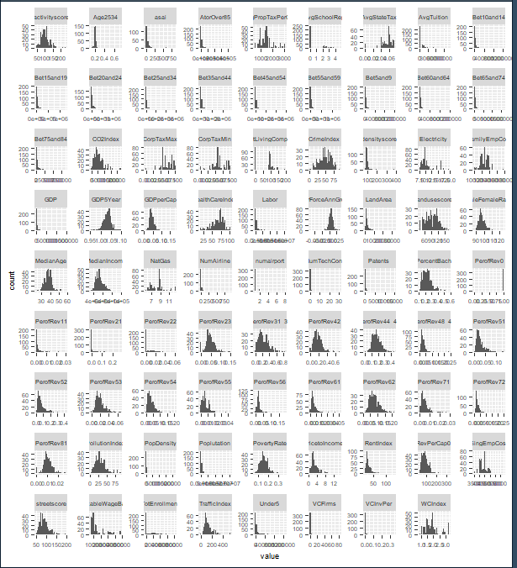
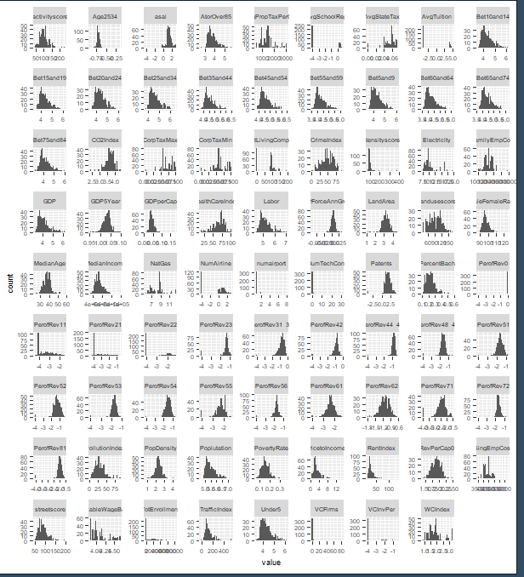
Transformations
Take log of all skewed variables (before and after) –R2 improves .1072 (.7781 to .8853)

Slide 6
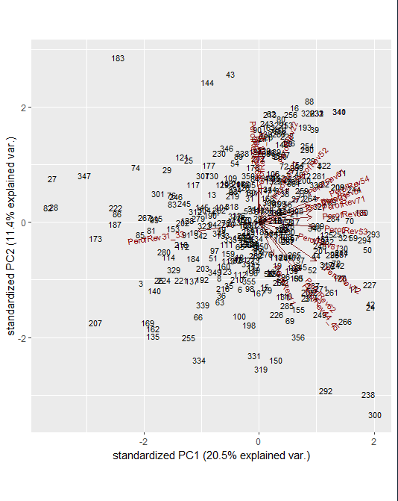
VIF shows multicollinearity so now we do ridge regression.
Note: research shows PCA’ing pred vars for regression is very common
#Results -> Looks like all the revenue stuff if important! Let's PCA that (helps remove multi b\c PCA creates uncorrelated variables…and so that we have just one or 2 variables that represent “industry breakdown of revenue”
#(Intercept) 1.488220e+00
#NumAirline 9.122145e-03
#TaxableWageBase 6.379546e-03
#PerofRev11 -6.324011e-03
#PerofRev22 2.123504e-03
#PerofRev44_45 -9.156522e-02
#PerofRev51 -1.712036e-02
#PerofRev52 7.025785e-03
#PerofRev53 -3.626712e-02
#PerofRev54 -2.050024e-02
#PerofRev62 -2.849507e-01
#PerofRev71 5.354693e-03
#PerofRev72 -1.748010e-01
#PerofRev55 4.302406e-03
#AvgPropTaxPerCap 1.058509e-05
#PovertyRate -4.464812e-01
#Electricity -5.800223e-05
#CorpTaxMax 1.838152e-01
#WCIndex -4.472801e-03
#GDP5Year -1.233853e-01
#MaleFemaleRatio -4.099508e-03
#MedianAge 3.995853e-04
#GDPperCap 3.686909e+00
#TopGrad 1.553890e-03
#landusescore 5.046025e-05
#activityscore 6.910573e-0
First principal component is a linear combination of original predictor variables which captures the maximum variance in the data set.
Second principal component is also a linear combination of original predictors which captures the remaining variance in the data set and is uncorrelated with 1^{st.}

Slide 7
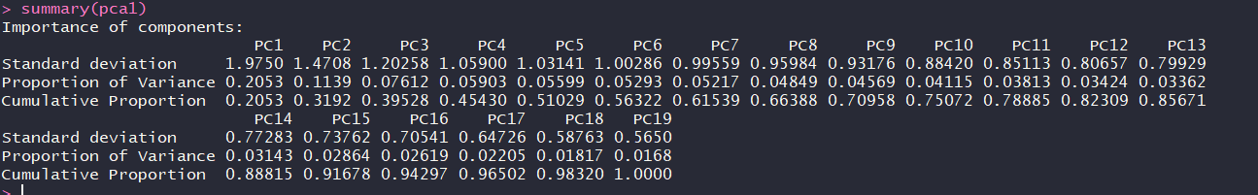
More on PCA
We did this b\c many of the percent of rev variables came out as predictive. So to reduce multicollinearity and reduce the dimensionality, we PCA’s all the percent of rev variables
“PCA is a type of linear transformation on a given data set that has values for a certain number of variables (coordinates) for a certain amount of spaces. This linear transformation fits this dataset to a new coordinate system in such a way that the most significant variance is found on the first coordinate, and each subsequent coordinate is orthogonal to the last and has a lesser variance. In this way, you transform a set of x correlated variables over y samples to a set of p uncorrelated principal components over the same samples.”
You obtain 19 principal components, which you call PC1-19. Each of these explains a percentage of the total variation in the dataset. That is to say: PC1 explains 21% of the total variance, which means that 1/5 of the information in the dataset (19 variables) can be encapsulated by just that one Principal Component. PC2 explains 11% of the variance. PC3 is 7%.
We did this b\c many of the percent of rev variables came out as predictive. So to reduce multicollinearity and reduce the dimensionality, we PCA’s all the percent of rev variables
“PCA is a type of linear transformation on a given data set that has values for a certain number of variables (coordinates) for a certain amount of spaces. This linear transformation fits this dataset to a new coordinate system in such a way that the most significant variance is found on the first coordinate, and each subsequent coordinate is orthogonal to the last and has a lesser variance. In this way, you transform a set of x correlated variables over y samples to a set of p uncorrelated principal components over the same samples.”
You obtain 19 principal components, which you call PC1-19. Each of these explains a percentage of the total variation in the dataset. That is to say: PC1 explains 21% of the total variance, which means that 1/5 of the information in the dataset (19 variables) can be encapsulated by just that one Principal Component. PC2 explains 11% of the variance. PC3 is 7%.

Slide 8
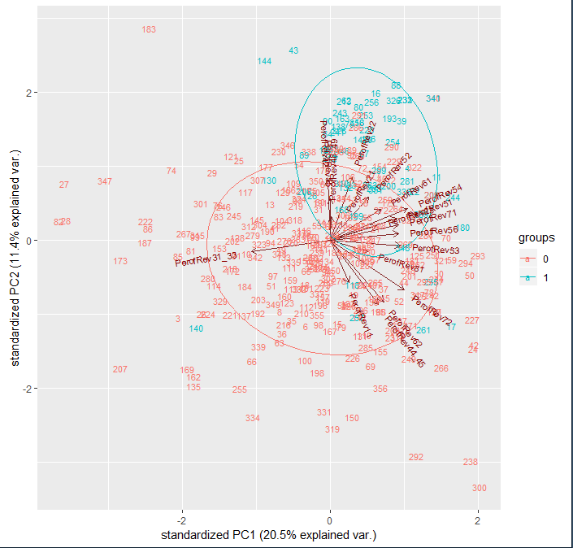
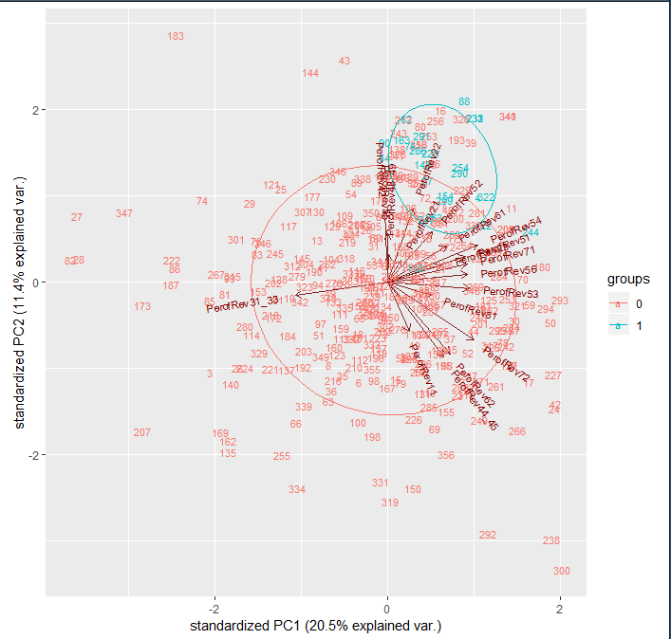
More on PCA
The chart on slide 6 lets you see which MSA’s are similar to each other (index’d by row number for the MSA)
But how do we make sense of this? Let’s try grouping the MSAs in Tech_hub or not. Yup…all the tech-hub guys are all groups together.
Let’s try by amazon bid or not. Yup, same thing.
These are all characterized by higher values of Rev 22, 42, 49, 52, 61, 54, 51 (utilities, wholesale trade, transportation, finance & insurance, educational services, professional/scientific/technical services, information) -> makes total sense!

Slide 9
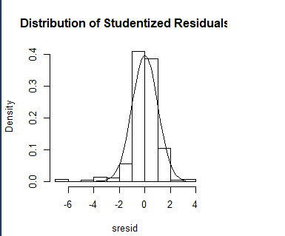
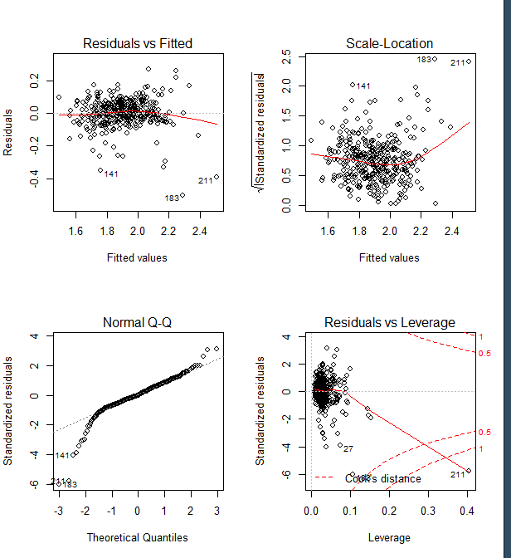
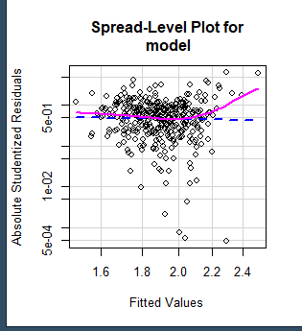
Rerun model (R2 now .849 -> didn’t lose much info at all) Then do ridge regression again -> keeping 12 variables.
More on normality
Refit the model & look at diag’s
Note: Vif all good
Not normal! -> remove outliers first
#(Intercept) 2.141026e+00
#PC1 -3.830211e-02
#PC2 4.064659e-02
#NumAirline 6.524268e-03
#GDP 1.459783e-02
#PovertyRate -5.761459e-01
#Electricity -7.577712e-04 -> DO NOT USE!
#CorpTaxMax 1.532226e-01
#GDP5Year -3.110169e-02
#MaleFemaleRatio -3.809430e-03
#MedianAge 3.604419e-04
#GDPperCap 4.046149e+00
#activityscore 6.345482e-05
YUP! PC1 & 2 are both predictive still!
Power trans of 1.332857
Look at leverage…what is that…
This plot helps us to find influential cases (i.e., subjects) if any. Not all outliers are influential in linear regression analysis (whatever outliers mean). Even though data have extreme values, they might not be influential to determine a regression line. That means, the results wouldn’t be much different if we either include or exclude them from analysis. They follow the trend in the majority of cases and they don’t really matter; they are not influential. On the other hand, some cases could be very influential even if they look to be within a reasonable range of the values. They could be extreme cases against a regression line and can alter the results if we exclude them from analysis. Another way to put it is that they don’t get along with the trend in the majority of the cases.
Unlike the other plots, this time patterns are not relevant. We watch out for outlying values at the upper right corner or at the lower right corner. Those spots are the places where cases can be influential against a regression line. Look for cases outside of a dashed line, Cook’s distance. When cases are outside of the Cook’s distance (meaning they have high Cook’s distance scores), the cases are influential to the regression results. The regression results will be altered if we exclude those cases.
So basically 211 might distort results….we removed it. We removed a few others that looked bad too. Basically these are cities where are the predictor variables look unimpressive but there is something going on in that area that earns a lot of revenue.
#removed 183: Lebanan, PA | 211: Midland, TX | 141: Hinesville, GA | 27: Bay City, MI | 155: Jacksonville, NC
#midland rev is driven by Mining, Quarrying, and Oil and Gas Extraction.
#lebanan rev is driven by Wholesale Trade
#hinesville rev is driven by Manufacturing
#bay city rev is driven by Wholesale Trade & Manufacturing
#Jacksonville NC is driven by Retail Trade

Slide 10
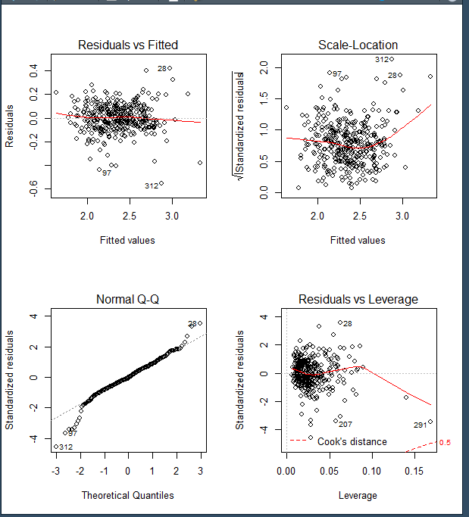
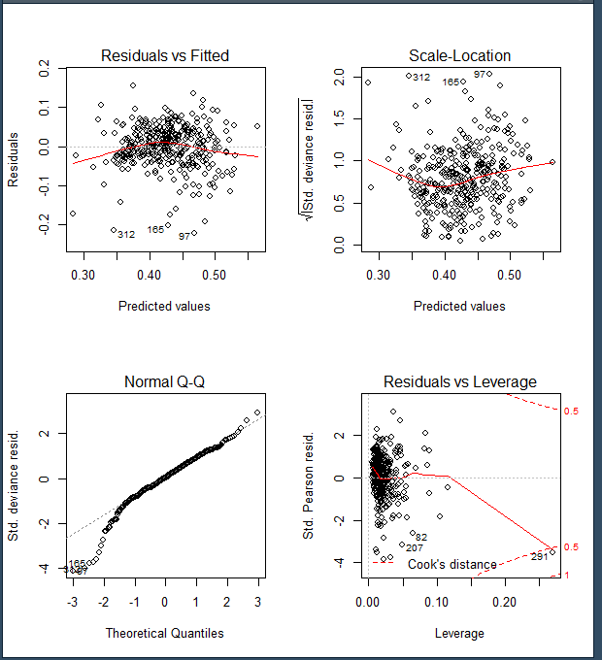
After removing outliers and power transform
Still not good with QQ plot… Gamma link function doesn’t work much better, neither does inverse.gaussian…
Still not normal. Maybe we can do something else?
In the report, talk about which cities were removed as outliers for the fit. THIS IS VERY IMPORTANT ☺. Also, point this out to our client.
Let’s consider delivering both sets of results (with and without outliers and prove it doesn’t really matter -> hopefully)

Slide 11
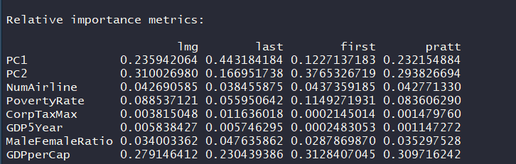
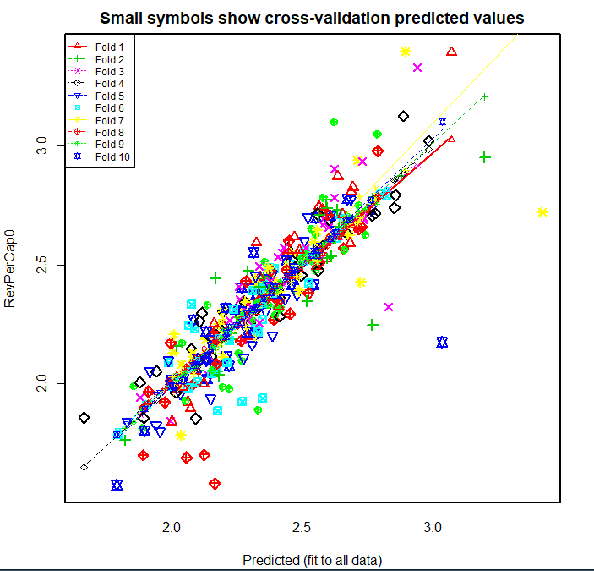
What happens if we don’t remove anything
#removed: Multiple R-squared: 0.8307, Adjusted R-squared: 0.8263
#not removed: Multiple R-squared: 0.7681, Adjusted R-squared: 0.7627 & median age is non predictive now
– not a big deal in model predictive power
PC1 & PC2 still among most important
Moral is that is doesn’t effect what we do if we don’t remove the outliers
Model not overfit…still good

Slide 12
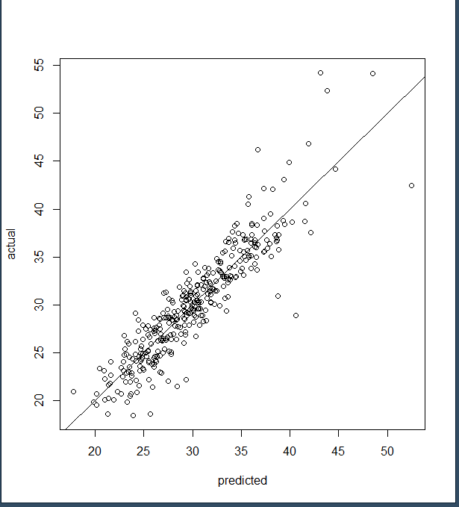
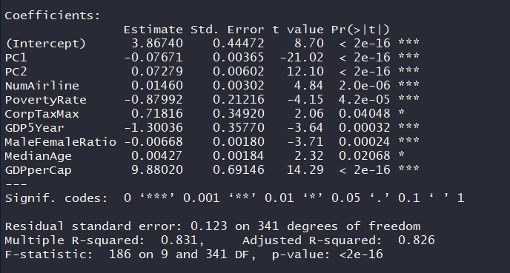
Final Regression Model (R-code):
model <- lm(RevPerCap0 ~ PC1 + PC2 + NumAirline + PovertyRate + CorpTaxMax + GDP5Year +
MaleFemaleRatio + MedianAge + GDPperCap, data = model_data2)
Key steps prior to finalize mode:
Imputation
Removing outliers
Principal component analysis (PCA)
Log transformations and y-power transformation
Regression results (from R-console):

Slide 13
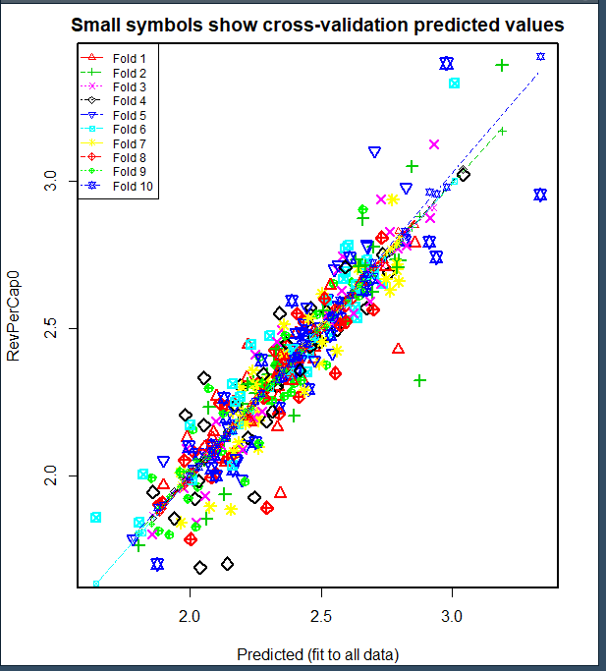
10 fold cross validation results

Slide 14
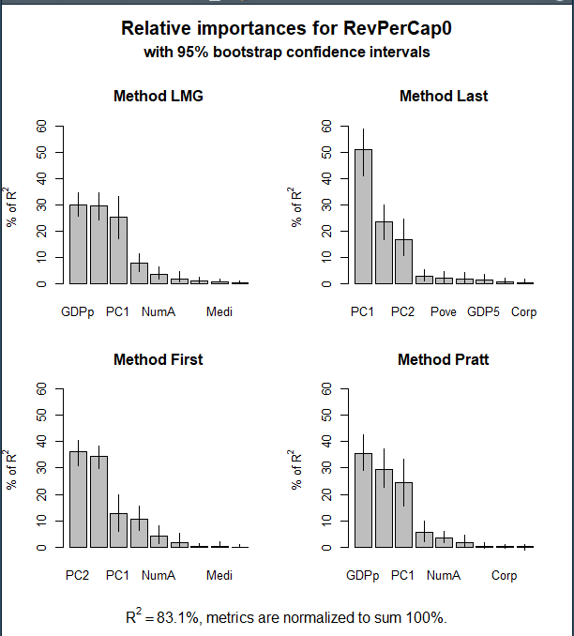
Relative Importance of Pred Vars
So, PC1 & PC2 are consistently important for all 4 methods tried.
The other variables are somewhat controllable.
PovertyRate
CorpTaxMax – this one is state level so that’s hard
MaleFemale Ratio
MedianAge
GDPperCap
Basically, the story is not surprising -> reduce poverty and increase revenue per capita. There is a little with age/gender but those coefs are small
The real take away is that the dist of industry revenue (by NAICs) really matters. Therefore, we’ll do a benchmarking dashboard specific to this.
Note: keep separate what we put in the report and what we delivery to james (if james cuts anything, still report on what we did and why)
Get James’s guidance on this and about the motivation for him.

Slide 15
Finally, we ran regression with Tech_hub as target as well (logistic b\c binary) – the purpose of this is to show that our conclusion that the breakdown of industry revenue really matters is robust. AKA…it’s not just b\c we selected the target for this to be total revenue…it’s also predictive about whether or not a MSA is a tech-hub. So the industry type breakdown is predictive of the total revenue that a MSA will bring in and also predictive of whether or not a MSA is a tech-hub. So it’ll pay for city managers to pay attention to the type of industry in their city…not just the total revenue.
Final Logistic Model
model <- glm(Tech_Hub ~ PC1 + PC2 + NumAirline + AvgTuition + MedianIncome + PovertyRate + PercentBach + PollutionIndex +
MaleFemaleRatio + WCIndex + CrimeIndex + Amazon + TopGrad + landusescore + streetscore , family=binomial(link='logit'), data = model_data)
summary(model)
#Multiple R-squared: 0.768, Adjusted R-squared: 0.763
#PC1 & 2 are still the most important variables
#PC1 2.8645
#PC2 3.0959
#NumAirline 0.9778
#AvgTuition 0.6052
#MedianIncome 0.1126
#PovertyRate 0.4664
#PercentBach 0.8578
#PollutionIndex 2.0072
#MaleFemaleRatio 0.0566
#WCIndex 0.0678
#CrimeIndex 0.1512
#Amazon1 0.1611
#TopGrad1 0.6777
#landusescore 0.4584
#streetscore 1.0618

