Slide 1
Solar-Panel-Dashboard
File created on: 11/5/21

Slide 2
Dashboard Tools
Tableau
JavaScript
D3
We intend to host our dashboard on a webpage

Slide 3
Interactive Elements
Buttons click through to detail data
Charts and maps allow clickthrough to display data
Drop down allows you to view 1 of 3 panel arrays

Slide 4
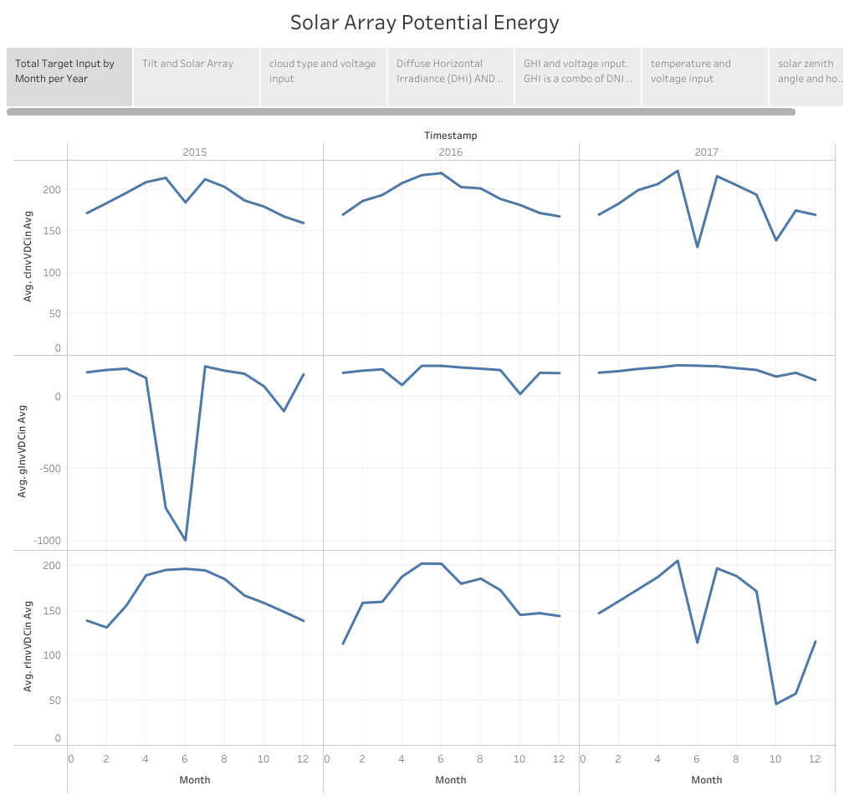

Slide 5
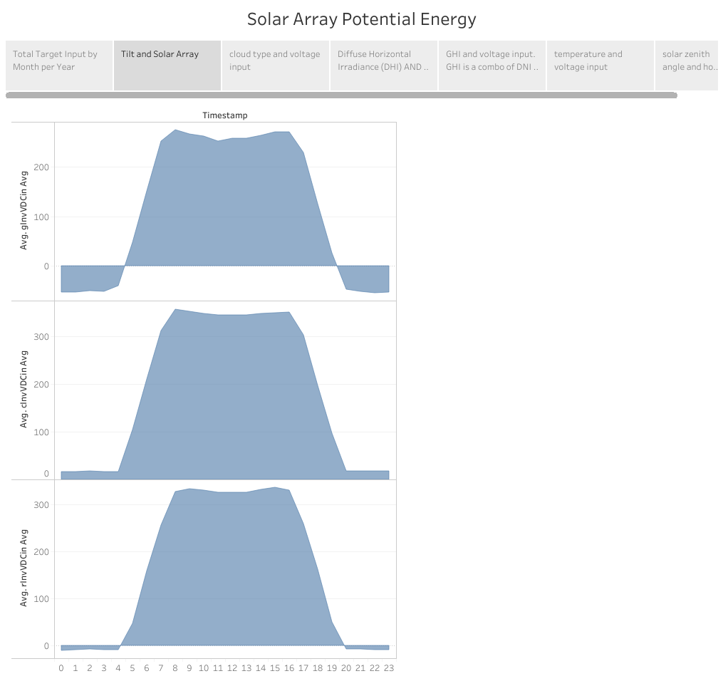

Slide 6
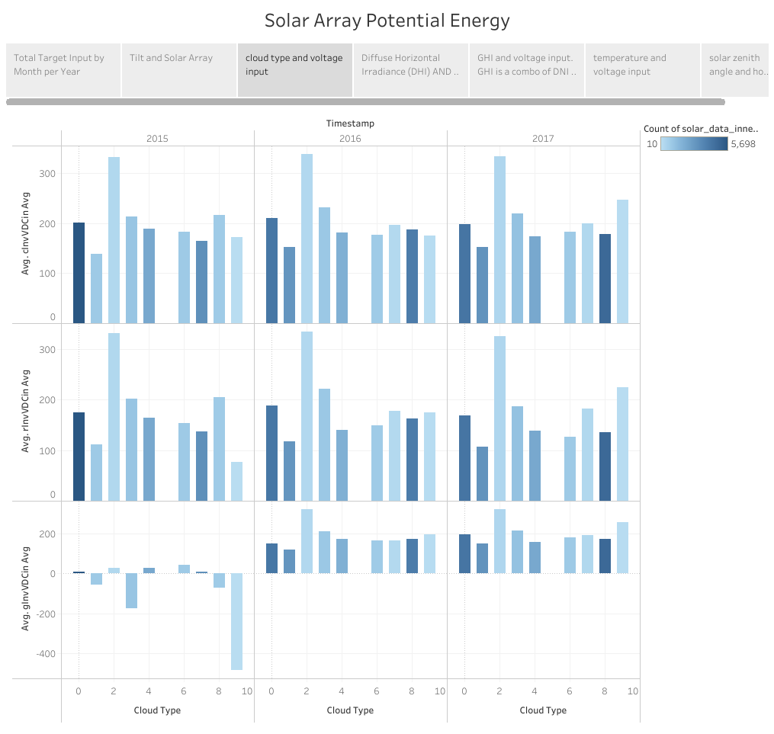

Slide 7
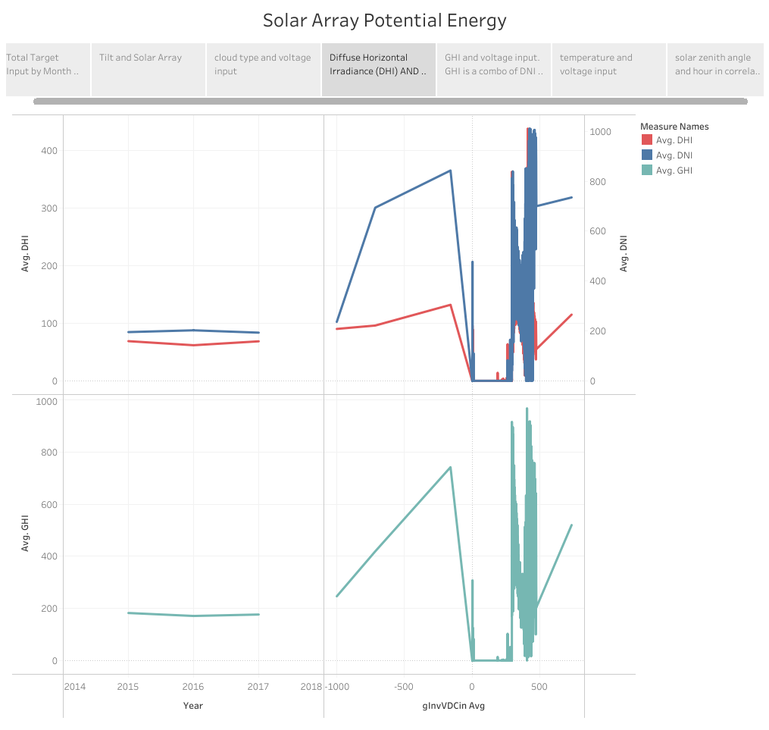

Slide 8
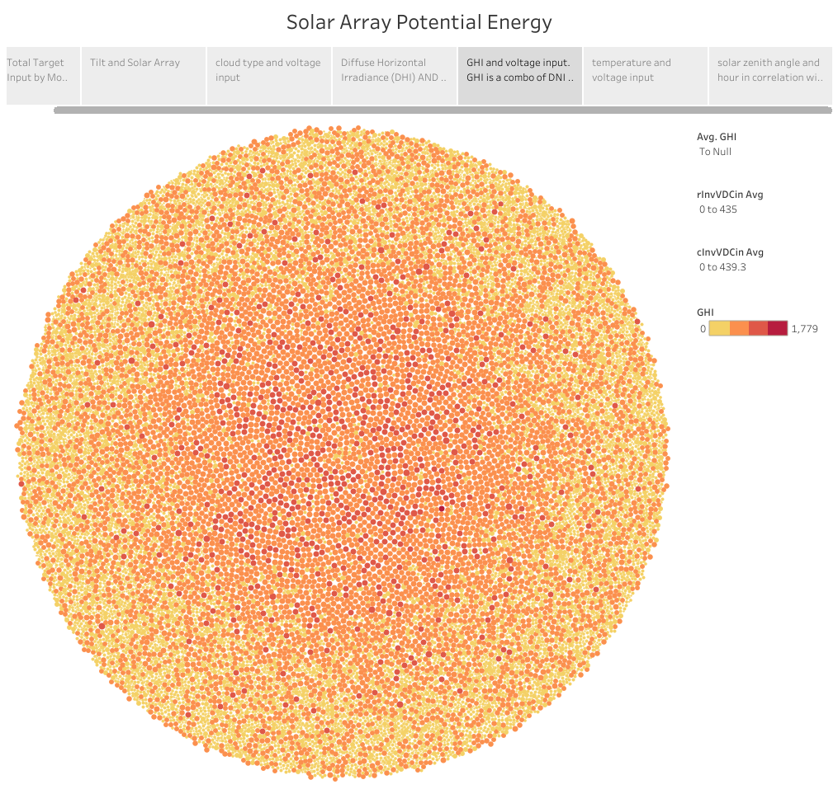

Slide 9
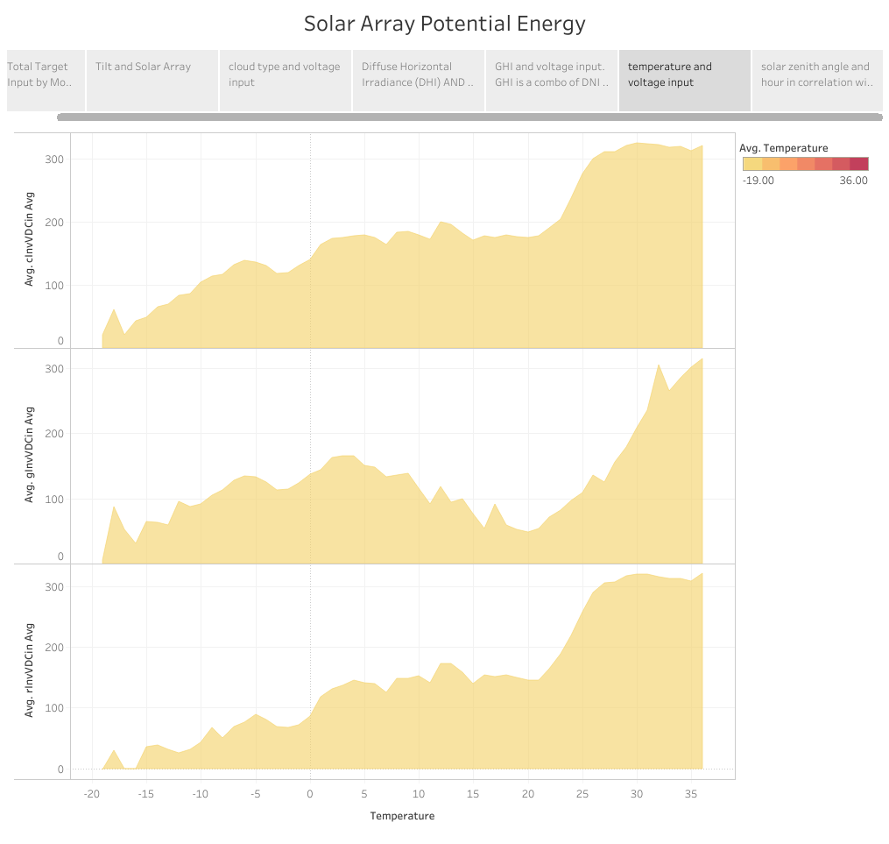

Slide 10
