Slide 1
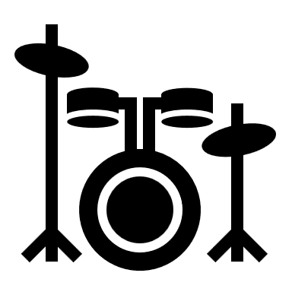

PC, NOTE
Drum triggers
HootBeat
Goggles
NOTE
Macbook running Puredata
PC
Trigger-to-MIDI interface
(e.g. Roland TM-2)
MIDI
BLE-MIDI
Bluetooth-enabled MIDI pedalboard

