Slide 1
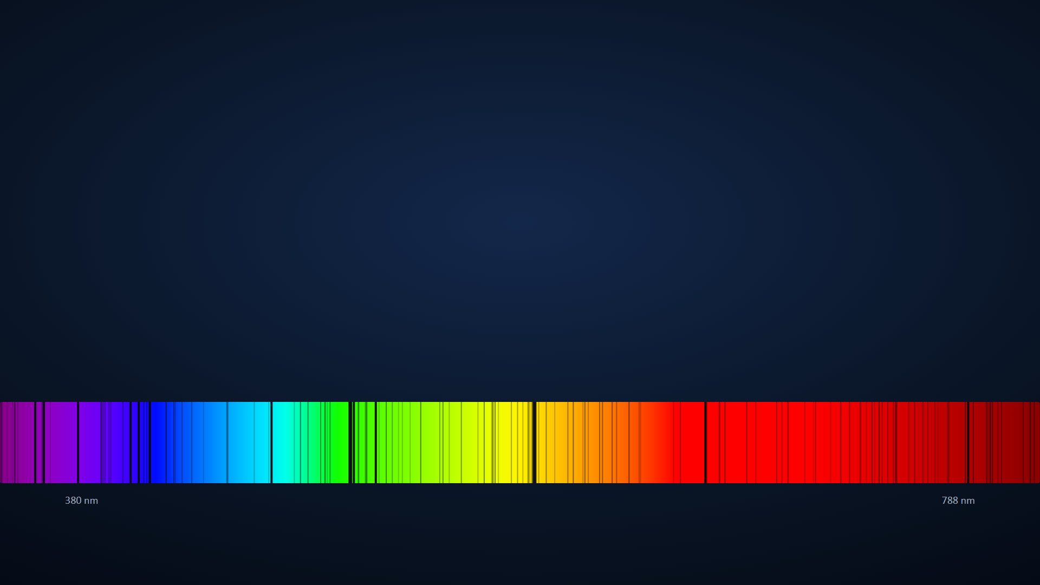
How to find a planet you cannot see
Two tiny signals: the shadow and the wobble
presentation-kit · expressive example · 2026
Notes:
The background spectrum sways: this is, greatly exaggerated, a star moving towards and away from us.

Slide 2
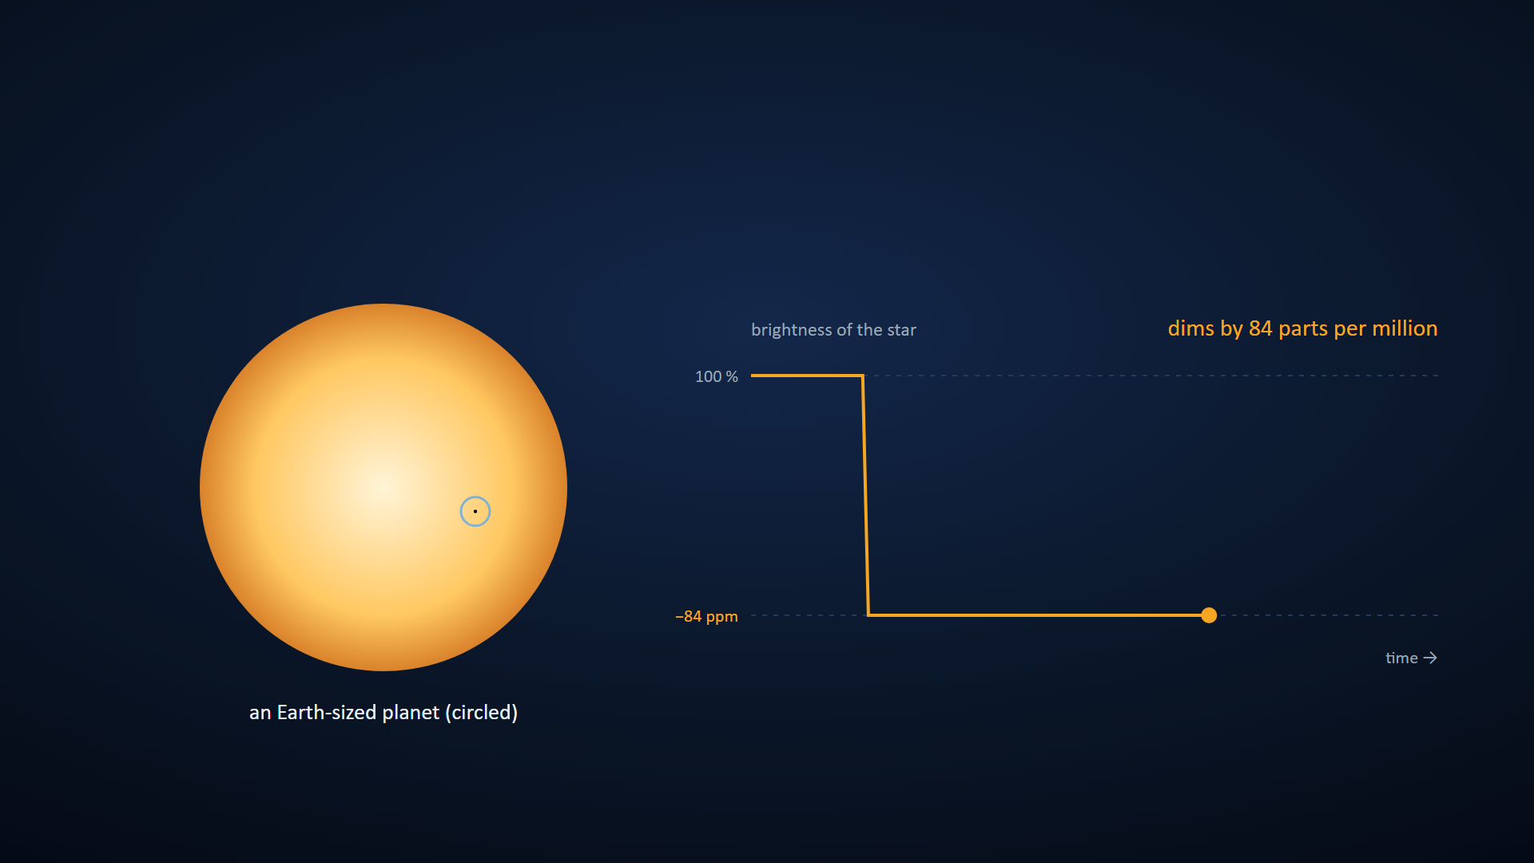
THE SHADOW
When a planet passes in front, its star dims a little
Source: Depth = (R_planet / R_star)², with IAU (2015) nominal radii: Jupiter in front of the Sun, 1.06 %; Earth, 84 ppm. No limb darkening; Earth's size not to scale in the curve.
Notes:
First a Jupiter-sized planet: the star loses 1 % of its light. Next, an Earth-sized one: 84 parts per million, and the vertical scale changes so it can be seen.

Slide 3
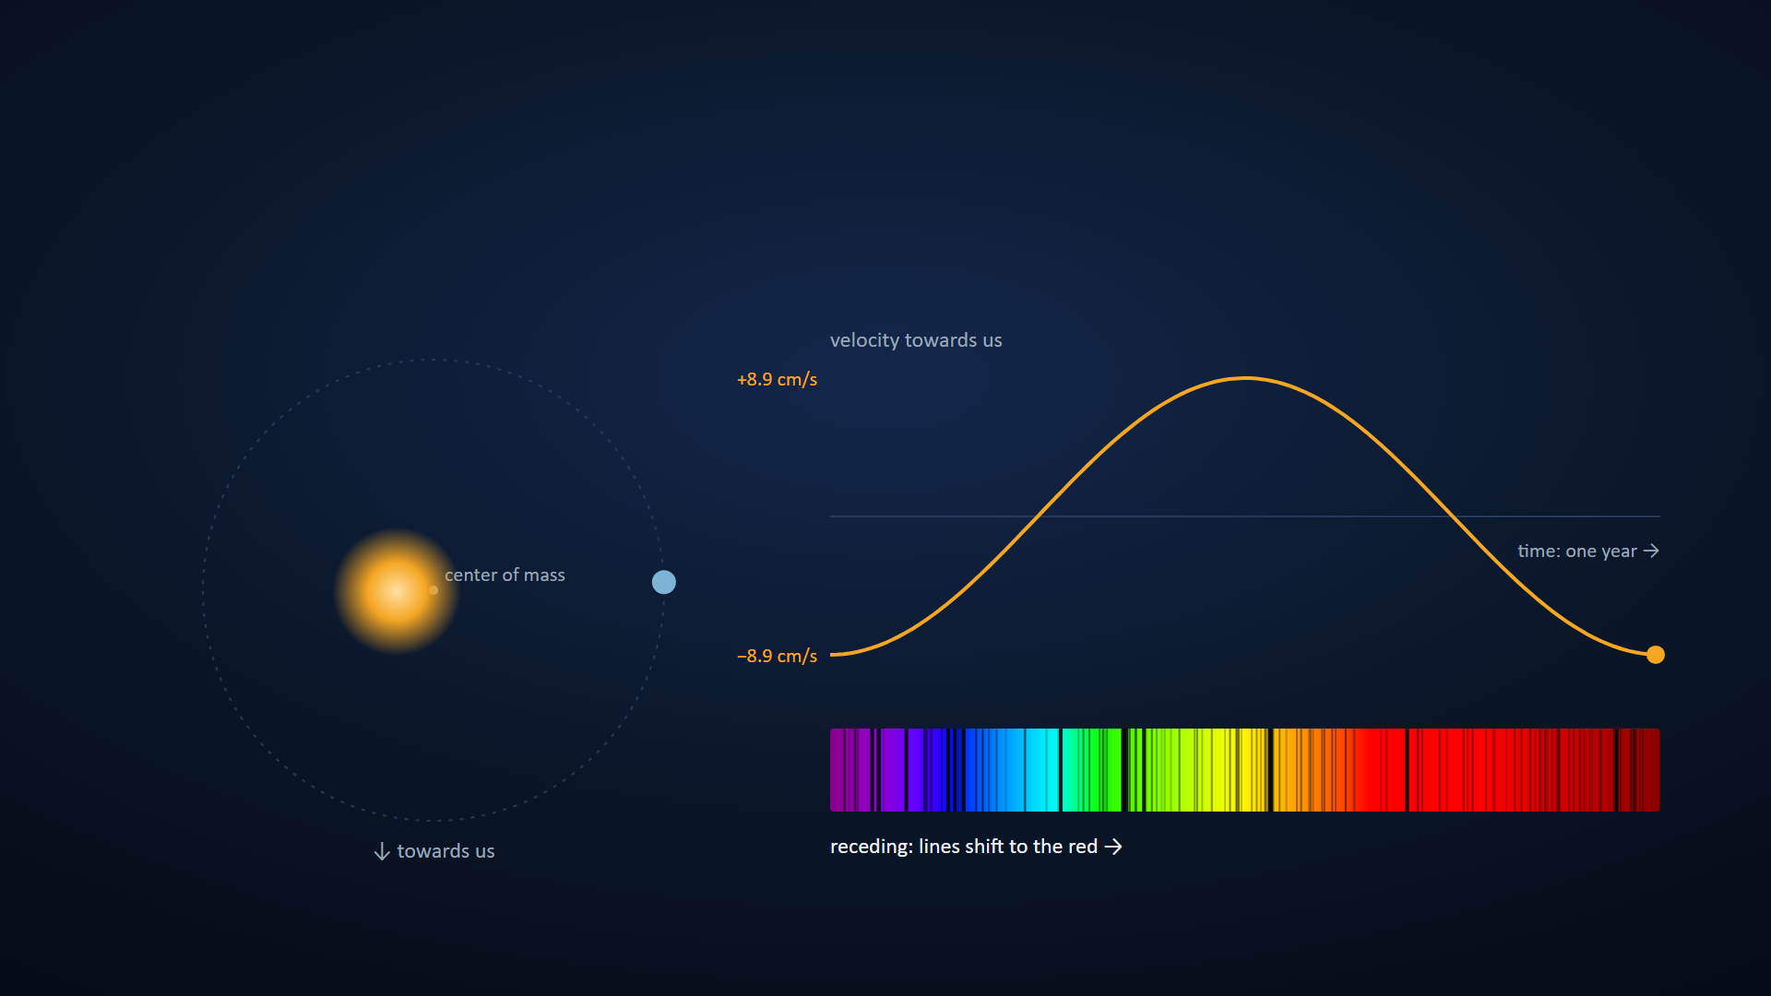
THE WOBBLE
The star wobbles too: Earth moves the Sun by only 9 cm/s
Source: Kepler's third law, circular orbit: Earth induces 8.9 cm/s on the Sun; Jupiter, 12.5 m/s. Motion and shift exaggerated so they can be seen.
Notes:
Step 1: the star also orbits the center of mass. Step 2: seen edge-on, it approaches and recedes. Step 3: the spectral lines shift to the blue and the red at the same pace.

Slide 4
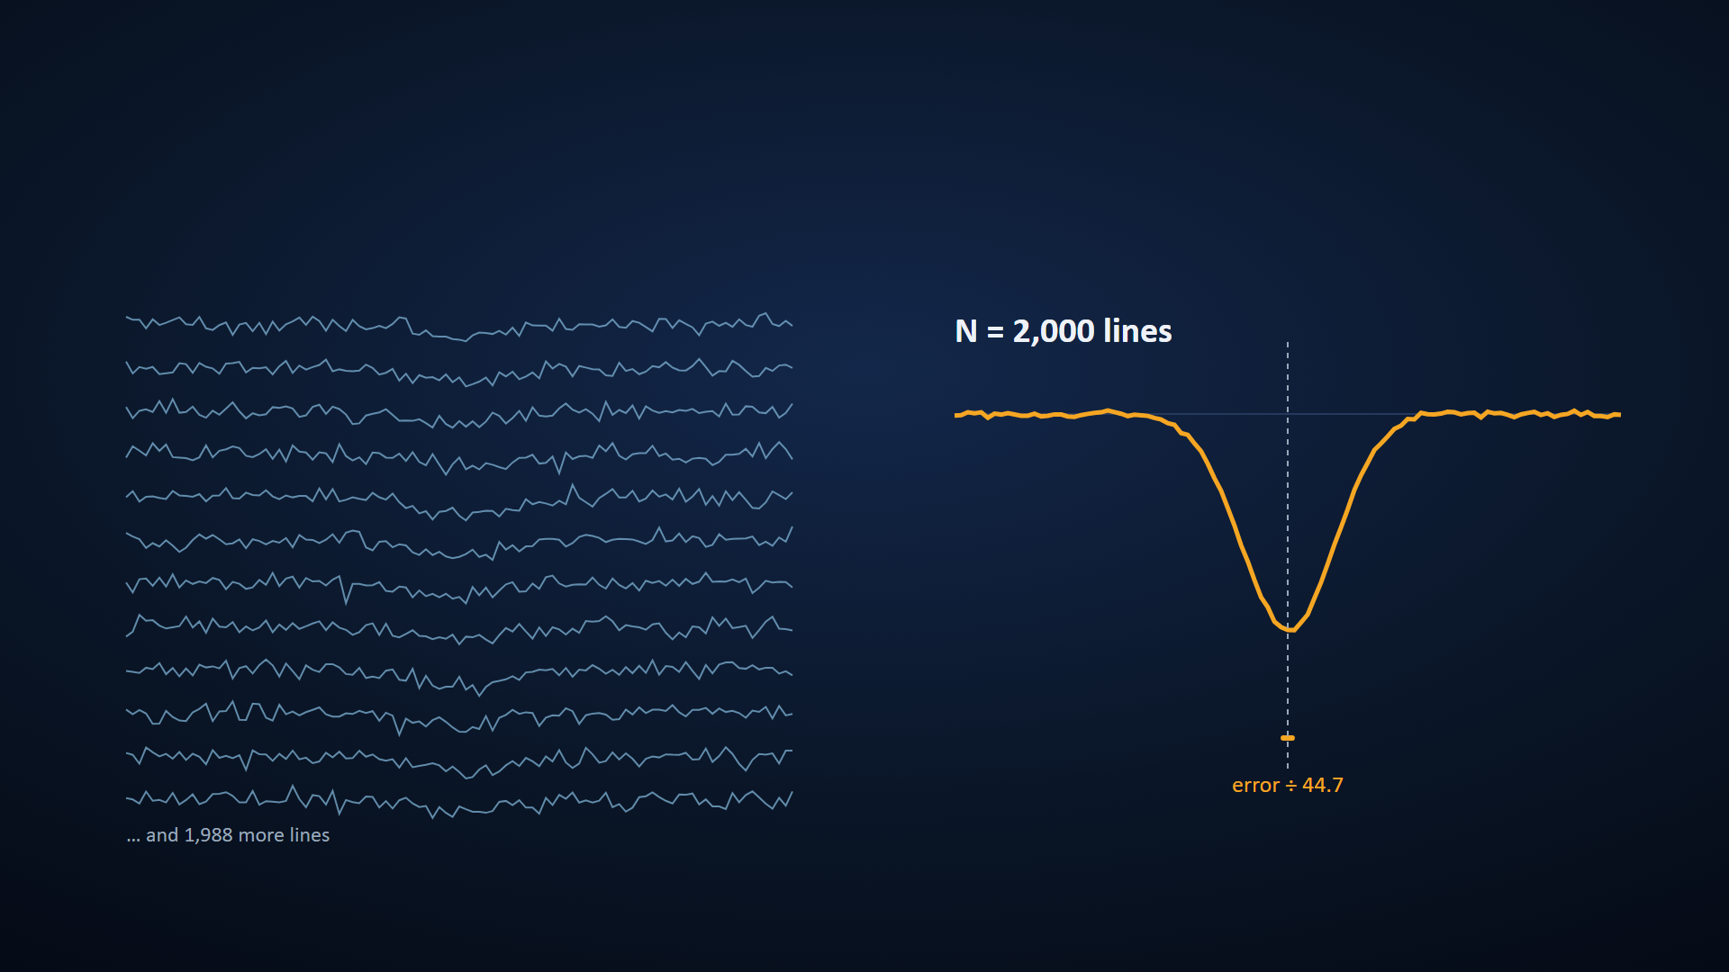
THE TRICK
A single line is noise; adding thousands, the error drops as 1/√N
Source: Simulation with identical Gaussian lines and photon noise; these are not real lines. The velocity error drops as 1/√N: with 2000 lines, about 45 times smaller.
Notes:
This is how centimeters per second are measured: no single line is enough, but thousands together are.

Slide 5
WHAT IS MEASURED
Together, the two signals tell what the planet is made of
• The shadow gives the size: the depth is (R_planet / R_star)².
• The wobble gives the mass (the minimum: it depends on the orbit's inclination).
• Size and mass give the density: rock like Earth or gas like Jupiter.
Source: Standard relations of the transit and radial-velocity methods.
Notes:
After four slides in motion, a still one: this is where it all comes together.

Slide 6
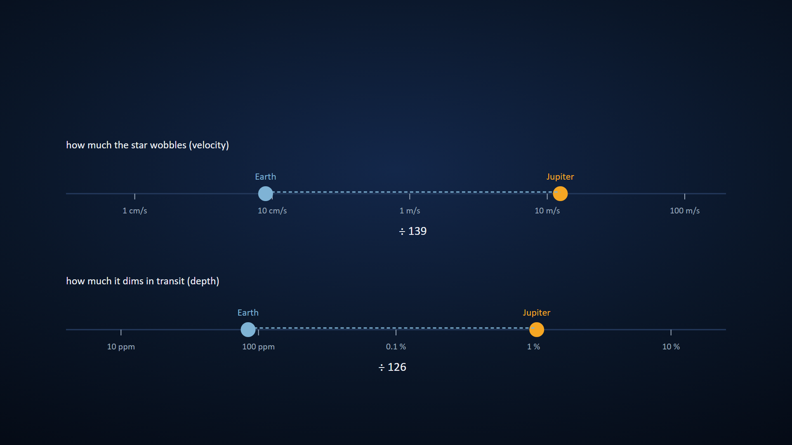
THE SCALE
Finding another Earth means signals more than a hundred times smaller than a Jupiter's
Source: Own computation: velocity (Kepler) 12.5 m/s vs 8.9 cm/s, ÷139; depth (IAU 2015) 1.06 % vs 84 ppm, ÷126. Logarithmic scales.
Notes:
First Jupiter on both scales; next, Earth slides to its place and the ratio for each signal appears.

Slide 7
HOW IT WAS MADE
This talk is a text script, five scenes and a profile
• script.md (and script.es.md): one conclusion-title per slide, with its source and notes.
• animations.js: five scenes built with K.scene, one state per step.
• night profile: colors and fonts; kit.py build produces the HTML and the .pptx.
Source: presentation-kit: engine/kit.py, engine/anim.js, profiles/night.
Notes:
Open script.md next to the deck to show that the content is just text.

Slide 8
APPENDIX
Sources
• Nominal radii: IAU 2015 Resolution B3 (Sun 695,700 km; Earth equatorial 6,378.1 km; Jupiter equatorial 71,492 km).
• Masses: Sun 1.989 × 10³⁰ kg; Earth 5.972 × 10²⁴ kg; Jupiter 1.898 × 10²⁷ kg. G = 6.674 × 10⁻¹¹ m³ kg⁻¹ s⁻².
• Induced velocity: Kepler's third law for a circular orbit.
• Everything is computed in animations.js; the animations exaggerate motion so it can be seen.

