Slide 1
Two clicks show what a correlation hides
A demo recorded from the real dashboard, not drawn
presentation-kit · software demo example · 2026
Notes:
One task, shown in the product itself: fit a line to two datasets and look at the residuals.

Slide 2
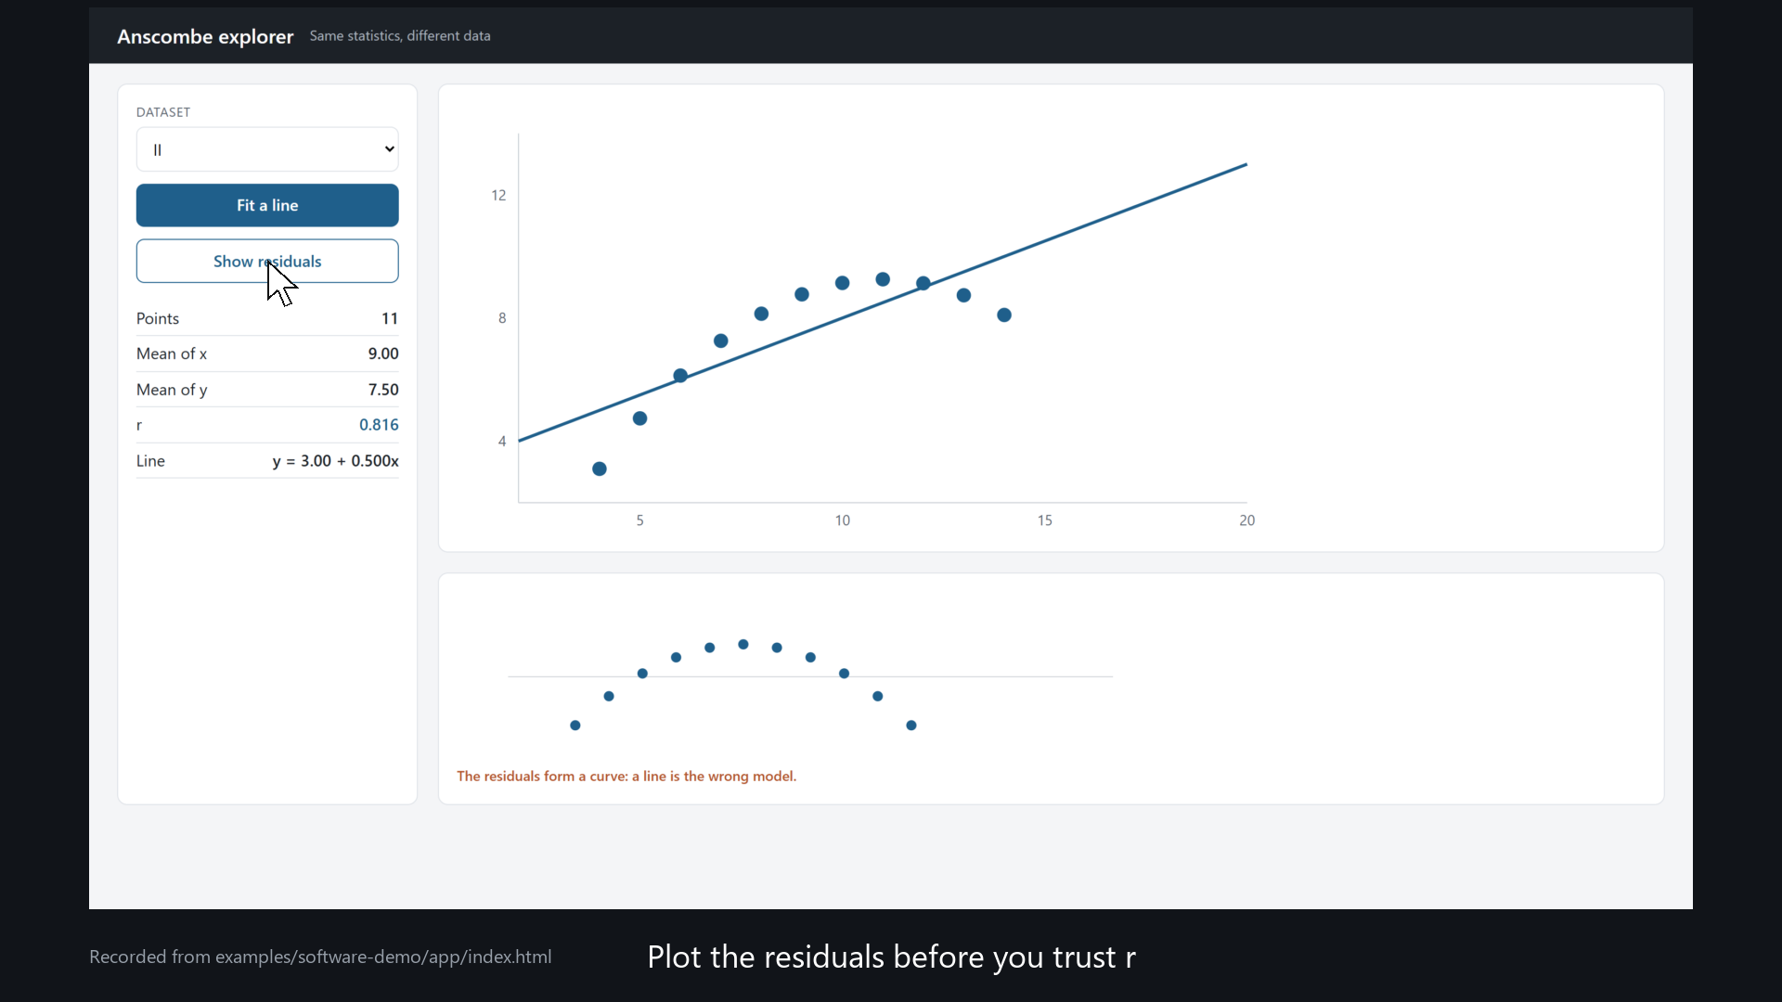
The dashboard gives the same r for two very different datasets; the residuals tell them apart
Source: Recorded with «kit.py demo» from app/index.html (demo.yml). Data: Anscombe (1973), The American Statistician 27(1), 17–21.
Notes:
Let the video run; it zooms where each click happens. Press V to pause on the residuals.

Slide 3
The video comes from running the code, step by step
• demo.yml lists the task: open, choose a dataset, click, zoom, wait.
• kit.py demo performs it in a real browser and takes a screenshot at every step.
• Zoom, cursor and captions are added afterwards, from the positions of the real elements.
• If there is no code yet, mockup: true stamps «Mock-up» on every frame.
Source: presentation-kit: engine/demo.py.
Notes:
This is the slide for whoever will record their own demo.

Slide 4
APPENDIX
Sources
• Anscombe, F. J. (1973). Graphs in Statistical Analysis. The American Statistician 27(1), 17–21. DOI 10.1080/00031305.1973.10478966.
• How to show software: docs/software-demos.md (catalog of recognized demos and of the evidence on screencasts).
• The app: app/index.html (plain HTML and JavaScript). The recording: demo.yml and engine/demo.py.

