Slide 1
Four datasets with the same statistics and four different stories
Why you should plot before you summarize: Anscombe's quartet (1973)
presentation-kit · sober example · 2026
Notes:
A ten-minute talk for any meeting where metrics get reported.

Slide 2
All four sets share the same mean, variance, correlation and regression line
r = 0.816
In all four: mean of x 9, variance of x 11, mean of y 7.50, variance of y 4.12 and fitted line y = 3.00 + 0.500 x.
If we only looked at this table, we would call them the same phenomenon.
Source: Anscombe, F. J. (1973), The American Statistician 27(1), 17–21. Own computation in figures/make_figures.py.
Notes:
Let the room guess for a second what these data look like before moving on.

Slide 3
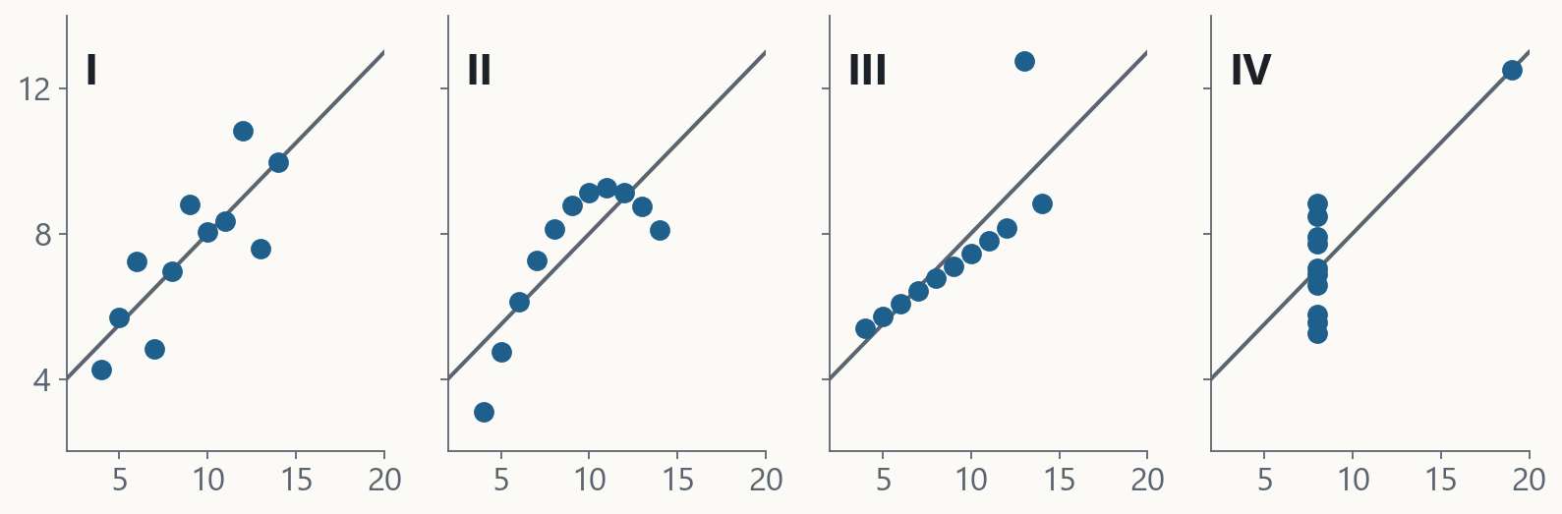
Plotted, they are four different stories
Source: Anscombe (1973). The four panels share axes; the grey line is the same fit in all of them.
Notes:
I is what we expect. II is a curve. III is a line with one point off. IV has no relation at all: a single point creates it.

Slide 4
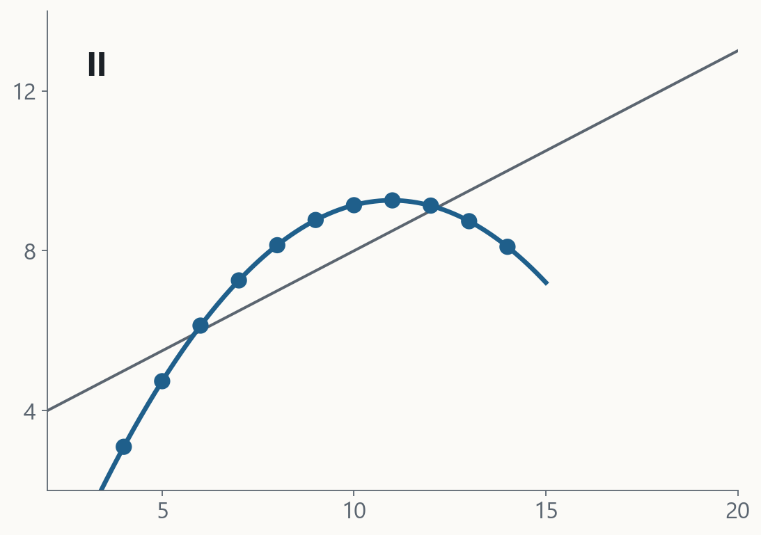
In II the data are a curve: the straight line is the wrong model
A parabola describes them almost exactly.
A correlation of 0.816 measures how well a line fits, not whether a line is the right model.
Source: Anscombe (1973); own quadratic fit.
Notes:
The question is not "how high is r?" but "what shape do the data have?".

Slide 5
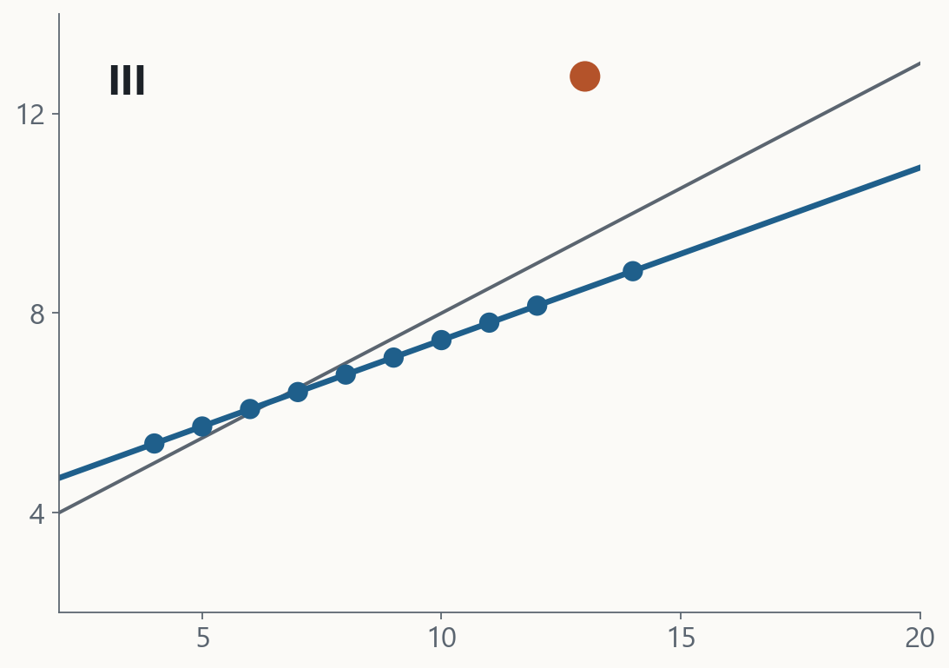
In III a single point bends the line: without it, the data are perfectly aligned
Without the highlighted point, the correlation is 1.000 and the line becomes y = 4.01 + 0.345 x.
One outlier is enough to change the slope we report.
Source: Anscombe (1973); fit without the outlier, own computation.
Notes:
Before deleting an outlier, understand it: it may be an error or the most interesting data point.

Slide 6
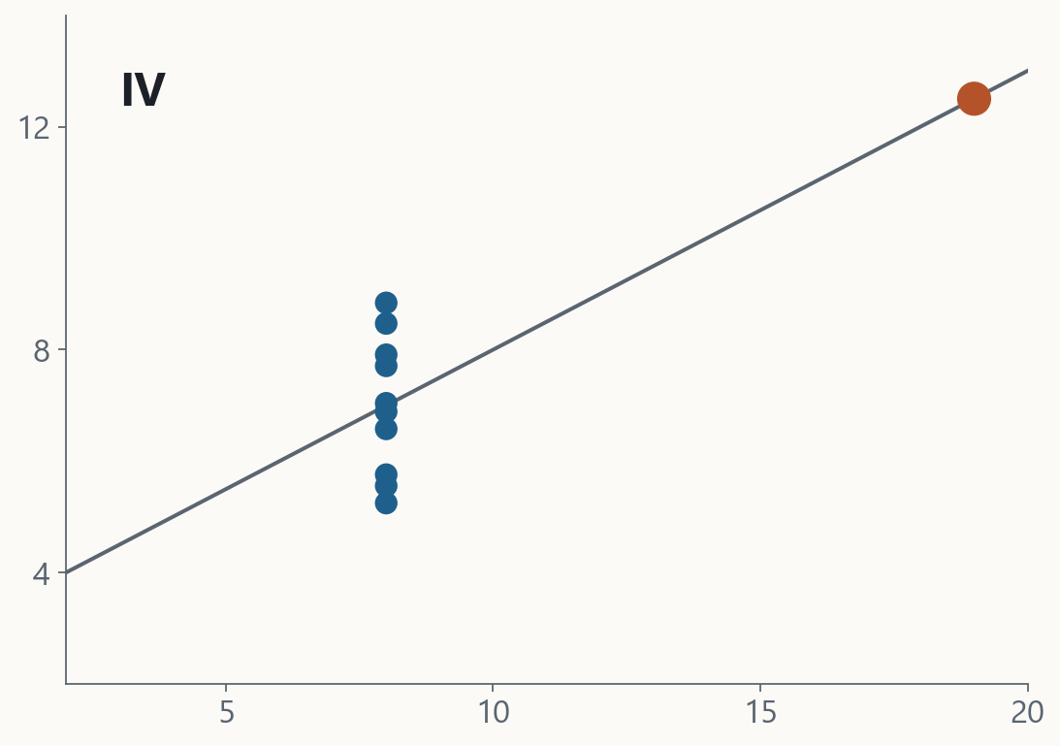
In IV there is no relation: a single point manufactures the whole correlation
Ten of the eleven points share the same x. The only different one decides the whole line.
Source: Anscombe (1973).
Notes:
Remove that point and the line cannot even be computed: all x values are equal.

Slide 7
Before reporting a metric, plot the data and the residuals
• Plot the distribution, not only the mean: points or boxes per group (Tukey).
• Plot the residuals of every fit: that is where II's curve and III's outlier show up.
• Look at every point that dominates the result before you trust the number.
Source: Anscombe (1973); Wickham & Stryjewski, "40 years of boxplots" (2011).
Notes:
This is the slide people take home. Close by asking which metric we report without plotting.

Slide 8
APPENDIX
Sources
• Anscombe, F. J. (1973). Graphs in Statistical Analysis. The American Statistician 27(1), 17–21. DOI 10.1080/00031305.1973.10478966.
• Wickham, H. & Stryjewski, L. (2011). 40 years of boxplots. https://vita.had.co.nz/papers/boxplots.pdf
• Data and computations: figures/make_figures.py (checks the statistics before plotting).

